Slide 1

Shri B.V.V. Sangha’s
BASAVESHWAR ENGINEERING COLLEGE, BAGALKOTE
DEPARTMENT OF MCA
Project Work on
“Smart Tailor System”
MASTER OF COMPUTER APPLICATIONS
2025-2026
Project Guide Project Coordinator HOD
Prof. C. M. Jangin Prof. C.M. Jangin Prof. S.M.Magi
Submitted by: Shrusti Mathapati USN:2BA24MC043

Slide 2
Abstract
Smart Tailor System is an online platform for customers and tailors.
It replaces manual tailoring with a simple digital system.
Customers can place orders, upload measurements, and track progress.
Tailors can manage all orders and customer details easily.
Makes tailoring faster, smarter, and more convenient.

Slide 3
Introduction
Smart Tailor System is an online platform for tailors and customers.
Helps customers place stitching orders easily.
Allows customers to upload measurements and track order progress.
Tailors can store customer details and manage orders online.
Helps tailors plan and schedule delivery dates.

Slide 4
Literature Servey
Existing System:
Tailoring shops still use manual methods for managing work.
Orders and measurements are written on paper or notebooks.
Communication happens through calls or in-person visits.
Difficult to track multiple orders and customer details.
Leads to delays, errors, and loss of information.

Slide 5
Cont’d...
Proposed System:
Smart Tailor System makes tailoring services digital and easy to use.
Customers can place orders, upload measurements, and track progress online.
Tailors can manage all orders and deliveries from one dashboard.
Provides real-time updates and reduces manual work.
Improves accuracy, saves time, and increases customer satisfaction.

Slide 6
Problem definition
Traditional tailoring shops use manual methods for measurements, order tracking, and customer communication. This results in frequent errors, delays, misplaced orders, and inconvenience for customers. There is a lack of a proper digital system to store measurements, track orders, maintain design preferences, and provide timely updates.

Slide 7
Problem statement
Communication requires physical visits.
No proper system to store customer measurements.
No digital tracking of order status.
Customers do not receive timely updates.

Slide 8
Software Requirement Specification
Hardware Requirements | Software Requirement
Processor: Intel i3➢ | Python (version 3.14.0) – for backend server ➢ ➢ ➢
RAM: 4 GB | Node.js and npm – for running React.js frontend
Hard Disc: 500GB | MySQL – for database management
 | Operating System: Windows 11
 | Tools and IDE :VS code,MySQL Workbench

Slide 9
Functional Requirements
1. Customer Module
Customers can register, login, and place stitching orders.
Can track order status.
2. Tailor Module
Tailors can view and manage all customer orders.
Store measurements digitally and update order status.
Generate reports for completed and pending orders.

Slide 10
Cont’d...
3. Admin Module
Admins manage users (customers and tailors).
Monitor all orders and assign tasks.
Ensure smooth and organized system operations.
4. Notification Module
Sends automatic alerts to customers.
Updates customers about order progress and delivery.
Keeps customers informed in real time.

Slide 11
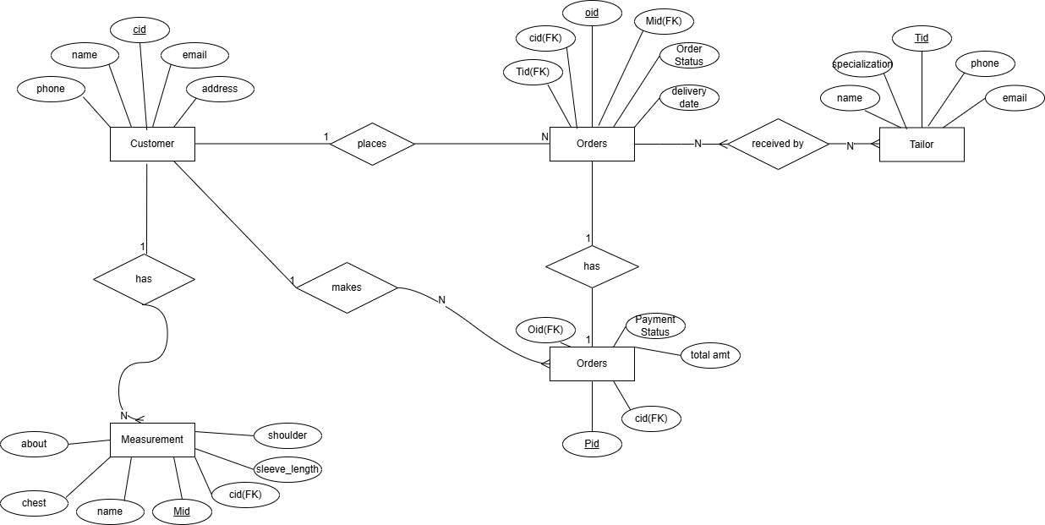
ER Diagram

Slide 12
Future Enhancements & Scope
Online Payment Integration: Customers can pay directly through the app or website.
AI-Based Design Suggestions: System can suggest designs and styles based on user preferences.
Mobile App: Dedicated Android and iOS apps for easy mobile access.
Cloud Backup: Secure cloud storage for saving orders and measurements safely.

Slide 13
References
Bootstrap Documentation
[Online].Available:https://getbootstrap.com/docs/5.3/getting- started/introduction/
Medium Articles – Smart Tailoring and Fashion Tech Trends
[Online]. Available: https://medium.com/tag/fashion-technology
React official site (latest docs & guides) – https://react.dev/

Slide 14
Conclusion
Smart Tailor System makes tailoring services simple and digital.
It helps customers place and track orders easily.
Tailors can manage all orders and measurements efficiently.
Reduces manual work, errors, and time delays.
Improves transparency, accuracy, and customer satisfaction.
Brings digital transformation to the tailoring industry.

Slide 15
Thank You

