Slide 1


Quantum Fourier Transform Gate Optimize via QDRL for Routing Problem using Quantum Metaheuristic Optimization
By:
Shruti Saini

Slide 2


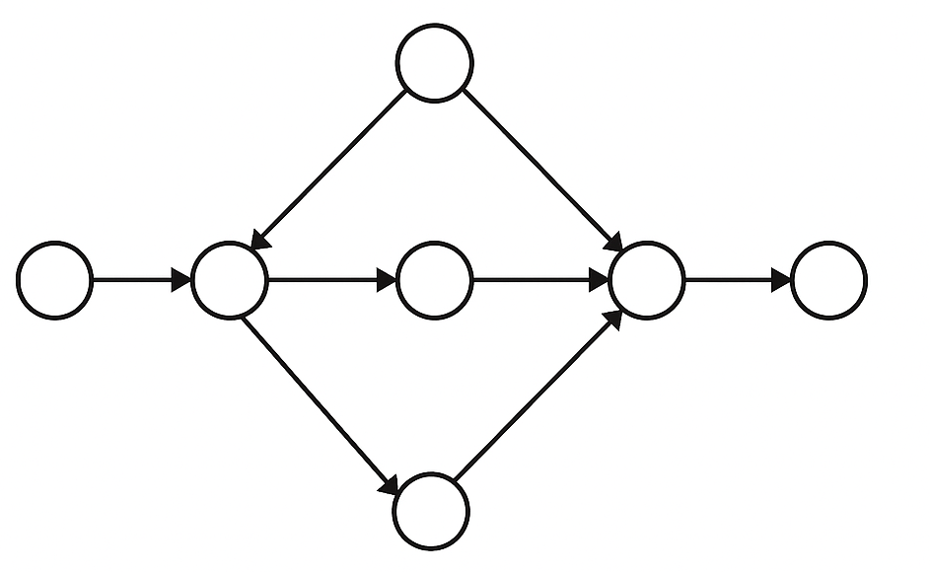
INTRODUCTION to PROBLEM
ROUTING PROBLEM
Solution
Initialize the variables
Construct a QFT circuit
Source
Apply the Gates
Target
Optimize the gates
QDRL
Solution

Slide 3
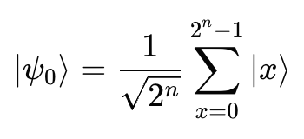
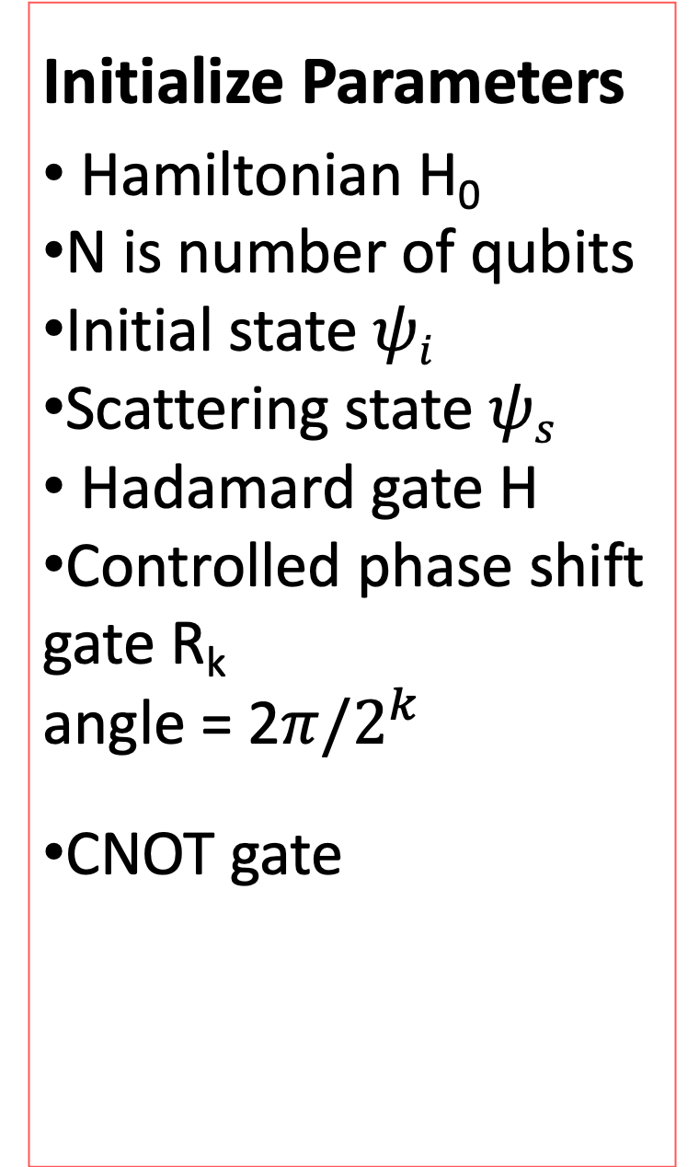

Hamiltonian & Gates
Initialize Parameters
Hamiltonian H₀
N is number of qubits
Initial state $ψi$
Scattering state $ψs$
Hadamard gate H
Controlled phase shift gate R_{k}
angle = 2$π/2^{k}$
CNOT gate
Conversion to inputs from client to Hamiltonian:
H(x) = $\sum_{i}{ai xi} \sum_{i<j}{bij xi xj}$
$xi xj$ are points from warehouse i to depot j. x $∈\{0,1\}$.
Above is Hamiltonian in binary form. Converted H using Pauli z- Hamiltonian is given as:
H(x) =$\sum_{i}{ai}[\frac{1−Zi}{2}]\sum_{i<j}{bij[\frac{1−Zi−Zj+ZiZj}{4}}]$
This H will be used for the calculations.
Initialize all states as:
The quantum system into an equal superposition of all route combinations using Hadamard gates.

Slide 4


QFT introduces interference and superposition across all paths.
This helps simulate routing across a large space efficiently.
QFT & Gates
Construction of QFT Circuit
QFT|x > = $\frac{1}{\sqrt{2^{n}}}\sum_{x=0}^{2n−1}{e^{ \frac{2πixy}{2^{n}} }|y> }$
Step 1: Apply Hadamard Gate:
H|x₀> = $\frac{1}{\sqrt{2}}\text{|0}\text{>}{+ e}^{2πi(x0.x1.x2)}|1>$
Step2: Apply controlled phase gates from q₁&q₂ to q_{0.}
R2​: controlled by q1, applied to q0, adds phase $e^{ \frac{2πix1}{4} }$.
R3​: controlled by q2, adds phase $e^{ \frac{2πix2}{8} }$ using the reference $e^{ \frac{2πixy}{2^{n}} }$.
Combining we obtain:
$$e^{2πi \left(\frac{x1}{2^{2}}+\frac{x2}{2^{3}}\right) = R2.R3}$$
$R2$signifies gate for 2 bits.
R₃ signifies gate for 3 bits.
Step3: Repeat for q₁, controlled by q₂ (R₂ from q₂ → q₁), then Hadamard on q₁.
Step4: Finally, Hadamard on q₂.

Slide 5
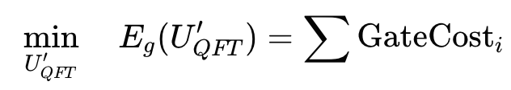

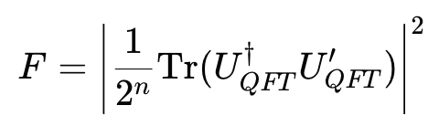

QDRL – where Quantum meets learning
Set Parameters that control rotation gates applied to each qubit.
U($θ$)= $\prod_{i=1}^{n}{R_{y}^{i}{(θ}_{i})}R_{x}^{i}{(θ}_{i}/2)$
Where:
$$R_{y}^{i}θ_{i}=[\begin{matrix}cos⁡(θ_{i}/2) & −sin⁡(θ_{i}/2) \\ sin⁡(θ_{i}/2) & cos⁡(θ_{i}/2)\end{matrix}]$$
and,
$$R_{x}^{i}{(θ}_{i}/2)=[\begin{matrix}cos⁡(θ_{i}/4) & −i sin⁡(θ_{i}/4) \\ −i sin⁡(θ_{i}/4) & cos⁡(θ_{i}/4)\end{matrix}]$$
Apply U($θ$)to the state $ψ$and obtain:
| $ψ$’> = U($θ$) | $ψ$>
Amplitude of this state will help us understand the probability based on applied gates for given route x.
Minimize gate cost with fidelity
We need to balance accuracy with efficiency. So, fidelity checks how we are to the desired state.
Lower is better
Along
Where fidelity is defined as:

Slide 6
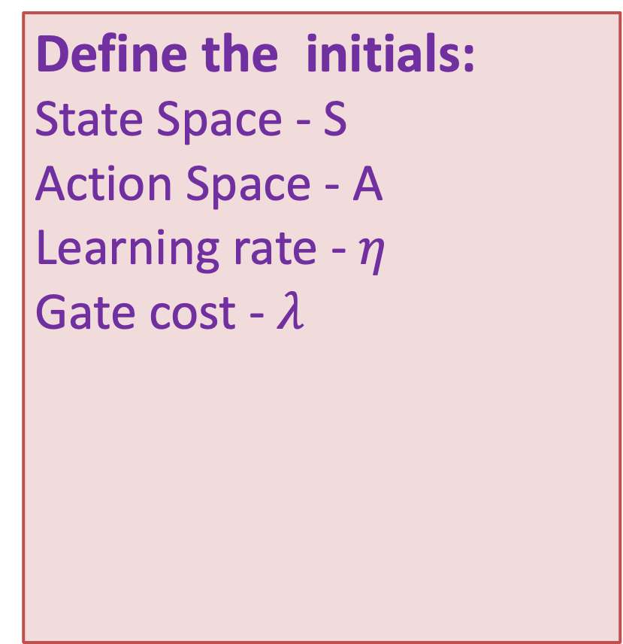
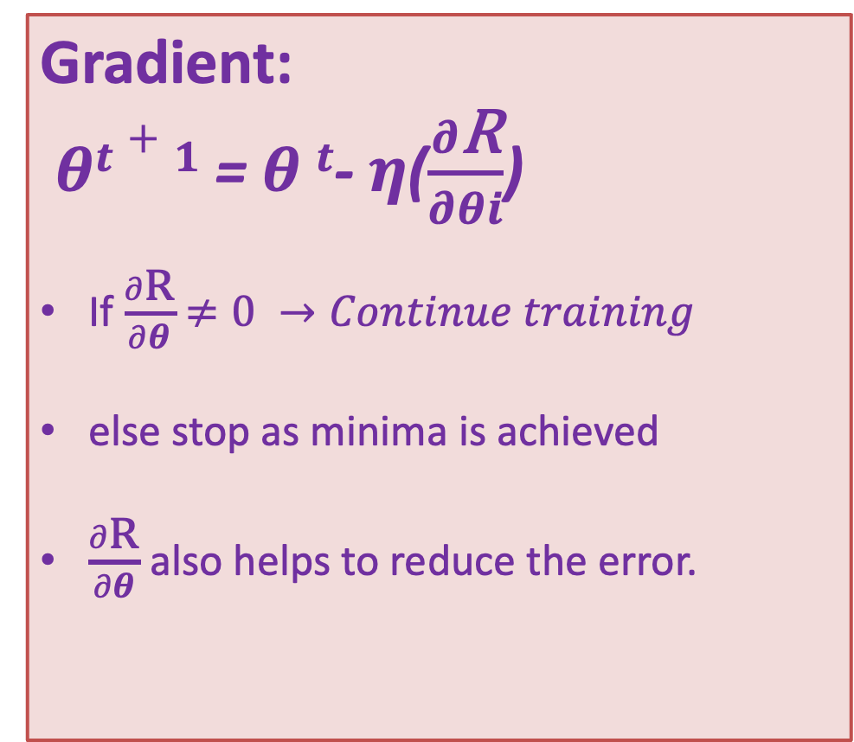
QDRL – where Quantum meets learning
Define the initials:
State Space - S
Action Space - A
Learning rate - $η$
Gate cost - $λ$
Reward function:
R(s,a) is calculated to understand which route (a) was most efficient for state (s).
High reward function = more efficient route
Gradient:
$θt+1$= $θ t$- $η$($\frac{∂\text{R}}{∂θi}$)
If $\frac{∂\text{R}}{∂θ}$ $≠0 →Continue training$
else stop as minima is achieved
$\frac{∂\text{R}}{∂θ}$ also helps to reduce the error.

Slide 7
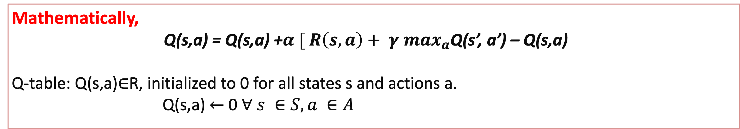
Q - Function
Definition
It is a reinforcement learning action value function. It estimates the cumulative rewards that agent receives by taking action “a” in state “s”.
Mathematically,
Q(s,a) = Q(s,a) +$α [ R\left(s,a\right)+ γ \max_{a}$Q(s’, a’) – Q(s,a)
Q-table: Q(s,a)∈R, initialized to 0 for all states s and actions a.
Q(s,a) $←$ 0 $∀ s ∈S, a ∈A$
It captures trade off between fidelity and cost.
It takes care of gate optimization.
This circuit learns from environment.
It estimates efficient routing decisions.

Slide 8

Learning Loop
The loop keeps learning until there is no improvement.
Greedy Policy ensures that the best action is selected.
As the time passes, the AI learns to select the best gate - action for efficient output.
Full rank matrix signifies no information is lost.
Pseudocode for QDR - learning
initialize θ = random small angles for each qubit for t in range(T): # T learning episodes qc = InitSuperposition(n_qubits) # Step 1: Prepare initial state |ψ₀⟩ qc = ApplyQFT(qc) # Step 2: Apply QFT ApplyParameterizedGates(qc, θ) # Step 3: Apply R_x(θ), R_y(θ/2) per qubit qc = ApplyIQFT(qc) # Optional: Return to computational basis measured_state = Measure(qc) # Step 4: Collapse state to classical route reward = R(measured_state) # Step 5: Evaluate reward based on route quality gradients = EstimateGradient(θ, reward) # Step 6: Use parameter-shift rule or finite difference for i in range(len(θ)): θ[i] = θ[i] + η * gradients[i] # Step 7: Update each θ based on reward

Slide 9
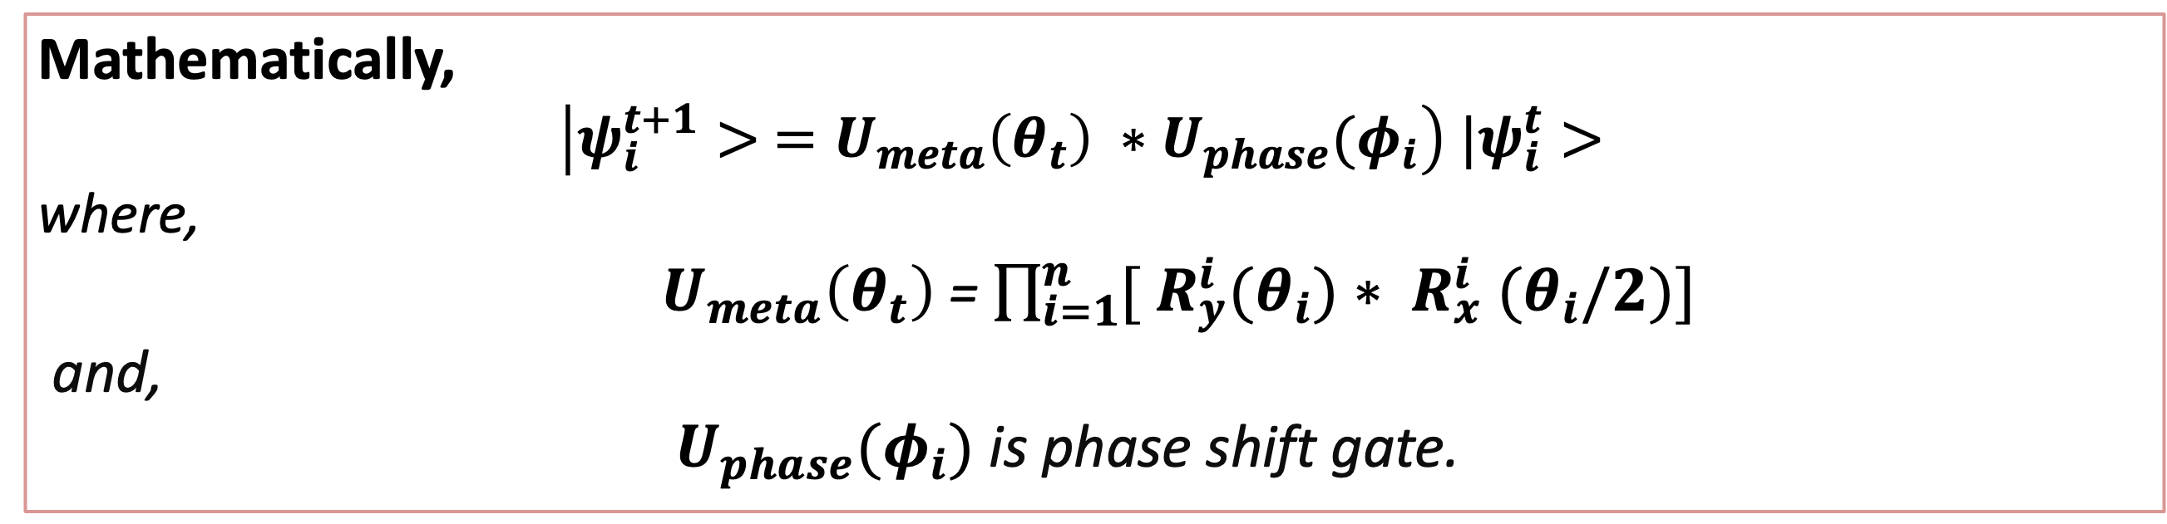
QUANTUM METAHEURISTIC OPTIMIZATION
Mathematically,
$$\left|ψ_{i}^{t+1}> =U_{meta}\left(θ_{t}\right){ ∗U}_{phase}{(φ}_{i}\right) |ψ_{i}^{t}>$$
where,
$U_{meta}\left(θ_{t}\right)$ = $\prod_{i=1}^{n}{{[ R}_{y}^{i}{(θ}_{i})}{∗ R}_{x}^{i}{(θ}_{i}/2)]$
and,
${ U}_{phase}{(φ}_{i})$ is phase shift gate.
Quantum Metaheuristics bring: Superposition: Represent multiple routes/solutions at once. Interference: Amplify good solutions, suppress poor ones. Tunnelling: Escape local minima by exploring the solution space. Entanglement: Create dependencies between food hubs/routes for optimization.
They help parallel exploration of many states. Learning and evolving using RL and quantum amplitudes. Efficient handling of uncertainty and noise.

Slide 10
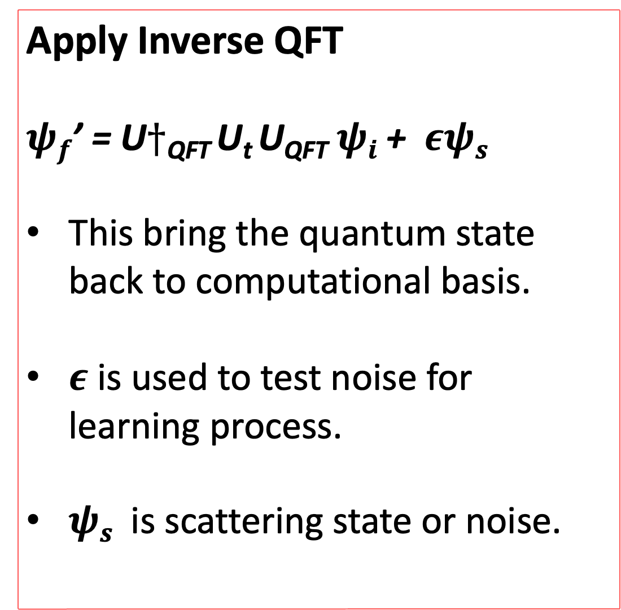

Inverse QFT
Apply Inverse QFT
$ψf$’ = U$†$_{QFT} U_{t} U_{QFT}$ψi$ + $εψs$
This bring the quantum state back to computational basis.
$ε$ is used to test noise for learning process.
$ψs$ is scattering state or noise.
Mathematically
IQFT |y>=$\frac{1}{\sqrt{2^{n}}} \sum_{x=0}^{2n−1}{\begin{aligned}e^{− \frac{2πixy}{2^{n}} }|x> \\ \end{aligned}}$
IQFT is implemented with the same gates as QFT but in reverse order and with conjugated angles (360 - $θ$).
This step makes interference-encoded information readable via measurement.

Slide 11
CONCLUSION
The algorithm combines:
Quantum Fourier Transform (QFT) for superposition and interference.
QDRL-inspired gate optimization for reward-driven routes.
Quantum Metaheuristic strategies for global solution space traversal.
As a result it helps in attaining:
Parallel evaluation of all route configurations via quantum superposition.
Dependencies between the solutions via entanglement.
Achievement of best result via QDRL.

Slide 12
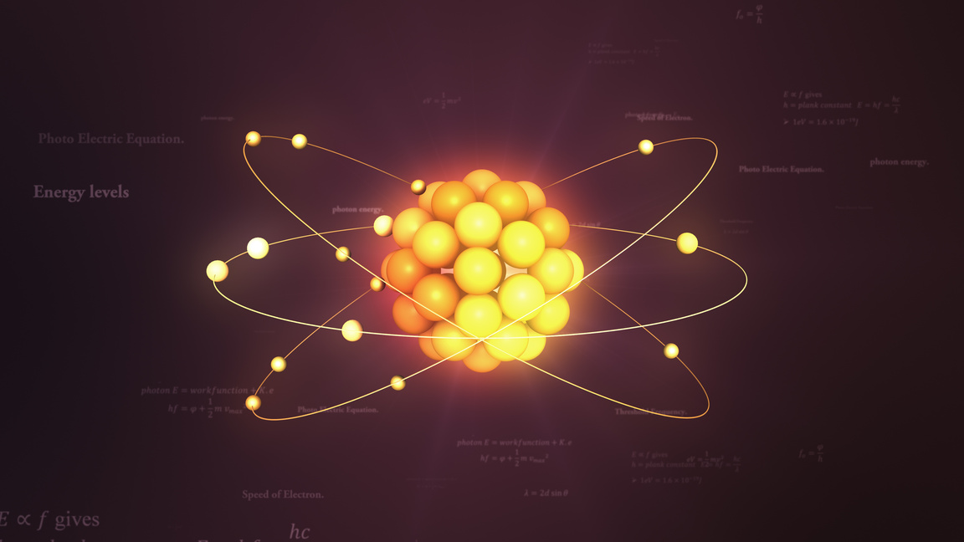





THANK YOU
Unlocking the Future of Computation
Get In Touch
+91-7082475149
shrutisainibdg62@gmail.com

