Slide 1
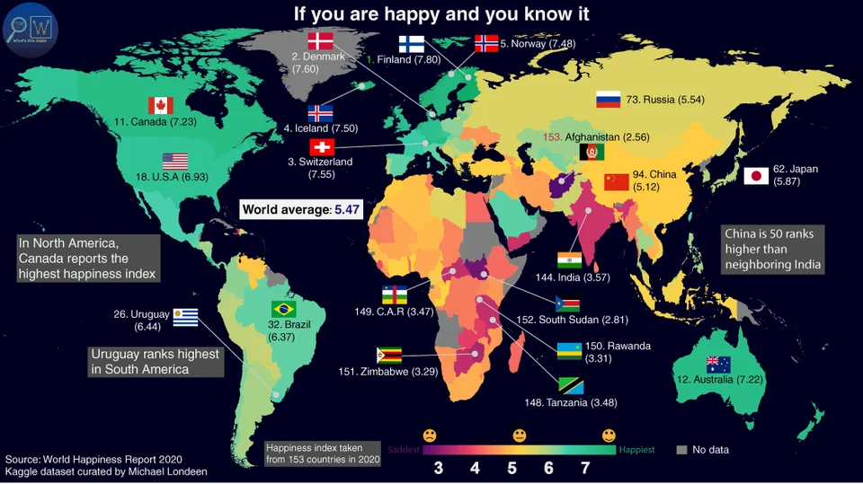
Do richer countries tend to be happier?
Happiness Index 2022
Happiness Index 2022
2022

Slide 2

Data Description
Happiness Index
GDPPC
Population
Life Expectancy
Social Support
Freedom to make life choices
Generosity
Education
Health
Crime

Slide 3
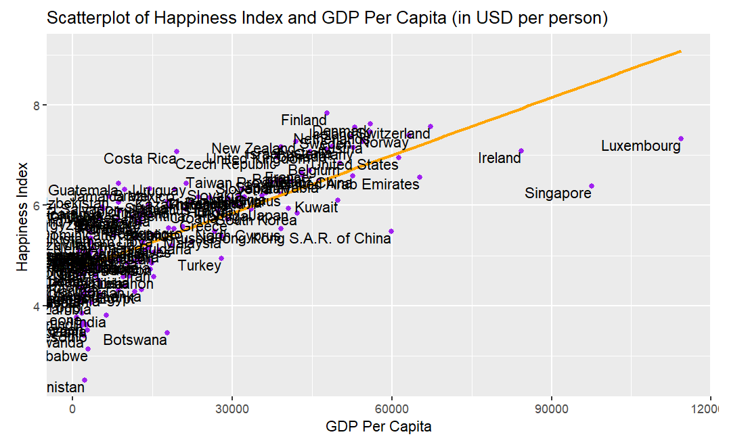
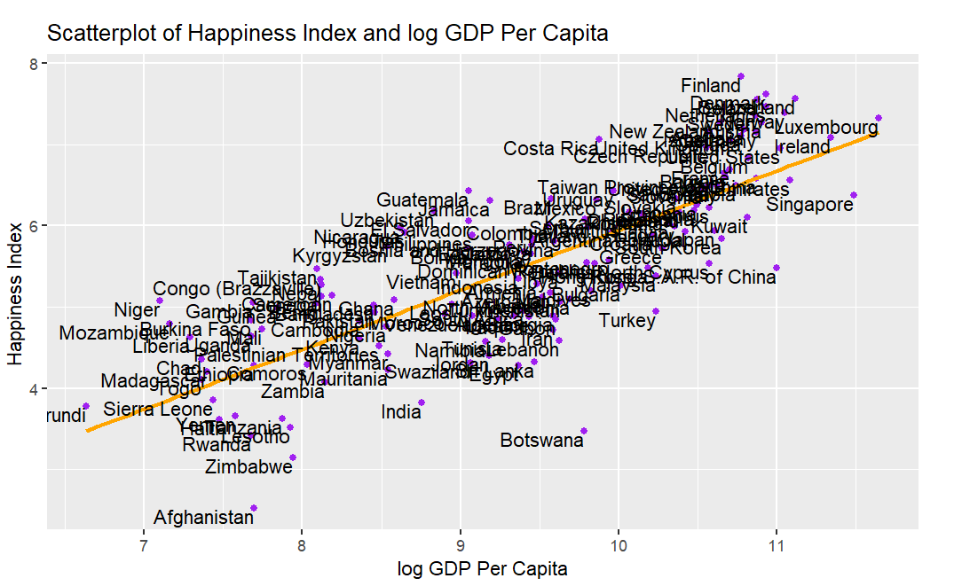
Scatterplots

Slide 4
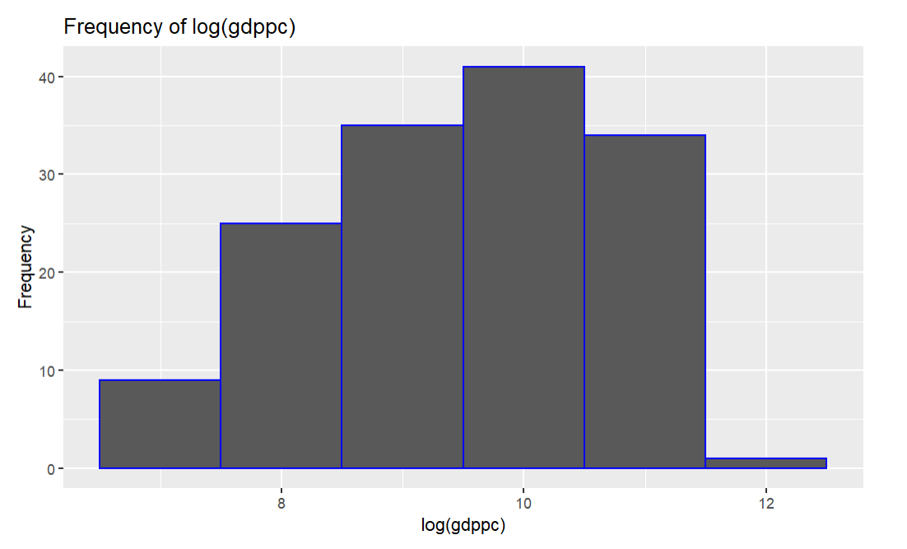
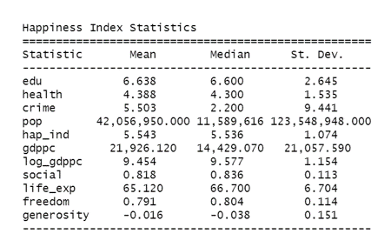
Descriptive statistics

Slide 5
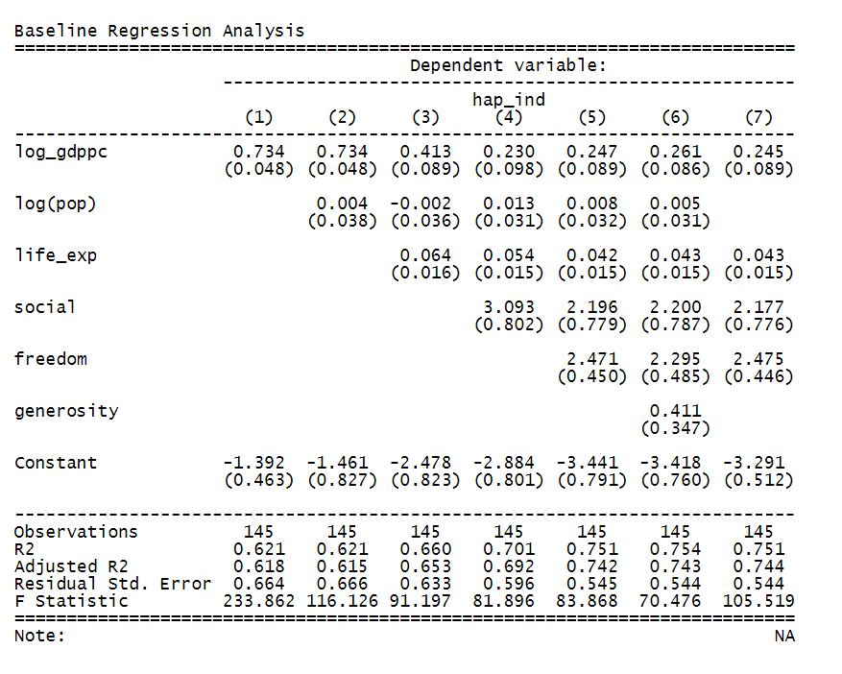
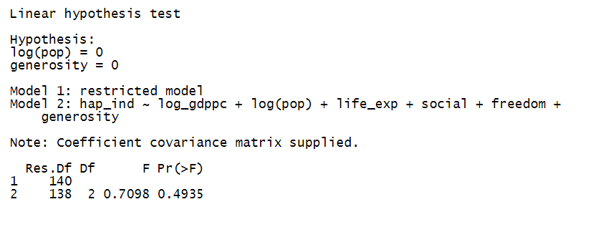
Baseline Regression

Slide 6
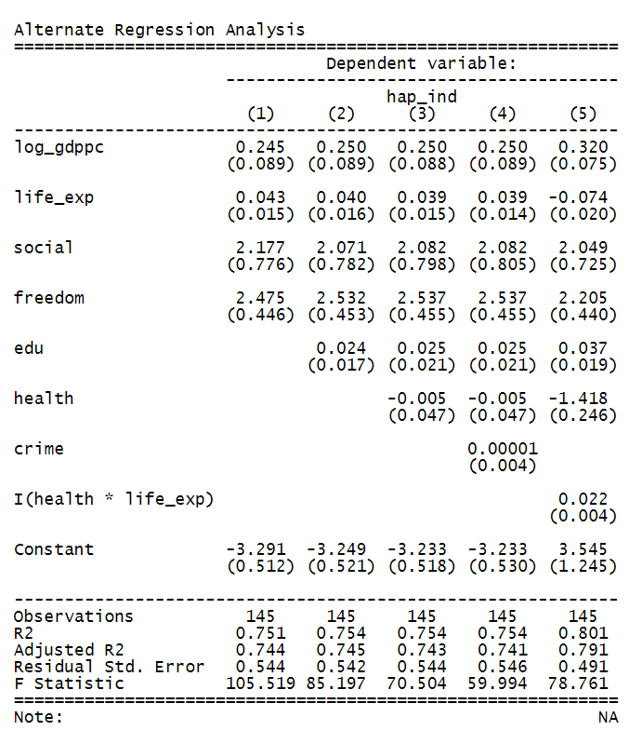
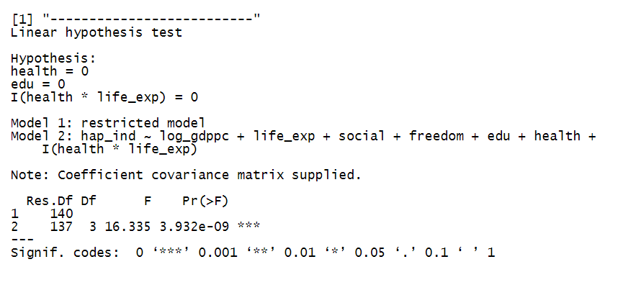
Alternative Specification

Slide 7
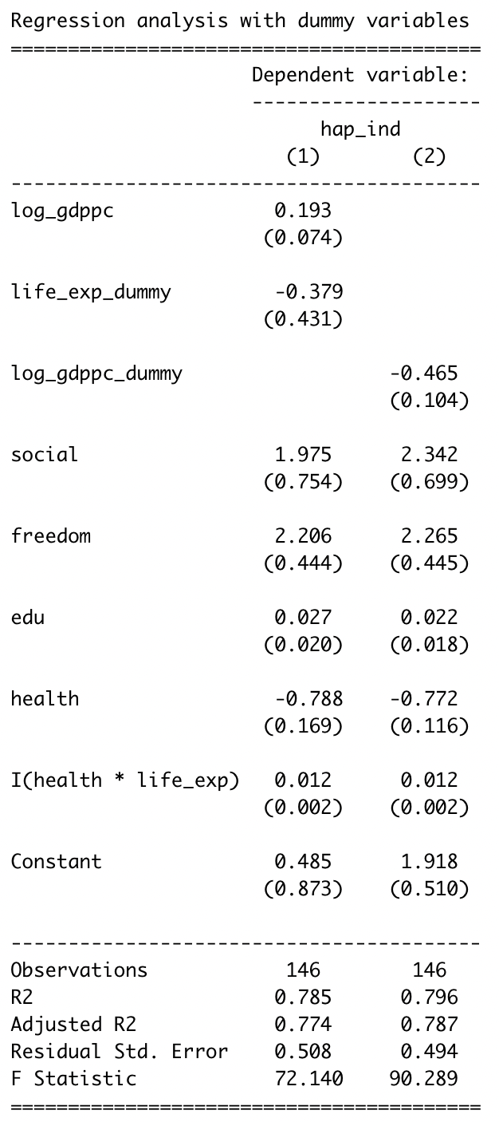
Dummy Variable

Slide 8

Validity
Internal validity:
Omitted Variable Bias
Happiness is fundamentally subjective
External validity:
Exclusion of smaller countries

Slide 9
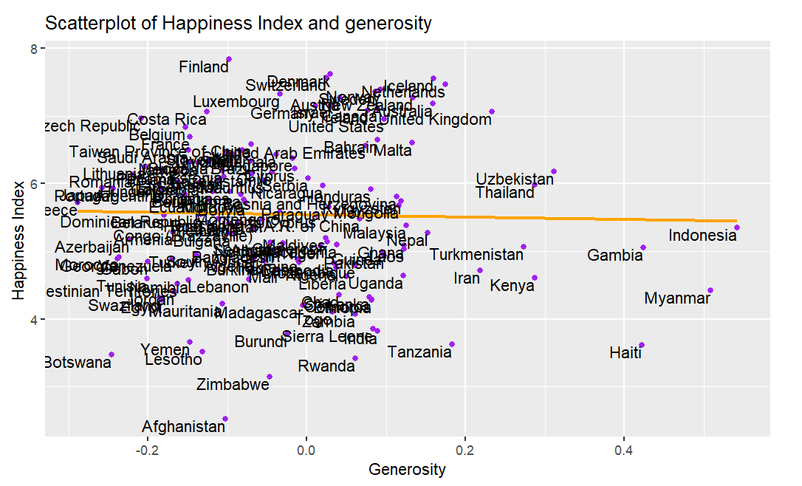
Interesting Findings
Life expectancy - higher the age, less happy.
Population has little to no effect on Happiness Index.
There is no relation between generosity and happiness index.

Slide 10

Thank You!!

