Slide 1
MEMEZEE
003 : D.Akshita
036 : K.Shruthi
037 : C.Samiksha

Slide 2
ABSTRACT
TITLE AND ITS IMPORTANCE :
-The aim of our project is to generate a meme for the user, where the user needs to choose the specifications like image or meme tamplete. After choosing the user is provided with options for text editing and adding at spcified location, drawing on the meme and then the user can save the meme created. Our project is build by using built-in-methods . We used the tkinter module to implement graphical user interface.
OUTLINE :
-Creates a meme according to the specifications given by the user
WORKING ENVIRONMENT :
-PyCharm

Slide 3
USE-CASE DIAGRAM
Memezee
Automatic Templet Download
c
Font Colour Selection
<<include>>
Text Edit
<<include>>
Re-size Text
Share Meme In Social Media
Voice Assistance
c
Re-size Image
<<include>>
Image Padding
Background Colour Selection
System Admin
User
<<include>>
Save Your Work
<<include>>
Help Box
Settings

Slide 4
TECHNOLOGY USED
SOFTWARE REQUIREMENTS
1.Windows 8 or latest
2.Processor speed minimum x64 Processor : 1.4GHz
3.Runtime Environment : PyCharm
HARDWARE REQUIREMENTS
None

Slide 5
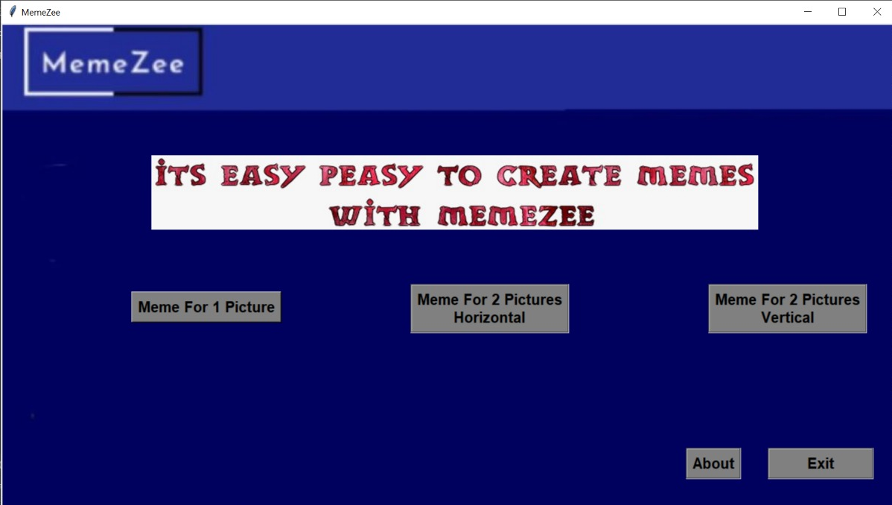
OUTPUT EXECUTIONS

Slide 6
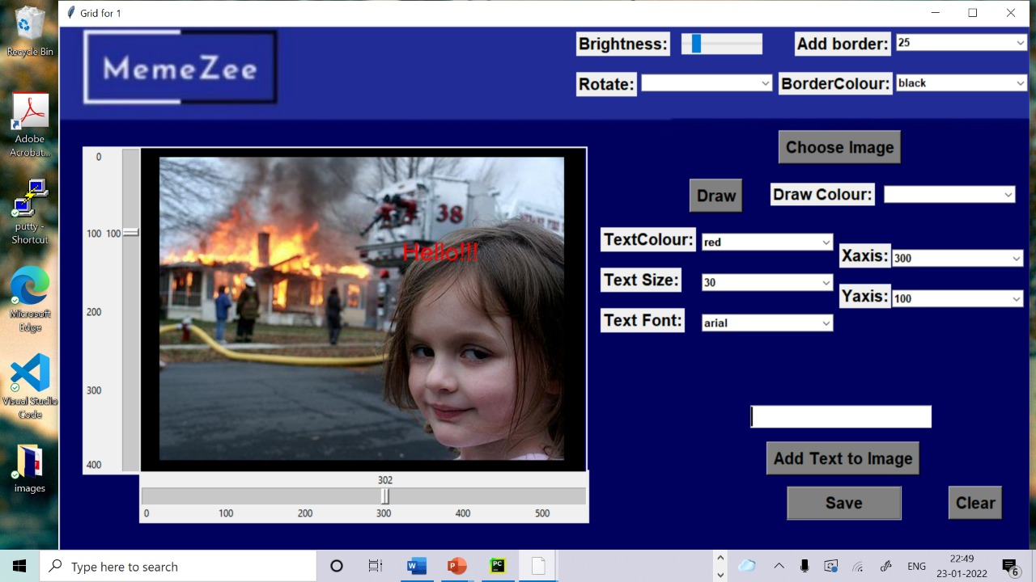

Slide 7
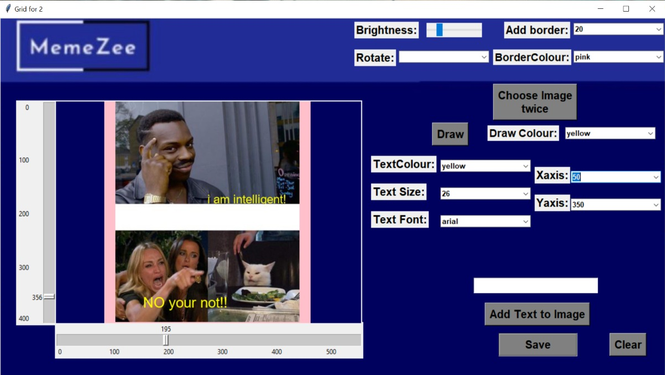

Slide 8
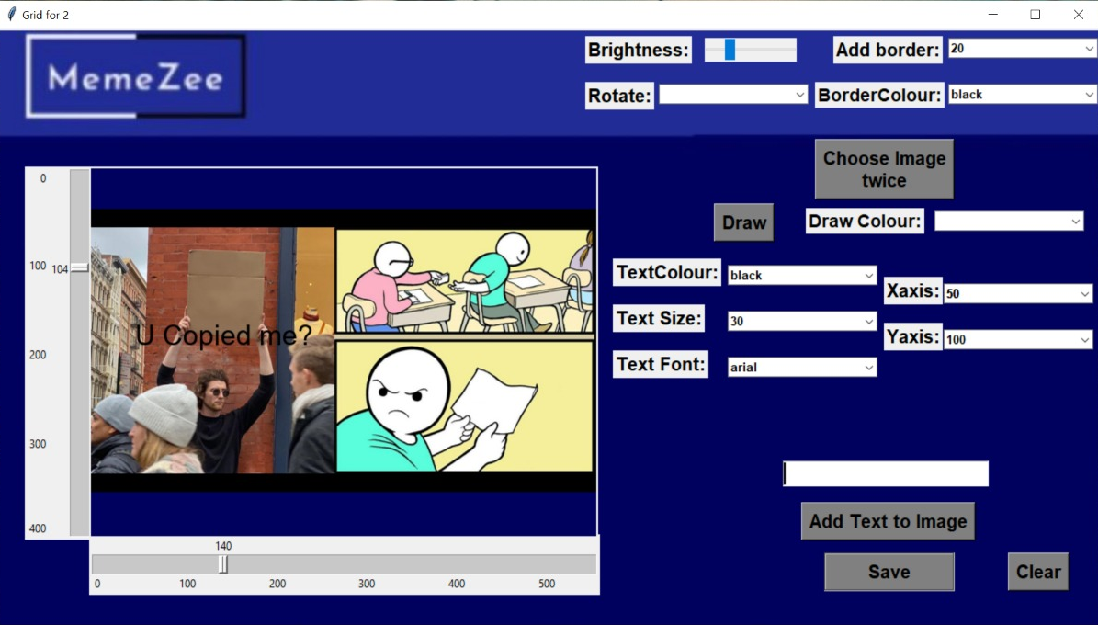

Slide 9
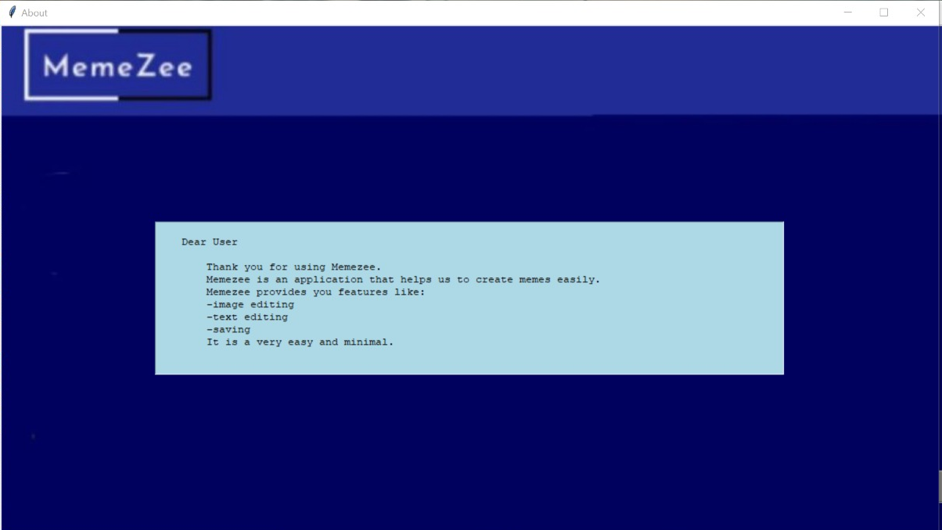

Slide 10
IMAGES SAVED IN FILES

Slide 11
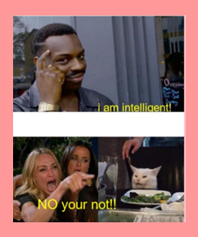
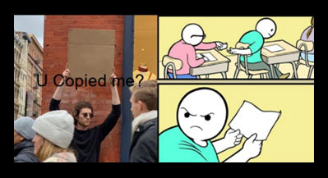

Slide 12
CONCLUSION AND FUTURE WORK
We learned how to manage time. Though we had lot of quizzes and assignments we somehow managed to pull up. This project helped us to gain interest in coding. From many topics we choose memezee and we went through a lot but as a team we faced them. We had an amazing experience working together.
Teamwork made understanding of our project a lot easier and helped us to be more creative in various steps of its development. We also had to revise a lot of concepts regarding graphical user interface, which made our basics even stronger and also helping us to be even more confident.
We have a lot of plans that we would like to add a lot of elements to our project. We would like add a feature that would allow the user to choose images directly from the web with the given spesification, also add a voice assistance to our project and a feature to allow the user to share the meme created on social media.We would also like to make the code more simpler and easier to understand.

Slide 13
THANK YOU

