Slide 1
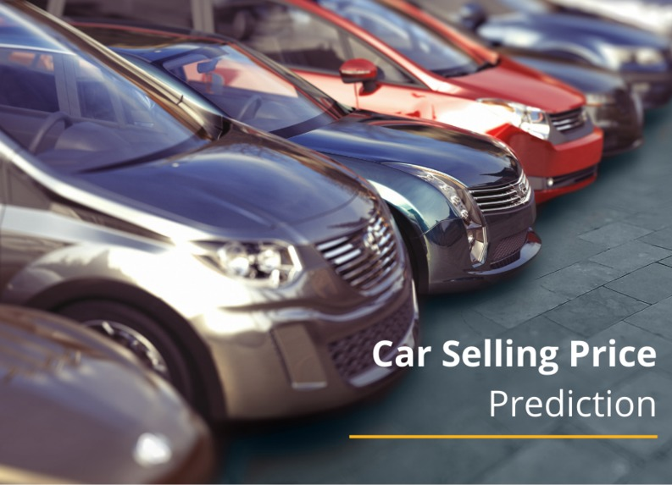
CAR PRICE PREDICTION
NAME : SHRUTHI TALAKOKULA
ROLL NO. : B19CS111
BRANCH : CSE
SECTION : 2

Slide 2

CONTENTS
INTRODUCTION
RANDOM FOREST ALGORITHM
WORKING
VIEW OF THE WEBSITE
ADVANTAGES
CONCLUSION

Slide 3
INTRODUCTION
Car price is one of the important issue for the one who want to sell or buy the car, mainly in these days because of many apps and predicting websites which may predict some false outputs.
Price prediction uses an algorithm to analyze a product or service based on its characteristics, demand, and current market trends. Then the software sets a price at a level it predicts will both attract customers and maximize sales.
In this, predicting the price will be at most accurate as it uses “Random forest algorithm” ,a Machine learning algorithm which is widely used in classification and regression problems.

Slide 4
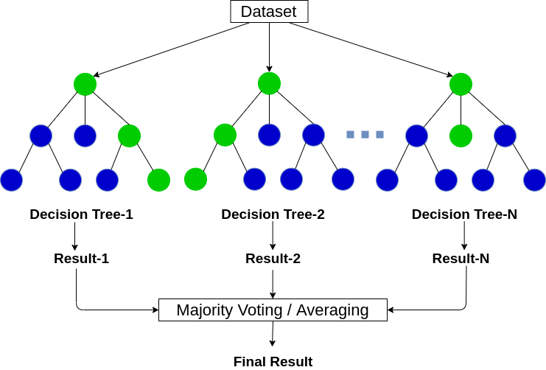
RANDOM FOREST ALGORITHM
Random forest is a Supervised Machine Learning Algorithm that is used widely in Classification and Regression problems. It builds decision trees on different samples and takes their majority vote for classification and average in case of regression.
One of the most important features of the Random Forest Algorithm is that it can handle the data set containing continuous variables as in the case of regression and categorical variables as in the case of classification. It performs better results for classification problems.

Slide 5

WORKING
At first, using Random forest algorithm we need to train the dataset with as many as possible data.
All the data will be stored in Microsoft excel and when we enter the values in the web page created it checks the values given in the training set.
By the data available in the training set, it predicts a value by which the car will get soled using given car details.
This prediction is displayed on the webpage with host name http://127.0.0.1:5000/ with the designed page.

Slide 6
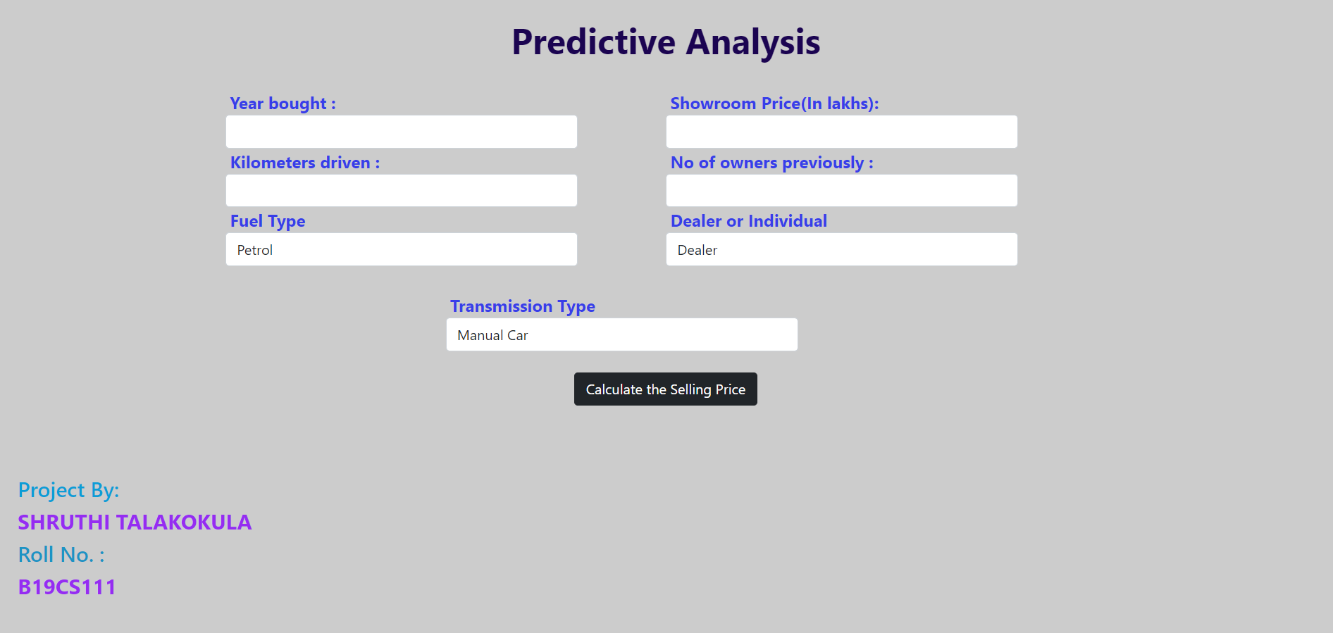
VIEW OF THE WEBSITE

Slide 7
ADVANTAGES
User friendly.
Easy to predict.
Available always.
Gives accurate prediction of the Car by the given car details.
We can directly sell the car by this prediction.

Slide 8

CONCLUSION
The increased prices of used car sales are on a global increase. Therefore, there is an urgent need for a used car prediction system which effectively determines the worthiness of car using a variety of features.
The proposed system will help to determine the accurate price prediction using Random forest algorithm with Machine learning Technology.

Slide 9
THANK YOU

