Slide 1

Blurring and Sharpening Images using FFT
Shruthi Rengarajan
Batch: b 22154

Slide 2
What is it
To blur and sharpen images using the Fast Fourier Transform (FFT) technique, the basic steps include:
Convert the Image to Frequency Domain: Perform FFT on the input image.
Apply Filter in Frequency Domain: Multiply the FFT result by a filter kernel in the frequency domain.
Convert Back to Spatial Domain: Perform Inverse FFT to get the processed image.

Slide 3
Image sharpening is a technique used to enhance the edges and details in an image, making it appear clearer and more defined. This is achieved by increasing
the contrast along edges, effectively making them appear sharper.
Similar to image blurring, FFT is used in image sharpening to perform operations more efficiently in the frequency domain rather than the spatial domain. By
manipulating the frequency components of the image, we can accentuate high-frequency details, which correspond to edges and fine features.
How the FFT is typically used for image sharpening:
a. Convert the Image to Frequency Domain: Start by converting the input image from the spatial domain to the frequency domain using the FFT.
b. Design a Sharpening Kernel: Define a sharpening kernel, which highlights high-frequency components while preserving the low-frequency components.
One common choice is the Laplacian kernel, which emphasizes edges.
c. Convert the Sharpening Kernel to Frequency Domain: Just like the image, the sharpening kernel needs to be transformed into the frequency domain using
the FFT.
d. Element-wise Addition: Add the FFT of the image to the FFT of the sharpening kernel. This enhances the high-frequency components in the image.
e. Inverse FFT: Finally, perform an inverse FFT on the result to convert it back to the spatial domain. This yields the sharpened image.
Benefits of FFT-based Sharpening:
- Efficiency: FFT-based sharpening is faster than spatial domain methods, especially for large images.
- Flexibility: FFT allows for easy experimentation with different sharpening kernels and image sizes.
- Edge Preservation: FFT-based methods typically preserve edges better than other sharpening techniques.
Notes:
*Image Sharpening*:1. *Frequency Analysis*: FFT can be applied to the image to analyze its frequency components. High-frequency components correspond to fine details and edges in the image.2. *Sharpening Filter*: By boosting the high-frequency components in the frequency domain, you can enhance the edges and details in the image.3. *Inverse FFT*: After adjusting the frequency components, you apply the inverse FFT to transform the image back to the spatial domain. This results in a sharpened image.

Slide 4
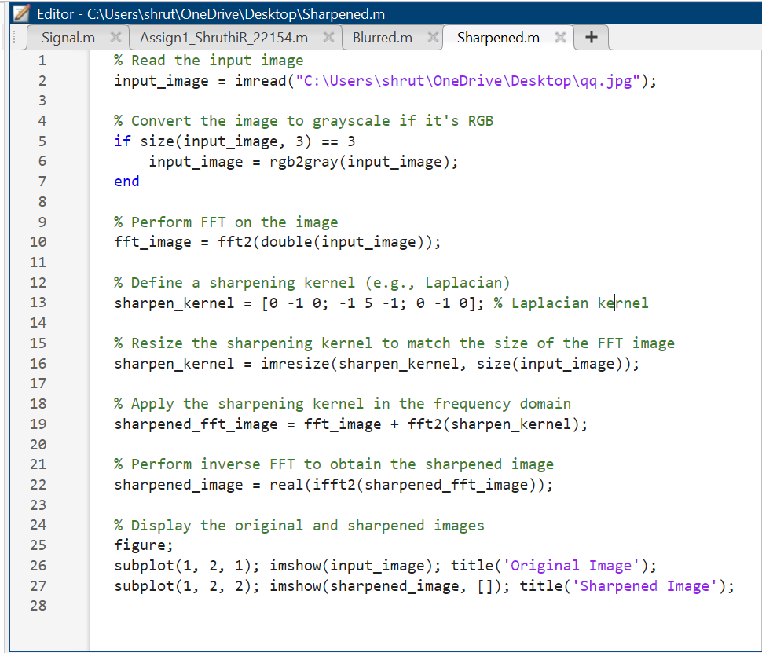
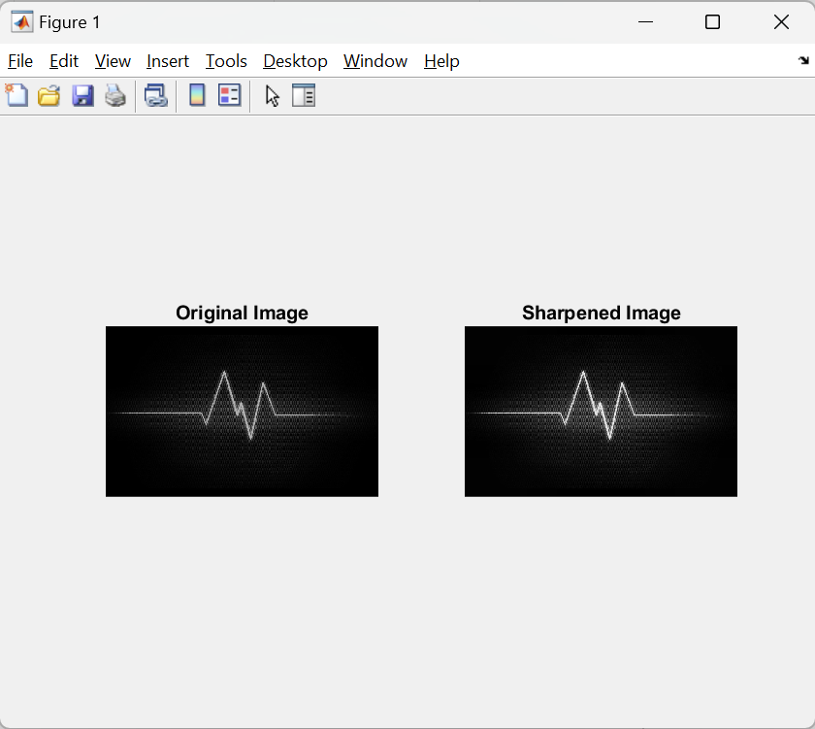
Sharpening an Image
Notes:
double(input_image): Converts the input image to a double precision array. This is often necessary for numerical operations, as it ensures that the pixel values are represented as floating-point numbers, allowing for more accurate computations.
fft2(...): Computes the 2-dimensional FFT of the double-precision input image. FFT (Fast Fourier Transform) is a mathematical algorithm used to transform a spatial domain image (i.e., an image in the pixel space) into the frequency domain. In the frequency domain, the image is represented as a complex-valued array, with each element corresponding to a specific frequency component.
By performing FFT on the image, we transform it from its spatial representation to its frequency representation. This is useful for various image processing tasks, such as filtering, compression, and analysis, as it allows us to manipulate the image in terms of its frequency content.
XXXXXXXXXXXXXXXX The Laplacian kernel is a 3x3 matrix used in image processing for edge detection and image sharpening. It's designed to highlight regions of rapid intensity change in an image, such as edges. The central value (5) is larger than the surrounding values, which enhances the intensity of the central pixel.
The surrounding negative values (-1) subtract neighboring pixel values from the central pixel's value. This subtraction emphasizes the difference in intensity between the central pixel and its neighbors, which effectively highlights edges and other rapid intensity changes in the image.
The zeros in the corners have a neutral effect on the sharpening process; they do not contribute to the sharpening effect but help maintain the structure of the kernel.
XXXXXXXXXXXXXXXXXXXXXXX ifft2(...): Computes the 2-dimensional Inverse FFT of the sharpened_fft_image. This operation reverses the process of the FFT, transforming the image from the frequency domain back to the spatial domain. In the spatial domain, the image is represented as a matrix of pixel values.
real(...): Since the result of the inverse FFT operation may contain complex numbers due to numerical errors, this function is used to extract the real component of the resulting matrix. This is done to ensure that the resulting image only contains real-valued pixel intensities.
The sharpened_image variable now holds the sharpened image in the spatial domain, ready for display or further processing. The sharpening effect is achieved by enhancing high-frequency components in the image, particularly emphasizing edges and details, due to the application of the sharpening kernel in the frequency domain.

Slide 5
Image blurring is a technique used to reduce the sharpness of an image, often to remove noise or to create a smoother appearance. One common method of
blurring is convolution, where an image is convolved with a blur kernel. This kernel is a matrix that modifies the values of pixels in the image, causing adjacent
pixels to blend together.
Traditional methods of image convolution involve performing a spatial convolution, which can be computationally expensive, especially for large kernels and
images. The FFT provides an efficient way to perform convolution in the frequency domain rather than the spatial domain.
How the FFT is typically used for image blurring:
a. Convert the Image to Frequency Domain: The first step is to convert the input image from the spatial domain to the frequency domain using the FFT.
b. Design a Blur Kernel: Define a blur kernel, which is usually a small matrix representing the blurring effect desired. Common choices include Gaussian blur
kernels.
c. Convert the Blur Kernel to Frequency Domain: Similar to the image, the blur kernel needs to be transformed into the frequency domain using the FFT.
d. Element-wise Multiplication: Multiply the FFT of the image by the FFT of the blur kernel. This is done element-wise, meaning each corresponding element
in the two frequency domain representations is
multiplied together.
e. Inverse FFT: Finally, perform an inverse FFT on the result to convert it back to the spatial domain. This yields the blurred image.
Benefits of FFT-based Blurring:
- Efficiency: FFT-based convolution is significantly faster than spatial convolution for large kernels and images.
- Flexibility: FFT-based methods allow for easy experimentation with different blur kernels and image sizes.
Notes:
*Image Blurring*:1. *Frequency Analysis*: Similarly, FFT is applied to the image to analyze its frequency components.2. *Blurring Filter*: To blur the image, you can reduce the high-frequency components, which correspond to sharp edges and details. This is typically achieved by applying a low-pass filter in the frequency domain.3. *Inverse FFT*: After adjusting the frequency components, you apply the inverse FFT to transform the image back to the spatial domain. This results in a blurred image.In both cases, FFT provides a way to manipulate the frequency components of the image efficiently, allowing for image enhancement or degradation depending on the desired outcome.

Slide 6
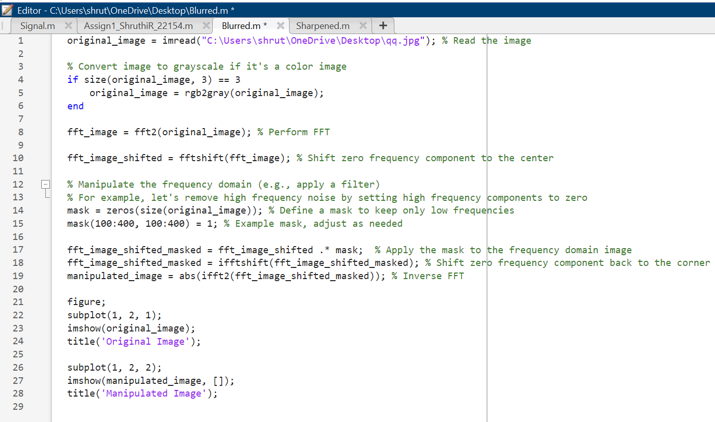
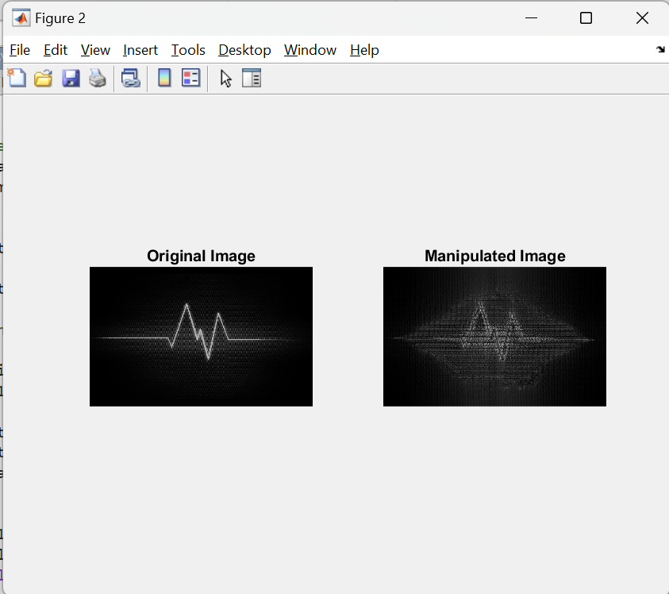
Blurring of Images
Notes:
The mask is initially created as a matrix of zeros with the same size as the original image. This ensures that initially, all frequency components are attenuated.
In this example, a portion of the mask is set to 1, indicating that those specific frequency components should be retained. The size and shape of this area determine which frequency components are preserved. In this case, it's a square region from row 100 to 400 and column 100 to 400. Adjusting the size and shape of this region allows control over which frequency components are kept.
A mask is defined to keep only low-frequency components. In this example, a square region in the center of the frequency domain image is selected to preserve low-frequency information while removing high-frequency noise. The mask is then applied to the shifted FFT image by element-wise multiplication. After applying the mask, the zero frequency component is shifted back to its original position in the corner using the ifftshift() function. The inverse FFT (ifft2()) is applied to the masked FFT image to obtain the manipulated image in the spatial domain. The abs() function is used to compute the magnitude of the resulting complex-valued image.

