Slide 1
FASHION ITEM CLASSIFICATION
USING CONVOLUTIONAL NEURAL NETWORK(CNN)
DEVADHARSHINI B

Slide 2
PROJECT TITLE
FASHION ITEM CLASSIFICATION USING CNN
This project aims to develop a fashion item classification system using Convolutional Neural Networks (CNNs) to categorize images from the Fashion-MNIST dataset.
It involves curating a diverse dataset encompassing various clothing items, accessories, and footwear.
It involves designing the CNN architecture, optimizing hyperparameters, and training the model with augmented data.

Slide 3
AGENDA
Problem Statement
Project Overview
End users
Solution and its Value Proposition
The Wow in a Solution
Modelling
Results

Slide 4
PROBLEM STATEMENT
Develop a deep learning model utilizing Convolutional Neural Networks (CNNs) to effectively classify fashion items depicted in images. The objective is to create a robust fashion item classifier capable of accurately identifying various clothing, accessories, and footwear categories with high accuracy. The model should be resilient to variations in fashion styles, textures, and colors, accommodating diverse user preferences and trends. The evaluation metric will primarily focus on classification accuracy, measuring the percentage of correctly categorized fashion items in the test dataset.

Slide 5
PROJECT OVERVIEW
This project entails developing a fashion item classification system utilizing Convolutional Neural Networks (CNNs) to accurately categorize various clothing, accessories, and footwear depicted in images.
The process encompasses data preprocessing, CNN model design, training, evaluation, and deployment. The primary objective is to achieve high accuracy in classifying fashion items across diverse styles and categories, ensuring robustness to variations in textures, colors, and designs.
Following standard machine learning practices, including data augmentation, model experimentation, and training-validation-test splitting, the project aims to deploy a user-friendly interface for practical use in fashion-related applications.

Slide 6
WHO ARE THE END USERS?
General Public: Individuals seeking an intuitive tool for efficiently categorizing fashion items for personal styling, wardrobe management, or shopping purposes.
Fashion Designers and Researchers: Professionals requiring accurate fashion item classification for research projects, trend analysis, or designing new collections.
E-commerce Platforms: Businesses in need of automated fashion item classification for enhancing product search, recommendation systems, and personalized shopping experiences.
Fashion Retailers and Merchandisers: Companies seeking efficient tools for inventory management, assortment planning, and optimizing product placement strategies.
Fashion Bloggers and Influencers: Individuals utilizing fashion item classification for creating content, generating style inspiration, and providing fashion-related recommendations to their audience.
Fashion App Developers: Software developers integrating fashion item classification functionality into applications, websites, or virtual styling platforms for enhanced user experiences and engagement.

Slide 7
SOLUTION:
Our project utilizes a Convolutional Neural Network (CNN) trained on the Fashion MNIST dataset to accurately classify fashion items. By leveraging advanced CNN architectures and data preprocessing techniques, we achieve robust performance in classifying clothing, shoes, and accessories.
VALUE PROPOSITION:
Accuracy: Precisely identifies diverse fashion items for reliable inventory management and trend analysis.
Efficiency: Swift classification streamlines e-commerce transactions and enhances operational speed.
Versatility: Seamlessly integrates into retail systems, catering to various user preferences and market demands.
Automation: Reduces manual effort in categorizing fashion items, improving workflow efficiency.
Accessibility: Democratizes advanced fashion classification technology for industry professionals and consumers alike.

Slide 8
THE WOW IN OUR SOLUTION
Unmatched Precision: Our CNN-based fashion classifier sets new standards with its unparalleled accuracy, revolutionizing fashion item recognition.
Rapid Processing: Powered by optimized architectures, our system swiftly analyzes fashion images, transforming trend identification and inventory management.
Seamless Integration: Adapting effortlessly to diverse systems, our solution meets the dynamic needs of retailers, designers, and consumers.
Automated Efficiency: By automating classification, we streamline operations, reducing manual labor and boosting productivity.
Inclusive Accesibility:Our user-friendly solution democratizes advanced fashion classification, empowering industry professionals and enthusiasts alike.

Slide 9
MODELLING
In the modeling phase of our digit recognition solution:
Architecture Design: Meticulously crafting our CNN architecture, we optimize layer count, filter sizes, and activation functions to ensure peak performance in fashion item classification.
Hyperparameter Tuning: Rigorously experimenting with parameters like learning rate and batch size, we fine-tune our model to maximize learning efficiency and generalization capability.
Data Augmentation: Applying rotation, scaling, and shifting techniques enriches our training data, enhancing the model's robustness to diverse fashion styles and variations.
Regularization: By integrating dropout layers and weight decay, we prevent overfitting and improve the model's ability to generalize to unseen fashion items.

Slide 10
5.Training: Utilizing preprocessed data, we train the CNN model on a subset while validating its performance on a separate set. Key metrics like loss and accuracy guide our training process.
6.Evaluation: Assessing the model's performance on a held-out test set, we analyze metrics such as classification accuracy and confusion matrices to understand its strengths and weaknesses.
7.Fine-tuning and Optimization: Based on evaluation insights, we further refine the model by adjusting hyperparameters or exploring alternative architectures to enhance performance.
8.Model Deployment: Satisfied with performance, we deploy the model into our fashion item classification system, enabling real-time predictions for diverse fashion items.

Slide 11
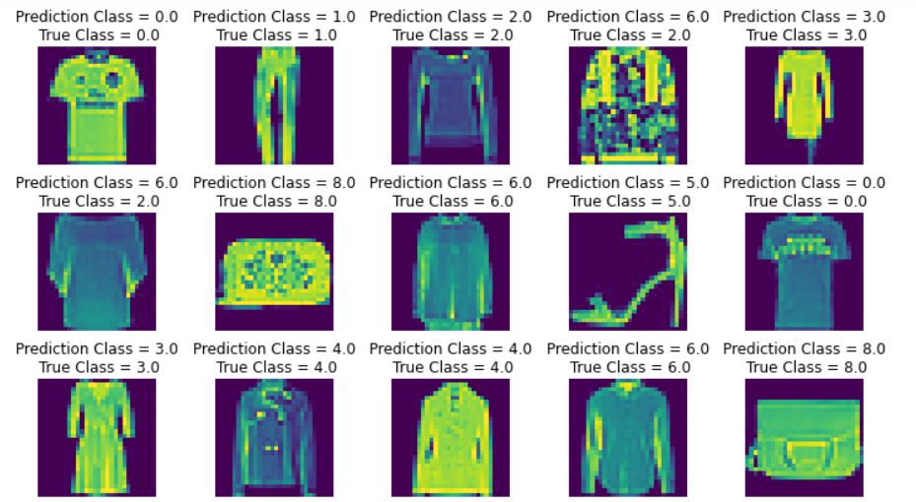
RESULTS

Slide 12
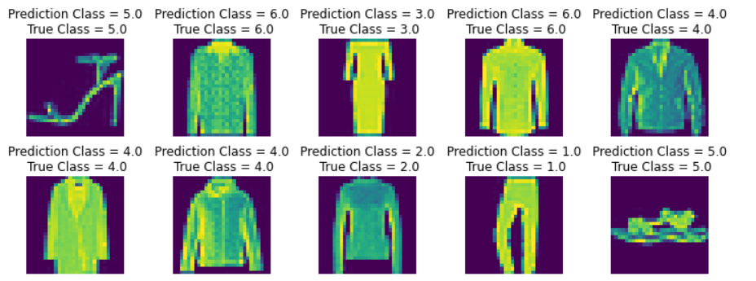
DEMO LINK

