Slide 1

HEALTH DATA SCIENCE
FINAL PROJECT PRESENTATION
PROFESSOR : JASON DOHERTY

Slide 2
The Impact of Technology Use on Academic Performance and Life Satisfaction Among Youth
Presented By:
Vudem Shruthi Reddy

Slide 3
Background and Research Gaps
Background:
Technology use among children/adolescents has increased dramatically
Impacts on academic performance and life satisfaction not fully understood
Existing studies (Lepp et al., 2014; Moksnes et al., 2016; Crede et al., 2015) found mixed results
Research Gap:
Focus on GSS dataset and unique SDOH variables
Examine moderating effects of SDOH factors
Research Question: How does technology use influence academic performance and life satisfaction among youth, and what role do sociodemographic factors play in these relationships?

Slide 4
Data Source and Variables
Data Source:
General Social Survey (GSS) dataset
High-quality, representative US sample
Includes SDOH variables relevant to the research question
Dependent Variables:
Academic Performance (EDUC)
Life Satisfaction (HAPPY)
Independent Variables:
Technology Use (USETECH)
Work Status (WRKSTAT)
Income (RINCOME)
Marital Status (MARITAL)
Sex
Race

Slide 5
DATA MANAGMENT
Data Cleaning:
Missing Values in "USETECH" Variable:
Replaced -1, 998, and 999 with NA (missing) using the na_if function in R.
Imputed mean value of non-missing "USETECH" scores for missing values.
Variable Transformation:
Recoding Categorical Variables:
"EDUC" variable recoded from numeric values (0-20) to education levels.
Other categorical variables assigned descriptive labels:
"HAPPY", "WRKSTAT", "RINCOME", "MARITAL", "SEX", "RACE", "HRS1", and "HRS2".
Subset Selection:
Selected Relevant Variables:
"EDUC", "HAPPY", "USETECH", "AGE", "SEX", "RACE", "WRKSTAT", "RINCOME", "MARITAL", "HRS1", and "HRS2".

Slide 6
Creation of New Variables:
"USETECH_group":
Divided into "High" and "Low" groups based on median value of "USETECH".
Facilitates comparison between groups using standard statistical techniques.
"LifeSat":
Binary variable derived from "HAPPY" variable.
Value of 1 for "Very Happy" and 0 for other happiness levels.

Slide 7
Descriptive Statistics
Key Variables:
EDUC (Education Level)
28% had 12th grade education
18.4% had 4 years of college
HAPPY (Happiness Level)
29.9% Very Happy
55.7% Pretty Happy
USETECH (mean = 55.15, SD = 29.32)
AGE (mean = 49.13, SD = 18.24)
Other Variables:
SEX: 44.8% Male, 55.2% Female
RACE: 72.2% White, 16.3% Black, 11.5% Others
WRKSTAT: 48.3% Working Full Time, 19% Retired
RINCOME: 59.8% $25,000 and over

Slide 8
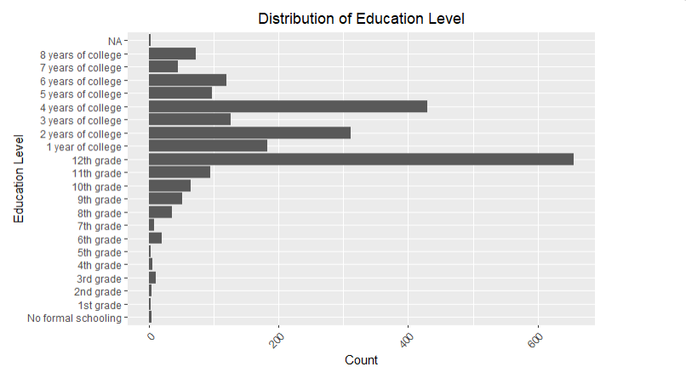
Distribution of Education Level

Slide 9
This bar chart shows the division of participants into various education levels. The x-axis is displayed as different education level categories, starting from "No formal schooling" and ending at "8 years of college." The y-axis represents the number of participants in each education level category. The graph shows that the most common level of education is "high school ", then "4 years of university" and "2 years of university". This graph clearly demonstrates the educational attainment of the survey population.

Slide 10
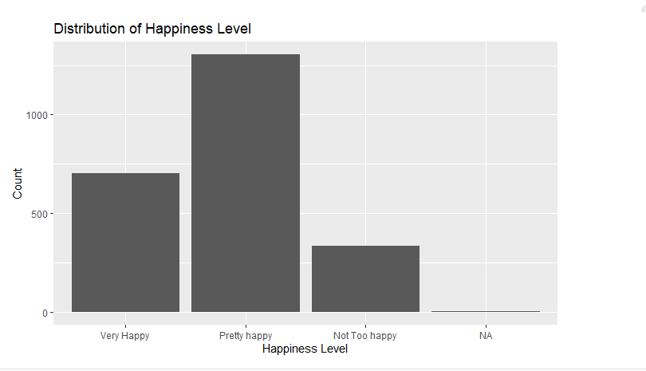
Distribution of Happiness Level

Slide 11
Distribution of happiness level
This bar chart shows the distribution of the happiness self-ratings made by the participants. The x-axis shows the three categories of happiness: "Very Happy", "Pretty happy", and "Not Too happy" are depicted on the x-axis, which also shows the count or frequency of the participants in each category. A glance at the chart can be seen that the majority of the people voted for "Pretty Happy," and then "Very Happy," while a smaller number selected "Not Too Happy." This makes it evident that the general happiness level of the sample is high.

Slide 12
Relationship between USETECH and Education
Such a scatter plot study is about the interaction between the participants' technological usage (USETECH) and their educational level. The USETECH variable is represented on the x-axis of the chart, and the y-axis shows the level of education. On the plot, every data point corresponds to the USETECH score of a participant and the education level that they have achieved. The regression line in blue shows the slope of the relationship between the two variables. This visualization is then used to analyze the possibility of the existence of the correlation between the use of technologies and the educational achievement in the given sample.

Slide 13
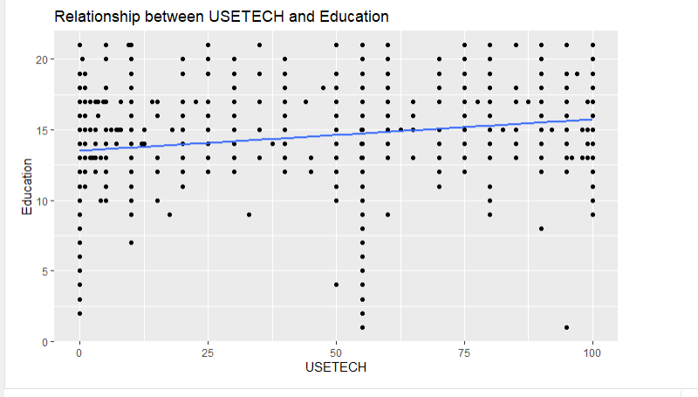
Relationship between USETECH and Education

Slide 14
Regression Models
Multiple Linear Regression (HAPPY):
Only RACE (Black) had a significant positive effect (β = 0.1127718, p = 0.00224)
Model: F(5, 2335) = 3.02, p = 0.01011, R2 = 0.004297
Binary Logistic Regression (Life Satisfaction):
AGE was the only significant predictor (OR = 1.005371, p = 0.0319)
USETECH, SEX, and RACE were not significant predictors
Model diagnostics: AIC, Count R-squared

Slide 15
stastical tests
Indepedent samples test
Shapiro wilk test
Levene’s test
Wilcoxon rank sum test
Cohen d test
Anova test
Kruskal-walis test
Tukey’s HSD

Slide 16
A binary logistic regression model
A binary logistic regression model was fit to predict life satisfaction (LifeSat), a binary variable derived from the HAPPY variable, using the same set of independent variables: USE, TECH, AGES, SEXES, and RACES.
The logistic regression model results unveiled that AGE was the only statistically significant factor affecting life satisfaction.
The odds ratio for AGE was 1.005371 (p = 0.0319), implying that older participants had a slightly higher probability of being "Very Happy" compared to their younger counterparts.
However, the other independent variables, namely, USETECH, SEX, and RACE, were insignificant with respect to life satisfaction

Slide 17
Key Findings
Significant difference in EDUC scores between high and low USETECH groups
Higher EDUC scores in high USETECH group (p = 1.079e-05)
Small to medium effect size (d = 0.2004482)
No significant difference in HAPPY scores between high and low USETECH groups
t-test: p = 0.3007
Wilcoxon rank-sum test: p = 0.3196

Slide 18
Key Findings
Differences in HAPPY scores across subgroups:
Significant differences across RACE (p < 0.05)
Black > White (Tukey's HSD)
Small effect size (η2 = 0.004)
Significant differences across MARITAL status (p < 0.001)
Medium effect size (η2 = 0.081)
Differences in EDUC scores across subgroups:
Significant differences across RACE (p < 0.001)
White > Black, Others (Tukey's HSD)
Small effect size (η2 = 0.021)
Significant differences across MARITAL status (p < 0.001)
Small effect size (η2 = 0.018)

Slide 19
Results Summary
Higher technology use (USETECH) was associated with higher academic performance (EDUC)
No direct relationship between technology use and life satisfaction (HAPPY)
Race and marital status influenced HAPPY and EDUC scores
Age was a significant predictor of life satisfaction
But the inference demonstrates that no significant difference exists in the HAPPY scores between the high USETECH and the low USETECH groups, which is shown by the t-test (p = 0.3007) and the non-parametric Wilcoxon rank-sum test (p = 0.3196).
This could mean that the influence of tech on life satisfaction of these participants does not have a direct relationship.

