Slide 1
San Francisco Auto Rental (SAR) Data Analysis
Final Project Presentation

Slide 2
Introduction
San Francisco Auto Rental (SAR) operates in the car rental market, handling 15,000 bookings per month.
This analysis examines 10,000 records to enhance predictive capabilities and optimize service delivery.

Slide 3
Business Problem & Goal
- Problem: SAR experiences 20% ride cancellations, affecting service reliability.
- Goal: Achieve 95% accuracy in predicting cancellations using machine learning.
- Optimize driver availability and booking fulfillment rates.

Slide 4
Data Understanding & Preprocessing
- Dataset: 10,000 bookings, 19 features.
- Missing values handled using MICE & KNN imputation.
- Feature Engineering: Distance calculation (Haversine formula), clustering (K-Means), and time-based features.

Slide 5
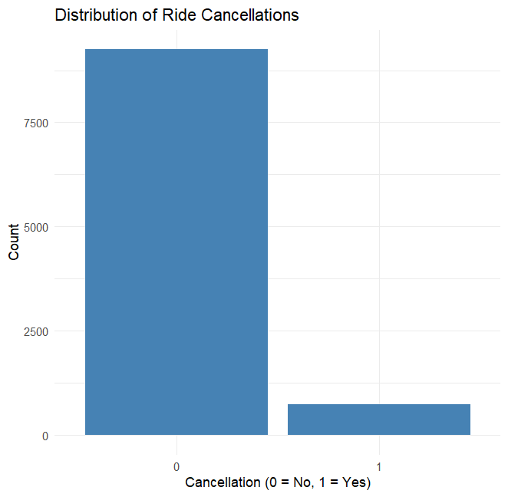
Exploratory Data Analysis (EDA)
- Mobile bookings have the lowest cancellation rate (0.7%).

Slide 6
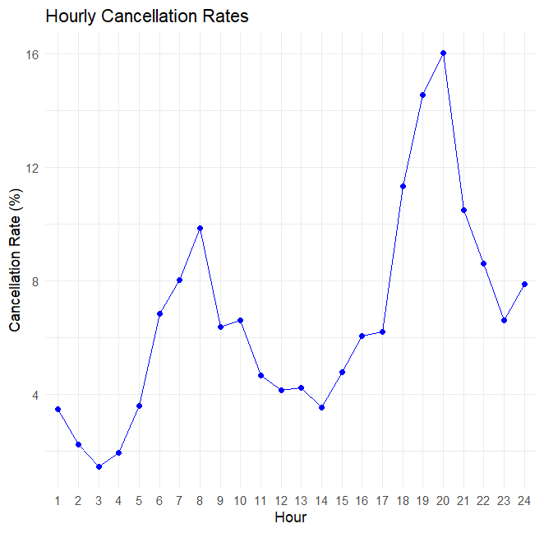
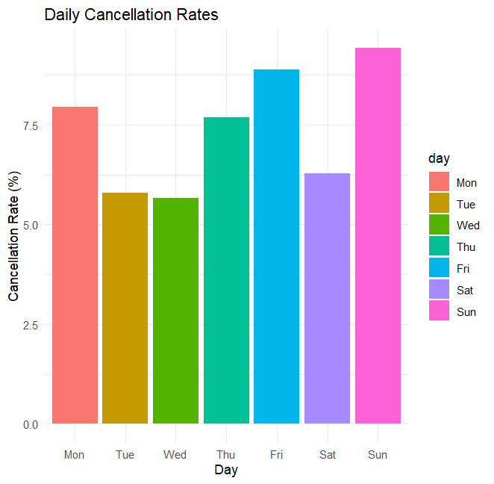
- Cancellation rate highest at night (21-22 hours: 16%).
- Weekend cancellations peak on Sundays (8.5%).

Slide 7
Model Development & Evaluation
- Models Implemented:
- Naive Bayes (77.25% accuracy)
- Logistic Regression (LASSO) (92.5% accuracy)
- Decision Tree (91.25% accuracy)
- K-Nearest Neighbors (92.3% accuracy)
- Random Forest (93.3% accuracy - Best Model)
- Addressed class imbalance with oversampling techniques.

Slide 8
Business Impact & Recommendations
- Estimated cost savings: $150K - $250K annually by reducing cancellations.
- Strategies:
- Incentives for high-reliability drivers.
- Predictive analytics for proactive service management.
- Enhanced mobile booking features for increased adoption.

Slide 9
Conclusion
- Random Forest emerged as the best model with 93.3% accuracy.
- Temporal, geographical, and booking factors impact cancellations.
- Implementation of predictive analytics can optimize SAR’s service reliability.

