Slide 1
FEEDBACK MANAGEMENT SYSTEM
GROUP-3
MENTOR:
RAHUL VIKASH
Notes:
©2016 Capgemini. All rights reserved.
The information contained in this document is proprietary and confidential. For Capgemini only.

Slide 2
Objectives
Project Understanding
Approach used
Project Execution
Modules
Learning
Best Practices
Opportunity for improvement
Demo and Code Walkthrough

Slide 3
Project Understanding
This project was aimed to develop a desktop feedback management system for Data global solutions . The Training department of Data global solutions constantly conducts several training programs for their employees. Collection and analysis of feedback is a very critical part of any training program/organization. This desktop application will help the training department to improve the training execution based on the analysis and collection of feedback reports.
Notes:
Add instructor notes here.

Slide 4
Project Understanding (Contd.)
In this application there are two types of users. All users are the employees of the Data Global Solutions. The functionalities performed by the different users are as follows:
Training Admin
  Maintain the skill set of faculties
  Maintain the Training courses
  View the feedback reports
Notes:
Add instructor notes here.

Slide 5
Project Understanding (Contd.)
Feedback data is collected from participants to understand the positives and improvement areas of the training. Following are the parameters on which the training will be rated by the participants:
Presentation and communication skills of faculty
Ability to clarify doubts and explain difficult points
Time management in completing the contents
Handout provided(Student Guide)
Hardware, software and network availability
Notes:
Add instructor notes here.

Slide 6
Approach Used
In this application we have followed Modular Programming. Modular Programming is a process which divides a computer program into separate sub-programs.
A module is a separate software component, which can be used in a variety of applications and functions with other components of the system. Similar functions were grouped in the same unit of code and separate functions are developed as separate units of code so that the code can be reused.
Modular programming enabled us to divide the work and debug pieces of the program independently. Modules were designed in such a way to minimize dependencies between different modules.
Notes:
Add instructor notes here.

Slide 7
Modules
Match Login
Show Monthly Feedback
Add Faculty Skills
Delete Faculty Skills
Update Faculty Skill
View Faculty List
Insert Course Record
Notes:
Add instructor notes here.

Slide 8
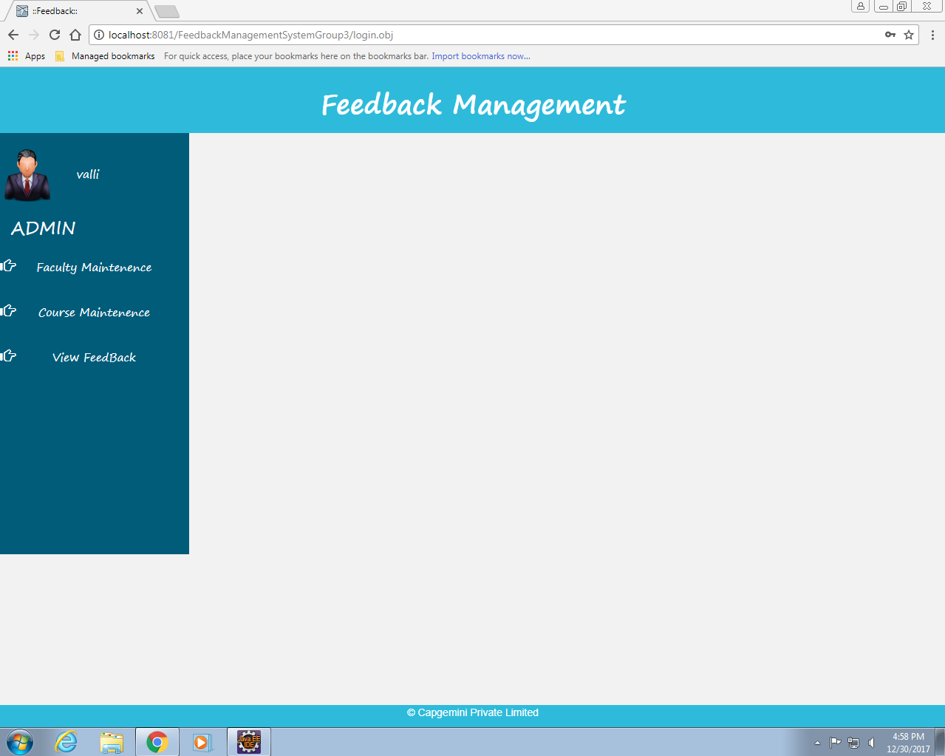
Modules
Match Login:
This module takes the Username ,Password. If its valid the user is forwarded to admin page.
Notes:
Add instructor notes here.

Slide 9
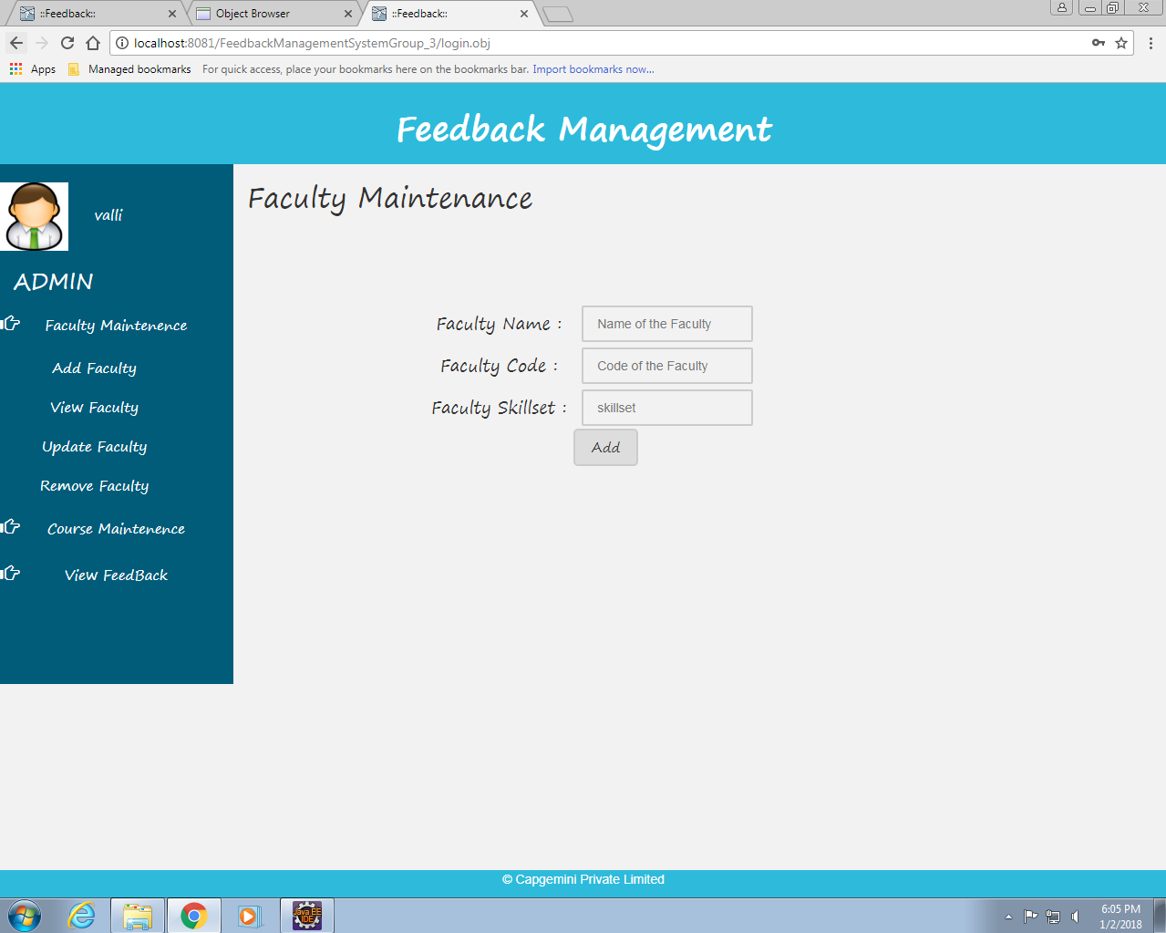
Modules
ADD Faculty Skills:
In this module we can add faculty with skill sets.
Notes:
Add instructor notes here.

Slide 10
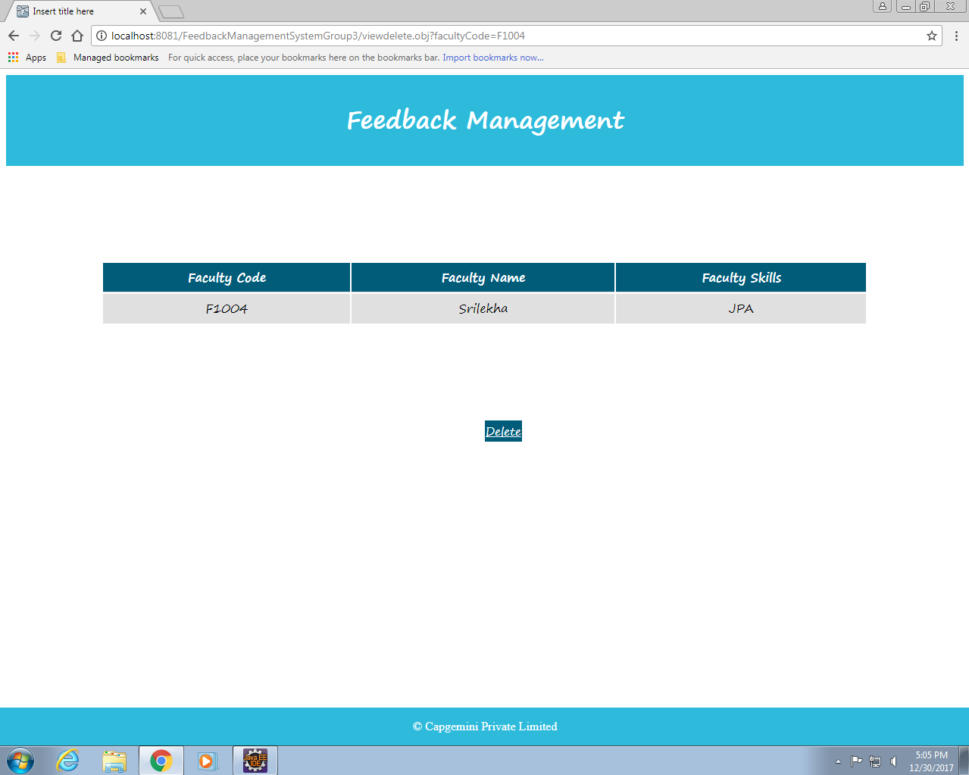
Modules
Delete Faculty Skills:
In this module we can delete a course for respective faculty selected from the table.
Notes:
Add instructor notes here.

Slide 11
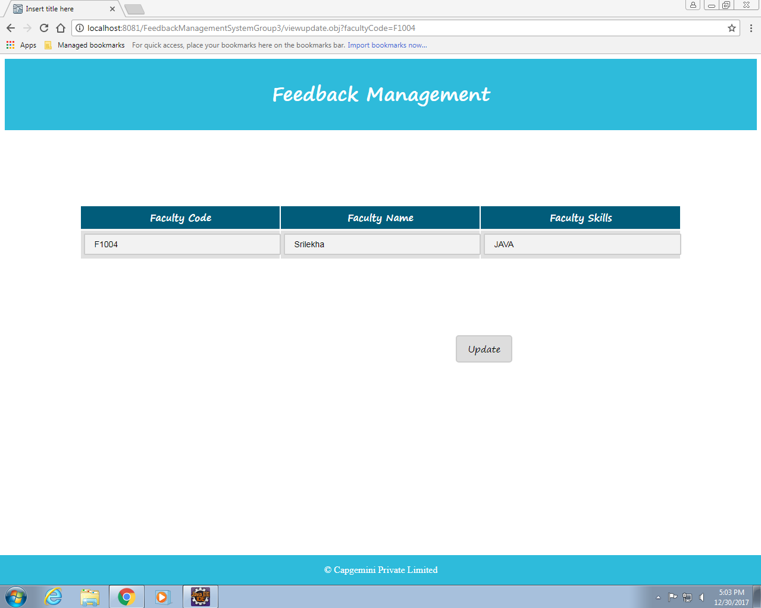
Modules
Update Faculty Skill:
In this module we can update the Courses taught by the faculties(i.e. add new skills/courses)
Notes:
Add instructor notes here.

Slide 12
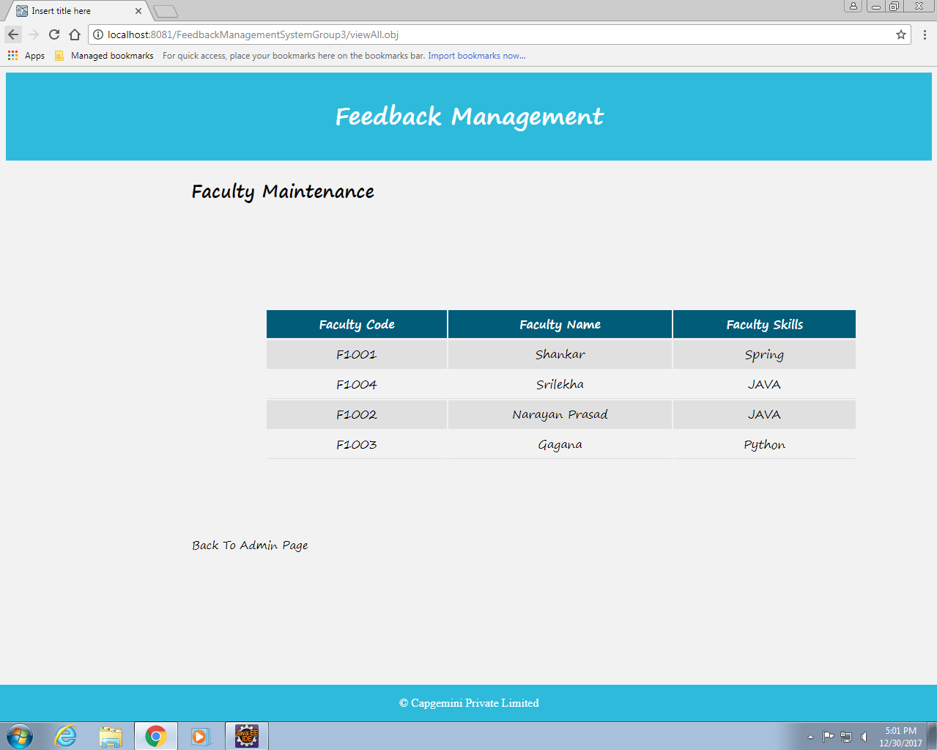
Modules
View Faculty List:
In this module the faculty name, faculty code and skill sets are displayed.
Notes:
Add instructor notes here.

Slide 13
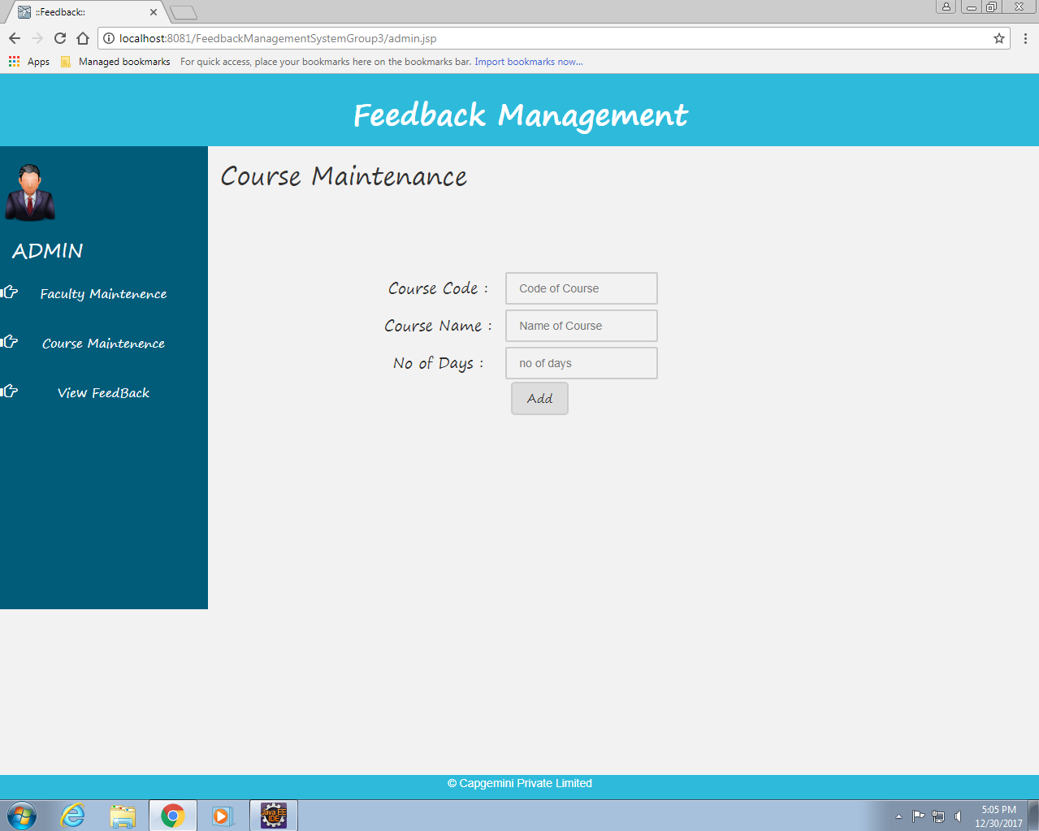
Modules
Insert Course Record:
In this module new courses can be added by the trainer/admin.
Notes:
Add instructor notes here.

Slide 14
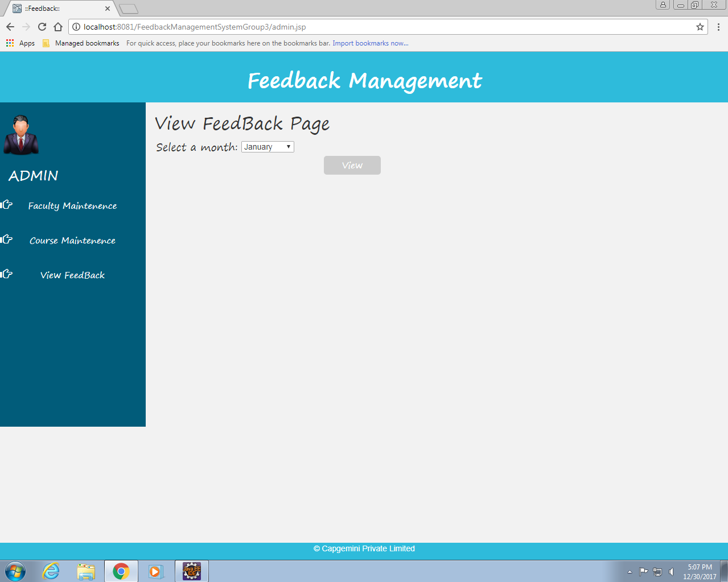
Modules
Show Monthly Feedback:
In this module when user(admin) selects a particular month, the feedback associated with the trainer in that month is displayed.
Notes:
Add instructor notes here.

Slide 15
Future Scope of Project
In our current system an employee can login using his username, password and employee type. But, in case an employee forgets his password he can reset his password by clicking on Forget password option.
Forget Password:
When the employee clicks on Forget Password, the link to reset the password will be sent to the registered email.
Using this link employee can reset his password.
Registration by admin:
The admin is responsible for registration of new employees. This feature will be added to our system later.
Notes:
Add instructor notes here.

