Slide 1


SMART INDIA HACKATHON 2024
Problem Statement ID – SH1761
Problem Statement Title – AI Based on Customized Time Slot Delivery System of E-Commerce Logistics for Postal Department.
Theme – Transportation and Logistics
PS Category – Software
Team ID –
Team Name – ROUTE BRIGADE

Slide 2

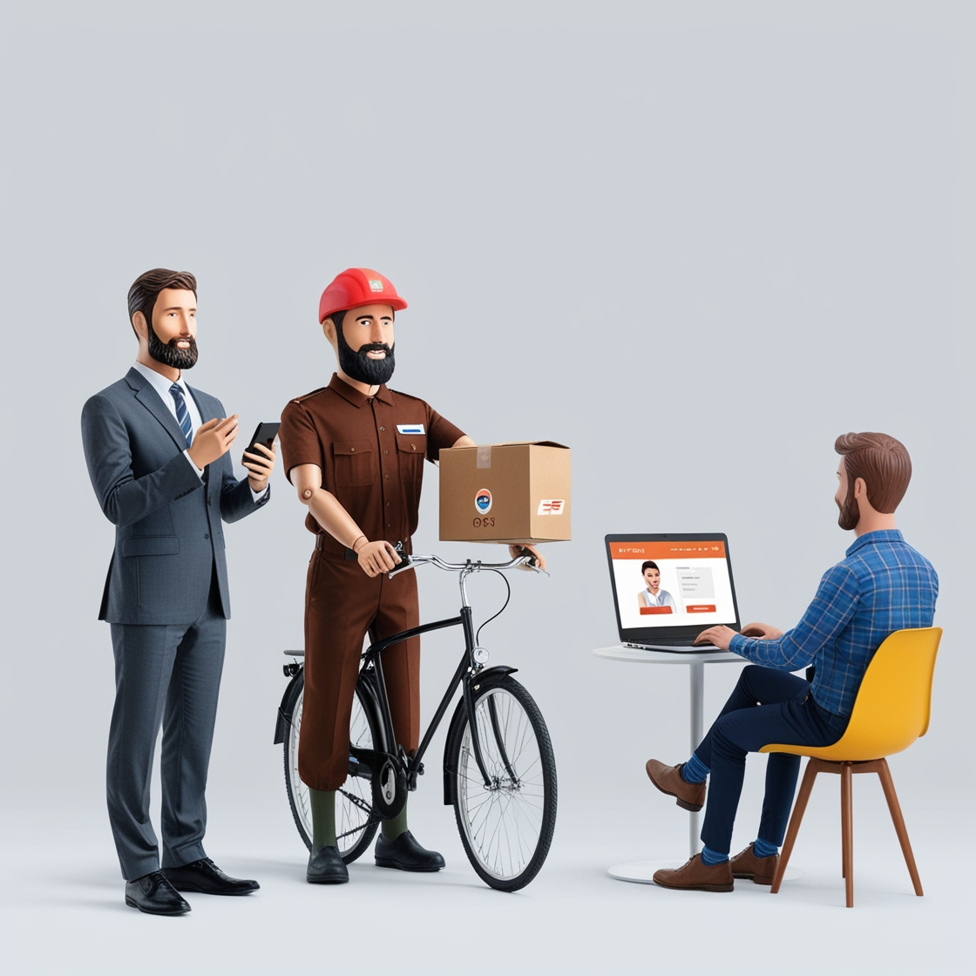
AI Based Customized Time Slot Delivery System of E-Commerce Logistics for Postal Department
Proposed Solution
This project develops an AI-powered customized time slot delivery system for department of post, enabling customers to choose flexible delivery times and improving logistics efficiency.
The system utilizes machine learning algorithms to optimize delivery routes, reduce costs, and enhance customer satisfaction. With real-time tracking and updates, customers can manage their deliveries conveniently.
The project aims to revolutionize Postal Department by providing a personalized, efficient, and sustainable delivery experience.
@SIH Idea submission- Template

Slide 3

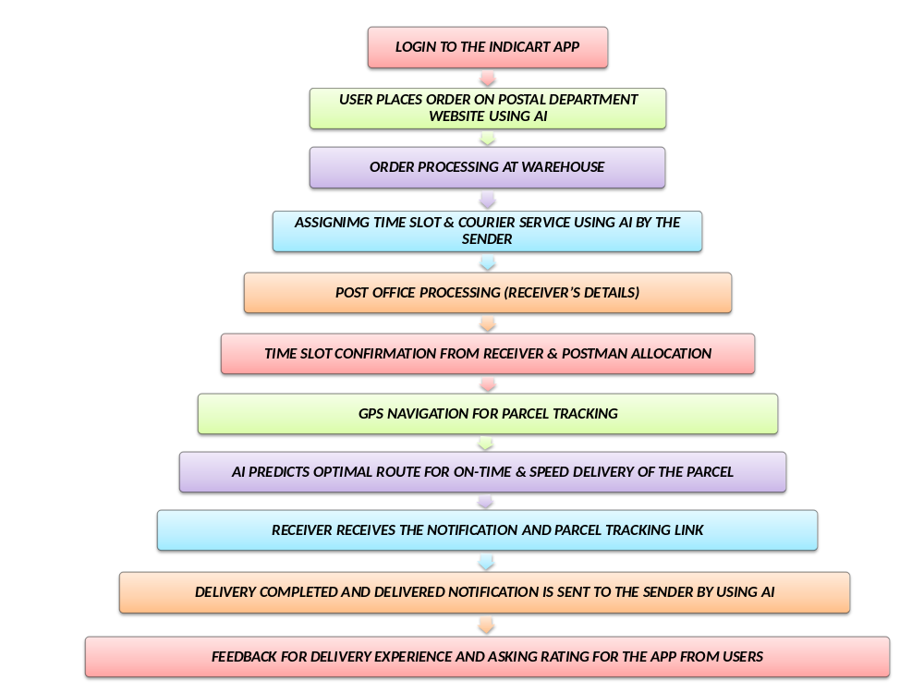
TECHNICAL APPROACH
BLOCK DIAGRAM:
TECHNOLOGY USED :
Data-based AI Algorithm
Learning Tool Ranked based AI Algorithm(LTR)
HTML
CSS
JavaScript
PHP
Bootstrap
Node.js
@SIH Idea submission- Template

Slide 4



FEASIBILITY AND VIABILITY
FEASIBILITY:
Time Slot
Easy to access
Customer convention
Route optimization
Website Access(App)
AI Guidance
Emergency Shipping
STRATEGIES TO OVERCOME CHALLENGES:
AI Assistance
GPS tracking
User feedback
Network Traffic troubleshooting
Encryption of Data
Load ,Route Optimization Software in Airlines
CHALLENGES:
Data quality
Quality Delivery
Real Time data management
Data insecurity
Transportation(Premium)
@SIH Idea submission- Template

Slide 5



IMPACT AND BENEFITS
IMPACT
Revolutionized logistics
Increased tech reliance
Exacerbated Social Availability
Efficient Delivery Stratergy
Job creation
BENEFITS
AI Guidance(easy to access)
Reduced logistics cost
Convenient delivery option
Increased accessibility
Precise GPS tracking
Emergency Courier (Premium Membership)
@SIH Idea submission- Template

Slide 6
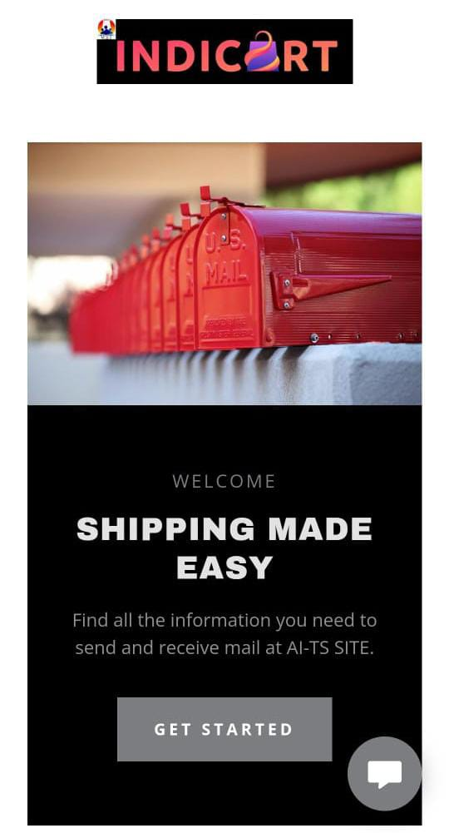
RESEARCH AND REFERENCES
By leveraging data-based AI, Department of Post providing doorstep products/service by using the advanced digital platform of Machine learning , Deep learning and overall AI which ties up robust system with operational system that enhances Efficiency , Competitiveness and Customer Satisfaction. Finally this creates another level of acceptance across world.
https://biteable.com/watch/4261045/951311b81c6bee1d630cd366b9915c15 - Reference of Video Creation for AI Time Slot for Postal Department
https://ai-tssite.godaddysites.com – Website for AI Time Slot for Postal Department.
@SIH Idea submission- Template

