Slide 1
Keylogger
Shruthi Reddy 23BCE1323

Slide 2
Abstract
A keylogger is a program designed to capture and record every keystroke made on a computer. This project focuses on building a keylogger with a Flask API, highlighting the critical connection between application development and operating system (OS) concepts such as process management, file I/O, multiprocessing (for parallel execution), and inter-process communication (IPC for a queue). The keylogger captures keystrokes, stores them securely, and sends the data to a Flask-based web interface for real-time monitoring, showcasing how OS resources are leveraged to manage concurrent tasks effectively.
Beyond technical implementation, this study provides insights into cybersecurity risks associated with keyloggers, as they are commonly exploited by attackers to steal sensitive information such as passwords, banking details, and personal data. By understanding their functionality, ethical considerations, and mitigation strategies, this research aids in developing more secure systems and defensive measures. Additionally, it highlights the ethical implications of keylogger usage, differentiating between legal monitoring applications and malicious intent.

Slide 3
Objectives
1.To design and implement a cross-platform keylogger in Python.
To establish a secure and efficient communication channel between the keylogger and a Flask API.
To understand OS-level keyboard hooks and file I/O operations.
To implement multiprocessing and inter-process communication (IPC) for smooth performance.
To create a real-time logging interface for keystroke monitoring.
To explore ethical considerations and responsible use of keylogging software.

Slide 4
Literature review
No. | Title | Description | Advantage | Disadvantage
1. | System Monitoring and Security Using Keylogger Tuli, Preeti, and Priyanka Sahu. "System monitoring and security using keylogger." International Journal of Computer Science and Mobile Computing 2.3 (2013): 106-111. | Explores keyloggers for monitoring employee activity in corporate systems. | Highlights keylogging for system security and monitoring | Focuses on corporate surveillance, not API-based keyloggers.
2. | Keylogger Detection and Prevention Singh, Arjun, and Pushpa Choudhary. "Keylogger detection and prevention." Journal of Physics: Conference Series. Vol. 2007. No. 1. IOP Publishing, 2021. | Analyzes detection techniques for preventing keyloggers from stealing data. | Provides insights into defensive mechanisms against keyloggers. | Focuses on malware prevention, not keylogger implementation.
3. | Survey of keylogger Technologies Ahmed, Yahye Abukar, et al. "Survey of Keylogger technologies." International journal of computer science and telecommunications 5.2 (2014). | Discusses different types of keyloggers and their threats to cybersecurity. | Gives an overview of keylogger methodologies. | Lacks implementation details relevant to Flask-based keyloggers.
4. | A Novel Approach of Unprivileged Keylogger Detection Wajahat, Ahsan, et al. "A novel approach of unprivileged keylogger detection." 2019 2nd International Conference on Computing, Mathematics and Engineering Technologies (iCoMET). IEEE, 2019. | Proposes detecting user-space keyloggers without privileged access. | Relevant for securing user-space keyloggers against detection. | Focuses on detection, not keylogging implementation.
5. | Keylogger Application to Monitoring Users Activity with Exact String Matching Algorithm Rahim, Robbi, et al. "Keylogger application to monitoring users activity with exact string matching algorithm." Journal of Physics: Conference Series. Vol. 954. IOP Publishing, 2018. | Uses a string-matching algorithm for keystroke tracking. | Efficient keystroke logging using string-matching. | Doesn't explore real-time data transmission via API.

Slide 5
Literature review
No. | Title | Description | Advantage | Disadvantage
6. | You Can Type, but You Can’t Hide: A Stealthy GPU-based Keylogger Ladakis, Evangelos, et al. "You can type, but you can’t hide: A stealthy GPU-based keylogger." Proceedings of the 6th European Workshop on System Security (EuroSec). Citeseer, 2013. | Implements a keylogger using GPU memory for stealth. | Novel approach to bypass detection methods. | Irrelevant to Flask API-based logging.
7. | Keylogger Detection: A Systematic Review Ekele Victoria, C., A. Adebiyi Ayodele, and O. Igbekele Emmanuel. "Keylogger Detection: A Systematic Review." International Conference on Science, Engineering and Business for Sustainable Development Goals (SEB-SDG). 2023. | Reviews keylogger detection strategies in modern security. | Covers detection techniques useful for countermeasures. | More relevant for defense, not keylogging development.
8. | Keyloggers software detection techniques Solairaj, A., et al. "Keyloggers software detection techniques." 2016 10th International Conference on Intelligent Systems and Control (ISCO). IEEE, 2016. | Compares various keylogger detection algorithms. | Provides insights into behavioral detection of keyloggers. | Focuses on anti-keylogging mechanisms instead of implementation.
9. | Analysis and Implementation of Novel Keylogger Technique Srivastava, Mayank, et al. "Analysis and Implementation of Novel Keylogger Technique." 2021 5th International Conference on Information Systems and Computer Networks (ISCON). IEEE, 2021. | Implements a stealthy keylogger that encrypts keystrokes. | Includes data encryption for security | Doesn’t cover web-based keylogger data transmission.
10. | A framework for detection and prevention of novel keylogger spyware attacks Wazid, Mohammad, et al. "A framework for detection and prevention of novel keylogger spyware attacks." 2013 7th International Conference on Intelligent Systems and Control (ISCO). IEEE, 2013. | Proposes a framework to detect and prevent spyware keyloggers. | Suggests countermeasures against keylogger-based spyware. | Targets prevention, not implementation of a keylogger API.

Slide 6
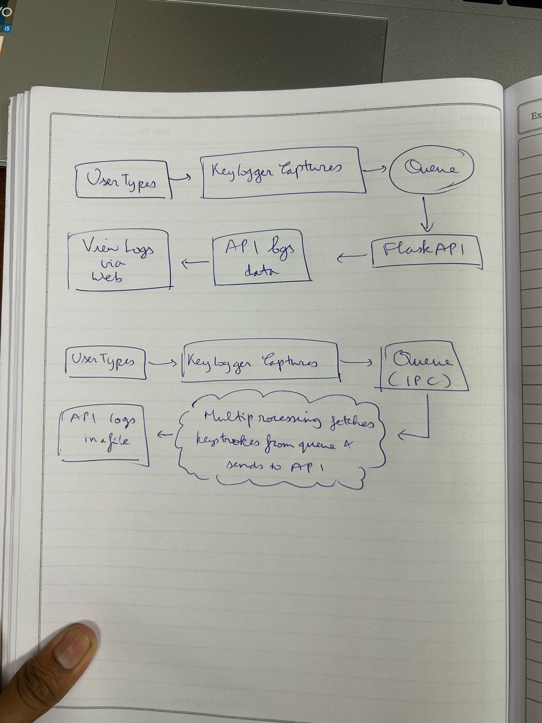
Architecture diagram
FLOWCHART

Slide 7
Modules used
pynput:
To capture keyboard inputs using low-level OS hooks.
multiprocessing:
To enable parallel execution of keylogging and Flask server processes.
Flask:
To create a lightweight web server for real-time keystroke monitoring.
Queue:
For inter-process communication between the keylogger and the Flask API.
os and sys:
To handle file paths and system-specific configurations.
logging:
To write captured keystrokes into a log file securely.

Slide 8
References
Python official documentation - https://docs.python.org/
Flask documentation - https://flask.palletsprojects.com/
Multiprocessing in Python - https://docs.python.org/3/library/multiprocessing.html
Google Scholar - https://scholar.google.com/
Ieeeexplore - https://ieeexplore.ieee.org/Xplore/home.jsp

