Slide 1
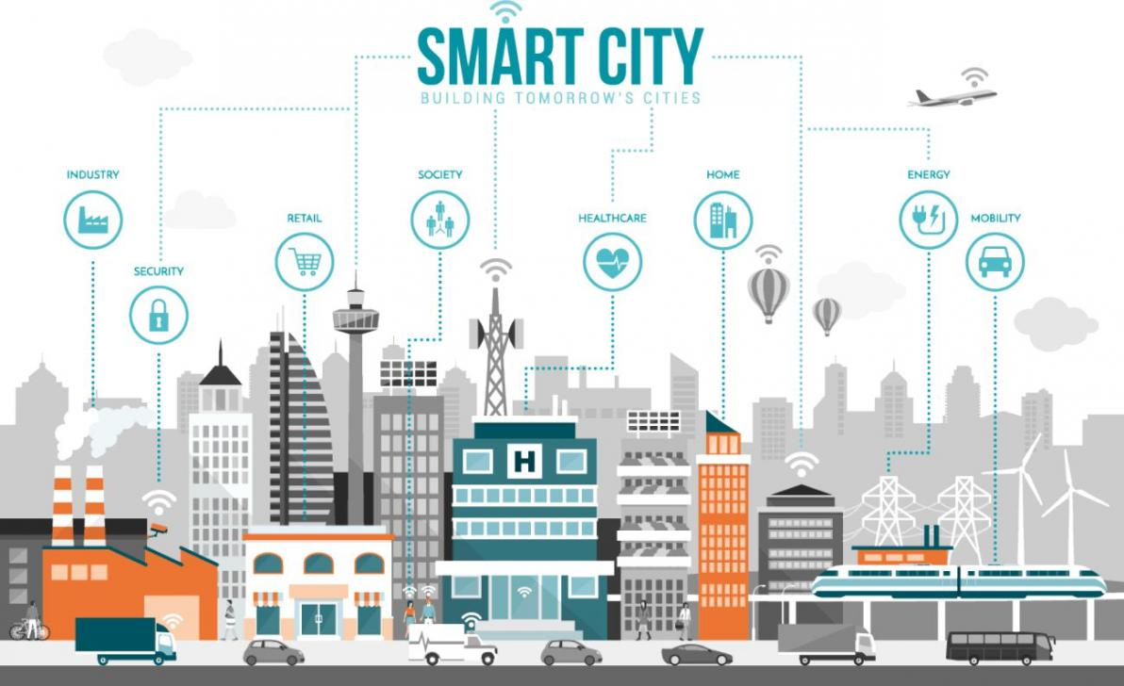
Shruthi K
PES University
Computer Science
June ‘19
Smart city – Entry to campus
SSTO OSTL
R&D Intern
Smart city mission is an urbanization program or you can say as adding new technologies or features to already existing old systems.
Last year HPE bagged a 300 crore contract from government of MP to set up an integration platform for seven cities. Bhopal, Gwalior, Jabalpur, Indore, Ujjain, Satna, and Sagar .
So, Obviously this project makes use of IOT, Machine learning
What is my project about?
When we are trying to install all these new technology to other cities first why not make HPE a smart workplace. This is where this project fits in…
Whenever we enter the HPE campus via vehicles(own transport or company’s) there is a person who notes down the license plate number manually for security purposes.
In this project using machine learning we are trying to make this process automated i.e detect the license plate numbers automatically without external user guidance

Slide 2
Before diving in deep
Machine learning is an application of artificial intelligence (AI) that provides systems the ability to automatically learn and improve from experience without being explicitly programmed.
Solution approaches:
Object detection technique
CNN content analysis
Input Data
My approach to this problem was:
Object detection technique. In simple terms
We have data which contains the images of vehicles with their number plate
These images have an annotated file which give the coordinates to the number plate, vehicle and the contents in the number plate
We train a cnn with this data and test to check the accuracy of the model
We predict the coordinates for the new image and check if its working…
Cnn’s are not as simple as it sounds ….
CNN
Output
OCR
Notes:
Machine learning focuses on the development of computer programs that can access data and use it learn for themselves.

Slide 3
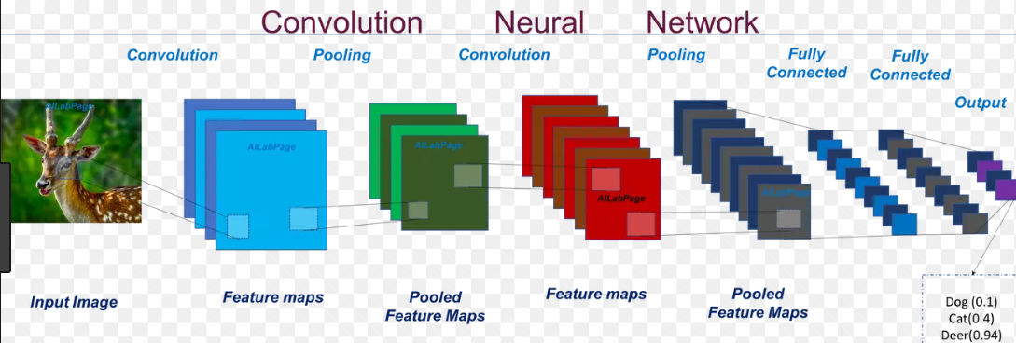
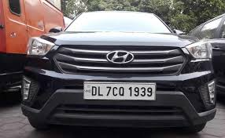

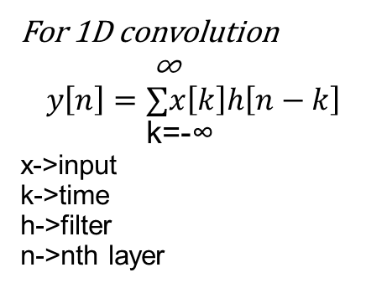
For 1D convolution
∞
$$y\left[n\right]=∑x\left[k\right]h\left[n−k\right]$$
k=-∞
x->input
k->time
h->filter
n->nth layer
Output – DL 7C0 1939

Slide 4

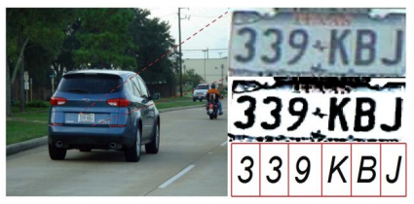
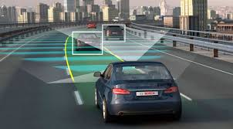
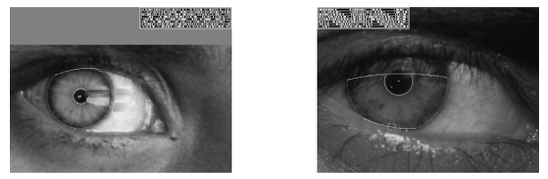
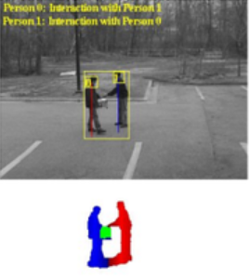
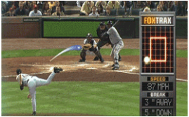
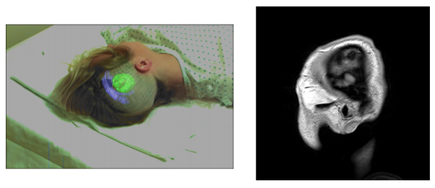
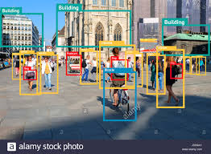
Cool applications of object detection:
Face detection and Recognition(Attendance, Face lock)
Optical Character Recognition
Self Driving cars(Detect people, cars, other objects in road)
Identity verification through iris code
Activity and posture Recognition
Ball tracking in sports
Medical imaging
People counting(statistics during an event)
These above examples can also be few of the application which can not only be used automate our daily process and be part of smart city ventures but also can help human race in reaching the next level in innovation and creativity
Thank you

