Slide 1
SHRUTHI S
Final Project

Slide 2
PROJECT TITLE
RNN-based Poetry Generation and Sentiment Analysis

Slide 3


AGENDA
Problem Statement
Project Overview
End Users and Their Needs
Proposed Solution and Value Proposition
The WOW Factor
Modelling Approach
Results and Performance Evaluation
Conclusion and Future Directions
3/21/2024 Annual Review

Slide 4

PROBLEM STATEMENT
In today's digital era, there is a growing interest in using artificial intelligence techniques for creative tasks such as poetry generation and sentiment analysis. However, developing accurate and contextually meaningful models for these tasks can be challenging due to the nuanced nature of language and human emotions.This project aims to leverage Recurrent Neural Networks (RNNs) to develop a system that can:
Generate original poems based on style or theme.
Analyze the sentiment of written text, including poems.

Slide 5

PROJECT OVERVIEW
This project aims to develop a robust RNN-based system for poetry generation and sentiment analysis. The system will allow users to generate poems based on a given seed text and analyze the sentiment of input text. By leveraging recurrent neural networks (RNNs), the system will capture the contextual dependencies in the input data, enabling it to produce coherent poems and accurate sentiment predictions.

Slide 6

WHO ARE THE END USERS?
The end users of this system could include poets, writers, students, and researchers interested in exploring and experimenting with poetry generation and sentiment analysis. Their needs include:
Generating high-quality poems for inspiration or creative purposes.
Analyzing the sentiment of text to understand its emotional tone or to gauge audience reactions.
Exploring the capabilities of AI in creative tasks and linguistic analysis.

Slide 7

YOUR SOLUTION AND ITS VALUE PROPOSITION
The proposed solution is a user-friendly system that offers the following key features:
Poetry Generation: Users can input a seed text, and the system will generate a poem based on that input. The generated poems will exhibit coherence and creativity, capturing the style and tone of the input text.
Sentiment Analysis: Users can input any text, and the system will analyze its sentiment, providing insights into the emotional tone of the text. This feature can be useful for understanding audience reactions, sentiment trends, or the emotional impact of written content.

Slide 8

THE WOW IN YOUR SOLUTION
The WOW factor of this project lies in its ability to produce high-quality poems that resonate with users' emotions and sentiments. The system's advanced RNN-based architecture ensures that the generated poems are not only grammatically correct but also contextually relevant and emotionally engaging. Additionally, the seamless integration of sentiment analysis adds an extra layer of functionality, allowing users to gain deeper insights into the emotional content of their text.
8

Slide 9
MODELLING
Data Preprocessing: Tokenization, padding, and encoding of input data for both poetry generation and sentiment analysis tasks.
Poetry Generation Model: Development of a bidirectional LSTM-based neural network for generating poems. The model learns the sequential patterns in the input data and generates coherent poems based on the provided seed text.
Sentiment Analysis Model: Development of a bidirectional LSTM-based neural network for sentiment analysis. The model learns to classify input text into predefined sentiment categories, such as positive, neutral, or negative.
Training and Evaluation: Training both models on the respective datasets and evaluating their performance using appropriate metrics such as accuracy, loss, and validation scores.
9

Slide 10
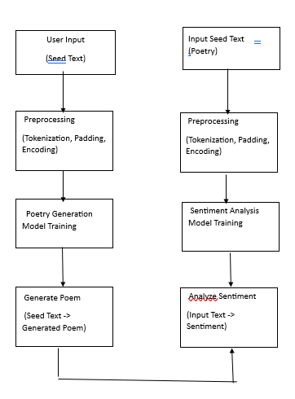

Slide 11
RESULTS
Data Preprocessing: Tokenization, padding, and encoding of input data for both poetry generation and sentiment analysis tasks.
Poetry Generation Model: Development of a bidirectional LSTM-based neural network for generating poems. The model learns the sequential patterns in the input data and generates coherent poems based on the provided seed text.
Sentiment Analysis Model: Development of a bidirectional LSTM-based neural network for sentiment analysis. The model learns to classify input text into predefined sentiment categories, such as positive, neutral, or negative.
Training and Evaluation: Training both models on the respective datasets and evaluating their performance using appropriate metrics such as accuracy, loss, and validation scores.
11

