Slide 1

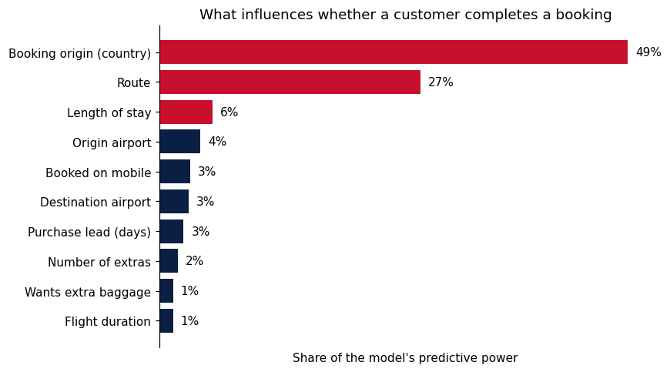
Booking origin is the strongest predictor of a completed booking
Random Forest trained to predict booking completion. The data is moderately predictive: the model correctly ranks who is more likely to book 80% of the time. Accuracy (81%) is not a useful measure here, as always predicting “no booking” already gives 85%.
80%
Ranking Accuracy
correctly ranks who is more likely to book, 8 times in 10 (ROC AUC)
Key findings
What drives the prediction
Share of total importance (permutation importance)
Location drives bookings. Booking origin and route explain about three-quarters of the model’s power. Australia converts at 5%, Malaysia at 34%.
Trip details add a little. Length of stay, mobile vs web and purchase lead help, but far less.
Extras matter less than expected. Baggage buyers do book more, but it adds little on top of location.
Next step: add price, past bookings and browsing data to improve accuracy.
50%
Bookings caught
of customers who booked were correctly flagged (recall)
39%
Hit rate
of flagged customers went on to book, vs 15% at random (precision)
Data: 50,000 bookings (49,281 after removing duplicates). New features: number of extras added (baggage, seat, meal), weekend flight, origin and destination airport.
Model: Random Forest with class balancing, 5-fold stratified cross-validation.

