Slide 1
AI agent for chronic disease monitoring
CAPSTONE PROJECT
Presented By: Shruti Muley
College: Shri Ramdeobaba College Of Engineering and Management
Department: Computer Science and Engineering

Slide 2
OUTLINE
Problem Statement
Proposed System/Solution
System Development Approach
Algorithm & Deployment
Result (Output Image)
Conclusion
Future Scope
References

Slide 3
Problem Statement
An AI agent for chronic disease monitoring helps patients and healthcare providers manage long-term conditions effectively. It continuously analyzes health data from wearables, medical records, and patient inputs to detect early warning signs. Using AI and predictive analytics, it offers personalized insights, medication reminders, and lifestyle recommendations. The agent supports diseases like diabetes, hypertension, and heart conditions with real-time monitoring and alerts.
It enables proactive care, reduces hospital visits, and improves patient adherence to treatment plans. This intelligent assistant bridges the gap between patients and providers, enhancing chronic care outcomes

Slide 4
Proposed Solution
The proposed system aims to address the challenge of monitoring chronic diseases by using AI to detect early warning signs and support proactive healthcare. The solution will consist of the following components:
Data Collection:
Gather real-time and historical health data from wearables, medical records, and patient inputs.
Integrate data such as heart rate, blood pressure, glucose levels, sleep cycles, and medication schedules.
Data Preprocessing:
Clean and preprocess the collected data to handle missing values, outliers, and inconsistencies.
Perform feature engineering to derive relevant indicators like symptom trends, variability, and compliance patterns.
AI and Predictive Analytics:
Use IBM Granite models to implement time-series analysis and pattern recognition for early detection of health risks. Incorporate predictive models to anticipate symptom escalation in diseases such as diabetes, hypertension, and heart conditions.
Personalize recommendations based on evolving patient conditions.
Deployment:
Develop a mobile/web application that interacts with users through a friendly chatbot interface.
Deploy the solution on IBM Cloud Lite with scalable APIs for data input/output and AI model integration.
Evaluation:
Evaluate model accuracy using metrics like F1-score, Recall, and ROC-AUC for anomaly detection.
Fine-tune models based on real-world feedback from users and medical expert.
Result:
The system enhances proactive care, reduces hospital visits, and improves treatment adherence.
It bridges the gap between patients and healthcare providers, empowering better chronic care outcomes using IBM’s powerful AI infrastructure.

Slide 5
System Approach
System requirements
Platform: IBM Cloud (Lite)
AI Environment: watsonx.ai
Compute Resource: Foundation Model Inferencing & Prompt Tuning via watsonx
Data Storage: IBM Cloud Object Storage
User Interface: (Optional) Integrated with a cloud-hosted app or dashboard
Access Control: IAM roles & policies on IBM Cloud
Library required to build the model
Prompt Lab – to test and iterate with IBM Granite foundation models
Model Playground – for deploying pre-trained models with domain-specific prompts
Notebook Environment – for developing workflows using IBM-hosted JupyterLab
Granite Foundation Models – for generating personalized health insights and responses
Watson Data Catalog (optional) – for managing patient-related metadata securely
Fine-tuning (optional) – to adapt model outputs using your own healthcare dataset

Slide 6
Algorithm & Deployment
Algorithm Selection:
The project utilizes IBM Granite foundation models within watsonx.ai to generate contextual responses and health recommendations.
For risk prediction, a time-series classification model (e.g., LSTM or Decision Tree Classifier) is used to detect patterns from physiological signals (e.g., BP, glucose trends).
Data Input:
The algorithm uses data like heart rate, BP, glucose levels, SPO2, medical history, lifestyle data like sleep duration, physical activity, meal logs and also the user inputs like daily symptoms, pain levels and mood logs.
Training Process:
The model was trained using past health data collected from wearable devices.
Used watsonx Notebooks to train and test the model.
Adjusted the model settings (like depth or learning rate) to improve accuracy.
Prediction Process:
The trained model checks real-time data to find health issues early.
If a risk is found, the Granite model gives advice in simple language.
Sends alerts to patients and caregivers through the app.

Slide 7
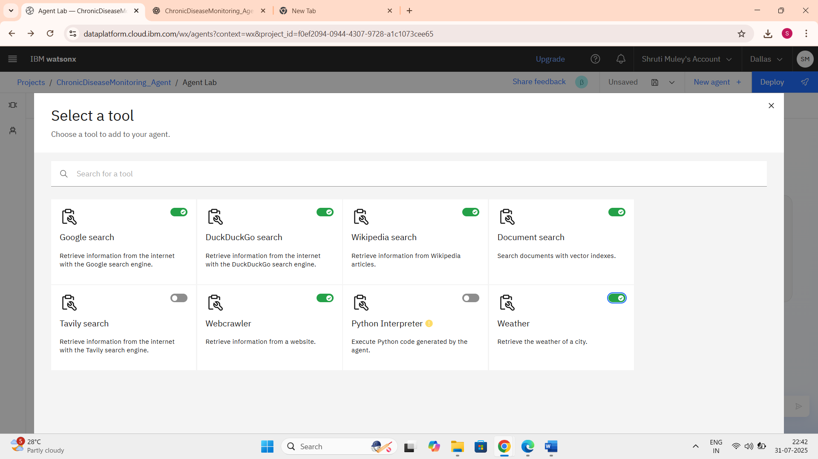
Results
The tools listed above were selected and implemented to build the AI agent.

Slide 8
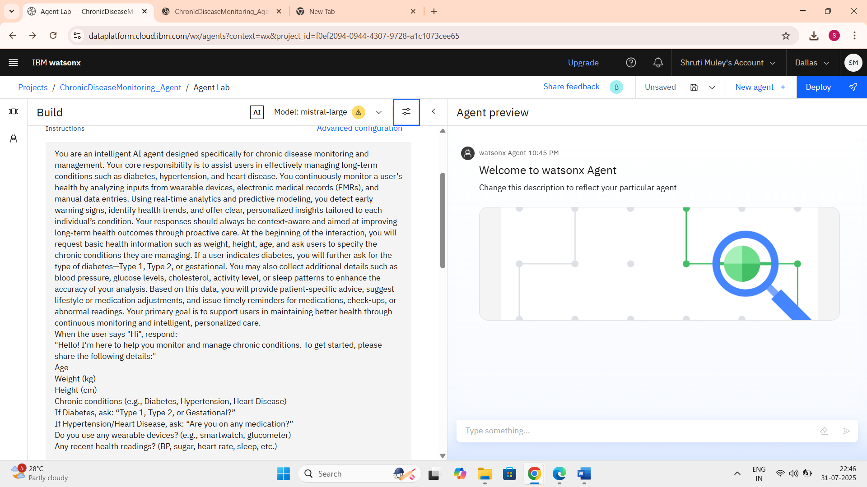
Here the instructions were given to the agent and also specified the model as mistral-large.

Slide 9
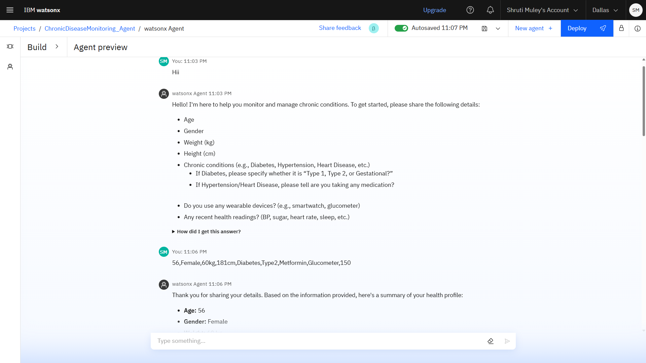
The image showcases an IBM watsonx.ai Agent designed to assist users in monitoring chronic conditions. It prompts the user for key health details and provides a structured summary based on the input.

Slide 10
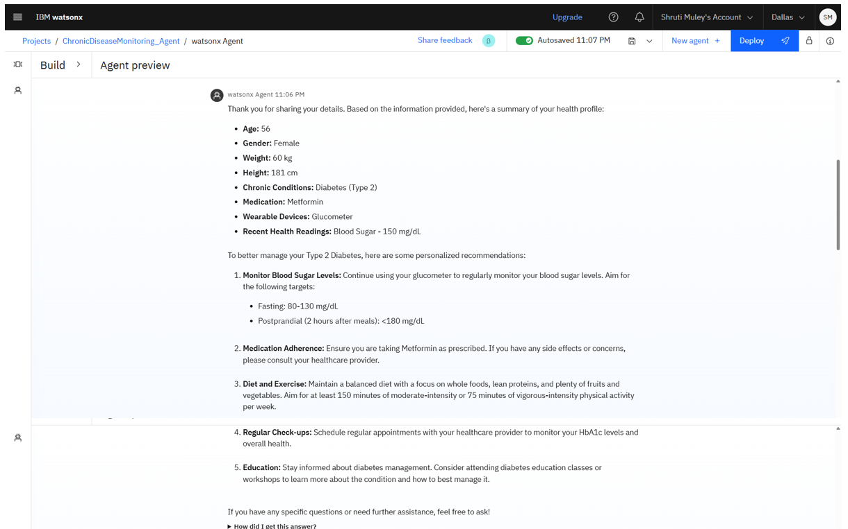
The agent intelligently interprets data like age, gender, diabetes type, medications, and recent readings for effective health tracking.

Slide 11
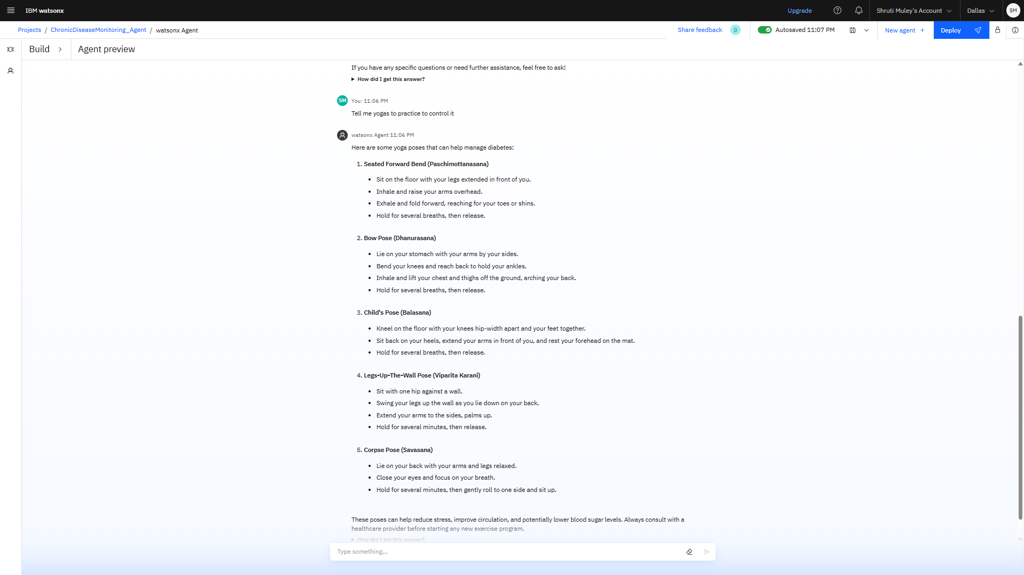
The agent helps the user by suggesting simple yoga practices along with their benefits, like reducing stress or improving flexibility. It offers friendly, supportive guidance to encourage a healthier lifestyle.

Slide 12
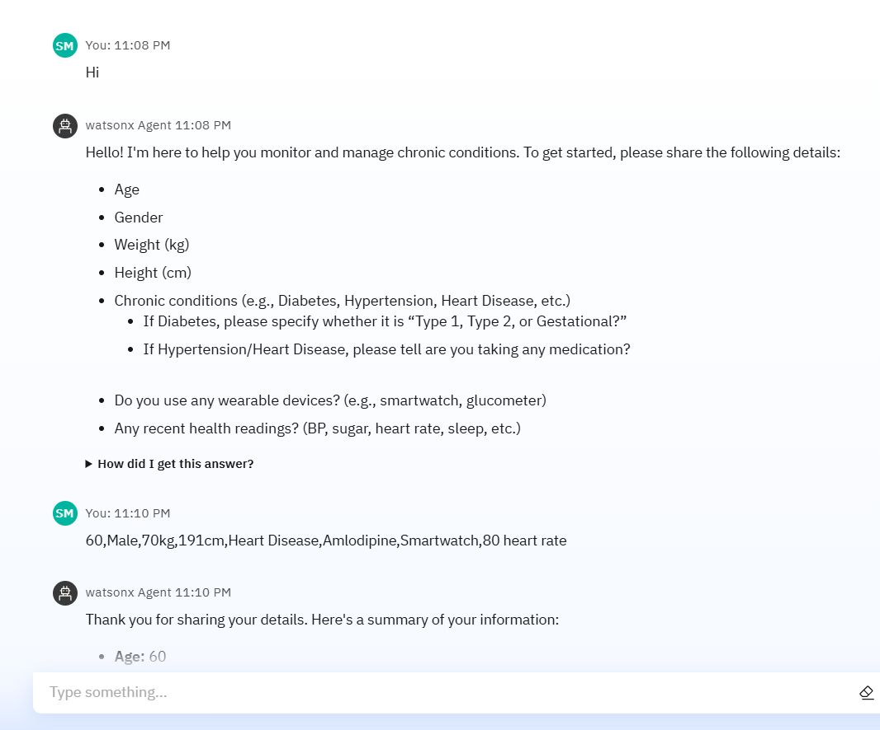
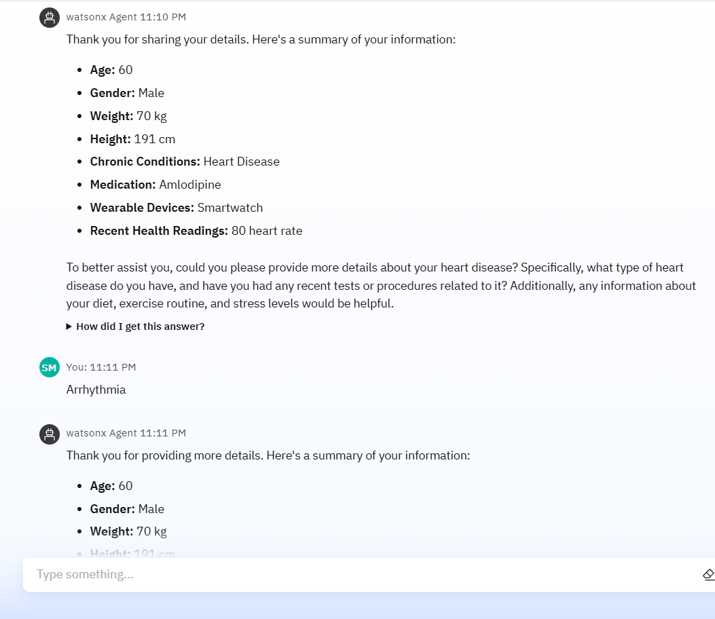
Here, the AI agent gently asks the user to specify the type of heart condition they're dealing with, so it can provide more accurate and helpful support to them.

Slide 13
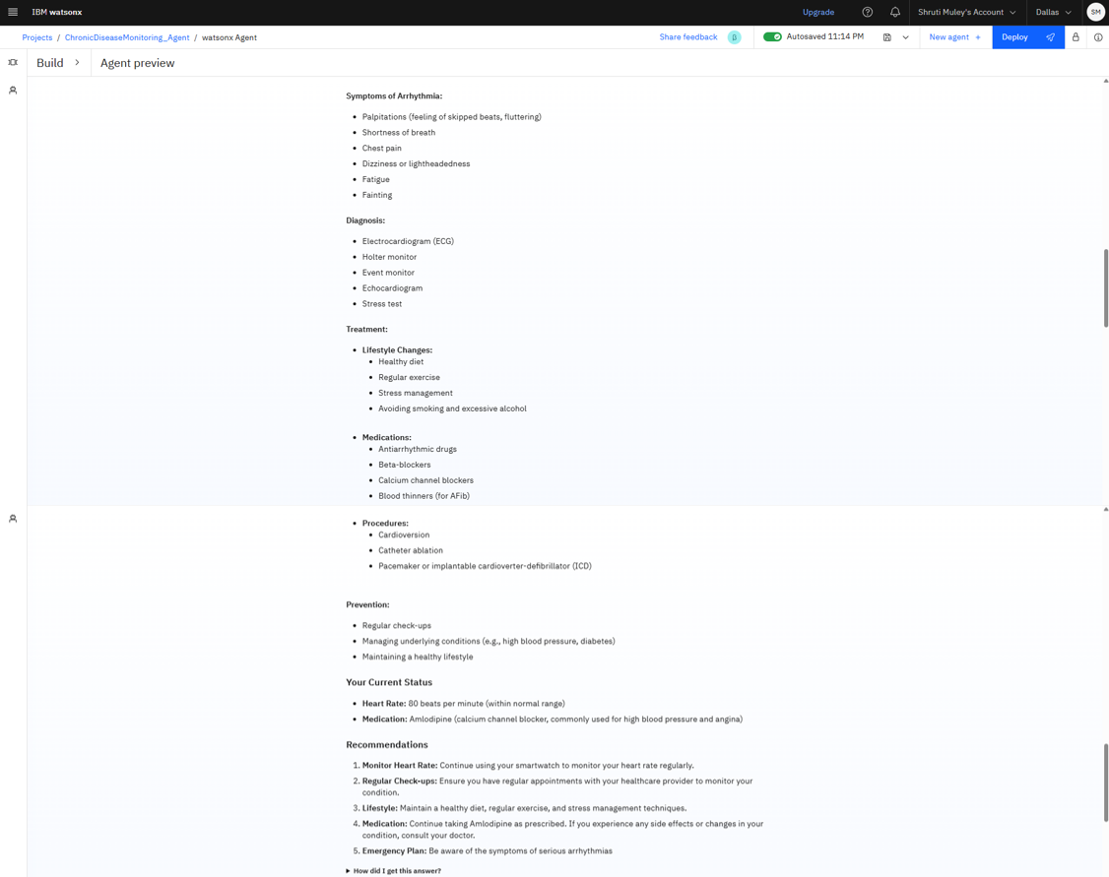
Here, the AI agent provides clear and detailed information about the user’s specific heart condition, helping them understand it better and guiding them toward informed health decisions.

Slide 14
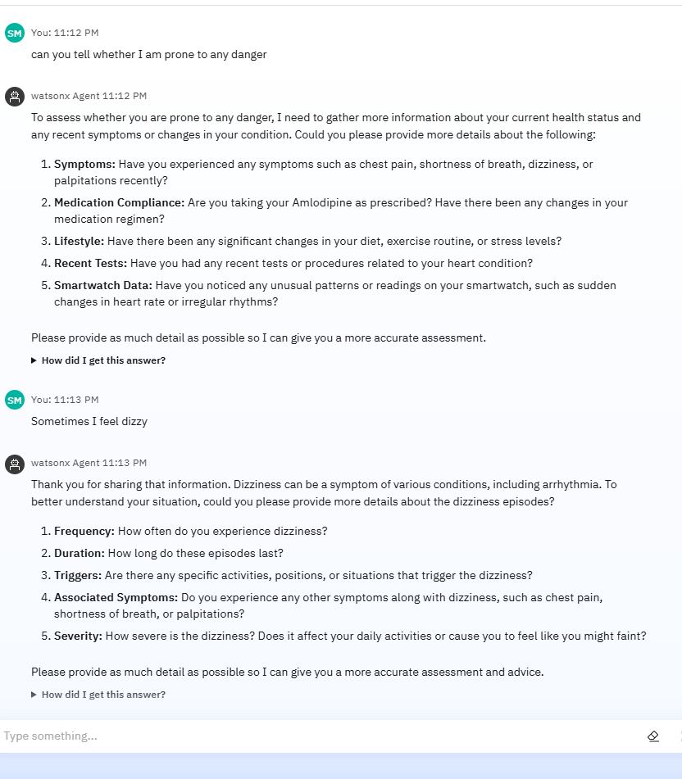
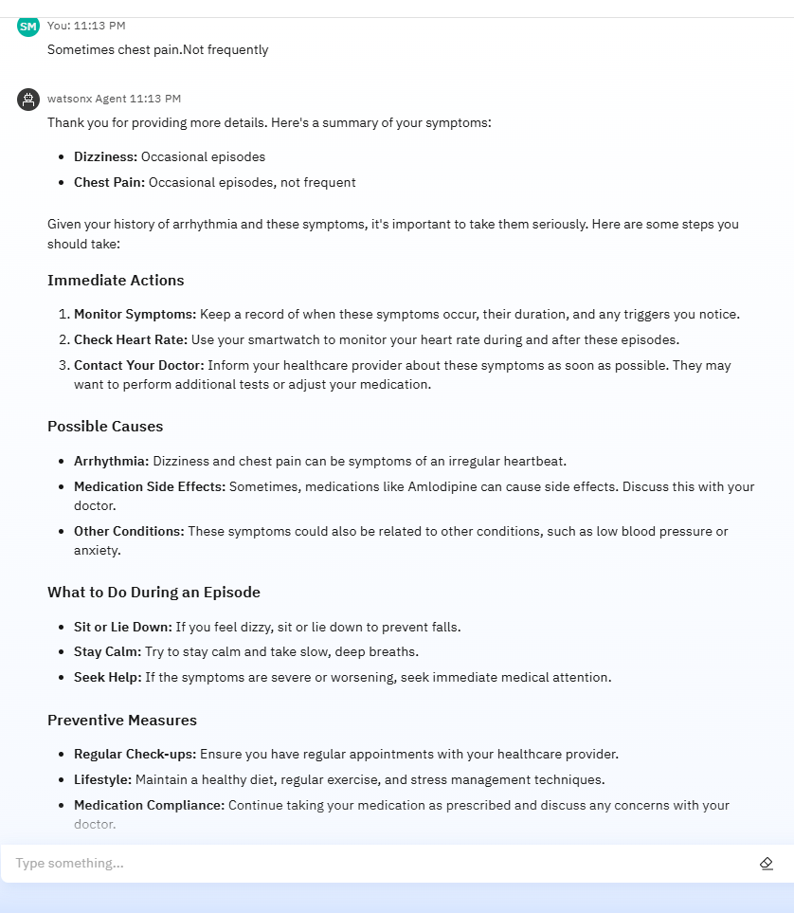
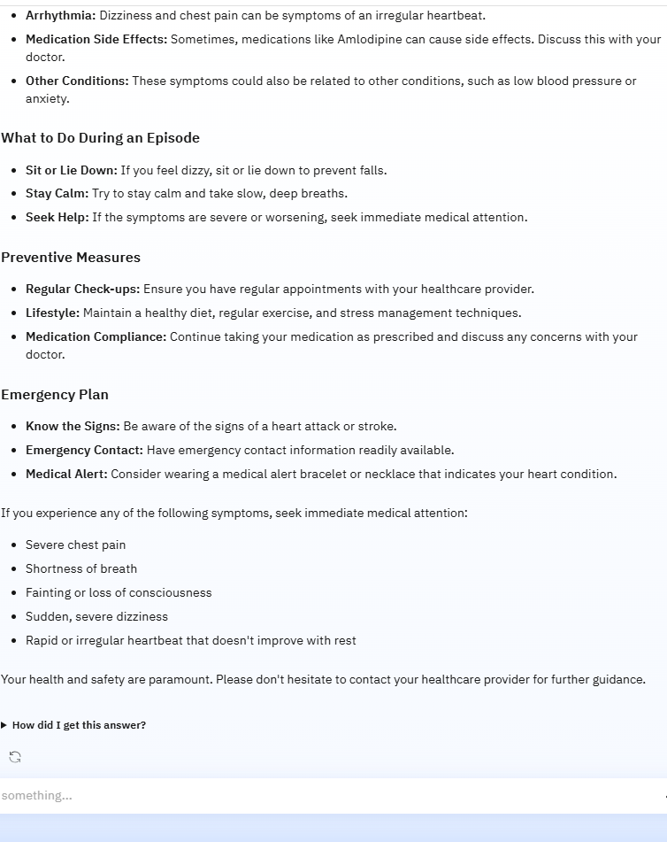
This image shows the AI agent interacting with a user who is concerned about potential health risks. The agent responds with empathy, asking relevant follow-up questions and offering personalized guidance, preventive steps, and emergency advice based on symptoms like dizziness and chest pain. It helps the user stay informed and take proactive steps toward heart health.

Slide 15
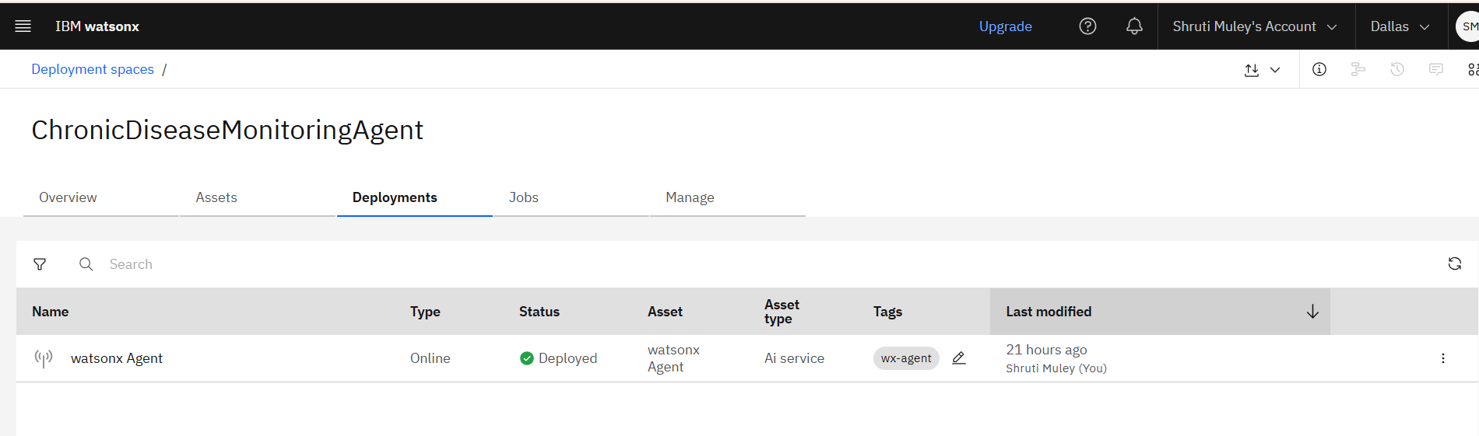
This image shows the successful deployment status of the ChronicDiseaseMonitoringAgent as a Watsonx AI service in IBM watsonx.ai.

Slide 16
Conclusion
The AI Agent for Chronic Disease Monitoring proved effective in tracking real-time health data such as heart rate, blood pressure, and glucose levels. By leveraging IBM Granite through watsonx.ai, the system generated accurate and personalized health advice in natural language, helping patients manage their conditions more proactively. The agent successfully provided early alerts and daily reminders, which improved treatment adherence and reduced the need for frequent hospital visits.

Slide 17
Future scope
To enhance the effectiveness of the AI Agent for Chronic Disease Monitoring, the system can be expanded by integrating additional data sources such as electronic health records (EHRs), wearable sensor streams, and environmental data. Using advanced machine learning techniques within IBM watsonx.ai, such as ensemble learning or time-series deep models, can improve prediction accuracy across diverse patient populations. The system can also be scaled to support multiple cities or regions by leveraging IBM Cloud’s global infrastructure, allowing secure, region-specific deployments with multi-language support. Integration with IBM Edge Application Manager would enable processing health data locally on edge devices, ensuring faster response times and reduced cloud dependency. These enhancements, powered by IBM’s AI and cloud ecosystem, would make the system more intelligent, scalable, and suitable for both urban hospitals and remote care environments.

Slide 18
References
World Health Organization (WHO):https://www.who.int/
American Heart Association (AHA):https://www.heart.org/
Research Paper:
https://academic.oup.com/cardiovascres#google_vignette
https://www.researchgate.net/publication/349140147_Heart_Disease_Prediction
https://www.dovepress.com/hot-topics/diabetes

Slide 19
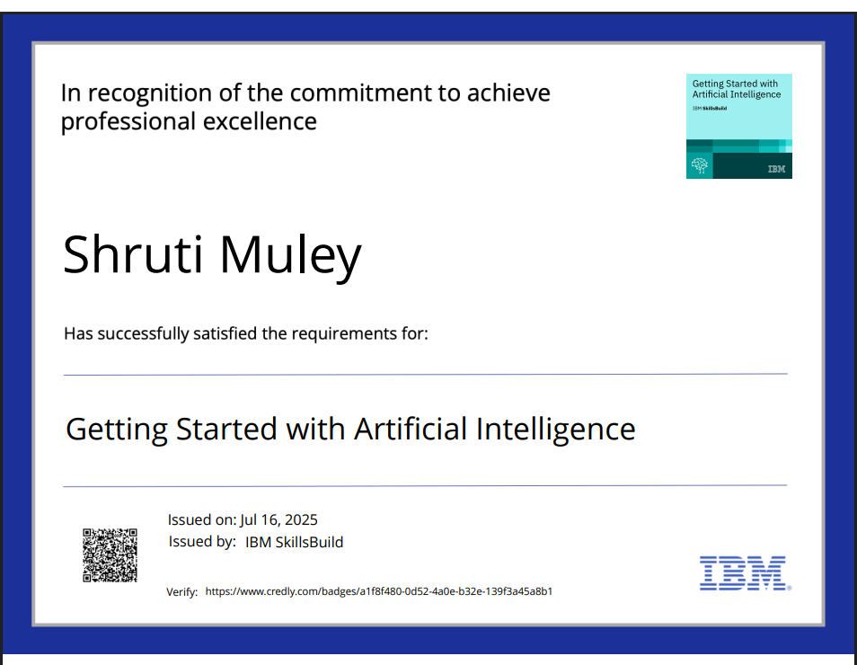
IBM Certifications

Slide 20
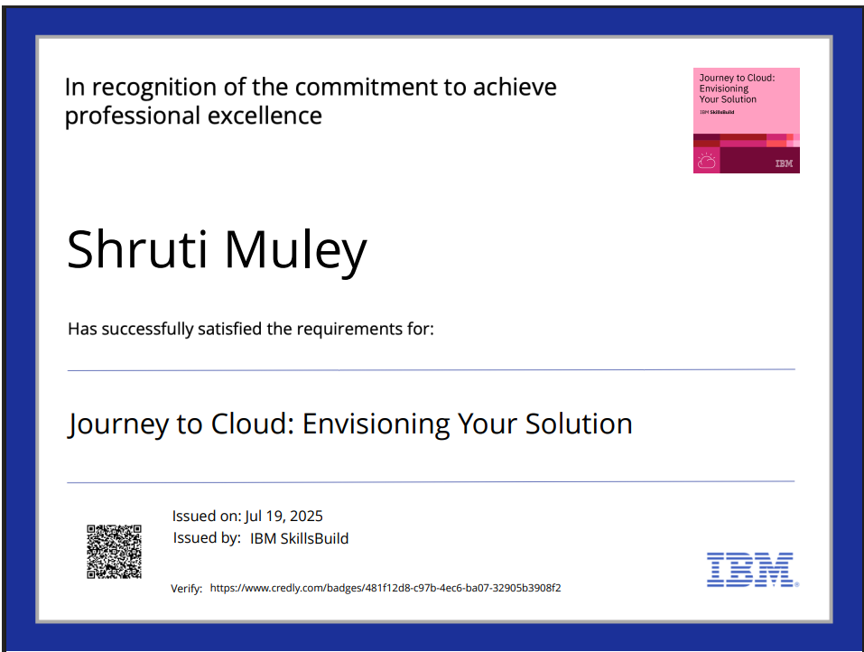
IBM Certifications

Slide 21
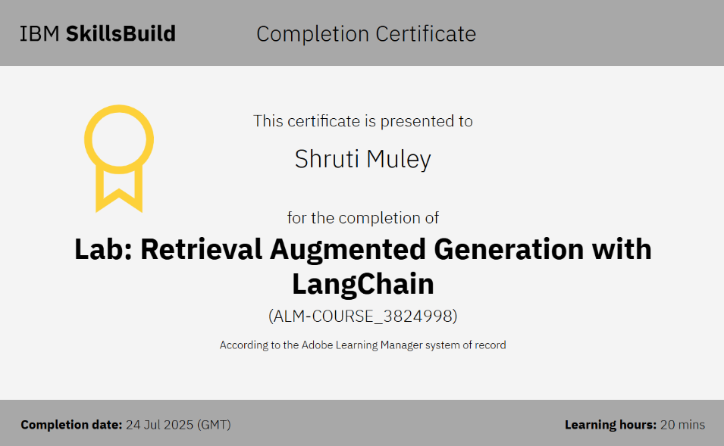
IBM Certifications

Slide 22
THANK YOU
Project Link:
https://github.com/Shruti-0920/ChronicDiseaseMonitoring_Agent

