Slide 1


“Eyes on the Fries’
(Just Not *Those* Fries)”
McDonald's
Sales Performance :Trends & Insights
‘’Analysing Data, Serving Insights’’
Go
PRESENTED BY : SHRUTI PATEL COHORT (4)

Slide 2
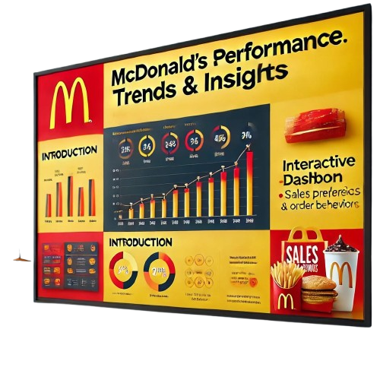
Introduction
This project presents an interactive and dynamic dashboard analyzing McDonald's sales data to uncover key insights. The analysis covers various aspects, including sales performance by category, order trends, popular menu items, revenue distribution over time, and customer ordering behavior. By leveraging data visualization, this dashboard provides actionable insights to help understand market demand, peak sales periods, and business growth opportunities

Slide 3
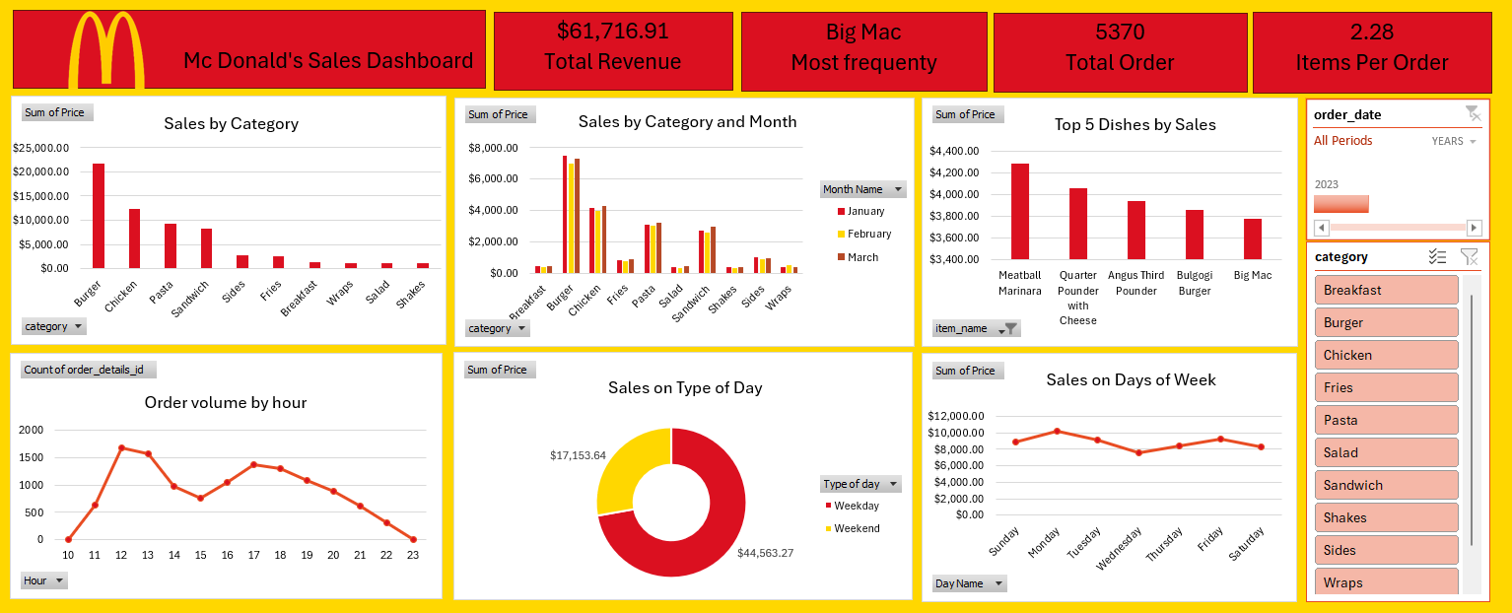
Mc Donald’s Sales Insights-Year 2023

Slide 4
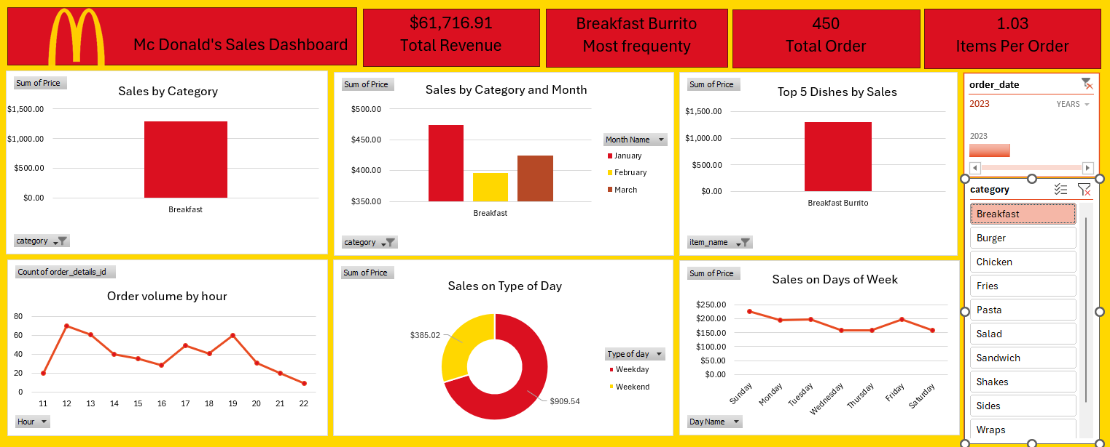
Mc Donald’s Breakfast Sales Report 2023

Slide 5
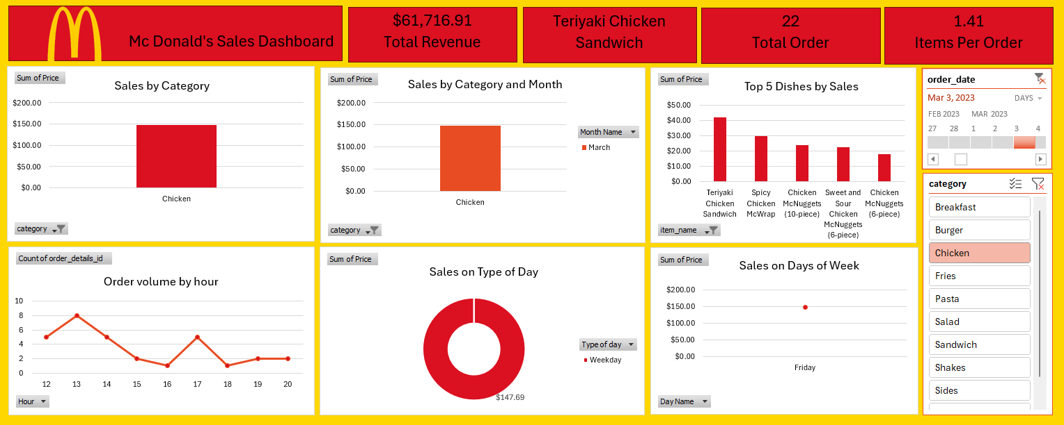
Mc Donald’s Chicken Sales Report – March 3, 2023

Slide 6
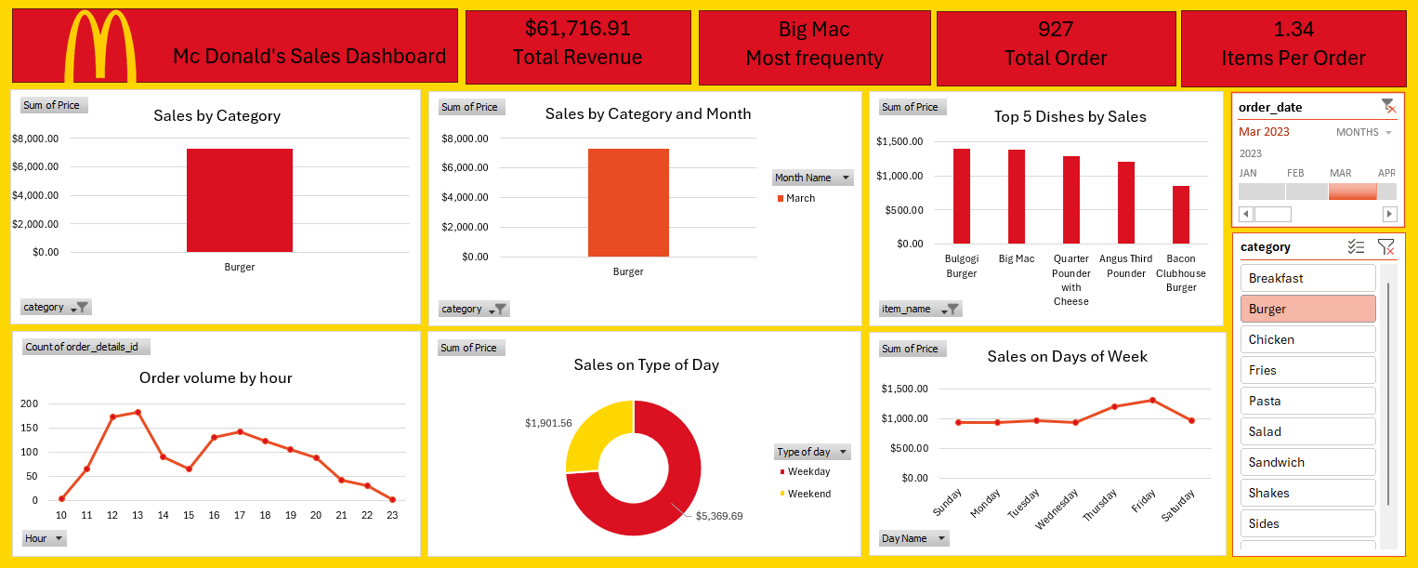
Mc Donald’s Burger Sales Report –March 2023

Slide 7
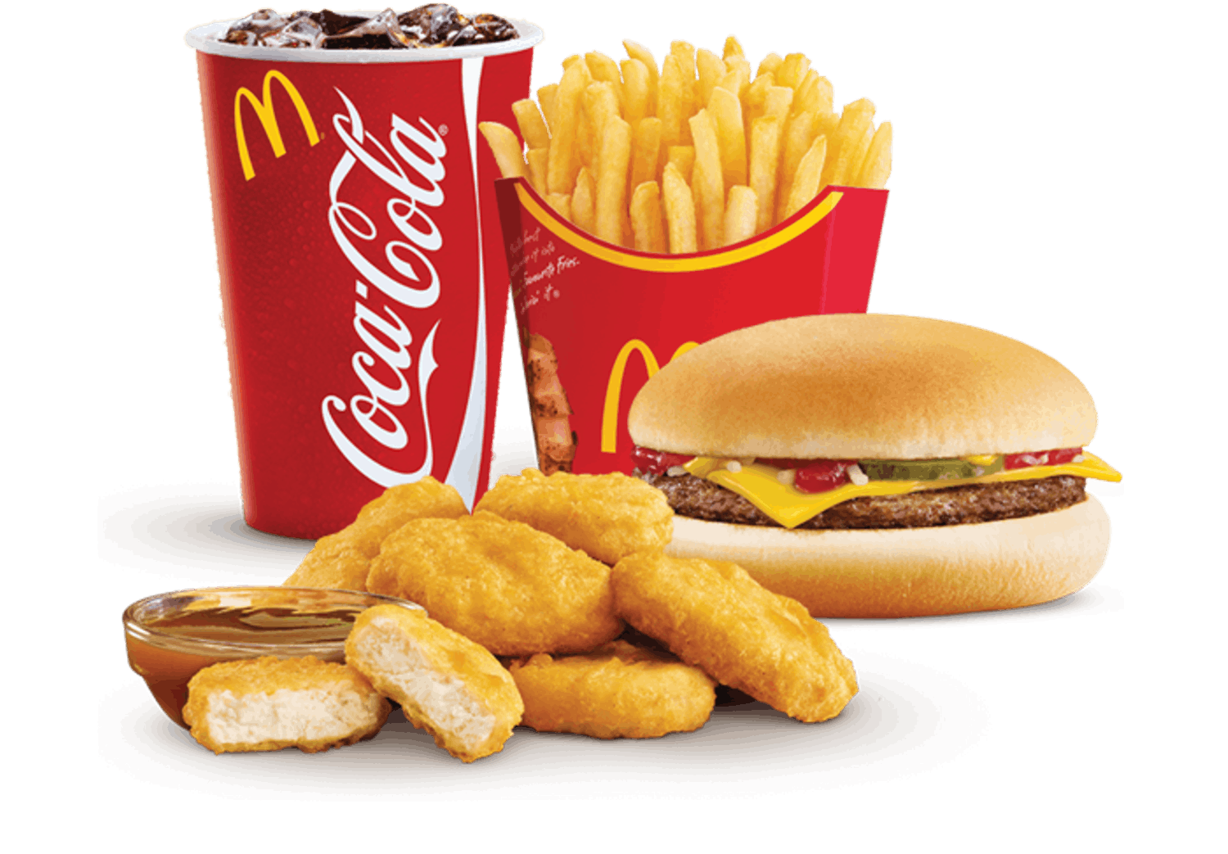
Mc Donald’s Sales Dashboard –Executive Summary
This report provides an analytical overview of McDonald's sales performance based on data visualization in Excel. The dashboard highlights key metrics, sales trends, and customer ordering behavior, offering valuable insights for strategic decision-making.
Overall Performance
Total Revenue: $61,716.91
Total Orders: 5,370
Average Items Per Order: Varies across categories, ranging between 1.03 to 2.28
Top-Selling Item (Most Frequent):
- Breakfast Burrito (in breakfast category)
- Teriyaki Chicken Sandwich (in chicken category)
- Big Mac (overall most frequent item)

Slide 8
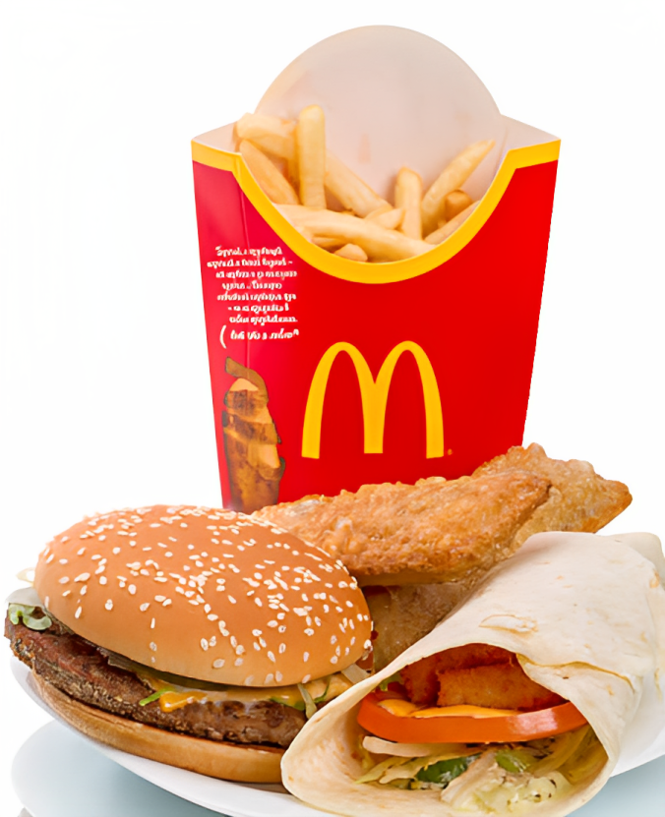
Sales Performance And Customer Ordering Behaviour Analysis
Sales by Category:
Burgers generate the highest revenue, followed by Chicken, Pasta, and Sandwiches.
The Breakfast category has relatively lower sales compared to other segments.
Sales by Month:
January, February, and March contribute significantly to revenue.
Burgers maintain strong sales performance across all months.
Sales by Day of the Week:
Weekends show higher sales volume, suggesting increased customer traffic.
Sales by Hour:
Peak ordering times are between 11 AM - 2 PM and 5 PM - 8 PM.
Sales drop significantly after 9 PM.
Order Trends by Type of Day:
Weekdays account for a larger share of sales revenue compared to weekends.

Slide 9
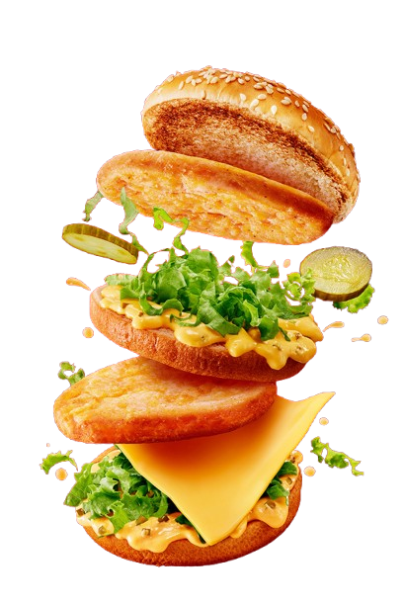
Key Business Insights & Recommendations
✔ Leverage Peak Hours: Optimize staff allocation during lunch (11 AM - 2 PM) and dinner (5 PM - 8 PM) to maximize efficiency.
✔ Weekend Promotions: Since weekends drive higher sales, McDonald's can implement targeted promotions for Fridays and Saturdays.
✔ Menu Optimization: Focus marketing efforts on high-selling items like burgers while enhancing visibility for underperforming categories like breakfast.
✔ Data-Driven Decision Making: Utilize this data to introduce customized meal combos, discounts, and loyalty programs to further boost sales.

Slide 10

Top Selling Menu Items
*Across various categories, Big Mac, Quarter Pounder with Cheese, Bulgogi Burger, Angus Third Pounder, and Meatball Marinara rank among the highest-selling items.
*Breakfast Burrito and Teriyaki Chicken Sandwich are the most popular items within their respective categories.

Slide 11
Conclusion
McDonald's sales are driven by Burgers and Chicken, while Breakfast sales remain low, indicating growth potential. Peak hours (11 AM - 2 PM, 6 PM - 8 PM) should be optimized, and weekend sales need improvement through targeted promotions. The drop on Valentine’s Day suggests seasonal trends, which can be addressed with special offers. Focusing on high-demand products, time-based strategies, and marketing efforts will help boost revenue and efficiency.
THANK YOU

