Slide 1
Secure data hiding in images using steganography
CAPSTONE PROJECT
Presented By: Shrutikana Patra
Student Name : Shrutikana Patra
College Name & Department : JIS College of Engineering, CST

Slide 2
OUTLINE
Problem Statement
Technology used
Wow factor
End users
Result
Conclusion
Git-hub Link
Future scope

Slide 3
Problem Statement
Traditional encryption methods make confidential data easily detectable, increasing the risk of interception. Existing steganography techniques often suffer from low capacity, poor imperceptibility, or vulnerability to attacks. This project aims to develop a robust steganography system that securely embeds information within digital media while remaining undetectable. The goal is to enhance covert communication by ensuring high security, imperceptibility, and resistance to steganalysis.

Slide 4
Technology used
Python – The main programming language for implementing the steganography logic.
Idle – The version of python idle is Python 3.10.5 for 64-bit machine.
OpenCV (cv2) – Used for image processing, reading, modifying, and saving images.
File Handling (os module) – Manages file operations like opening and saving encrypted images.
Character Encoding (ASCII Mapping) – Converts characters to numerical values and vice versa for embedding and extracting the message.
Basic Cryptography (Password Protection) – Implements password-based access control for decryption.

Slide 5
Wow factors
Secret Message Hiding in Images – The ability to conceal data within an image without noticeable changes makes this project intriguing.
Password-Protected Decryption – Adds an extra layer of security, ensuring that only authorized users can access hidden information.
Real-Time Encoding & Decoding – Instantly embeds and extracts messages, making it practical for secure communication.
Minimal Image Distortion – The hidden message does not significantly alter the visual appearance of the image.

Slide 6
End users
Cybersecurity Professionals – Use steganography to protect sensitive data and secure communication from cyber threats.
Government & Intelligence Agencies – Employ steganography for covert communication, secure data exchange, and espionage activities.
Military & Defense Organizations – Utilize it for confidential information transfer, preventing interception by adversaries.
Journalists & Whistleblowers – Use steganography to securely share sensitive information while avoiding detection.

Slide 7
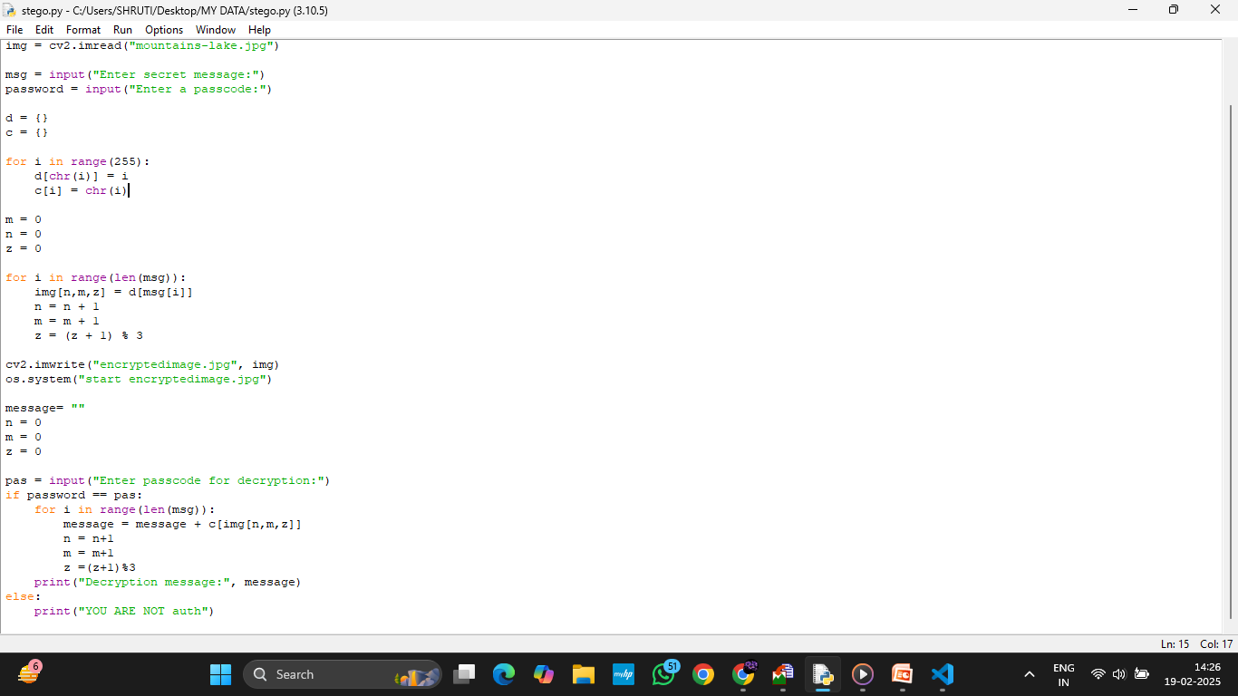
Results

Slide 8
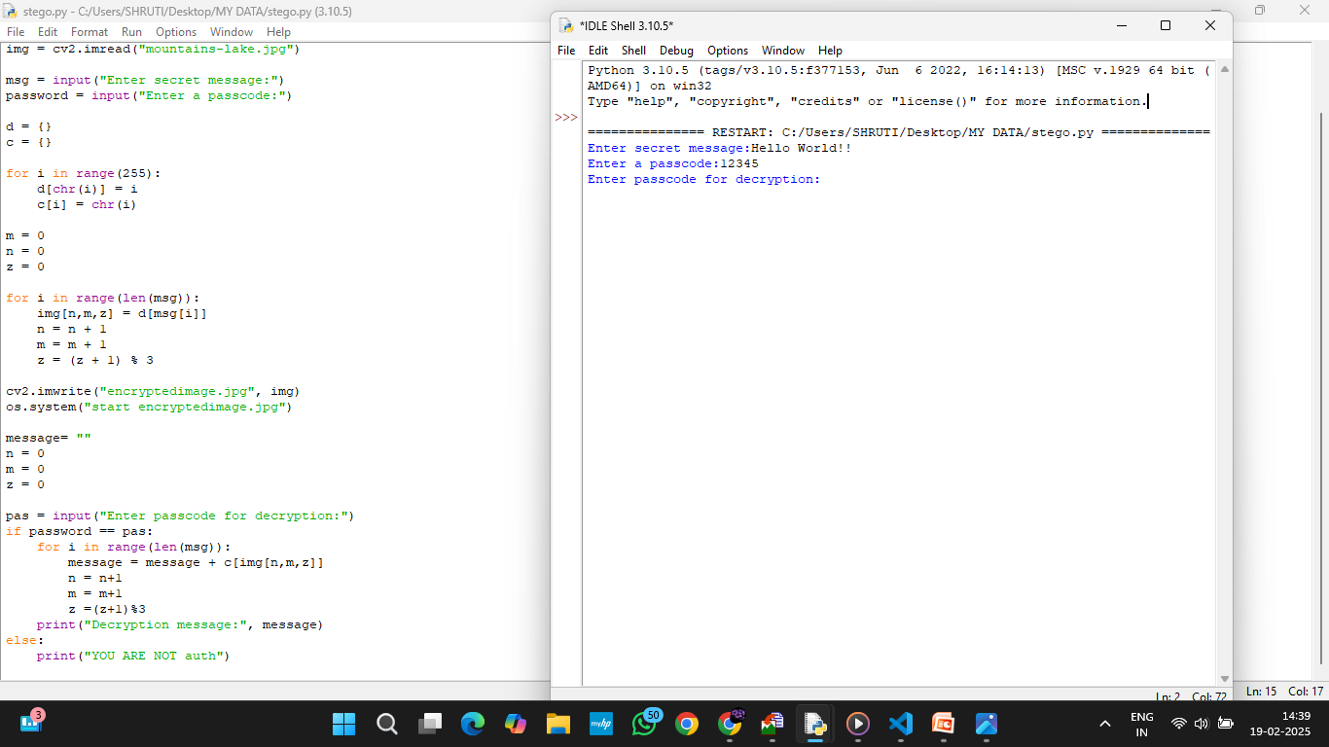
Results

Slide 9
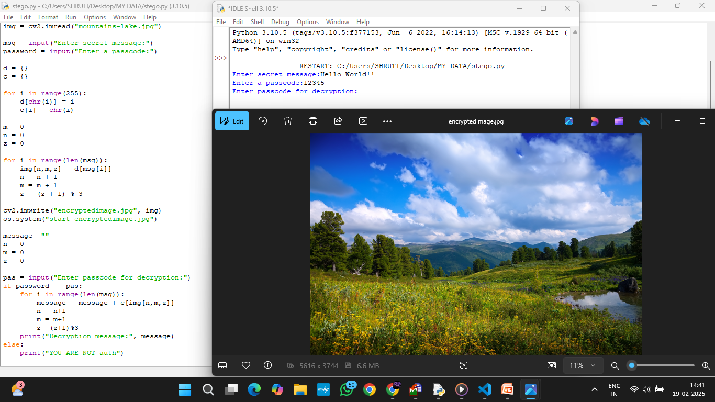
Results

Slide 10
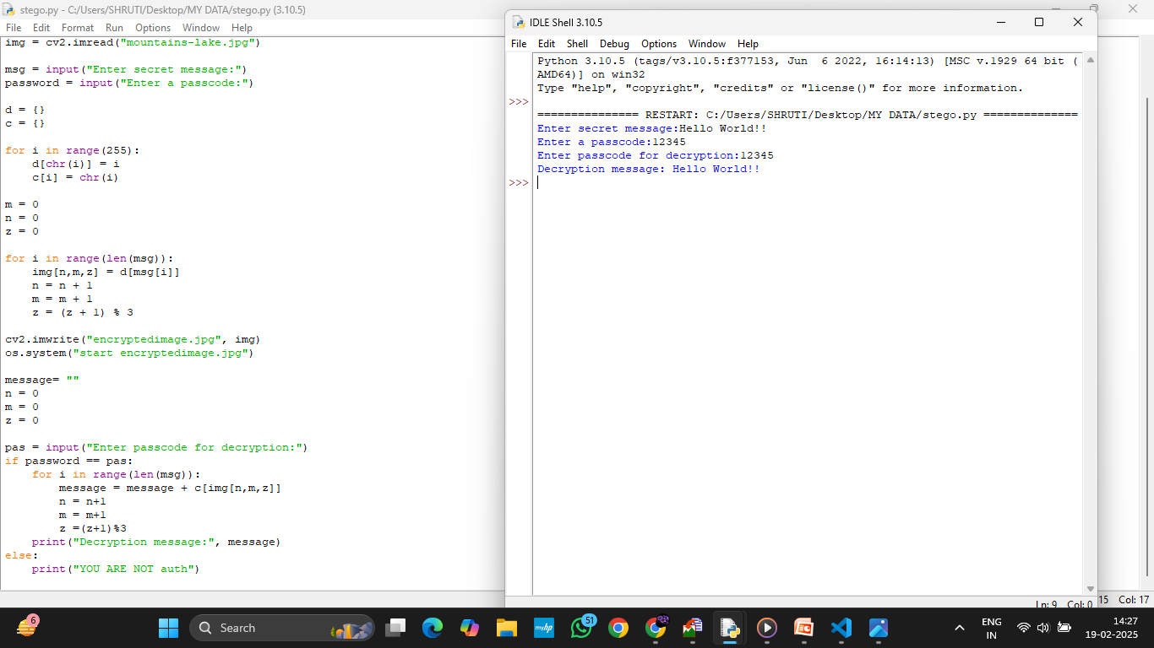
Results

Slide 11
Conclusion
This steganography project effectively hides secret messages within an image using Python and OpenCV, ensuring secure communication. Password protection adds an extra security layer, making data retrieval restricted. The approach is simple yet powerful, demonstrating digital confidentiality techniques. Future enhancements, such as stronger encryption and improved embedding algorithms, can further strengthen its security and resistance against detection.

Slide 12
GitHub Link
Project github link: https://github.com/Shruti-2611/Steganography-Project-by-AICTE.git

Slide 13
Future scope
Enhanced Security with Encryption – Integrating AES or RSA encryption alongside steganography for double-layered security.
AI-Powered Steganography – Implementing machine learning models to optimize data hiding and make detection nearly impossible.
Improved Image Processing Techniques – Using more advanced image manipulation methods to embed data more efficiently.
Support for Multiple File Formats – Expanding functionality to hide messages in videos, audio files, and PDFs.
Cloud-Based Secure Communication – Developing a web-based steganography service for encrypted message exchange.

Slide 14
THANK YOU

