Slide 1


Slide 2

C# Development E-Commerce App Presented By Shruti Thakkar January 13 , 2023
Instructor:
Louise Rennick

Slide 3



Overview:
Introduction
Objective
Tools
Feasibility
Pages
E-R Diagram Design
Screen Shot Of site
Future Scope
Conclusion

Slide 4
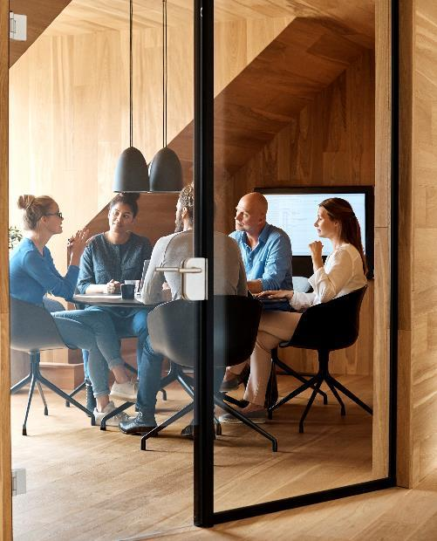



Introduction
Shopping is one of the essential part of our daily life. We're using different types of shops to buy different kind of things everyday.
Today our life is divided into two parts
Physical Life: We met everyone physically
Virtual Life : we met people on a Virtual world called “Internet”.

Slide 5
Objective
Create a complete responsive Online Electronic shop store website design template with multi role-based login system ,don’t have account we have register system add to cart, product crud (Read, Update, and Delete ) and dashboard using html , CSS ,JavaScript , Bootstrap , MySQL Li database.

Slide 6
Tools
IDE: Visual Studio Community
Local Database using Entity Framework
Bootstrap 5
Images
Nice Admin for admin access
Microsoft SQL Server management
Multishop Design for front -end

Slide 7

FEASIBILITY
Technical Feasible :
Technically, this project is very feasible because of use of current and latest techniques.
Financial Feasible:
Financially, it is also very feasible it made up in very low cost and will be free for all customers.
Operational Feasible:
Very easy to use.

Slide 8
Pages :
Login Page
Register page
Home Page
Product page
Category page
About page
Contact Page
Footer Page
Admin Page
Admin category page
User add to cart page

Slide 9
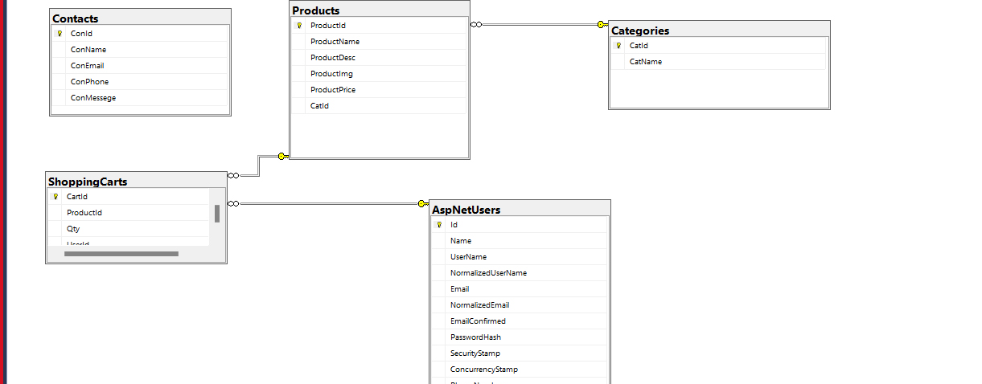
Database diagram

Slide 10
Tables
Categories
Products
Contacts
Shopping Carts
CatId
CatName
ProductId
ProductName
ProductDesc
ProductImg
ProductPrice
CatId
ConId
ConName
ConEmail
ConPhone
ConMessege
CartId
ProductId
Qty
UserId

Slide 11
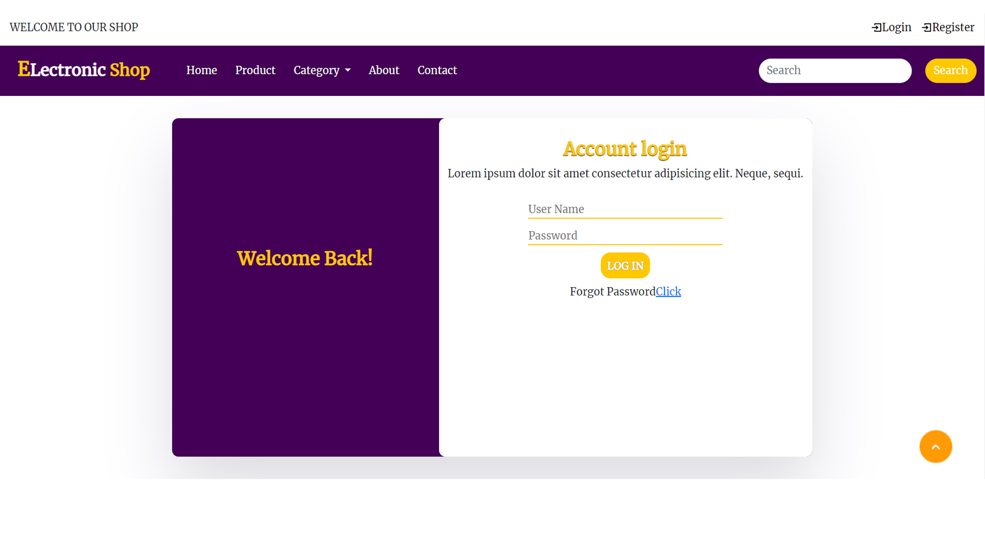
Login Page

Slide 12
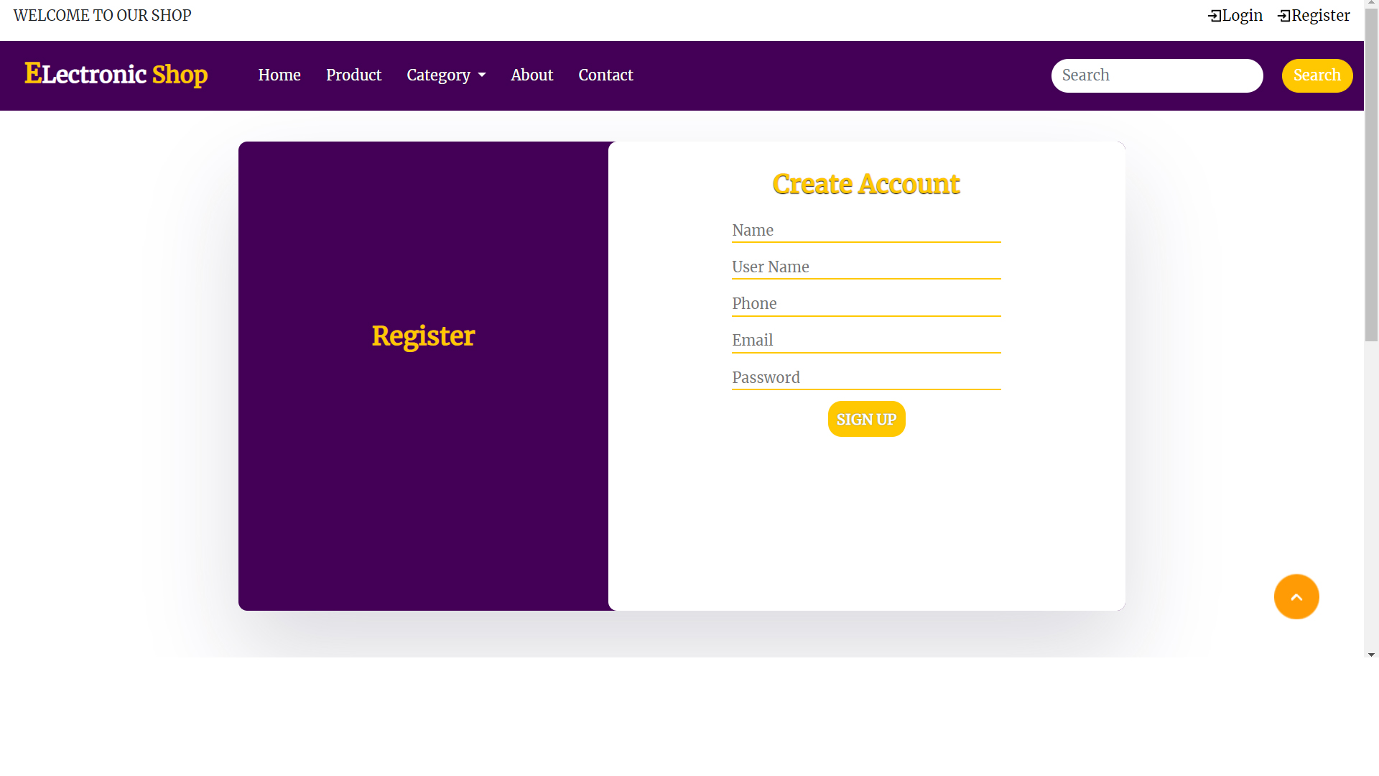
Register Page

Slide 13
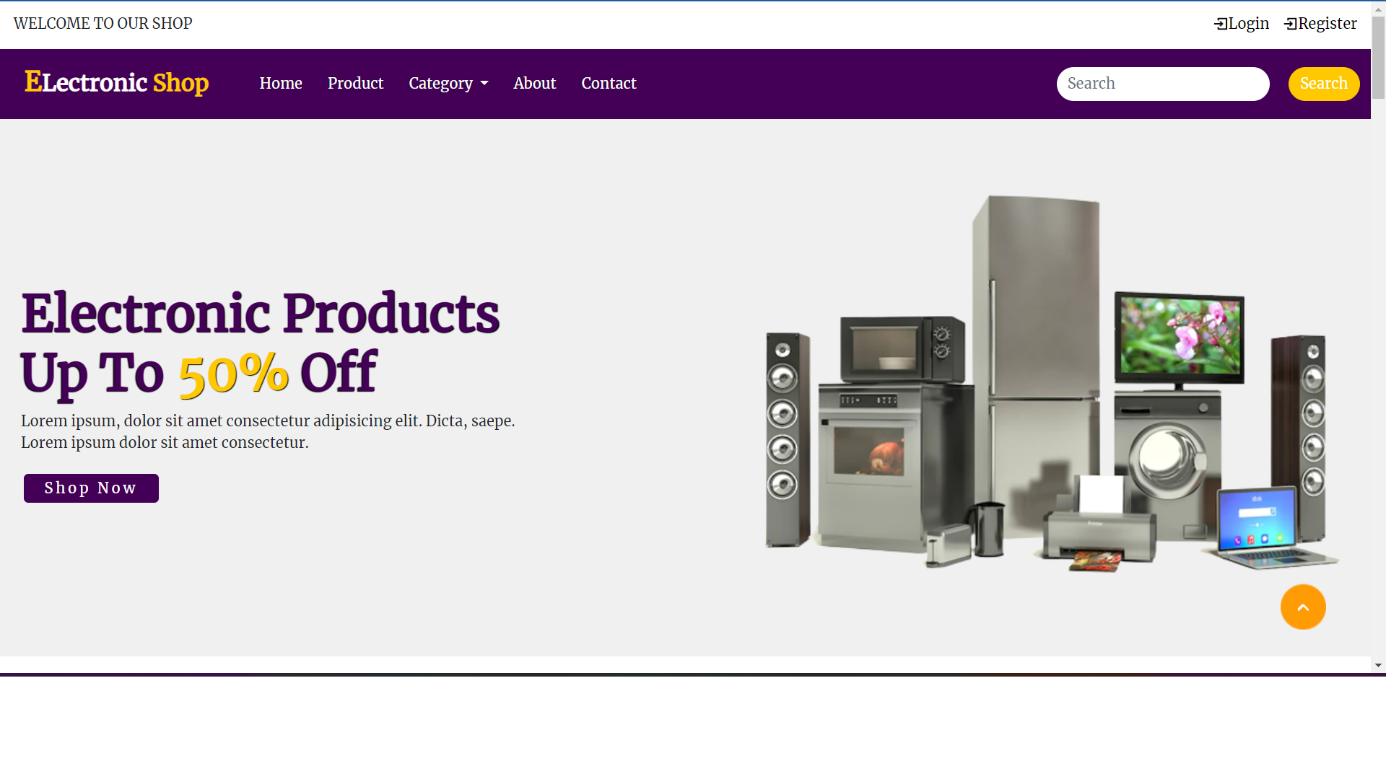
Home Page

Slide 14
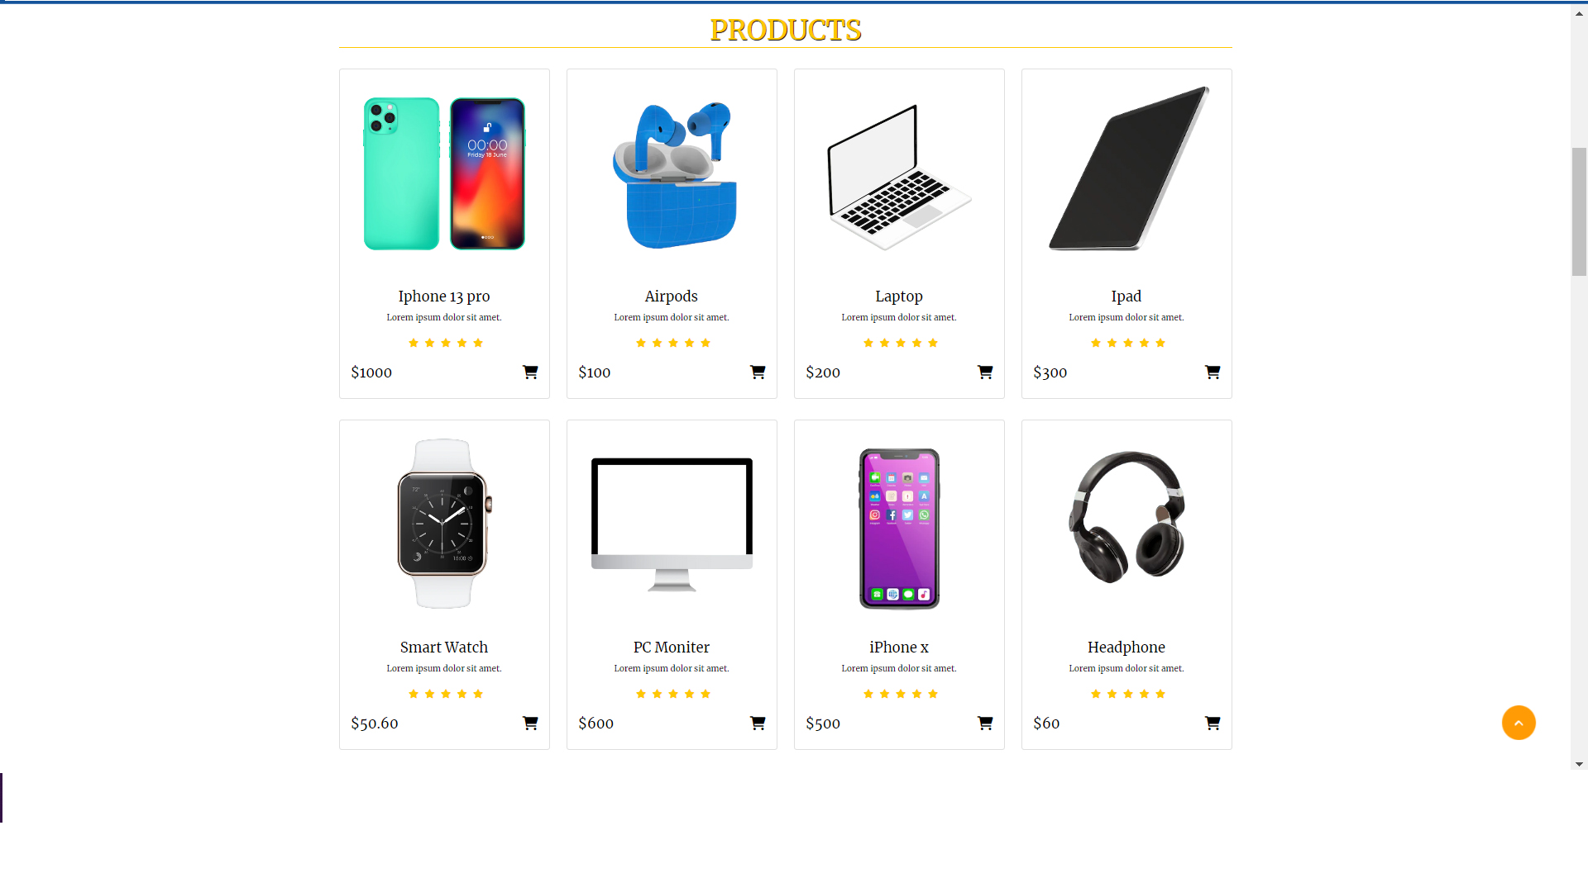
Product Page

Slide 15
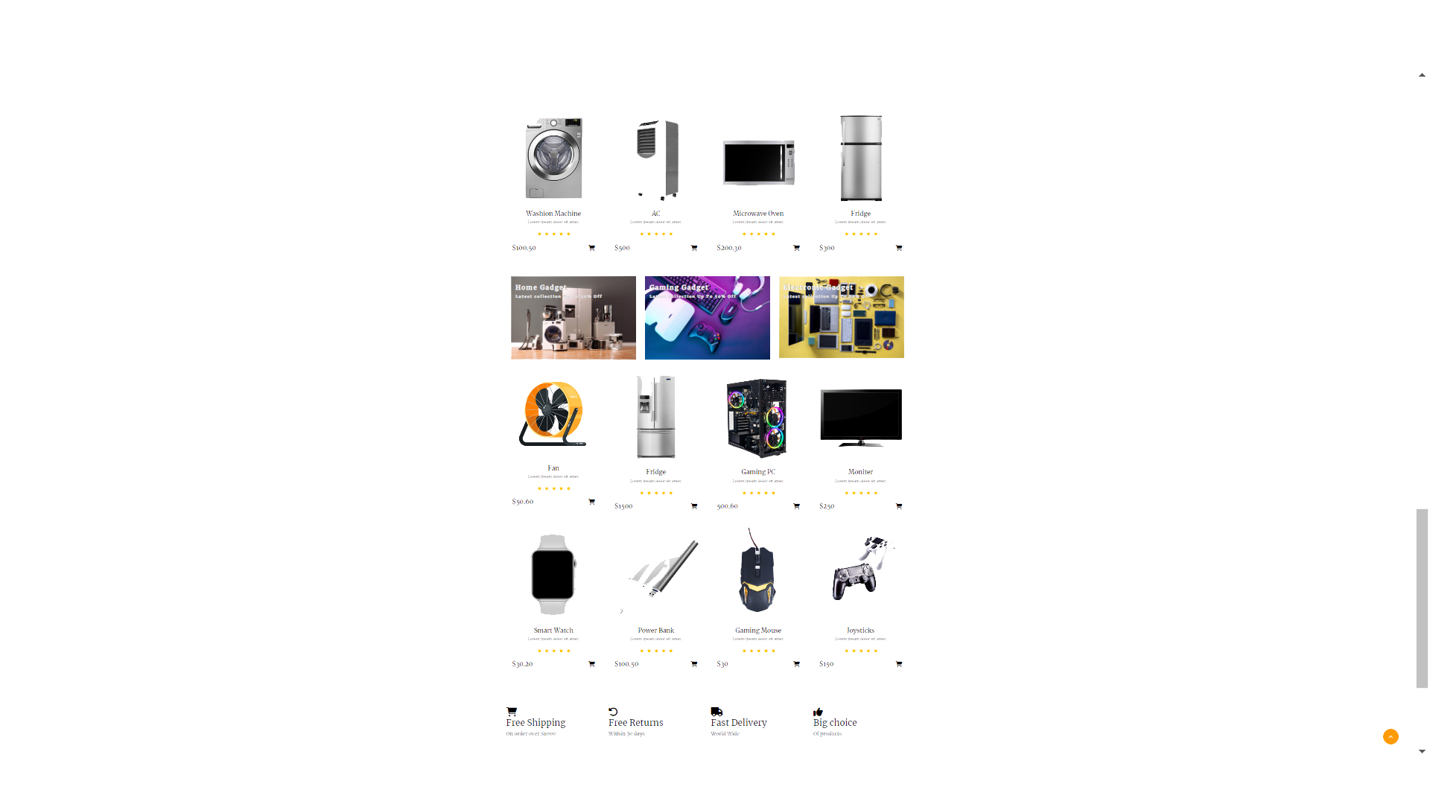
Category Page

Slide 16
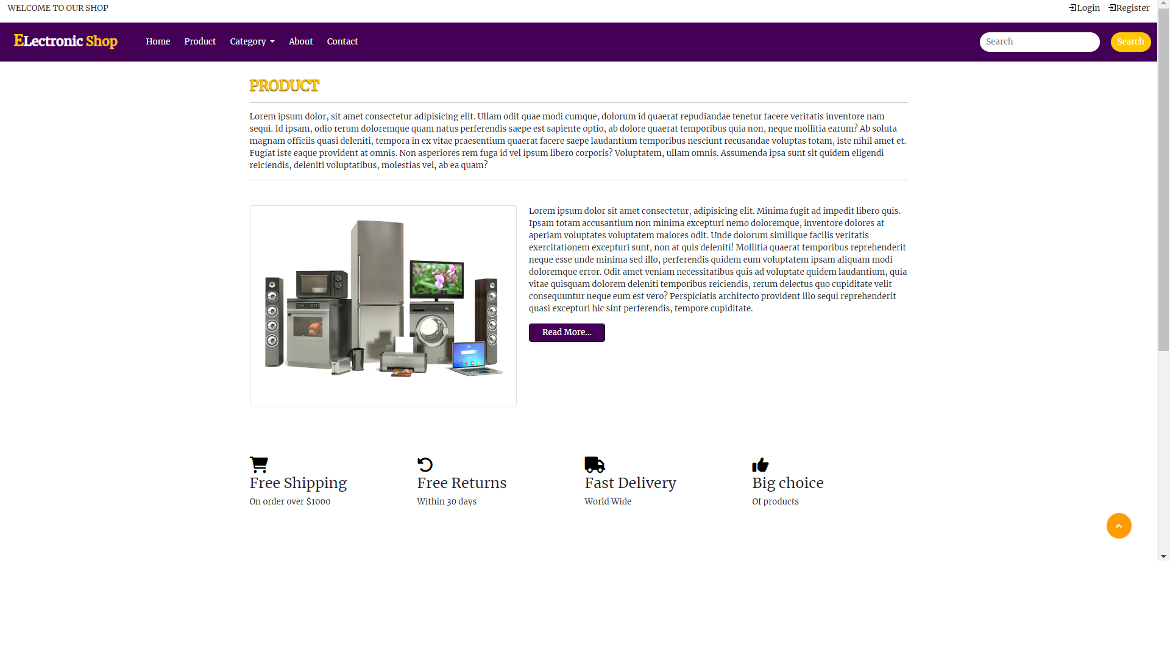
About Page

Slide 17
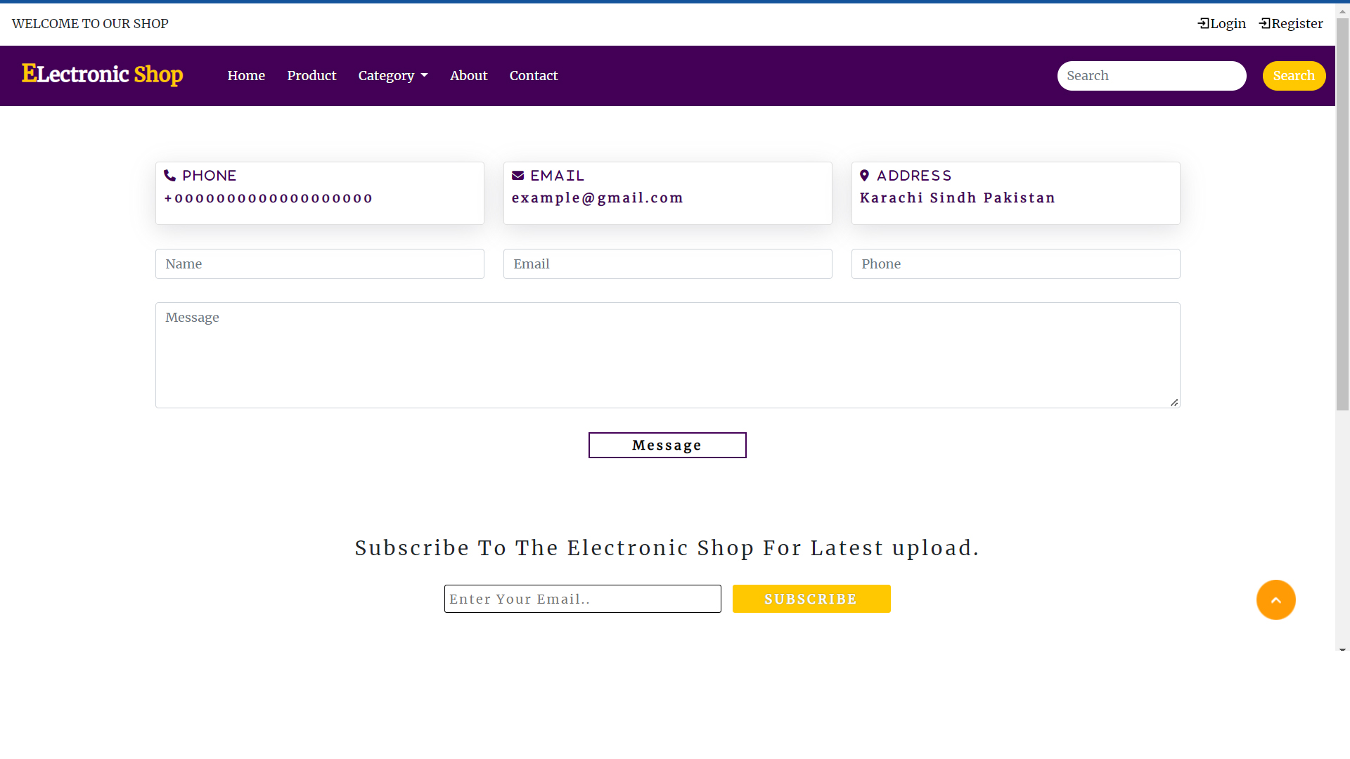
Contact Page

Slide 18
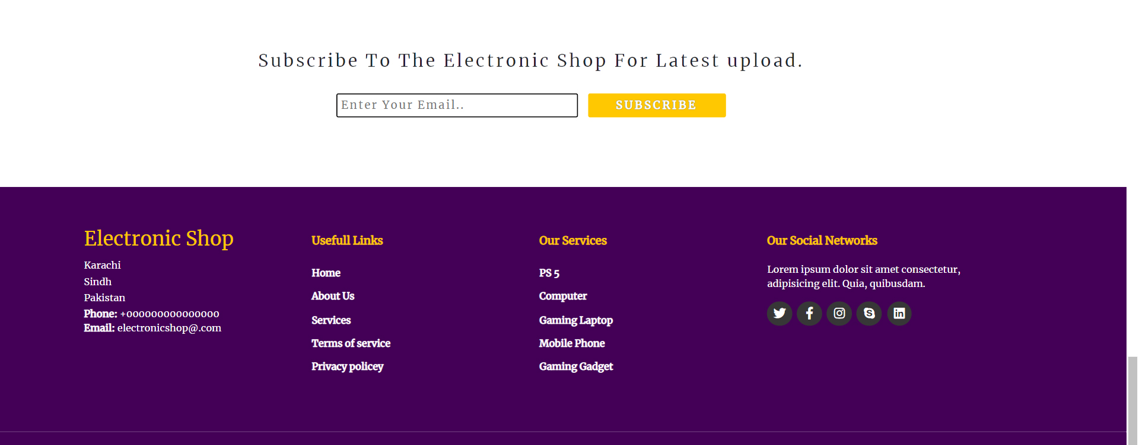
Footer Page

Slide 19
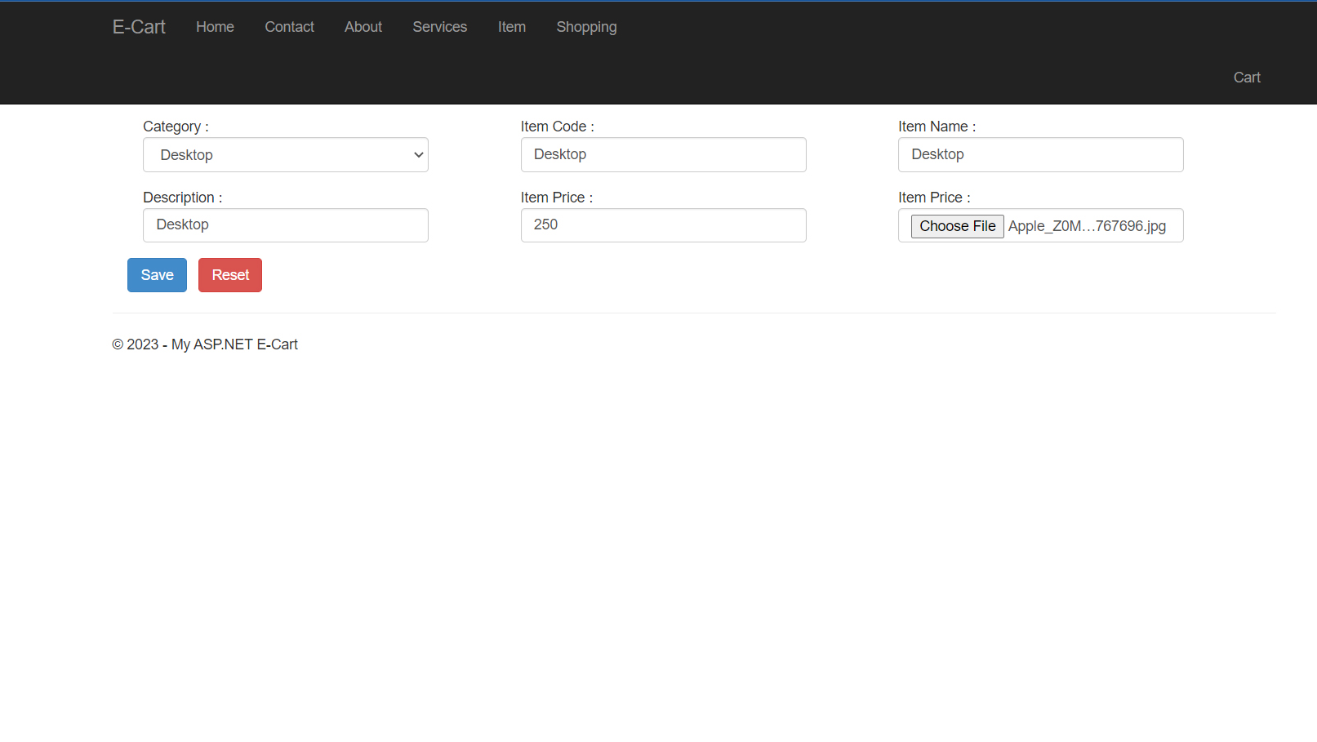
Admin Category page

Slide 20
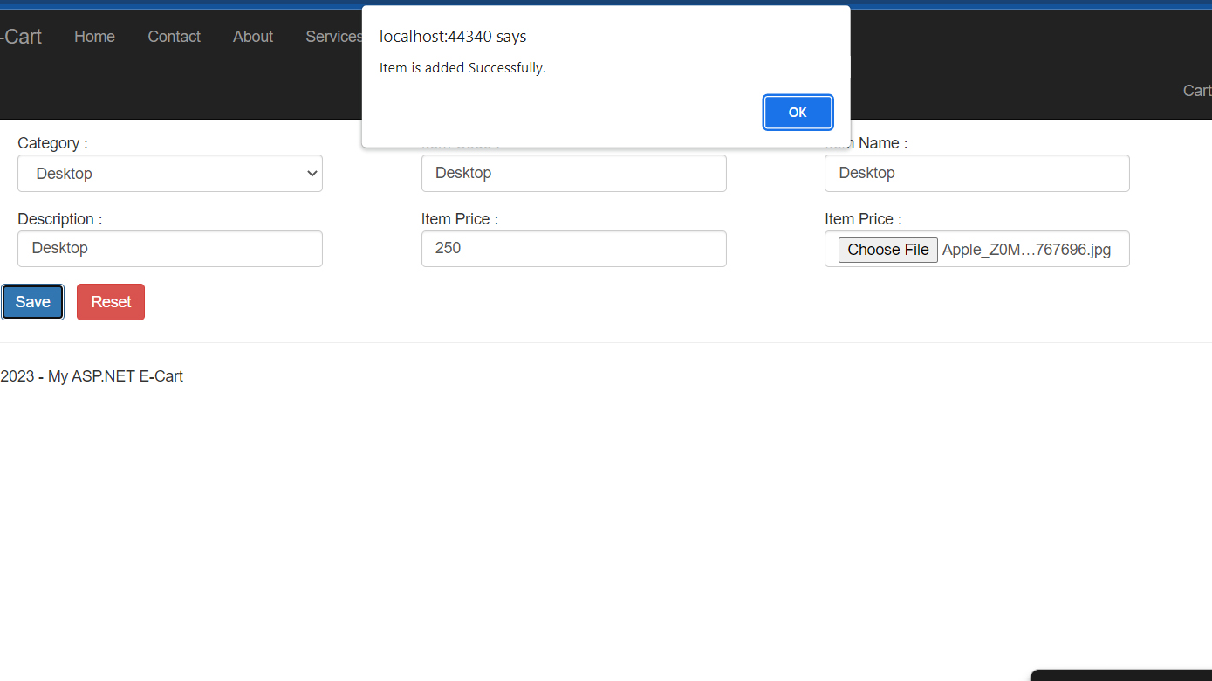
Admin category save page

Slide 21
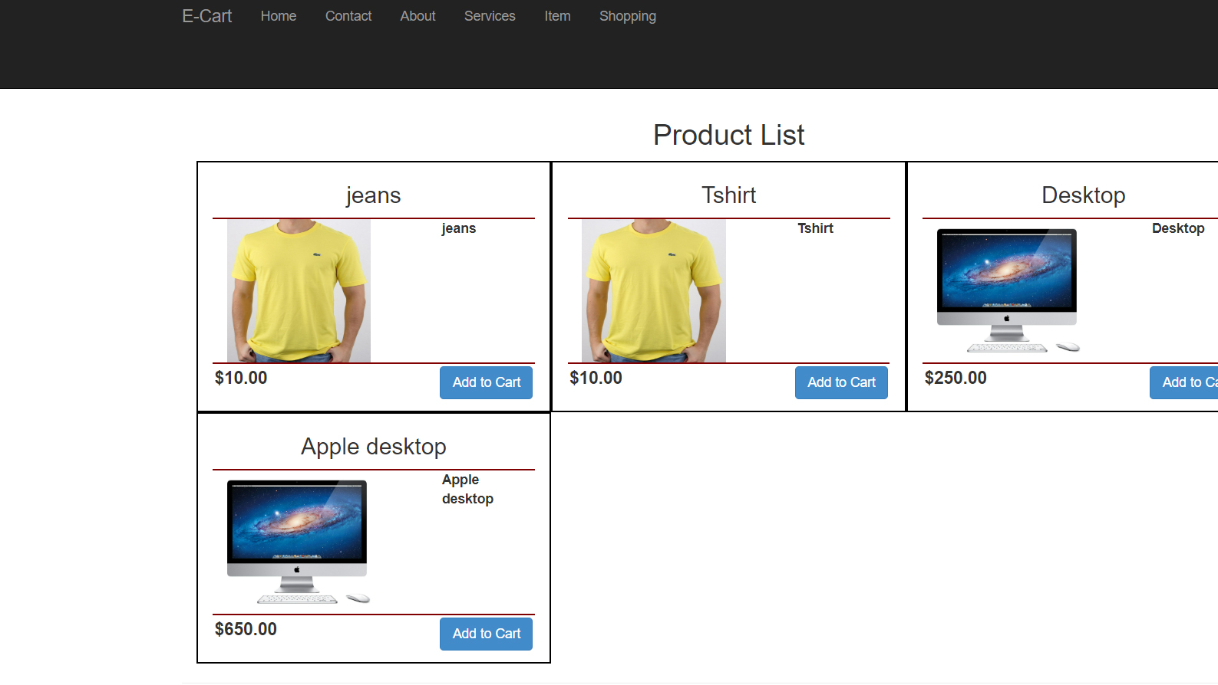
User side Category Page

Slide 22
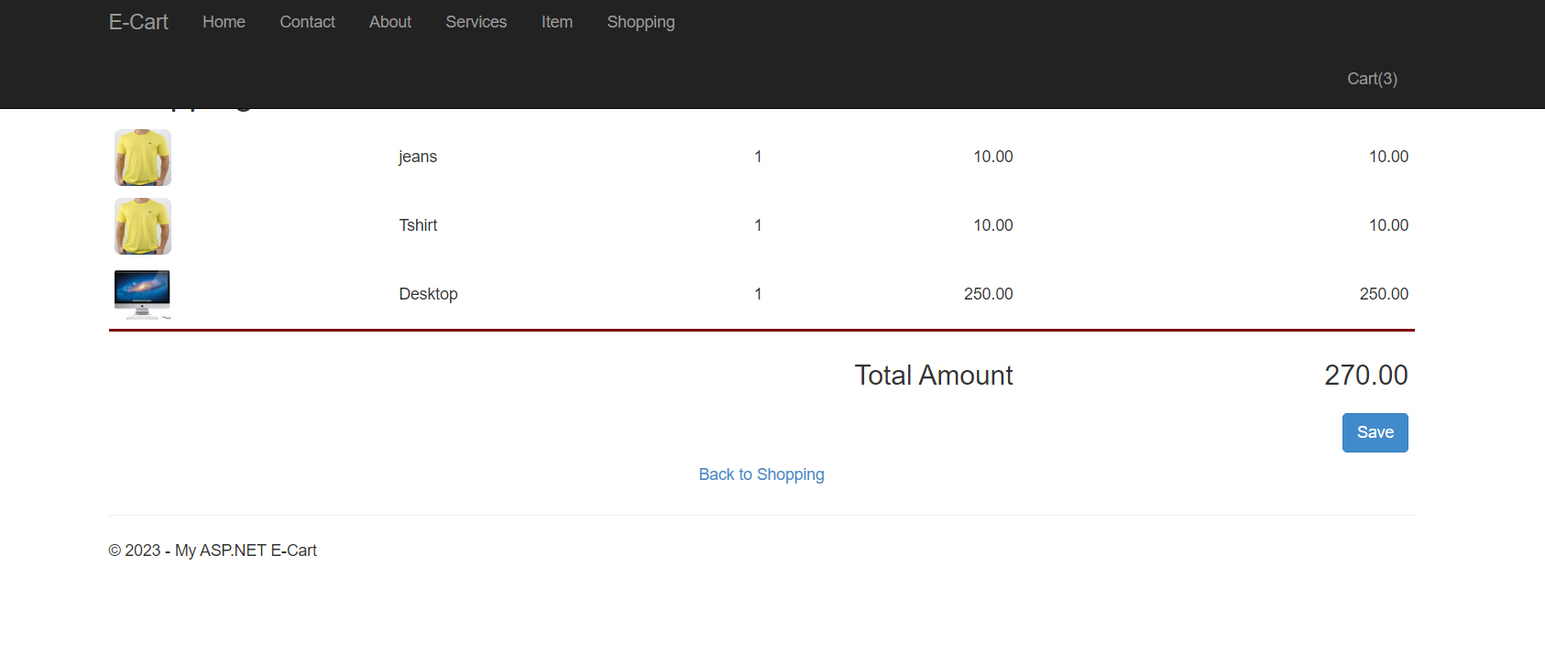
User cart deatils page

Slide 23

Future Scope:
The project made here is just to ensure that this Product could be valid in today real challenging world. Here all the facilities are made and tested.
Currently it is not visible on virtual world (Internet) because of some limitations of project. In future it may be there.

Slide 24
Conclusion:
Online Shopping is the best way to purchase any item but be careful because there may be some fake products on different sites.
Only purchase those items which can be recognized easily that item is fake or not or choose according rating of buyers.
But not to worry , on my site you will get all items genuine and trusty ,just check once here before buy anywhere.

Slide 25


Thank You
Shruti Thakkar
Shruti. Thakkar@triosstudent.com

