Slide 1
PREDICTIVE ANALYSIS FOR MACHINE FAILURE IN A FACTOTY

Slide 2
PROBLEM STATEMENT
To Deploy Machine Learning based Web-App to predict Machine Failure in Factory.
Our Approach :
Use GitHub version control system
Use various statistics and Machine Learning Models to find optimum prediction system.

Slide 3
FLOW OF TASK
Data Gathering
Data Preprocessing
Yash Jain
2
Data Visualisation
Literature Review
Shruti Saxena
3
Model Training
Azure Workout & Deployment(Heroku)
Shruti Jain
4
GitHub &Web App
Model Deployment(GCloud)
Siddharth Kekre
1

Slide 4
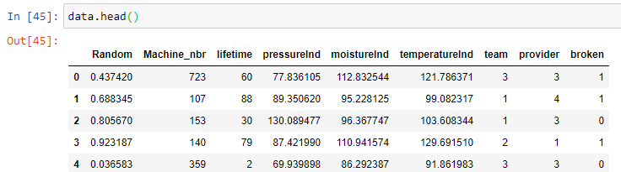
DATA GATHERING
The Dataset which we used comes from a Manufacturing Unit, that uses many machines to make a final product.
Task Type : Binary Classification
Number of features : 9
Target Variable: Broken
Machine State : Yes/No

Slide 5
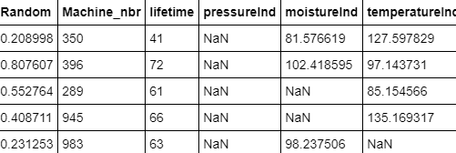
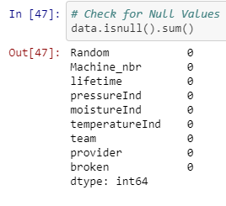
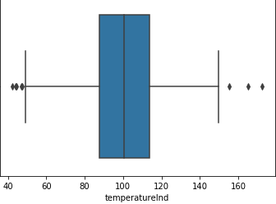
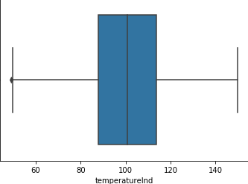
DATA PRE-PROCESSING
Before Pre-processing
After Pre-Processing

Slide 6
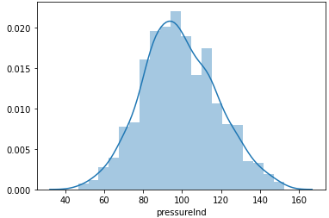
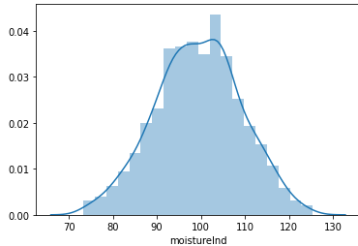
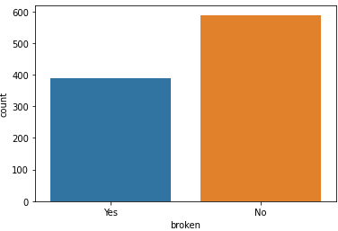
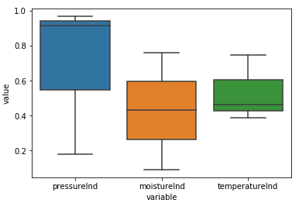
DATA VISUALIZATION

Slide 7
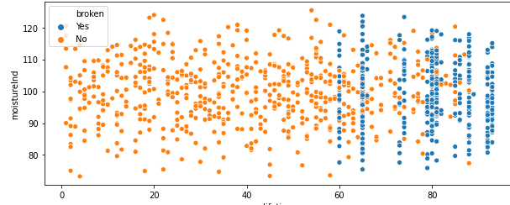
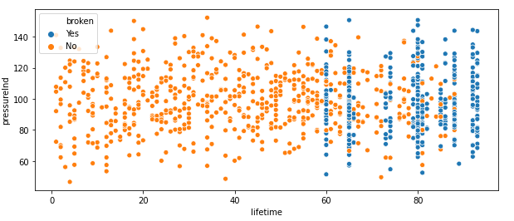

Slide 8
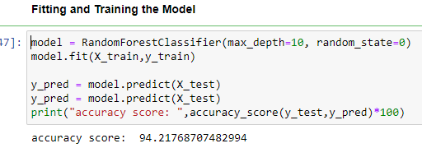
MODEL TRAINING
MODELS | ACCURACY
DECISSION TREE | 93.2%
RANDOM FOREST | 94.21%
LOGISTIC REGRESSION | 84%
SUPPORT VECTOR MACHINE | 86%

Slide 9
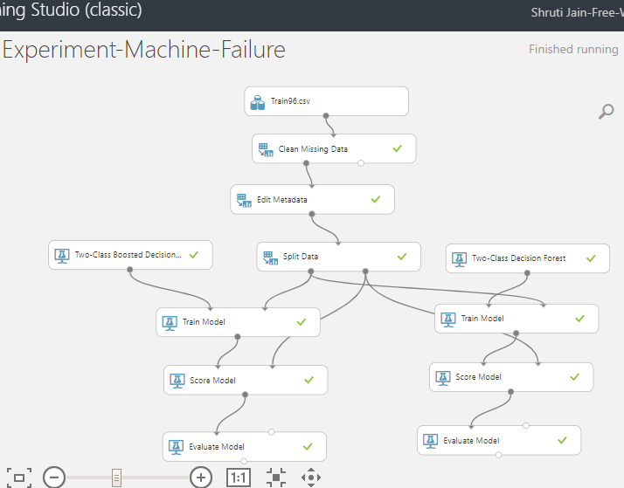
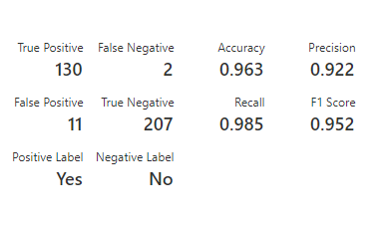
AZURE WORKOUT

Slide 10
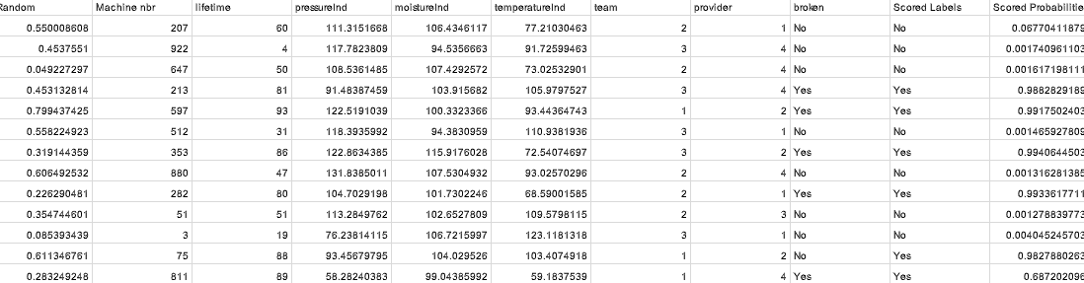
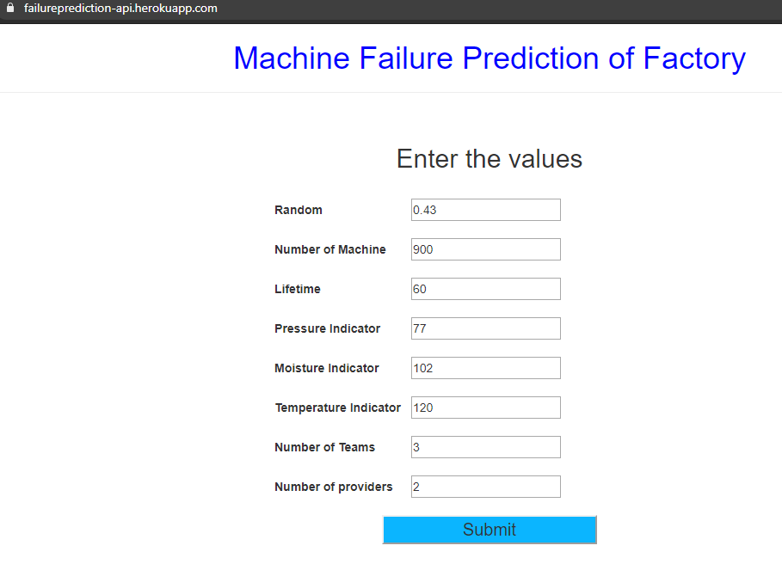
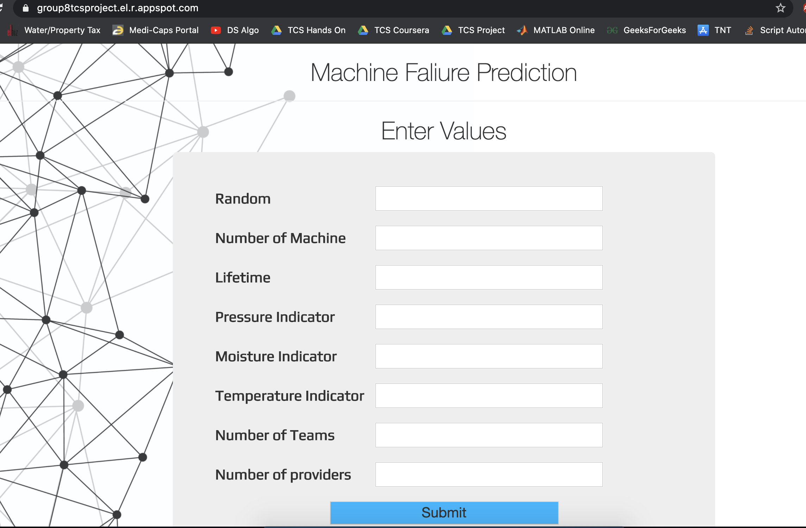
BATCH EXECUTION AND WEB-APP

Slide 11
FUTURE SCOPE
Applying Multi-Class Classification :
Rather than just showing YES/NO, the model would predict the degree of risk of breakdown
Build a Recommendation System :
If the output says Machine will breakdown, then it will also recommend optimum settings to prevent that.

Slide 12
THANK YOU

