Slide 1





A CASE STUDY ON
Student Name : Shruti Gaikwad
Email id : gaikwadshruti2006@gmail.com
Guide: Mr. Deepneel Majumdar
Disclaimer: The content is curated for educational purposes only.
Notes:
Slides: Prepare a short slide deck (10-12 slides) summarizing the project objectives, methodology, and key results.

Slide 2
OUTLINE
Problem Statement
Analyzing the distribution of mutual fund returns based on risk levels using
Line Chart
Scatter Plot
Box Plot
Heat Map
Histogram
This helps in understanding how different risk categories impact fund performance.

Slide 3
Problem Statement
Analyzing the distribution of mutual fund returns based on risk levels using various graphs.
This helps in understanding how different risk categories impact fund performance.

Slide 4
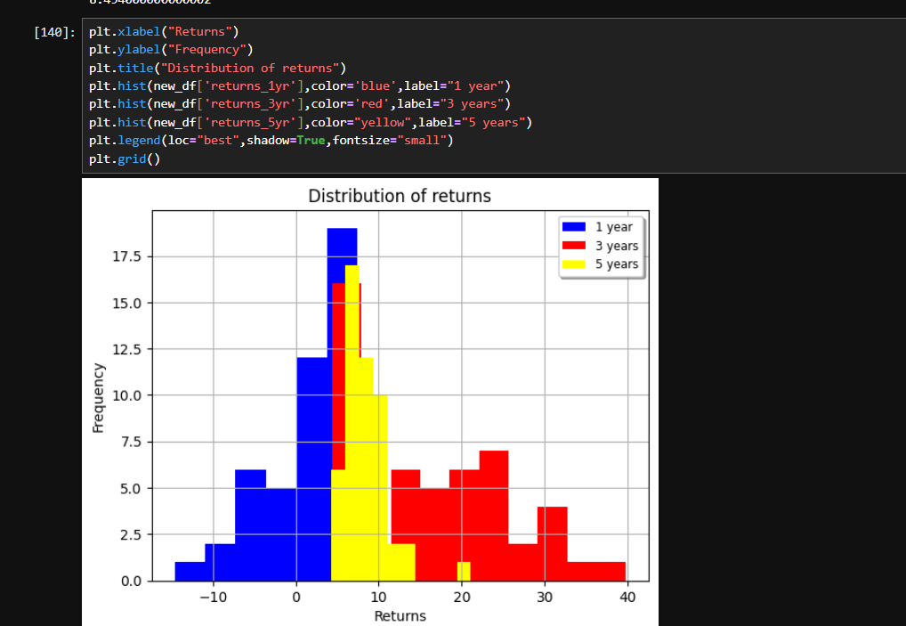
Output Screenshots

Slide 5
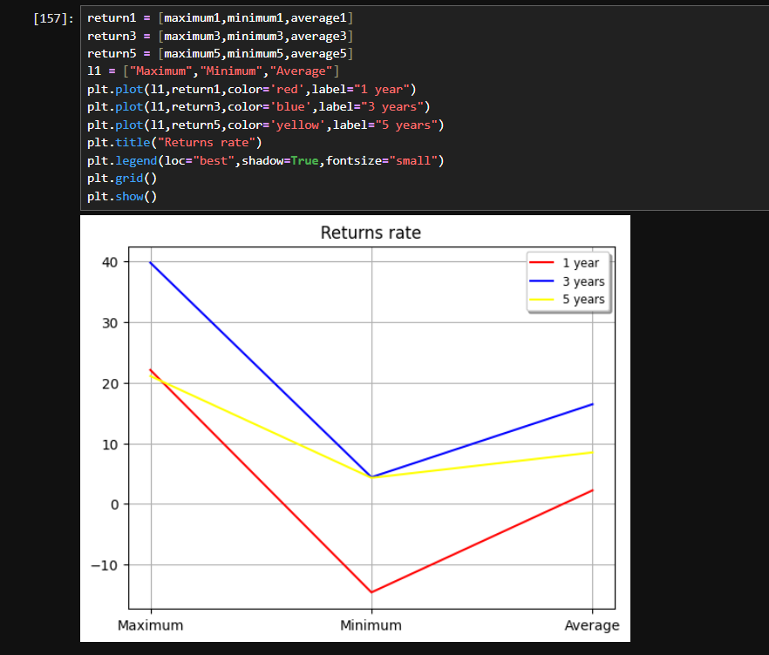

Slide 6
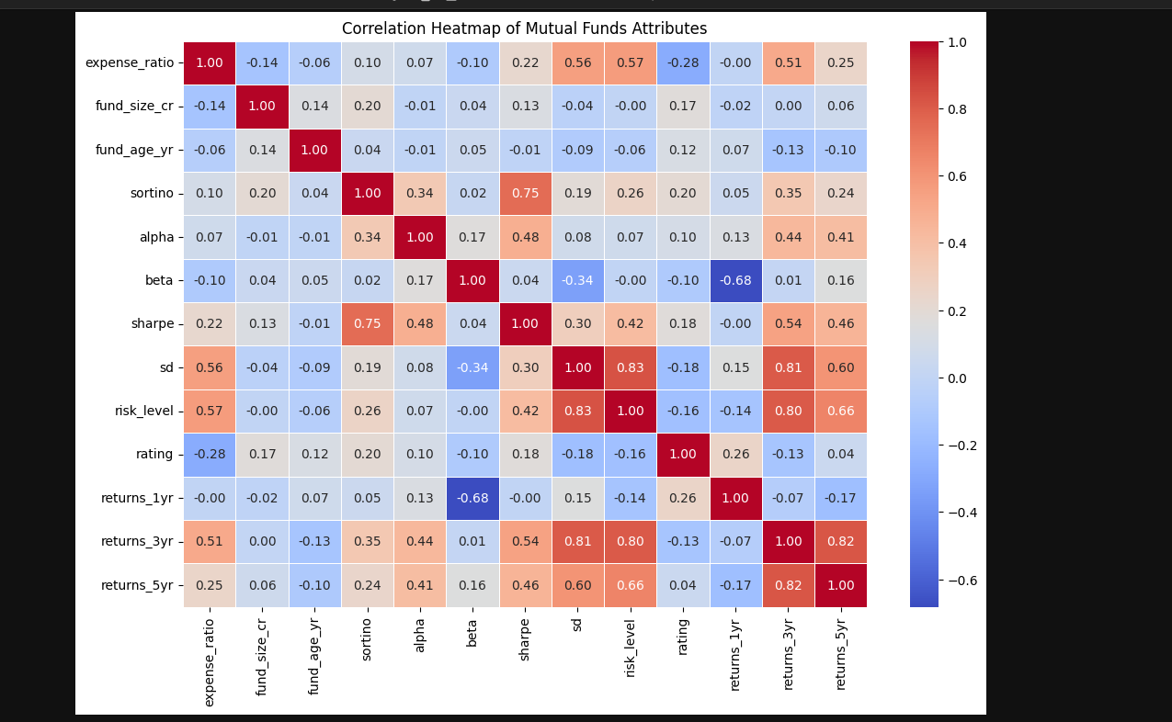

Slide 7
Github Link
https://github.com/Shruti18-19/Mutual-Fund-Analysis

Slide 8
Thank you!
Notes:
thank you very much for joining this PPT, keep learning.
8

