Slide 1
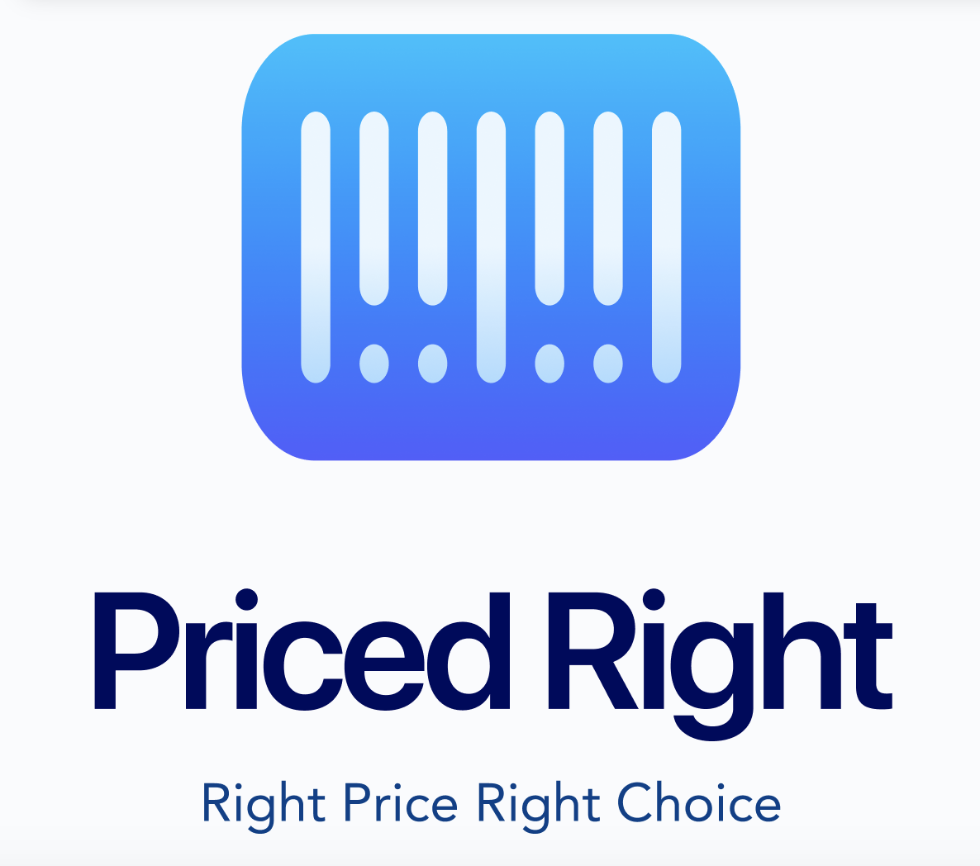
Priced right
₹
₹
₹
₹
₹
₹

Slide 2


Price gouging is wrong
Busting Price Gouging the Right Way
ILLEGAL

Slide 3
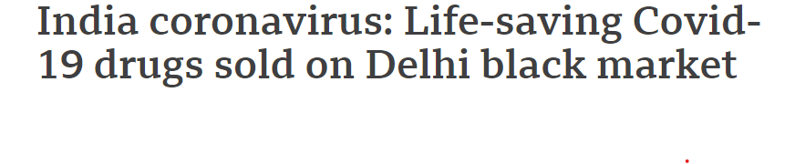
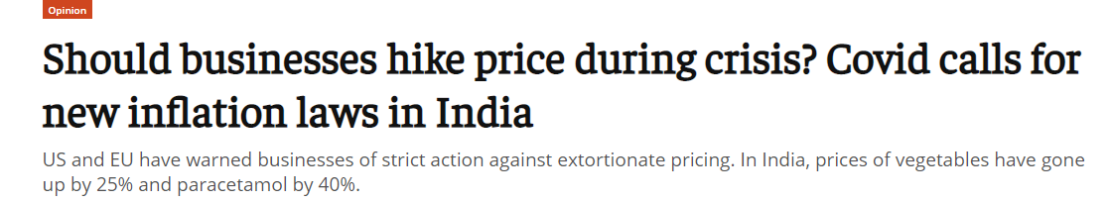
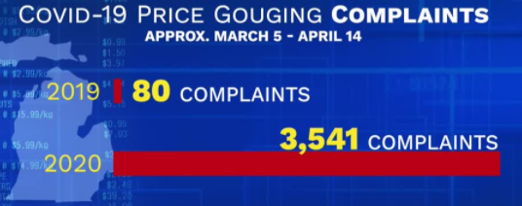
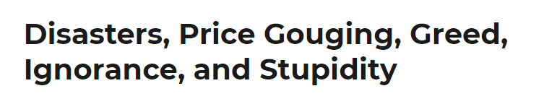
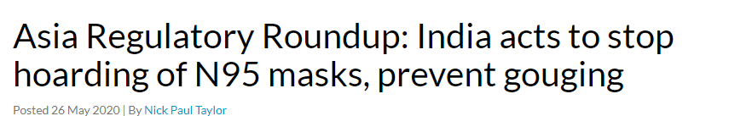
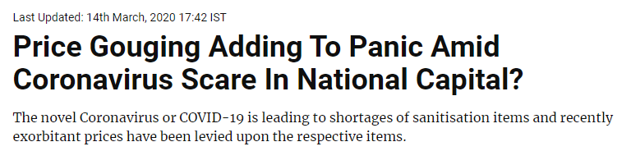
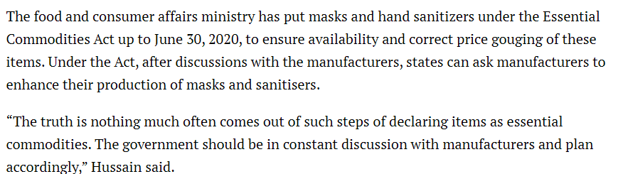
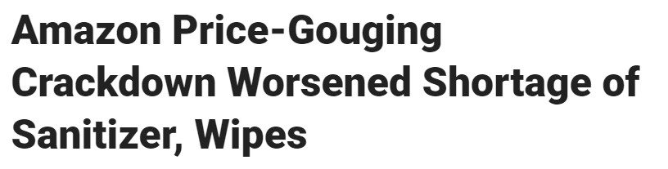
2020 price SURGE DURING COVID CRISIS

Slide 4
11. ENABLE TRANSPARENCY
1. SELF-SUSTAINED
FAIR PRICE GUIDANCE
111. Create AwarenesS
111. FAIR TRADING
“Atmanirbhar Bharat” (SUCCESS!) —Mr. Sanjiv Mehta
The Vision
To build a fair economy and boost customer trust with factual pricing information within the essential commodities ecosystem during crisis like COVID.

Slide 5
Pain Points
₹
Why Price Gouging needs attention?
₹
Standardized Prices - Low Accessibility and Unawareness
Price Surge - Supply and Demand Mismatch
Detached ecosystem - Retailer, Consumer and Govt.
Pseudo - shortage - Fear not Free Economy
₹
₹
Notes:
widespread panic buying
supply-demand mismatch
Detached Ecosystem between Urban/Rural areas

Slide 6
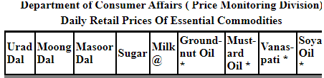







Business Model
Unified platform for pricing essential commodities by integrating the consumers, retailers and government/local bodies.
Government
Daily Release of Retail Price Guidance
Price Gouging Meter Set
Retailer Sign up
Retailer
Choose Store Type (Home Based/ Local Kirana)
View Baseline/
Competition Pricing
Set Price for Essential Commodities Daily
Consumer Sign up
Local Price Search
Local Results on Map
Price Gouging Indications
Select Store
Consumer
Essential Commodity STD Pricing

Slide 7
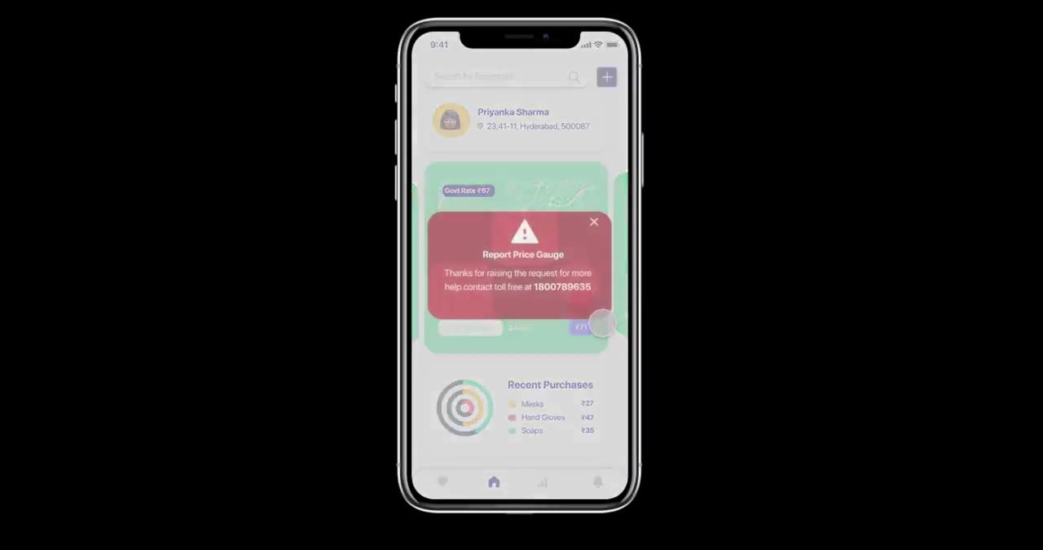
Data-Driven Growth Strategy
Phase 1 4 months
Phase 11 5 months
Phase 111 5 months
Develop/Launch App on Play Store
Target: At-home Entrepreneurs (Platform for Trade)
Pilot Test in Urban/Rural Gujarat
Retain Customers
Increase Visibility
Increase Downloads (Organic Keyword SEO)
Target: Expand to Retail Stores
Involvement of Government to Scale Up
Analyze Results and Adjust (A/B) Testing
Expansion Nationwide

Slide 8
PLATFORM - BUILDING BLOCKS
Mobile UI
IVR
Text SMS
Event Engine
Cloud
Business Intelligence Engine

Slide 9
THANK YOU
₹
₹
₹
₹
₹
“Atmanirbhar Bharat”
(SUCCESS!)
₹

