Slide 1

Car Market Trends Analysis
Using Car Dekho Data Python • Pandas • NumPy • Matplotlib
Shruti Gangadhar Kale
Edunet Foundation – AICTE Internship
Internship ID: INTERNSHIP_17830691666a4779eecfe8a
STU ID: STU6a6a57e2817f71785354210

Slide 2

PROBLEM STATEMENT
Data-driven market insights
Used-car prices vary with vehicle age, usage, fuel type, seller type, transmission and ownership. The objective of this project is to analyze the Car Dekho dataset and identify meaningful patterns in vehicle prices and market characteristics.
• Understand the structure and quality of the dataset
• Measure price ranges and average selling prices
• Compare fuel, seller, transmission and ownership patterns
• Explore relationships between price, kilometres and vehicle year

Slide 3
Project Description
This project performs exploratory data analysis on the provided Car Dekho dataset using Python in Google Colab. The workflow includes data loading, structure inspection, missing-value checking, descriptive statistics, categorical analysis, price analysis and visualization.
301
records
9
variables
98
different car names
0
missing values
Data fields
Car_Name • Year • Selling_Price • Present_Price • Kms_Driven • Fuel_Type • Seller_Type • Transmission • Owner
Price range
₹0.10 lakh – ₹35 lakh | Manufacturing years: 2003–2018

Slide 4

WHO ARE THE END USERS?
Used-car buyers
Compare prices and vehicle characteristics.
Car dealers
Understand inventory mix and market pricing.
Used-car businesses
Support pricing and sales decisions.
Market analysts
Identify market patterns and segments.
Students & researchers
Learn and demonstrate real-world data analysis.
The analysis is designed as a decision-support view of used-car market data.

Slide 5

Technology Used
Python
Core programming language for analysis
Google Colab
Cloud notebook used to run the project
Pandas
Data loading, cleaning and analysis
NumPy
Numerical operations and calculations
Matplotlib
Charts and data visualizations
Analysis
describe(), value_counts(), groupby(), sorting and plots
Workflow: Load → Inspect → Clean → Analyze → Visualize → Interpret

Slide 6
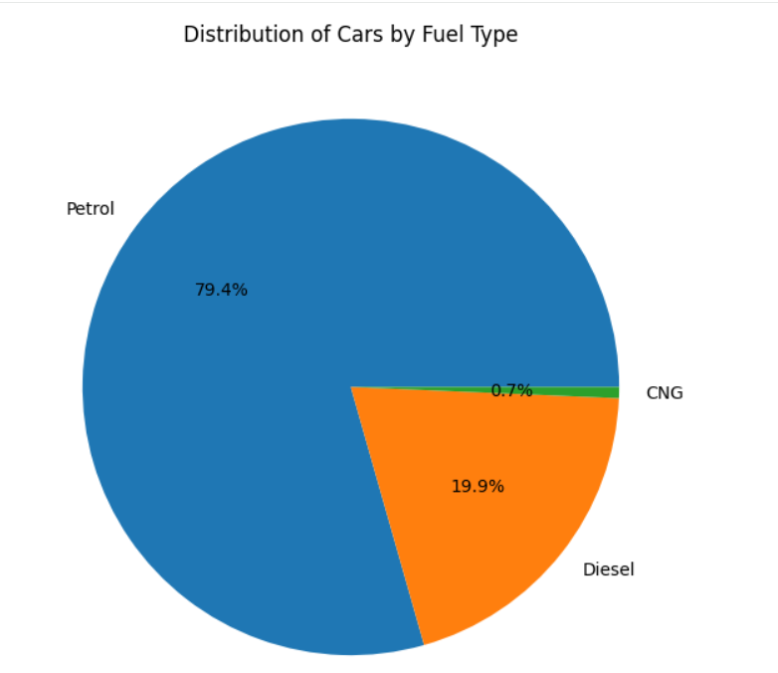
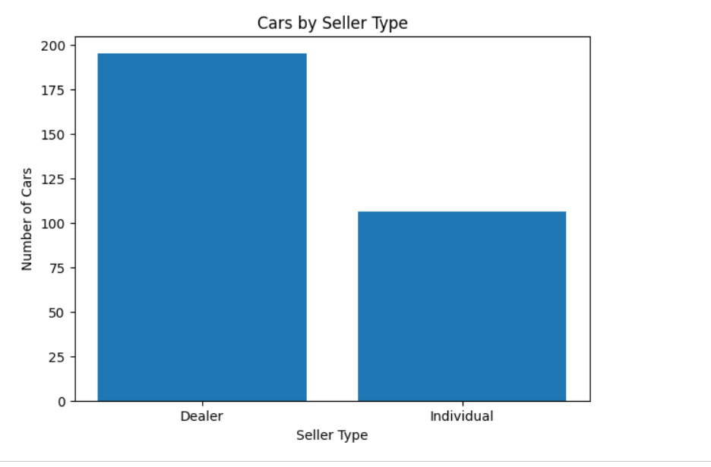
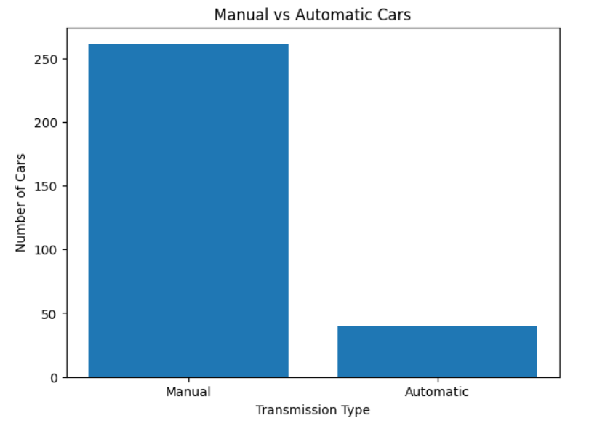
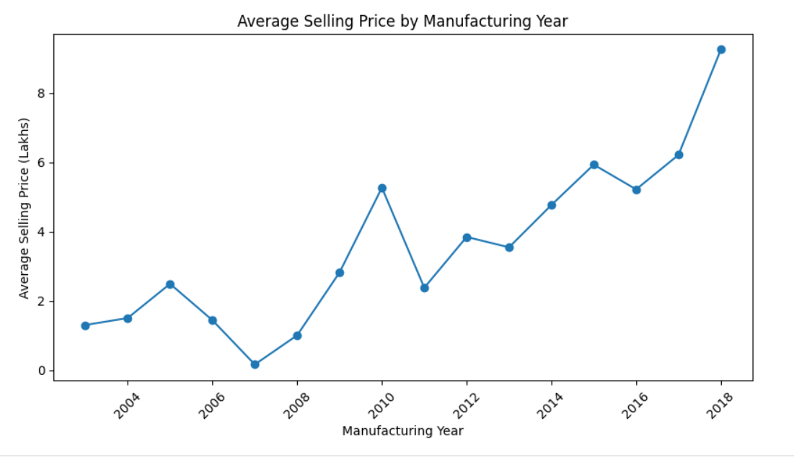
RESULTS
Key findings: Petrol 79.4% • Dealer sales 64.8% • Manual cars 86.7% • Highest selling price ₹35 lakh (Land Cruiser)
Demo Link
Paste your Google Colab notebook URL here before submission.

Slide 7
Thank You
Questions?
Car Market Trends Analysis • Car Dekho Dataset

