Slide 1


SMART INDIA HACKATHON 2025
TITLE PAGE
• ProblemStatementID– 26123
• ProblemStatementTitle- Edge-AI Based Distributed
Fleet Coordination for Autonomous Mobile Robots (AMRs) in Smart Warehouses
• Theme- Smart Automation
• PS Category- Software
• TeamName- Loose Screws

Slide 2


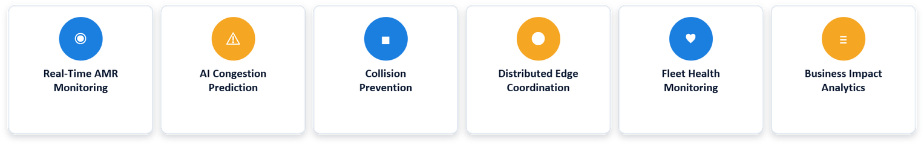
IDEA TITLE
LOOSE
SCREWS
THE PROBLEM:
Proposed Solution:
Centralized control: most AMR fleets depend on one server for task allocation.
Single point of failure: a server outage halts every robot at once.
Costly downtime: stalled fleets mean delayed shipments and lost throughput.
No graceful degradation: existing systems have no fallback coordination mode.
Peer-to-peer edge coordination — robots talk directly, no single choke point.
Intelligent failover: fleet keeps operating the instant the central server drops.
AI congestion prediction with automatic rerouting around bottlenecks.
Live warehouse digital twin for real-time monitoring & collision prevention.
KEY FEATURES:
@SIH Idea submission-Template
2

Slide 3
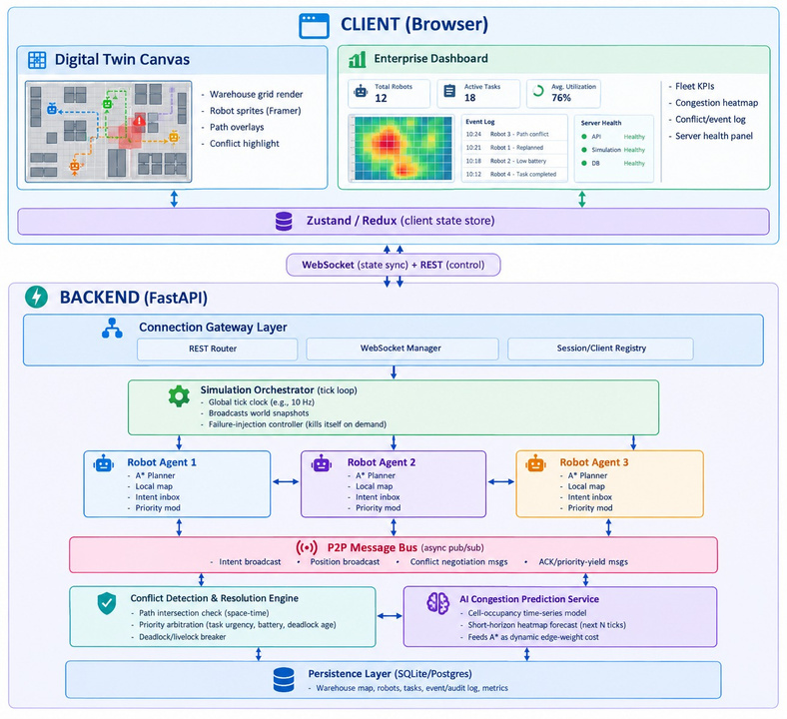
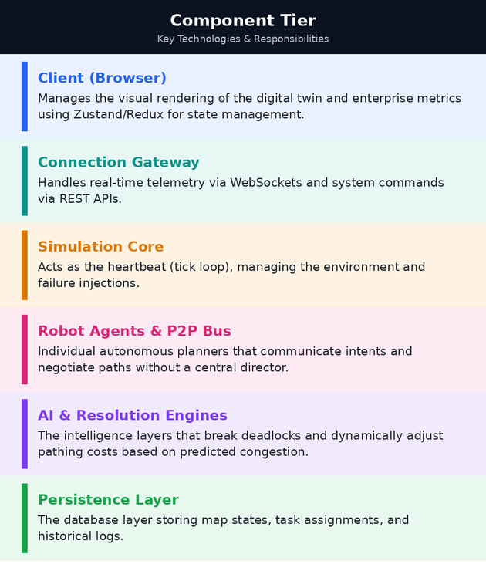
TECHNICAL APPROACH
LOOSE
SCREWS
@SIH Idea submission-Template
3

Slide 4
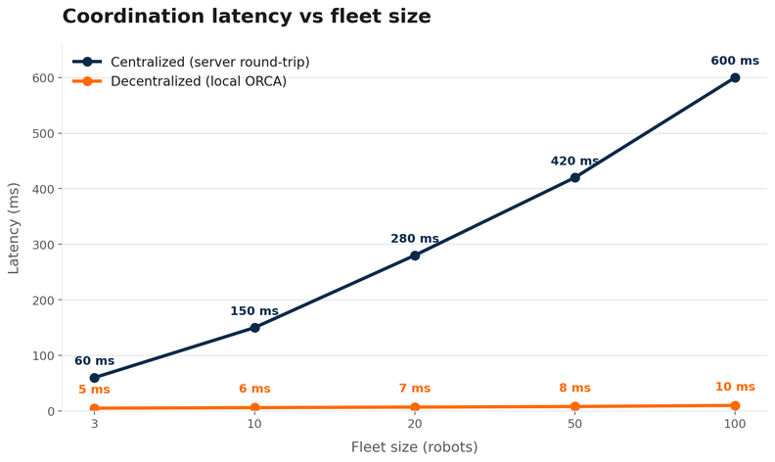
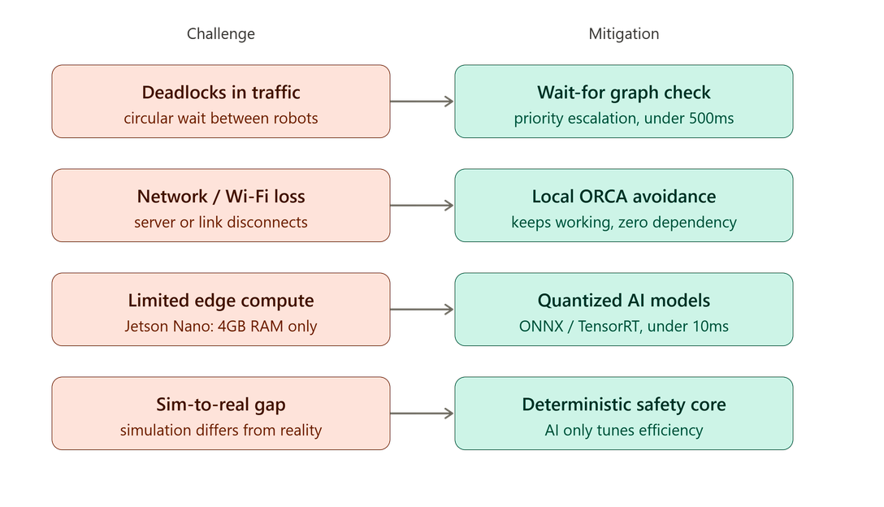
FEASIBILITY AND VIABILITY
LOOSE
SCREWS
TECHNICALLY FEASIBLE
ROS 2 + DDS → P2P coordination
ORCA / NH-ORCA → real-time avoidance
Priority-based planning → 20+ AMRs
Edge-AI → predictive traffic management
OPERATIONALLY VIABLE
Network failure resilient
<5 s recovery target
>95% task completion target
0 collision target
@SIH Idea submission-Template
4

Slide 5
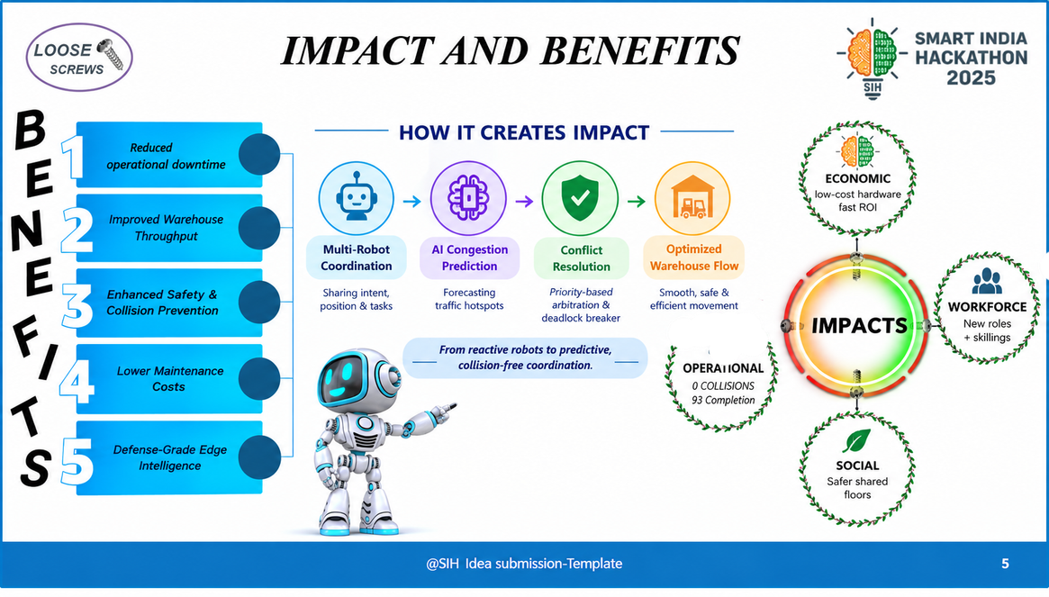
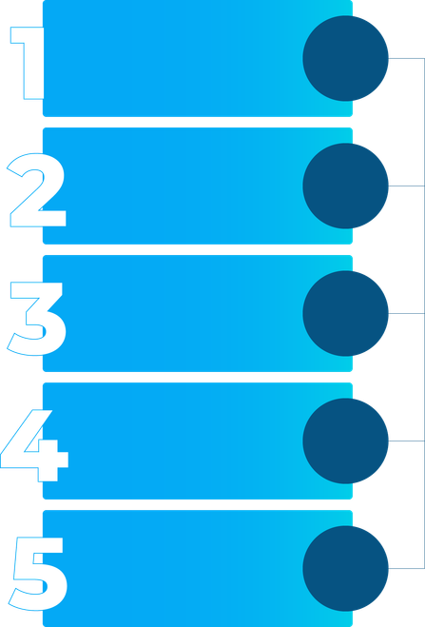

IMPACT AND BENEFITS
LOOSE
SCREWS
ECONOMIC
Low-cost hardware
Fast ROI
Reduced
operational downtime
Improved Warehouse
ThroughOut
OPERATIONAL
WORKFORCE
IMPACTS
New roles
+ skillings
0 COLLISIONS
93 Completion
Enhanced Safety &
Collision Prevention
BENEFITS
Lower Maintenance
Costs
SOCIAL
Safer shared
floors
Defense-Grade Edge
Intelligence
@SIH Idea submission-Template
5

Slide 6

RESEARCH AND REFERENCES
LOOSE
SCREWS
Global path planning
https://www.sciencedirect.com/science/article/pii/S0004370214001386
Why this problem is real
https://github.com/ros-navigation/navigation2/issues/4685
Peer-to-peer robot communication
https://docs.ros.org/en/rolling/
Local collision avoidance
https://gamma.cs.unc.edu/ORCA/
Edge-AI hardware feasibility
https://developer.nvidia.com/embedded/jetson-nano
Distributed task allocation
https://doi.org/10.1109/TC.1980.1675516
Deadlock detection in distributed systems
https://doi.org/10.1145/357360.357365
Edge-AI congestion/traffic prediction
https://arxiv.org/abs/2101.11174
@SIH Idea submission-Template
6

