Slide 1
Data Science Job Salaries
Shruti Maruti Pawar
Domain: Data Science

Slide 2
Problem Statement
Objective: Uncover salary trends, determine major salary drivers, and develop a model to accurately predict data science salaries.

Slide 3
Model Prediction Accuracy
Tech Stack | Used in Project
Programming Language | Python
Libraries | Pandas, NumPy, Matplotlib, seaborn, matplotlib
Machine Learning | XGBoost Regressor
Tools | VS Code, Jupyter Notebook
Data Source | CSV Dataset

Slide 4
Dataset Overview
Dataset contains data science job salary information.
Features: Job Title, Experience Level, Employment Type, Company Location, Company Size, Remote Ratio, etc.
Target Variable: Salary (in USD)

Slide 5
Data Preprocessing
Handling Missing Values
Feature Engineering
Label Encoding / Categorical Encoding
Feature Selection
Train-Test Split
Target Transformation

Slide 6
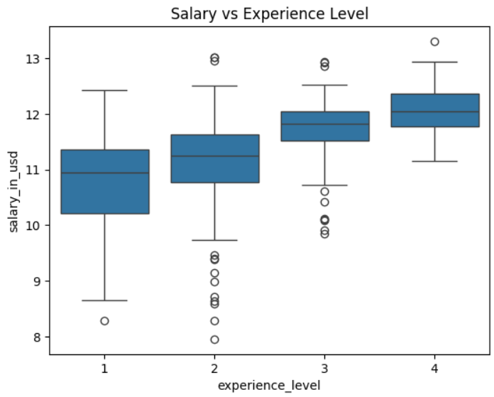
Salary vs Experience Level

Slide 7
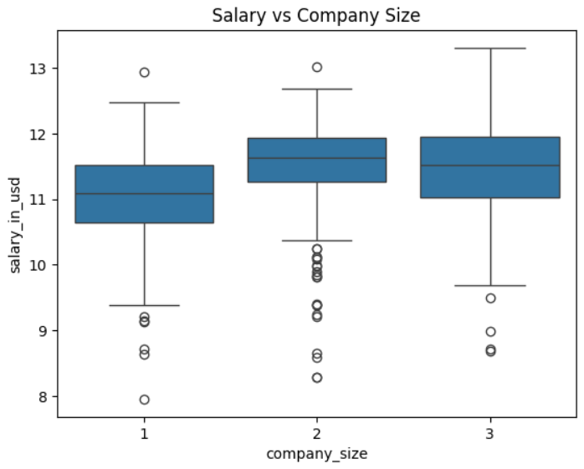
Salary vs Company Size

Slide 8
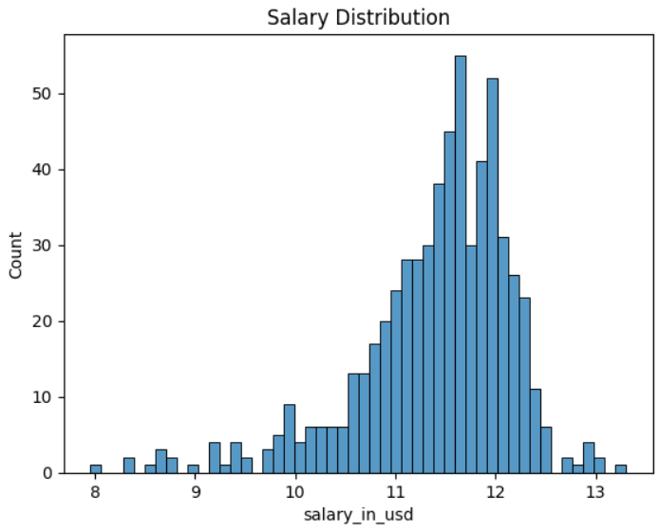
Salary Distribution

Slide 9
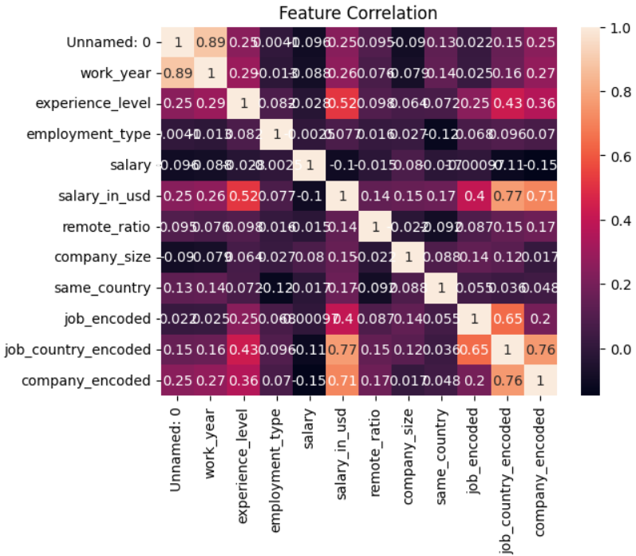
Feature correlation

Slide 10
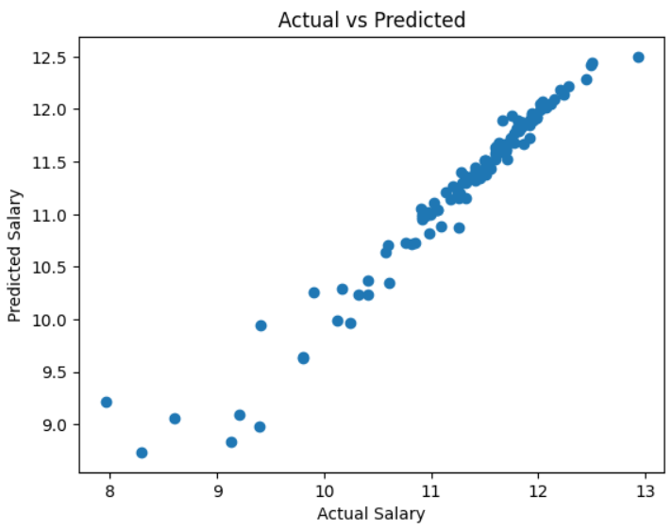
Actual vs Predicted Salary

Slide 11
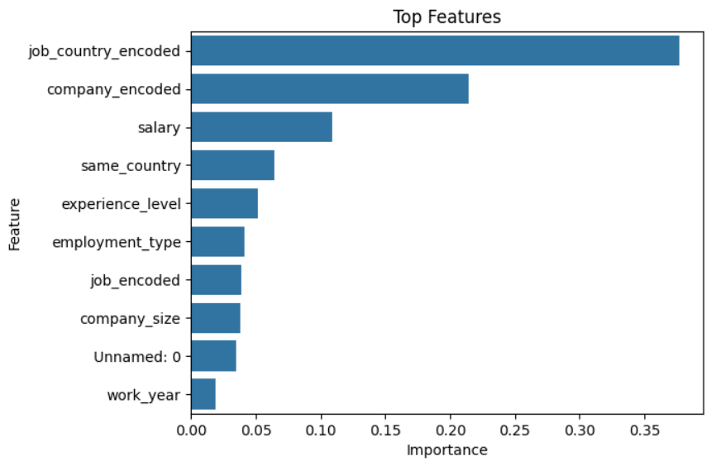
Top Features

Slide 12
Model Evaluation
R² Score
Train-Test Split Evaluation
Visual Evaluation
Log Transformation Effect
Encoding Evaluation

Slide 13
Key Insights from Graphs and Model
Experience level is the strongest factor affecting salary
Larger companies generally offer higher salaries
Job role combined with location strongly influences salary
Location differences create significant salary variation
Target encoding helped improve model performance
XGBoost captured complex patterns in salary prediction effectively

Slide 14
Final Results
XGBoost R² Score: 0.9541

Slide 15
Conclusion
Built a machine learning model to predict job salaries
XGBoost model gave good prediction results
Experience, location, and company size affect salary most
Feature engineering improved model performance
Model works well on unseen data

Slide 16
GitHub Repository

