Slide 1


Plant Disease Detection System for Sustainable Agriculture
By,
Shruti Banerjee
STU654647baefeb31699104698

Slide 2

Learning Objectives
Explored Deep Learning Concepts: Gained hands-on experience with Convolutional Neural Networks (CNNs), a powerful deep learning architecture used
for image classification tasks.
Classified 38 Plant Disease Classes: Successfully trained a model to identify and distinguish between 38 different plant diseases from leaf images,
contributing to precise crop monitoring.
Implemented CNN-Based Image Classification: Designed a custom CNN model using TensorFlow and Keras with multiple convolutional and pooling layers
for feature extraction.
Preprocessing and Data Augmentation: Utilized ImageDataGenerator to normalize and augment data for robust training and better generalization.
Used Key Evaluation Metrics: Evaluated model performance using accuracy, precision, recall, and loss to ensure reliability in
predictions.
Trained and Validated Using Real Dataset: Worked with a real-world augmented dataset of plant leaves, split into training, validation, and test sets.
Applied Callbacks for Better Model Training: Integrated EarlyStopping, ModelCheckpoint, and ReduceLROnPlateau to improve model efficiency and
prevent overfitting.
Visualized Learning Curves: Analyzed model performance across epochs using plots for training/validation accuracy and loss.
Real-World Application Understanding: Understood how AI can support sustainable agriculture by enabling early and accurate detection of plant diseases,
reducing crop loss and pesticide misuse.
GOAL
Source :
www.freepik.com/

Slide 3
Tools and Technology used
Programming Language: Python
Frameworks & Libraries:
TensorFlow & Keras – For building and training deep learning models.
NumPy, Pandas, Matplotlib, Seaborn, OpenCV – For data manipulation and visualization.
Development Environment: Google Colab – Chosen for its GPU support and ease of model training in a cloud-based environment.
Dataset:
Sourced from Kaggle link- https://www.kaggle.com/datasets/vipoooool/new-plant-diseases-dataset
Comprises 38 plant disease classes with augmented images.
Organized into training, validation, and test directories.

Slide 4
Methodology
Data Collection
Downloaded a public plant disease dataset from Kaggle. Dataset includes 38 plant disease categories with both healthy and infected leaf images. Data was structured and stored in Google Drive for access in Colab.
Data Preprocessing
Applied using ImageDataGenerator: Rescaling (Normalization to [0,1] range), Label Encoding via categorical class mode, Set all images to a fixed size of 224×224 pixels for uniform input.
Model Selection
Chose CNN (Convolutional Neural Network) for image classification: 4 Convolutional Layers with ReLU activation for feature extraction, MaxPooling Layers for downsampling, Flatten Layer to convert image matrix into a vector, 2 Dense Layers, with final softmax layer to predict probabilities across 38 classes.
Training Configuration
Loss Function: Categorical Crossentropy, Optimizer: Adam, Evaluation Metrics: Accuracy, Precision, Recall, Callbacks Used: EarlyStopping – Prevents overfitting, ModelCheckpoint – Saves the best model, ReduceLROnPlateau – Adjusts learning rate on plateau
Model Training
Initial training target was 15 epochs. Due to Google Colab resource constraints, training was interrupted after 11 epochs. To avoid runtime termination, model was trained for 5 stable epochs.
Model Evaluation
Tested the trained model on unseen data. Collected final metrics: Loss, Accuracy, Precision, Recall.

Slide 5
Problem Statement:
Real-World Challenge:
Plant diseases significantly reduce crop yield and quality, directly impacting the livelihoods of farmers and the global food supply.
Traditional methods of disease identification rely on manual inspection by experts, which is:
Time-consuming
Subjective and error-prone
Not scalable for large farms
Project Motivation:
Early and accurate detection of plant diseases is essential to:
Prevent widespread crop damage
Optimize pesticide use
Improve agricultural productivity
Identified Gap:
There is a pressing need for an automated, fast, and reliable system to detect plant diseases from leaf images.

Slide 6
Solution:
Built a Deep Learning model using CNN architecture to classify leaf images into 38 disease categories.
Key Features of the Solution:
CNN-based Model:
Automatically learns features from images.
Removes dependency on manual feature extraction.
Trained on a real-world dataset sourced from Kaggle.
Evaluated with relevant metrics to validate performance.
Performance Metrics Achieved:
Loss: 0.3538
Accuracy: 88.55%
Precision: 90.95%
Recall: 86.61%
Impact of the Solution:
High accuracy ensures reliable detection.
Utilizes cutting-edge AI technology (CNN, TensorFlow, Keras).
Can prevent disease spread by enabling early intervention.
Scalable and can be integrated into mobile or web-based platforms for farmers.
GitHub Link: https://github.com/Shruti83100/AICTE_Internship/tree/main

Slide 7
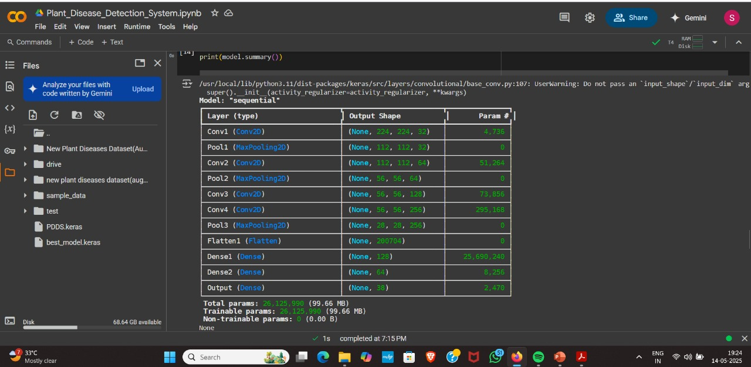
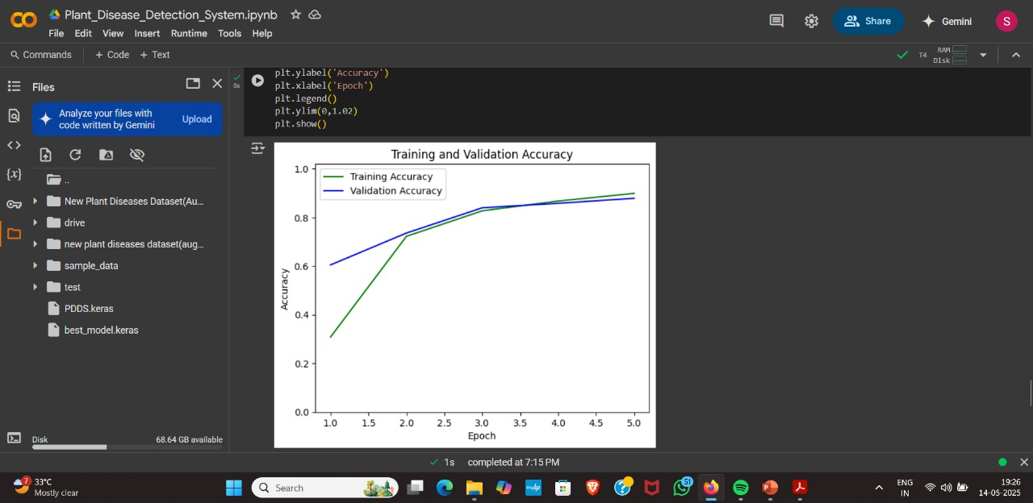
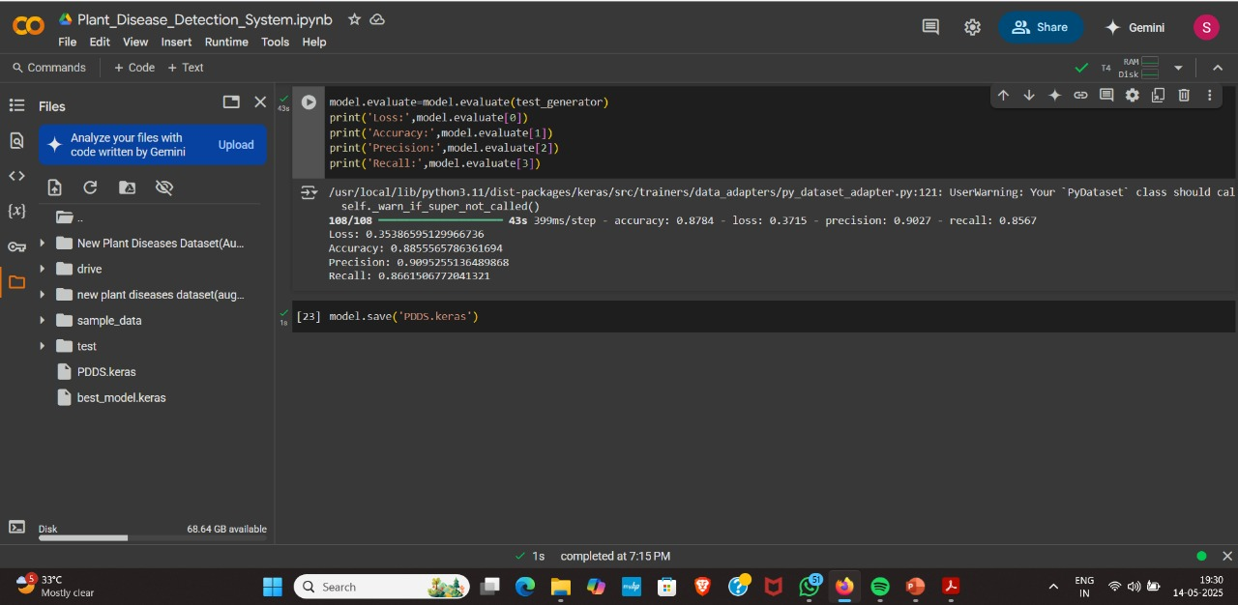
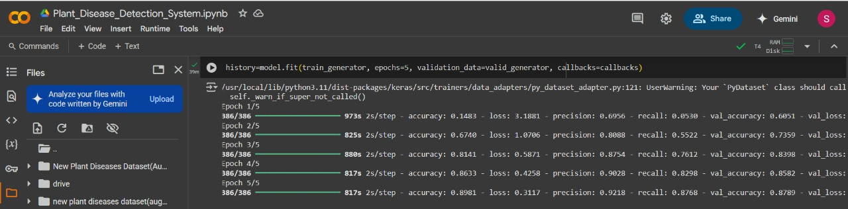
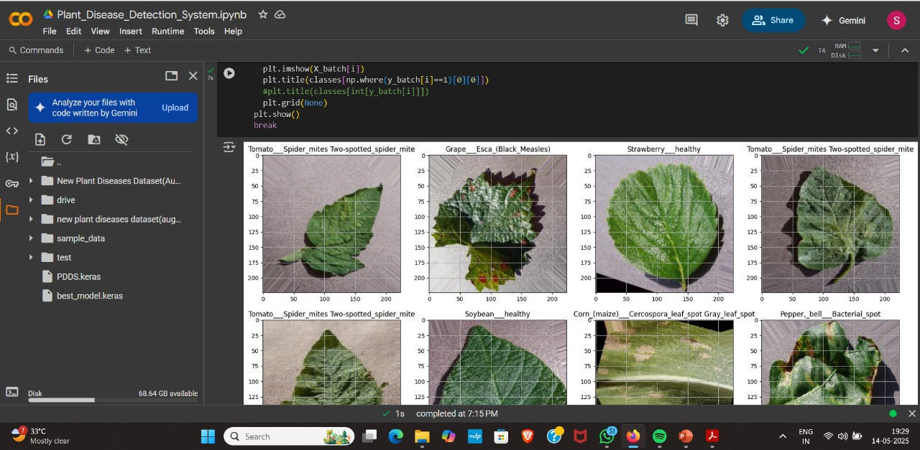
Screenshot of Output:

Slide 8
Conclusion:
Successfully developed a Plant Disease Detection System using Convolutional Neural Networks (CNN) to classify
38 different plant diseases from leaf images.
Achieved a commendable performance: Accuracy: 88.55%, Precision: 90.95%, Recall: 86.61%
Employed key optimization techniques to improve model performance: Adam Optimizer for efficient gradient descent,
Categorical Crossentropy as loss function suitable for multi-class classification.
Integrated regularization techniques to prevent overfitting: EarlyStopping to halt training when validation loss stopped improving,
ModelCheckpoint to save the best-performing model, ReduceLROnPlateau to dynamically adjust learning rate on plateaus
The model shows strong generalization capabilities and can be extended to real-world agricultural platforms
(e.g., mobile apps, field scanners).
This project demonstrates how Deep Learning can offer scalable, accurate, and fast solutions to critical problems in
sustainable agriculture.

