Slide 1

Tripsyy
#YourTravelPartner….

Slide 2
Squad Infotech project presenter: SHRUTI CHAURASIYA
Project : DjangoProject

Slide 3
SUMMARY :
The system will capture the following process and keep the records in respect of all the places and traveller present in the project.
The project at first is divided into two Sections :
User Section.
Admin Section.

Slide 4
SCOPE OF THE PROJECT :
Social Integration: Integrate social media sharing options, allowing users to share their travel plans, experiences, and photos directly from website.
Mobile App Development: Expand my platform by developing a mobile app for iOS and Android devices. This will help provide a seamless experience on smartphones and tablets.
No chances of missing on any famous Tourist Attractions as we love to stay Updates with latest trends.

Slide 5
ADMIN SECTION: USER SECTION:
ADMIN LOGIN:
Display passengers.
Add new packages.
Delete/ modify existing packages.
Display Places.
Delete/ modify existing Countries.
Display Booking Details.
Delete/ modify existing details.
LOGIN
View Packages
Book Tickets.
Amount Generation Process.
SIGNUP
Register
Login
Book Tickets
Home Page
(in the home page all the travelling places are listed.)

Slide 6
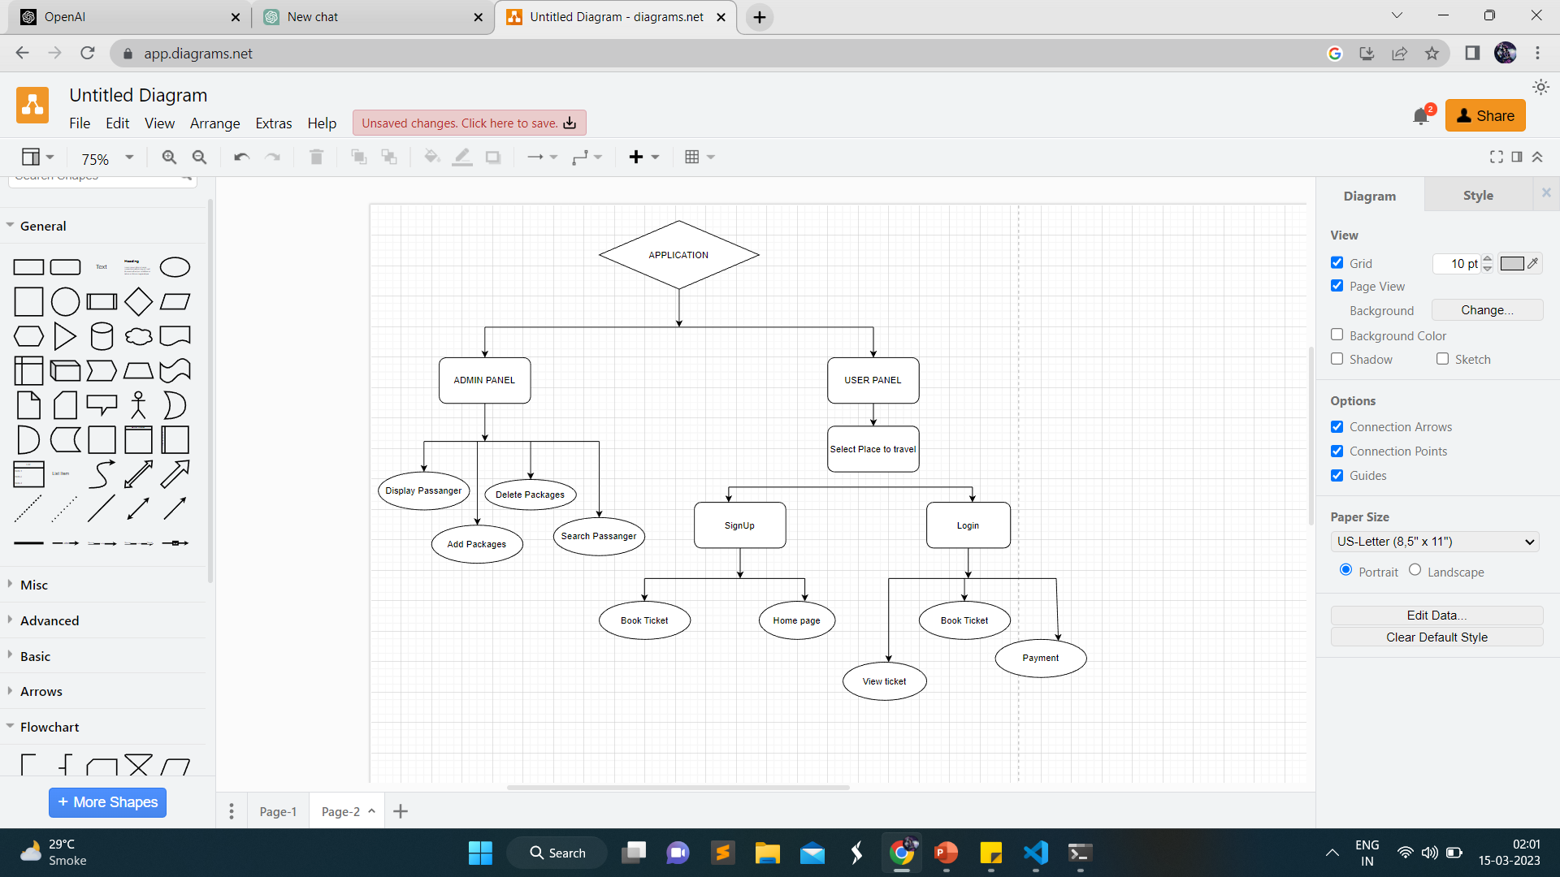
FLOW CHART:

Slide 7


