Slide 1

Tripsyy
#YourTravelPartner….

Slide 2
Squad Infotech project presenter: SHRUTI CHAURASIYA
Project : Terminal Based Project

Slide 3
SUMMARY :
The system will capture the following process and keep the records in respect of all the places and traveller present in the project.
The project at first is divided into two Sections :
User Section.
Admin Section.

Slide 4
ADMIN SECTION: USER SECTION:
DISPLAY PASSANGERS.
ADD NEW PACKAGES.
DELETE/ MODIFY EXISTING PACKAGES.
SEARCH PARTICULAR PASSANGER USING TICKET_ID(TID).
LOGIN
View Tickets.
Book Tickets.
Payment Process.
SIGNUP
Book Tickets
Home Page
(in the home page all the travelling places are listed.)

Slide 5
KEYPOINTS of MY PROJECT:-
re: for validations.
maskpass: for ‘*’ in passwords.
random: for generating otps.
datetime: for booking dates and time.
Multithreading: for loading effect.
OOPS Concept: for project building.
User Defined Modules: tables and Admin
Pretty Table: for data visualization.
Exception Handling.

Slide 6
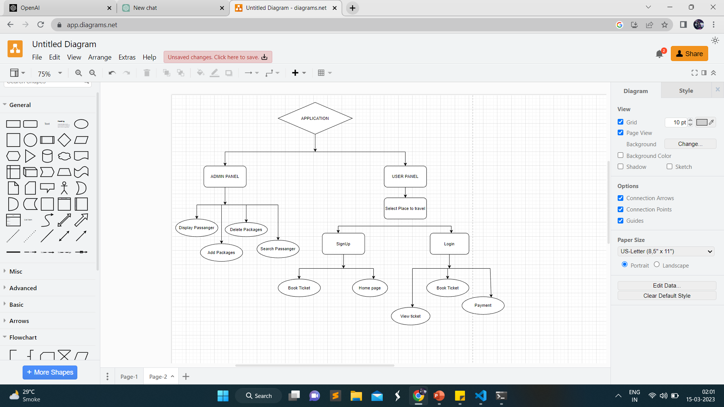
FLOW CHART:

Slide 7
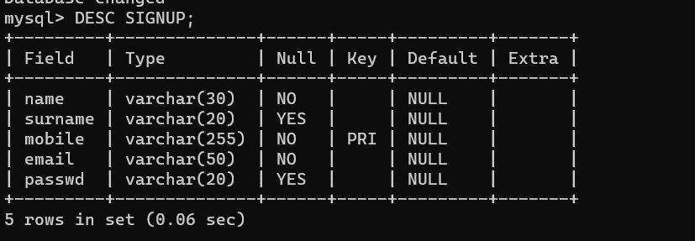
TABLES DESCRIPTION:
SIGNUP TABLE:

Slide 8
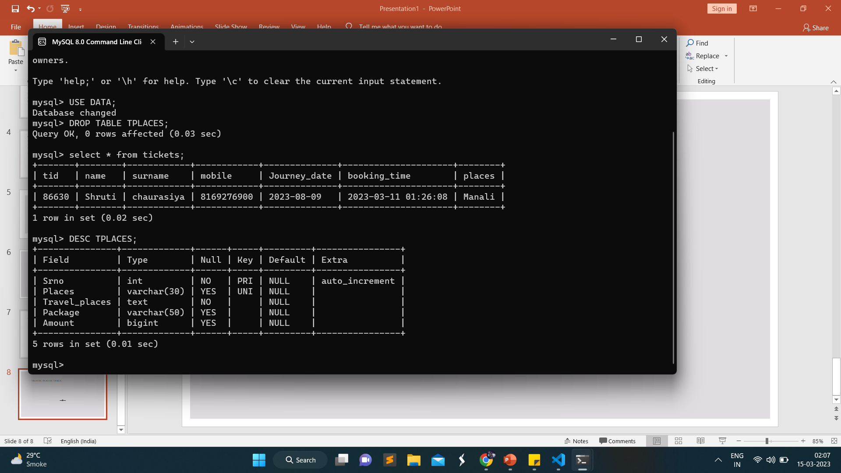
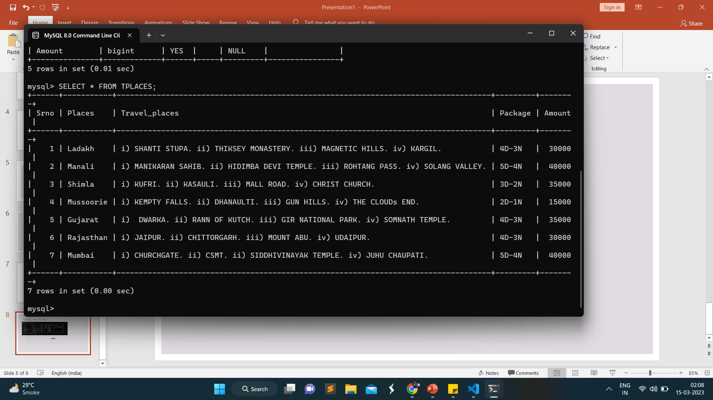
TRAVEL PLACES TABLE:

Slide 9
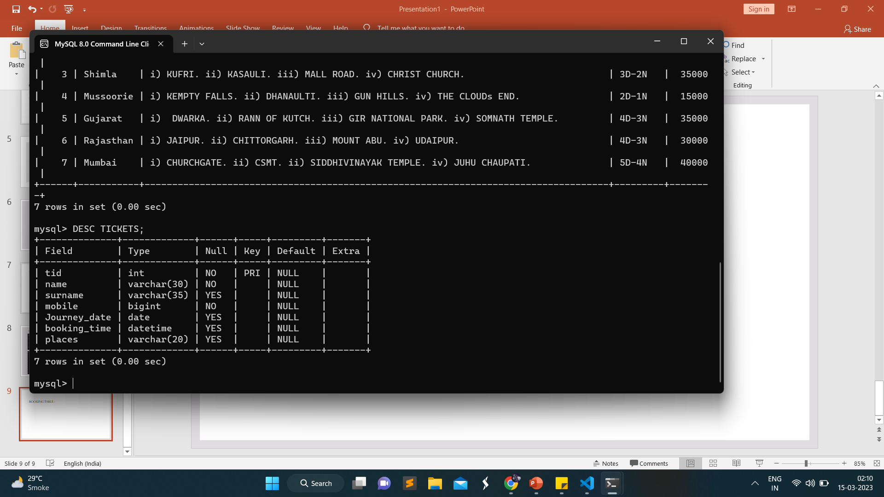
BOOKING TABLE :

Slide 10


