Slide 1
UCB – Python for Data Analysis and Scientific Computing Final Project
By : Shruti Kaushik
Date: June 27th, 2018

Slide 2
Game Plan
Basic Definitions
Project 1 Objective
Down-Sampling – Quarterly
Down-Sampling – Annual
Overall Sales Observation
Up-Sampling – Interpolation
Prediction - Extrapolation
Project 2 Objective
Basic Plotting of Data
Data Analysis
Overall Sales Observation

Slide 3
Definitions
Resampling - Estimating the precision of sample statistics by using subsets of available data or drawing randomly with replacement from a set of data points. Resampling may be required if the data is available at the same frequency that we want to make predictions.
Interpolation – In the mathematical field of numerical analysis, interpolation is a method of constructing new data points within the range of a discrete set of known data points. Will be used in Up-Sampling.
Extrapolation - In mathematics, extrapolation is the process of estimating, beyond the original observation range, the value of a variable on the basis of its relationship with another variable.

Slide 4
Project 1 Objective – Perform Resampling and Interpolation/Extrapolation of Time Series Data
I intend to use various Python packages like pandas, numpy, scipy and matplotlib to perform up-sampling and down-sampling on the time series data and plot the results for better understanding.
Dataset - I have prepared a ‘Monthly Sales dataset for the Diabetes Control Pills over the period of 2015-2017’.
Down-sample - time series data to a ‘lower frequency’ and summarize the higher frequency observations. Here, I will
decrease the frequency of the data samples from ‘Months to Quarters / Years’ and calculate the quarterly mean and total annual sales of the product.
Up-sample - time series data to a ‘higher frequency’ and interpolate the new observations. Here, I will increase the
frequency of the data samples from ‘Monthly to Daily’ sales and determine how the fine-grained observations
are calculated using scipy interpolation.

Slide 5
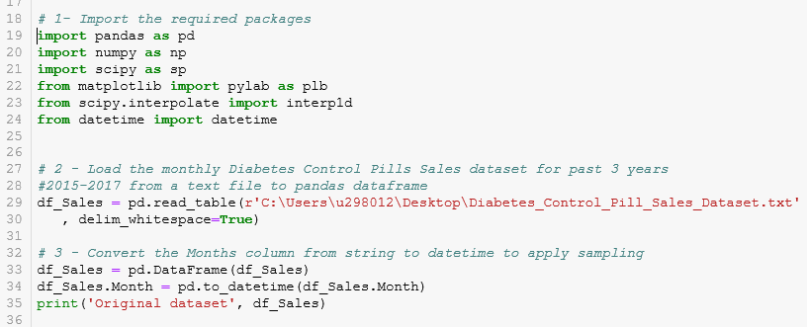
Down-Sampling – Import the required packages and load the input file.

Slide 6
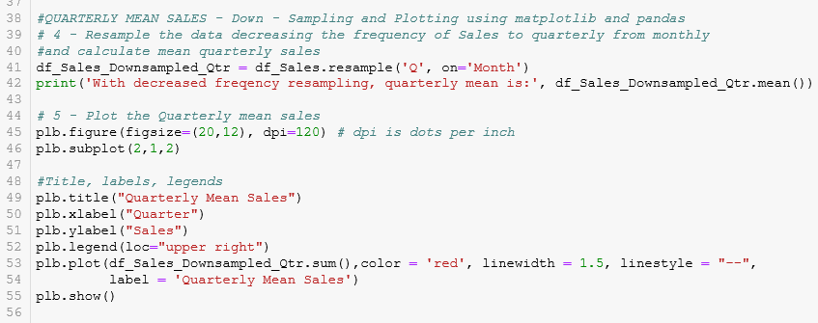
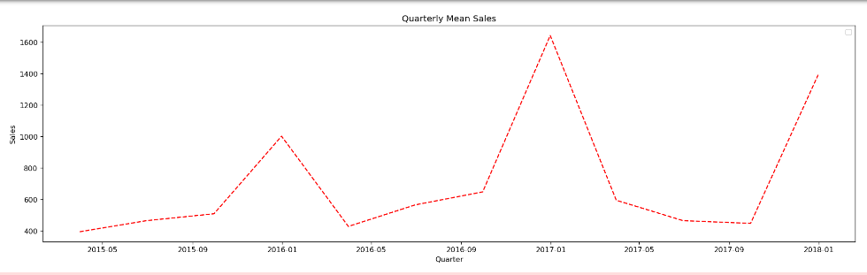
Down-Sampling – Resample the data to Quarterly frequency and Plot the Mean Sales

Slide 7
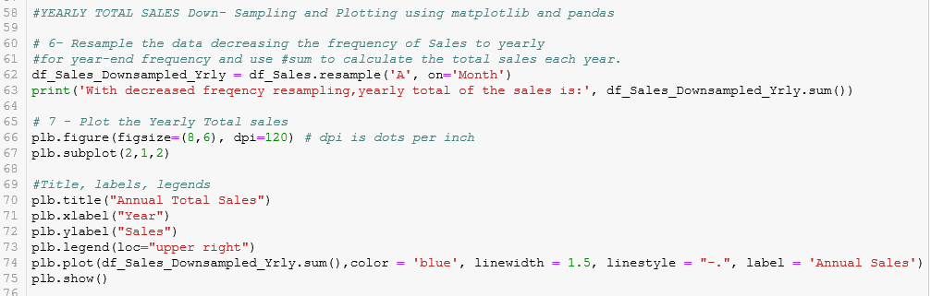
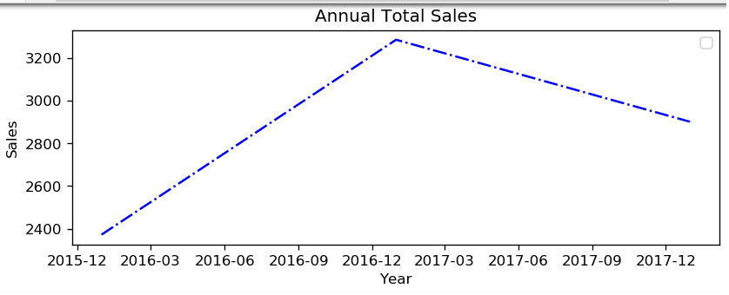
Down-Sampling - Resample the data to Annual frequency and Plot the Total Annual Sales

Slide 8
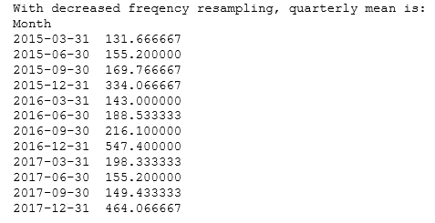

Down-Sampling – Overall Observation of Sales
Data insight - Looking at the graph and above vitals, we can conclude that the overall sales of pills go high during the last quarter of the year! Festive season and over-eating may have something to do with this?! :-)

Slide 9
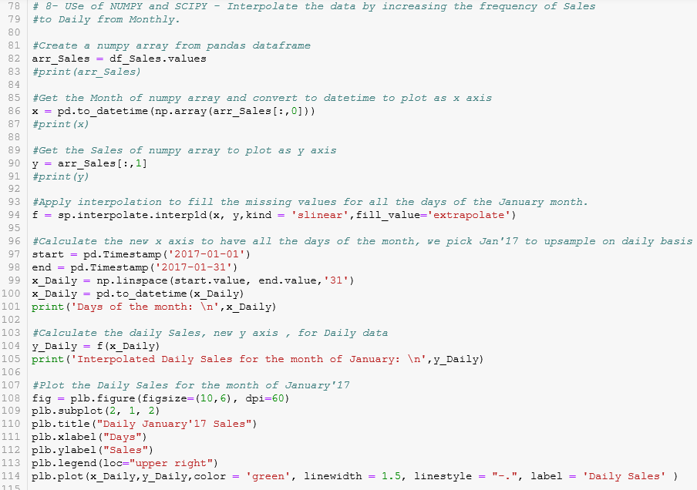
Up-Sampling - Resample the data to Daily frequency and interpolate the Daily Sales values for the month of January’17

Slide 10
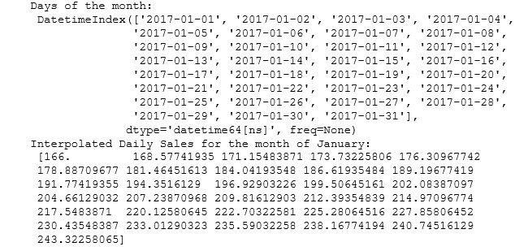
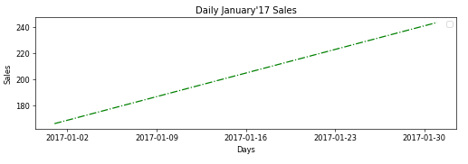
Up-Sampling - Resample the data to Daily frequency and interpolate the Daily Sales for the month of January’17

Slide 11
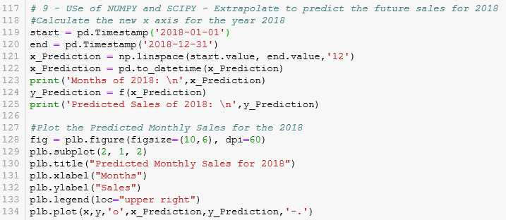
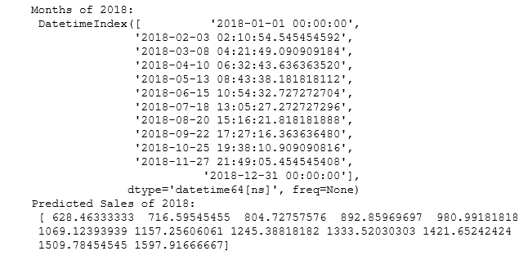
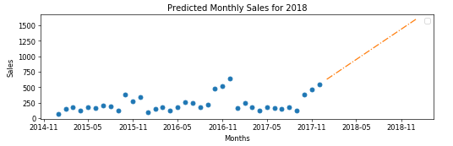
Up-Sampling – Extrapolate to Predict the Future Sales for 2018

Slide 12
Project 2 Objective - To perform data analysis on the Store Sales data and identify the customer's purchase patterns
I intend to use various Python packages like pandas, numpy and matplotlib to perform the data analysis on the Store Sales and understand the customer’s purchase patterns like –
•How many customers have purchased an item of particular category?
•Which customers have purchased items of all categories?
•How many customers have purchased items of only few categories? etc.'''
Dataset -

Slide 13
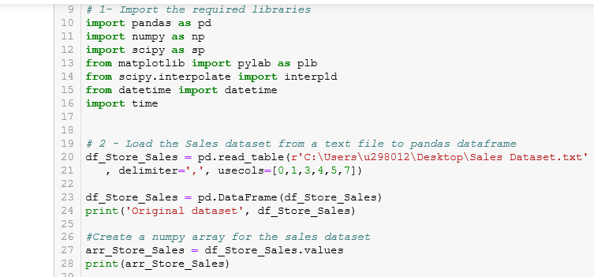
Import the required packages and load the input file

Slide 14
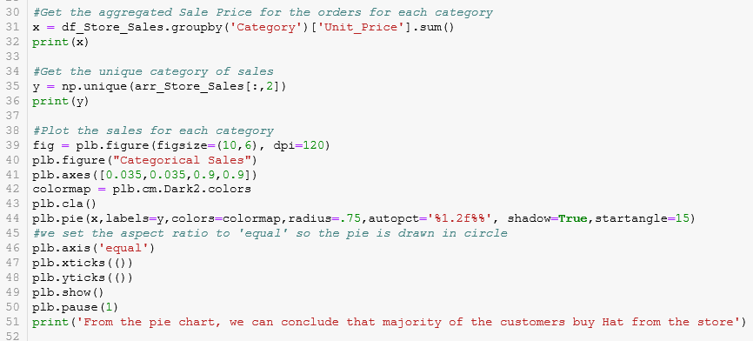
Capture the distinct Categories of Sales data and plot their Sales using Pie Chart

Slide 15
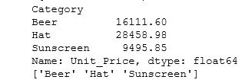
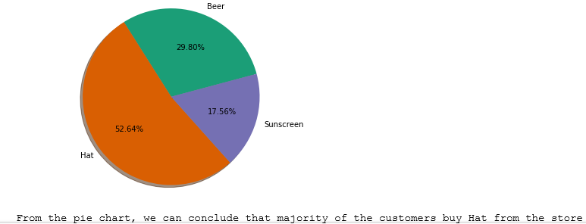
Capture the distinct Categories of Sales data and plot their Sales using Pie Chart

Slide 16
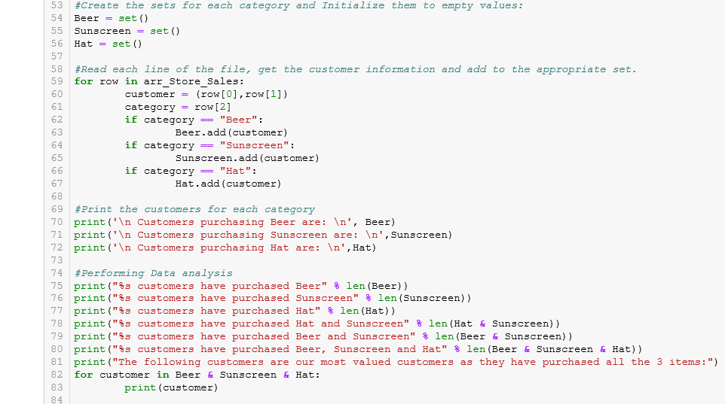
Perform Data Analysis on the Customer data to identify patterns

Slide 17
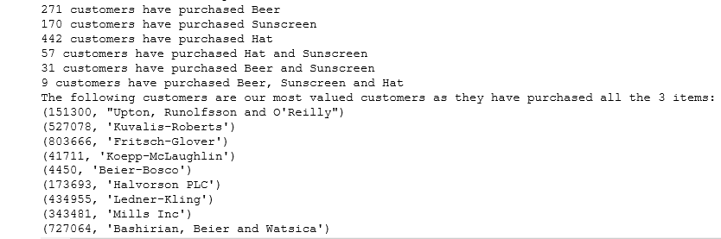
Capture the results and draw conclusion -
Capture the results and draw conclusion - .
Data insights –
The store has highest sales of Hats and lowest of sunscreen. Placing the Sunscreen close to Hats might help improve the sales on sunscreen.
Beer has 2nd highest sales, placing snacks or other such items close to beer might help improve the overall sales of the store.
The valued customers should be offered special promotional sales and/or discounts from time to time.

Slide 18
Thank You!

