Slide 1
VOLUNTEER MANAGEMENT SYSTEM

Slide 2
INTRODUCTION
Volunteer Management System is a Dynamic Web Project.
Motto is to initiate useful programs for students from various Institutions by the volunteers from different companies.
Advantages of this system will be:
Increased Participation.
Powerful Connections.
Simplified Administration.
Relationship Building.

Slide 3
TECHNOLOGIES USED
The project is created using Eclipse platform
Java Server Page (JSP) is used to create the user interface
Java is used to create a connection between the backend and the frontend
MySQL queries are used to create the databases at the backend
External Markup Language (XML) used in the form of web.xml which is a development descriptor for the servlet based Java web application

Slide 4
HOME PAGE
Intelligent login without mentioning entity.
Validation of login.
Upcoming events.
Implementation of header and footer.
Automatic slider for reviews.

Slide 5
REGISTRATION
Different registration for the different end users.
Types of end users :
College
Company
General
Single page registration based on entity.

Slide 6
REGISTRATION (Contd.)
College registration dialog box containing fields for registering college id, college name, email, contact information and password.
Company registration dialog box containing fields for registering company name, company id, email, address, contact information and password.
General registration dialog box containing fields for registering name, contact information, address, email, username and password.

Slide 7
COMPANY AS END USER
ADDING OF NEW EVENT
UPLOADING CERTIFICATE
VIEWING OF REQUESTS
VOLUNTEER REGISTRATION

Slide 8
ADDING OF NEW EVENT
Company can add any new event, after getting logged in from the registered userId.
Table into which the data inserted is “events”.
Same table is referred to view the different events registered by the Company

Slide 9
UPLOADING CERTIFICATE
To upload the certificate, table referred is “certificate”.
Fields like course_id, usn and company_id is filled when a student is registered for a particular event.
While uploading the certificate, the course_id, usn and company_id which is entered by the user is validated by the database and the file to be uploaded is inserted into the selected row.

Slide 10
VIEWING OF REQUESTS
Company will be able to view request sent by all the colleges.
Company will be able to see college name, id, email, contact, course and number of students.
Company can accept their request by sending a confirmation mail.

Slide 11
VOLUNTEER REGISTRATION
Company will register volunteers by providing their details.
Company will be able to view those volunteers' details.
Details include:
Name
Volunteer ID
Company ID
Email
Contact

Slide 12
COLLEGE AS END USER
EVENTS
VIEW CERTIFICATES
REQUEST

Slide 13
EVENTS
College can register students to the respective events.
The details of the students are entered in the database table.

Slide 14
VIEW CERTIFICATES
Creation of a page to view a uploaded certificate based on user selected year and selected company.
Selection of a year from drop down box and company name, displays all the certificates of that particular year.

Slide 15
REQUEST
Page to send requests from different colleges to different companies to offer different courses.
Display of a confirmation box to ask the college authority whether he/she is sure about the request.
Selection of OK from confirmation box confirms request and enters in database
Selection of CANCEL from confirmation box request will be cancelled and not updated in database

Slide 16
GENERAL USER
Student not associated with any of the registered colleges and wants to be a part of this program belongs to this category.
He can directly go and signup on this website and the website can recognize them as a General category
Viewing of events being organized by different companies.
Registration of the student for the event

Slide 17
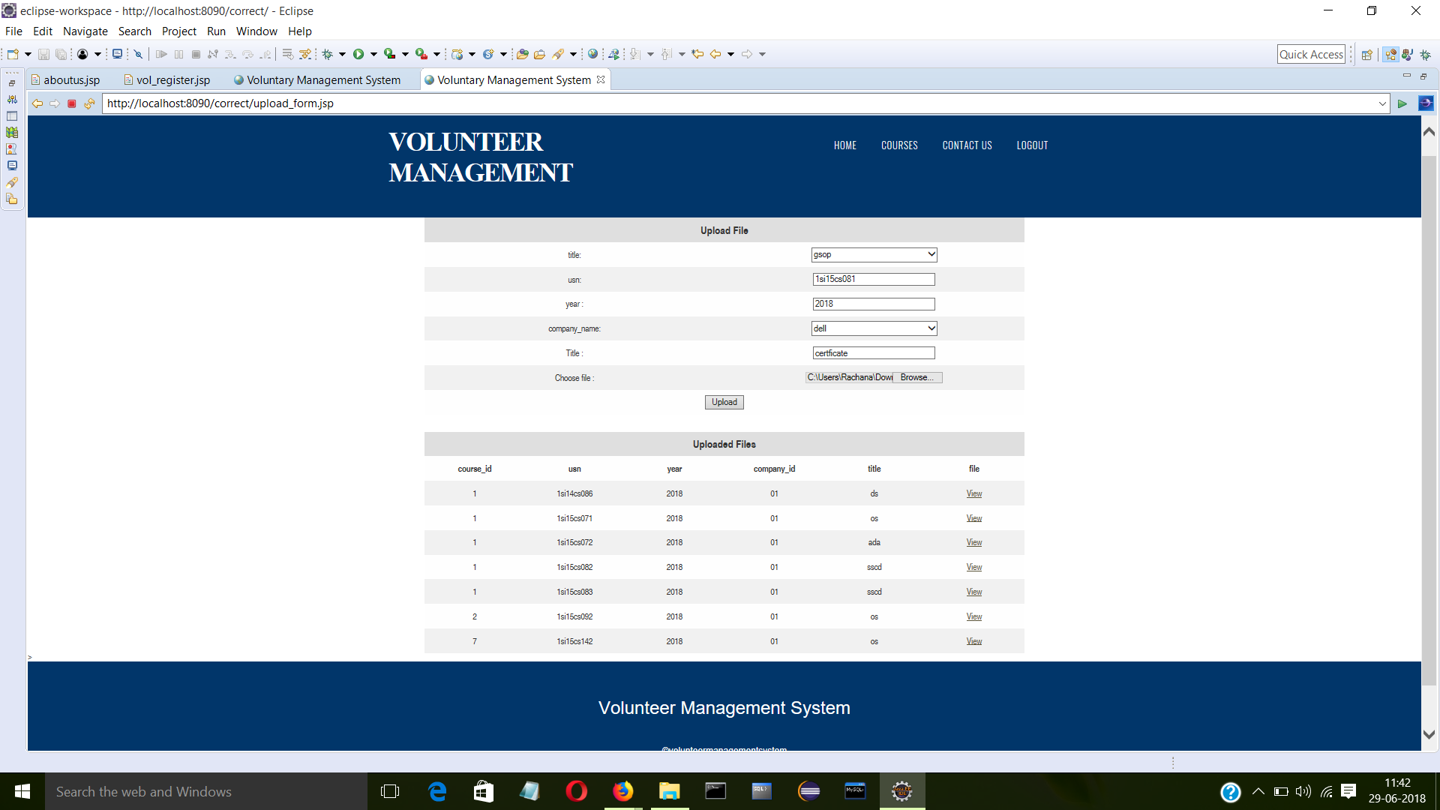
RESULT

Slide 18
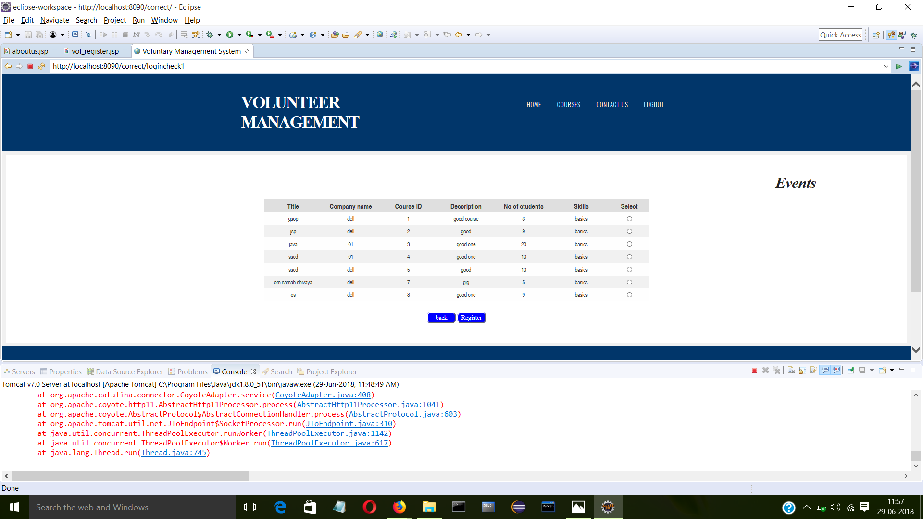
RESULT (Contd.)

Slide 19
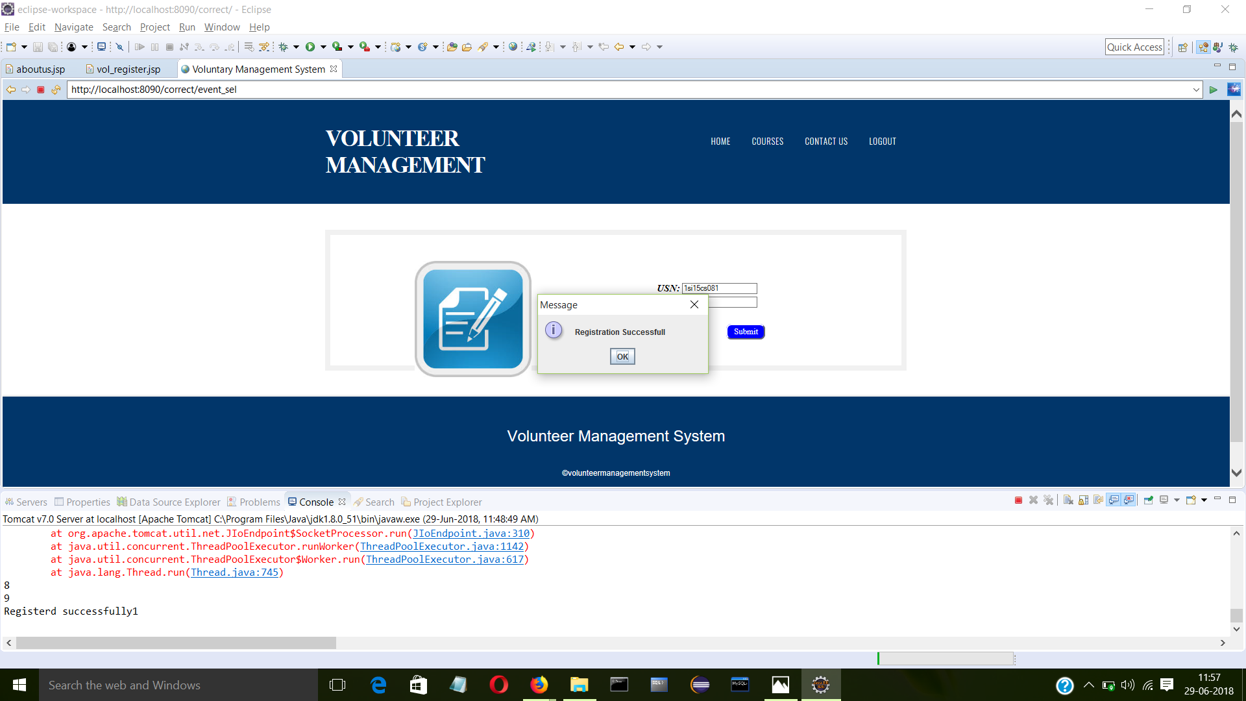
RESULT (Contd.)

Slide 20
FUTURE ENHANCEMENTS
Dynamic reviews from the user
Allocation of volunteers for courses
Captcha Generation
Deploying the project on the cloud

Slide 21
ARCHITECTURE DIAGRAM

Slide 22
THANK YOU !

