Slide 1
COLLEGE DONATIONS DATA ANALYSIS

Slide 2
INTRODUCTION
Agenda
Analyze the data of donation gifts to various colleges
Analysis and Visualization
Donations distribution by Location
Donations distribution by College Type
Donations distribution by Academic Major
Donations distribution by Graduation Year
Top Academic Majors of Donors
Top College Types that received donations
Donation trend over years
Findings/Results
Interesting insights

Slide 3
Analysis and Visualization

Slide 4
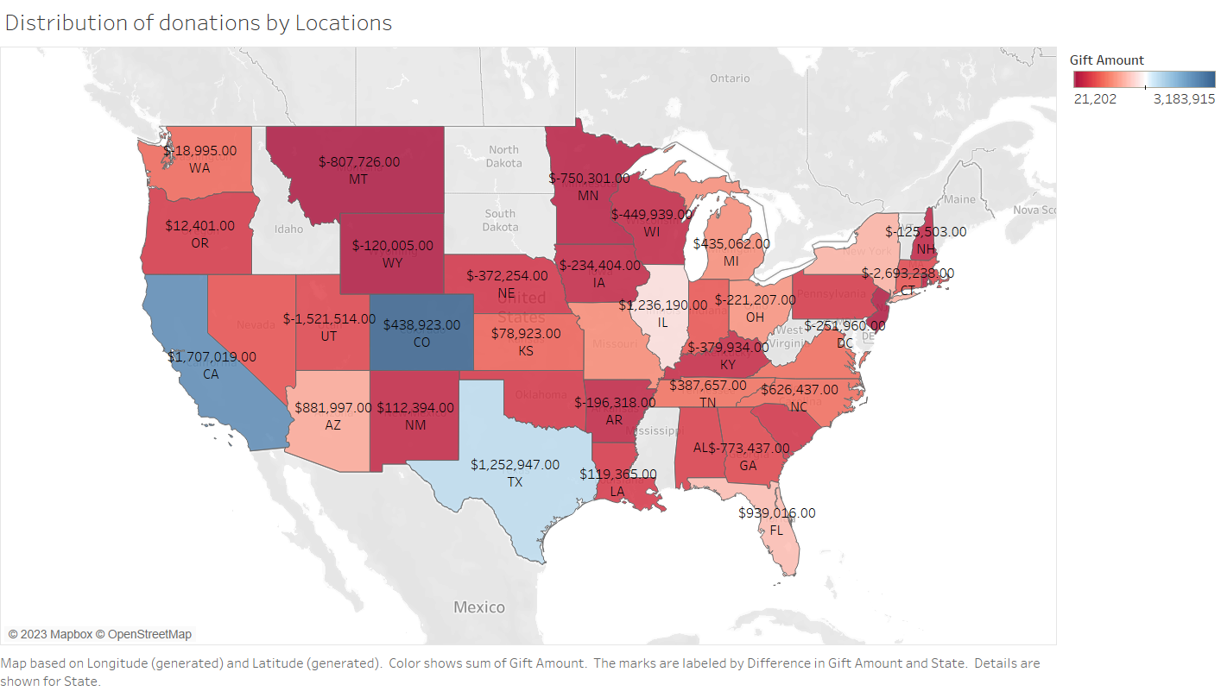

Slide 5
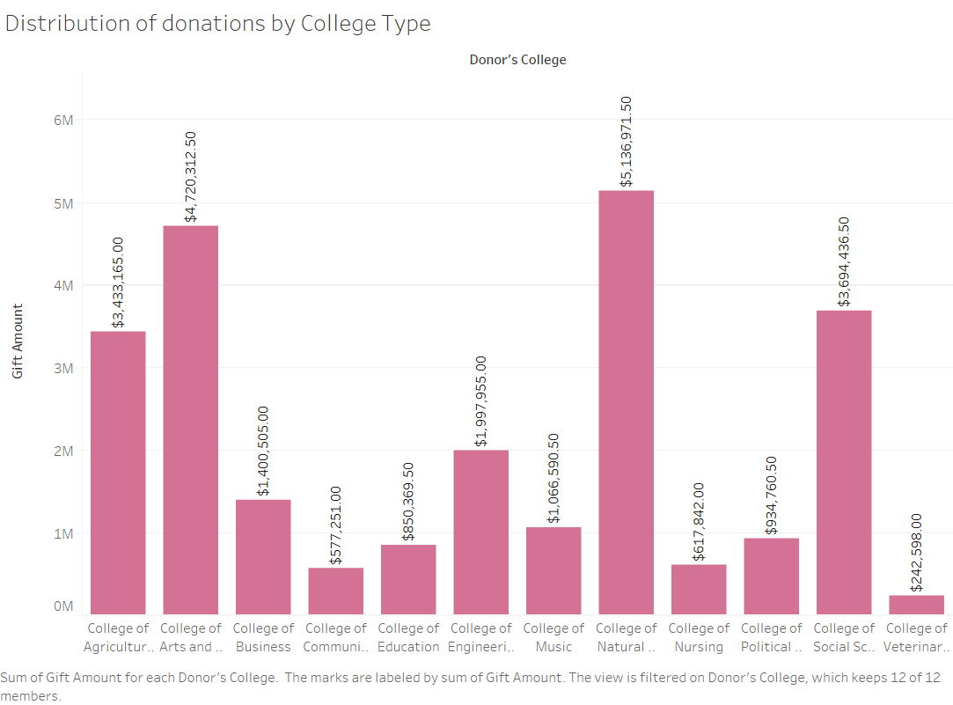

Slide 6
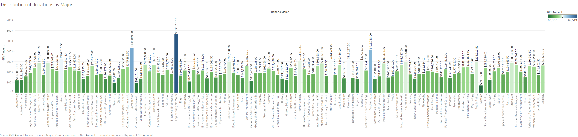

Slide 7
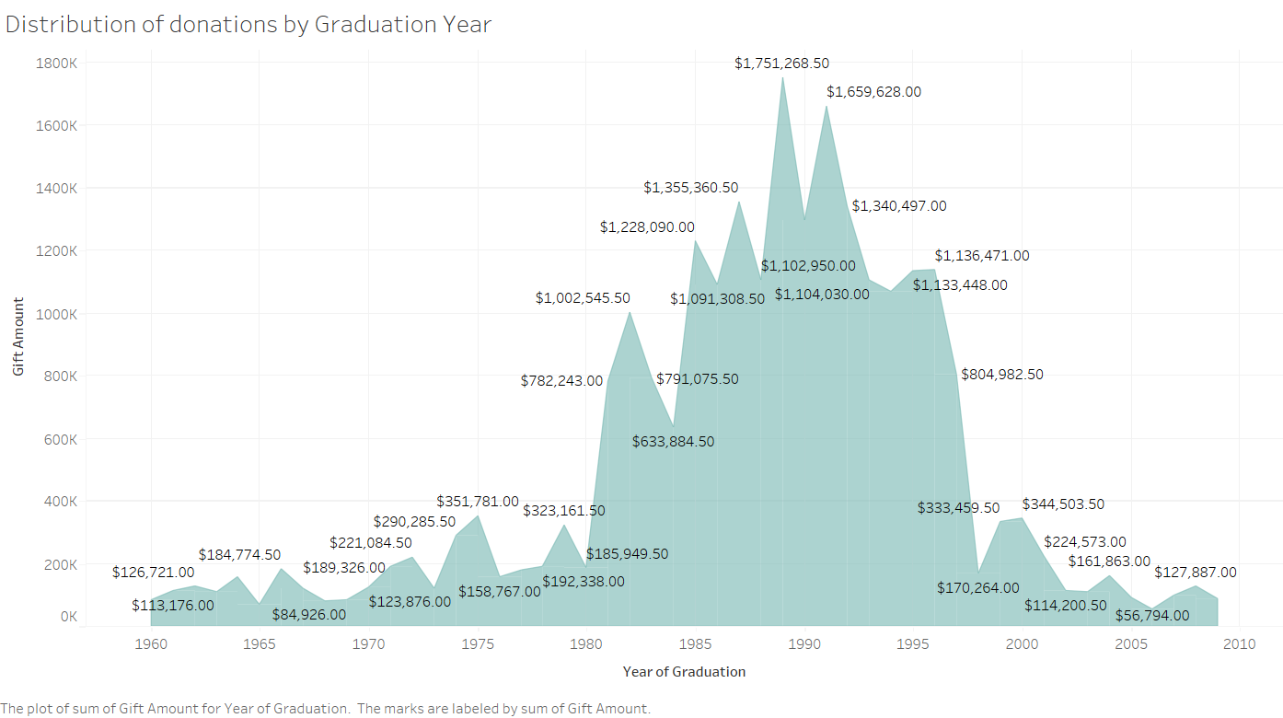

Slide 8
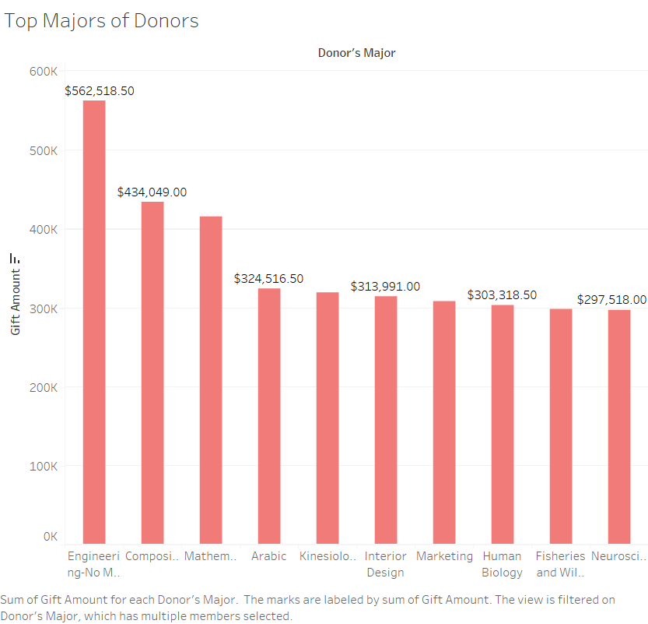

Slide 9
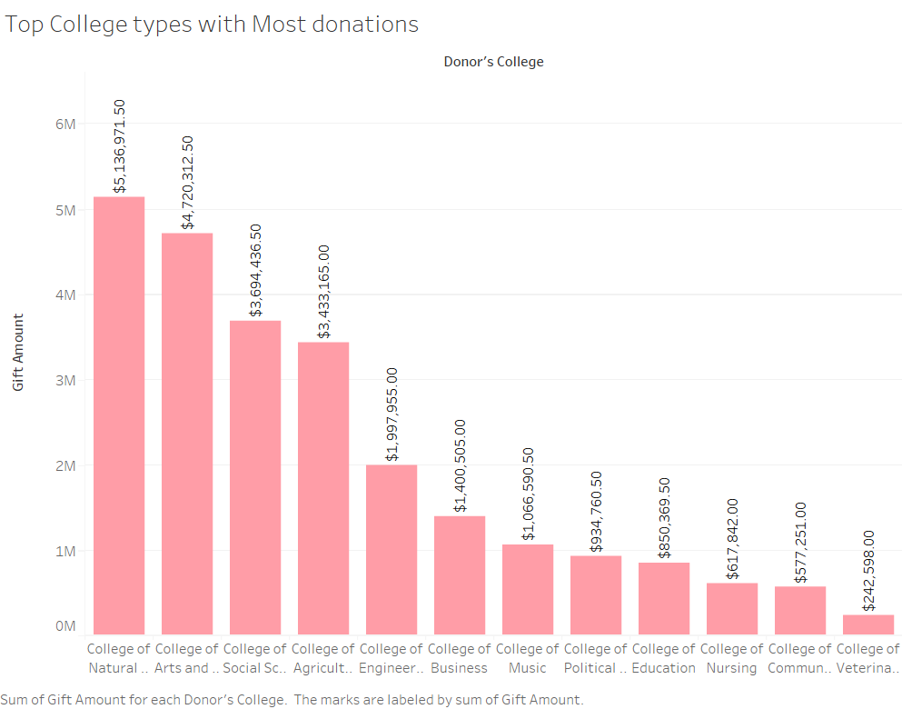

Slide 10
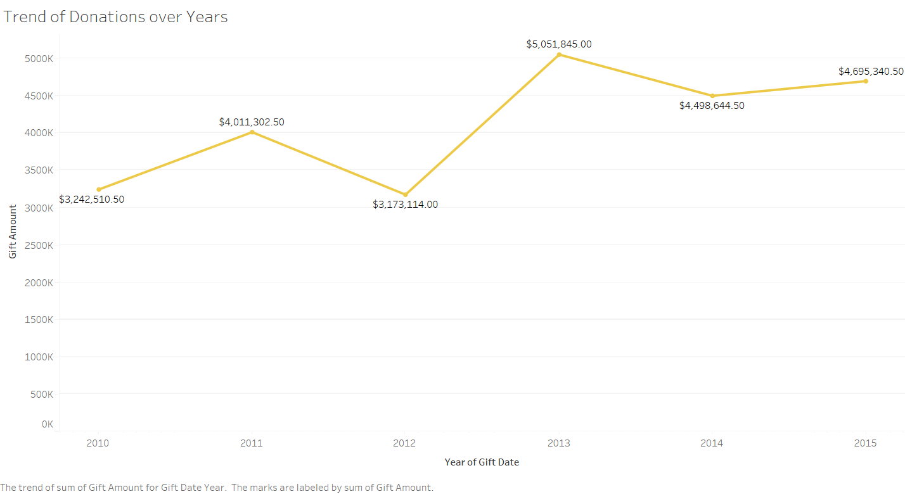

Slide 11
Findings/Results

