Slide 1

COLLEGE DONATIONS
DATA ANALYSIS

Slide 2

INTRODUCTION
Agenda
Analyze the data of donation gifts to various colleges
Analysis and Visualization
Donations distribution by Location
Donations distribution by College Type
Donations distribution by Academic Major
Donations distribution by Graduation Year
Top Academic Majors of Donors
Top College Types that received donations
Donation trend over years
Findings/Results
Interesting insights

Slide 3

Analysis and Visualization

Slide 4
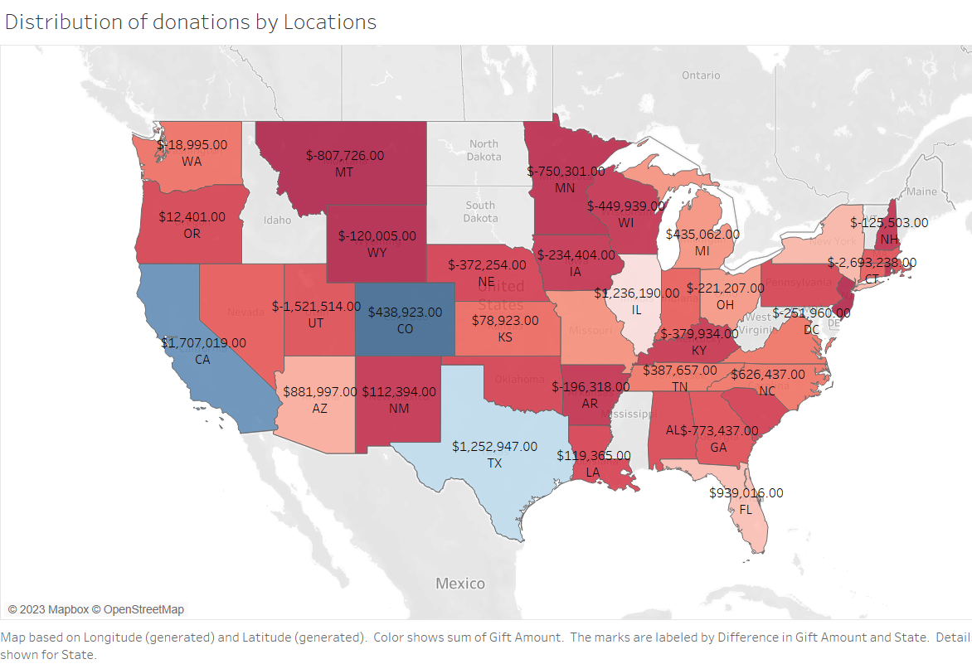
Donations distribution by Location
Top 5 states that have highest donations – Colorado(CO), California(CA), Texas(TX), Florida(FL), Arizona(AZ)
Bottom 5 states with lowest donations –Montana(MT), Wyoming(WY), New Jersey(NJ), Minnesota(MN), New Mexico(NM)
The city with the highest donation is Denver and the city with the lowest donation is Murfreesboro

Slide 5
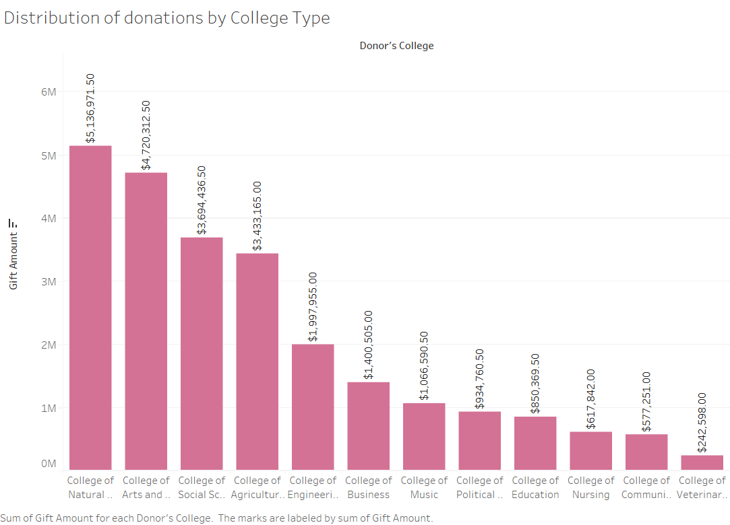
Donations distribution by College Type
Top 5 colleges with highest donations – College of Natural Science, Arts & Sciences, Social Science, Agriculture & Natural Resources, Engineering
Bottom 3 colleges with lowest donations – College of Veterinary Medicine, Communication Arts & Sciences, Nursing

Slide 6
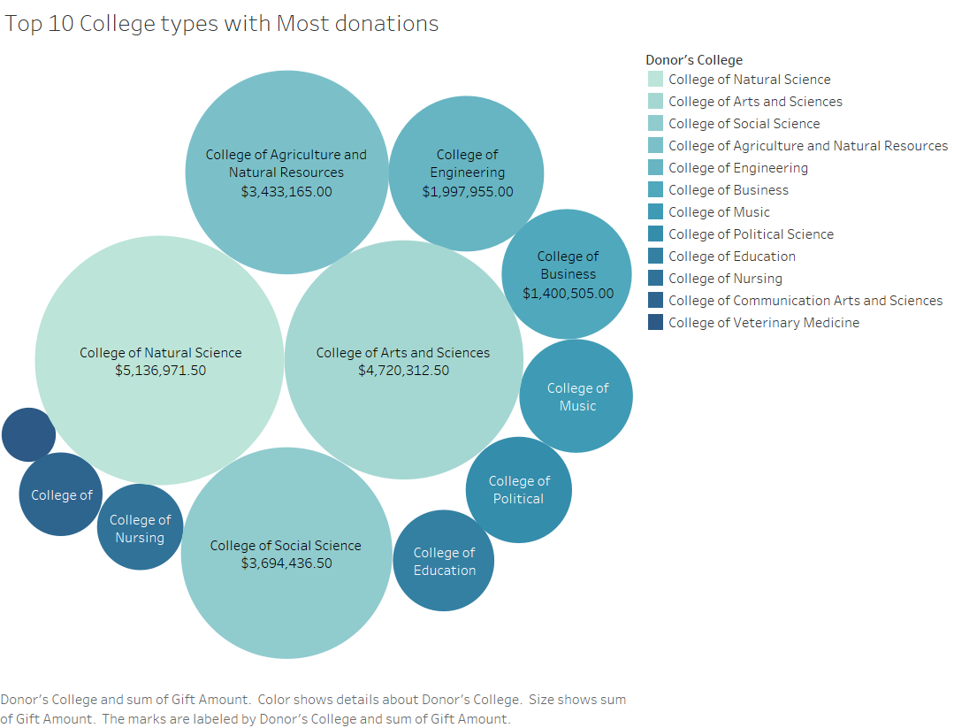
Top College Types that received donations

Slide 7
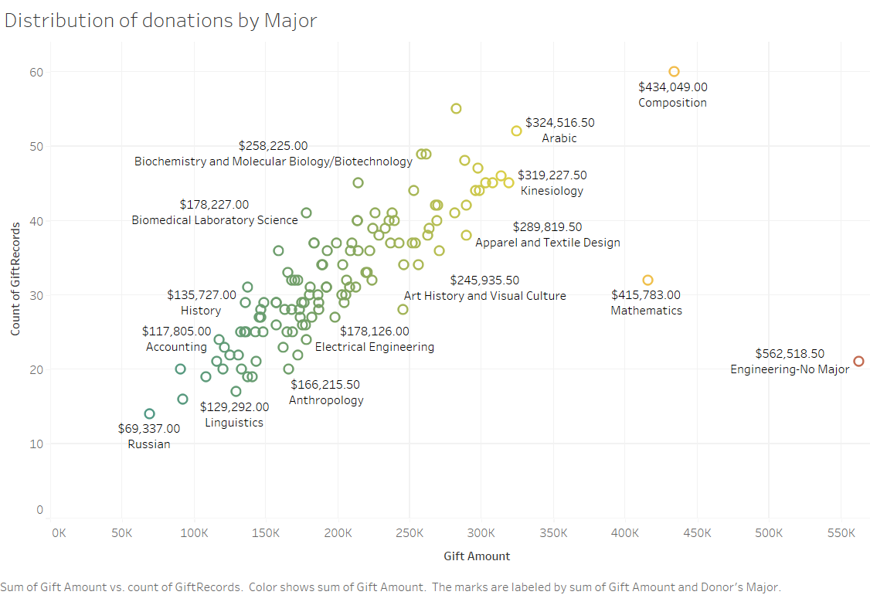
Donations distribution by Academic Major
Top 5 academic majors by donation – Engineering, Composition, Mathematics, Arabic, Kinesiology
Bottom 5 academic majors by donation – Russian, Chemistry, Computational Mathematics, Environmental Biology, Genomics & Molecular Science

Slide 8
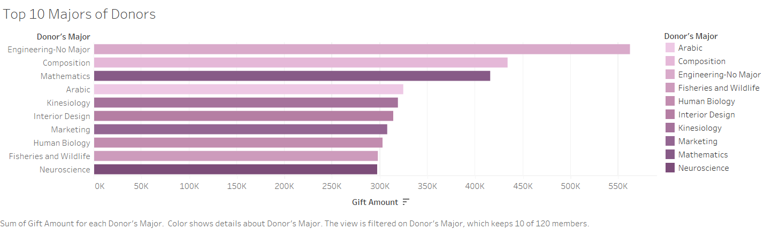
Top Academic Majors of Donors

Slide 9
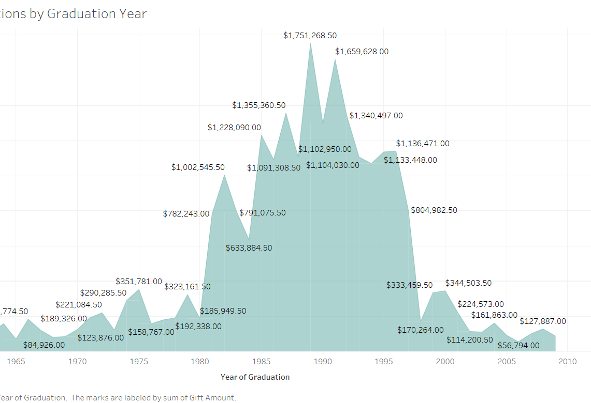
Donations distribution by Graduation Year
The highest donations were received from 1985-1996 graduation years.
The lowest donations by graduation year were received in the years 1960-1980 and 1998-2009

Slide 10
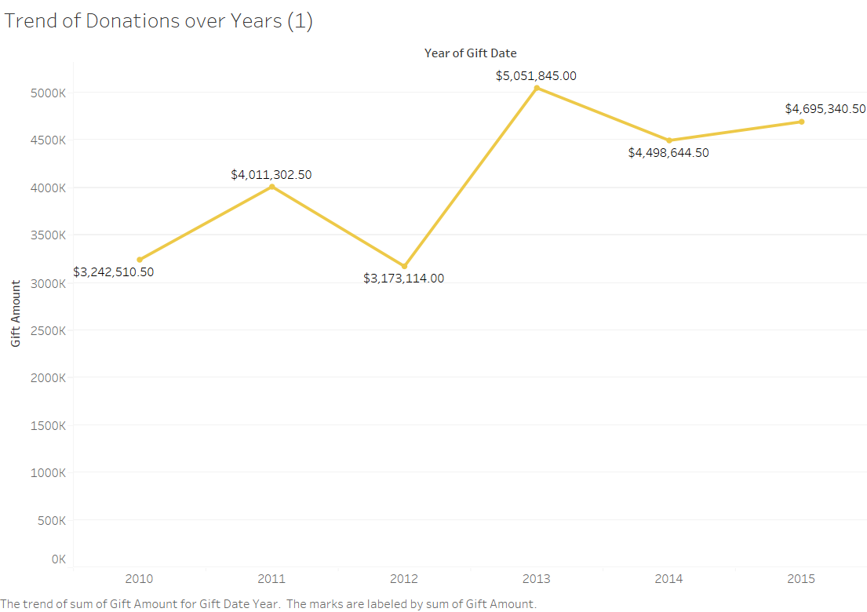
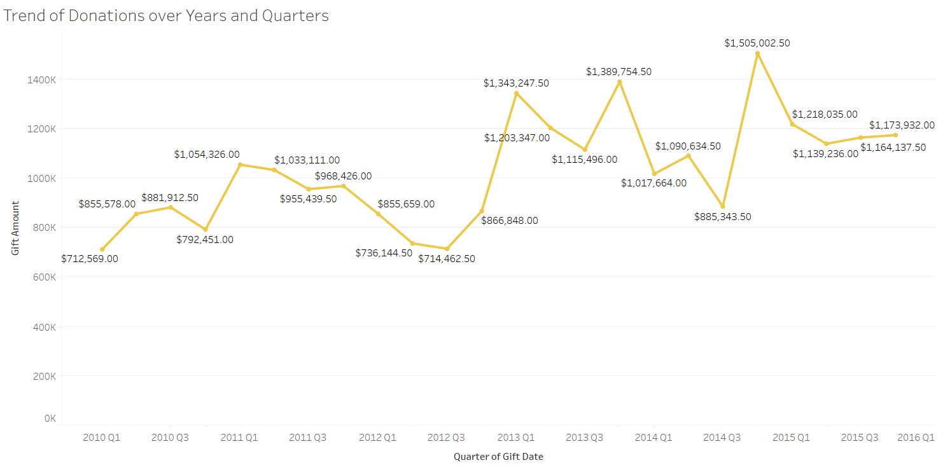
Donation trend over years
The donations are much higher for the years 2013-2015, with the highest peak in 2013.
Based on the Quarters, the donations seem to be much higher for the last quarter for years 2013, 2014. And the highest donation for 2015 is in the early quarter.

Slide 11

Findings/Results

Slide 12
Insights
Based on the graphs produced, we can conclude that most of the donations come from Colorado(CO) and California(CA).
The colleges that receive the most sum of donations is College of Natural Science, College of Arts & Sciences, College of Social Science, College of Agriculture & Natural Resources and College of Engineering.
Engineering and Composition majors received the most amount of donations.
From the trend graph, we can determine that the highest donations were received in 2013 and we can also see that the donations are typically higher in early quarters(Q1) or late quarters(Q4) of the years.

Slide 13

Thank you
Shruti Ramesh Babu Mallavolu
smallavolu@umass.edu

