Slide 1



Digital Skill Passport Empowering India's Blue-Collar Workforce Team Synapse | HackX 2025
HACKX 2025

Slide 2
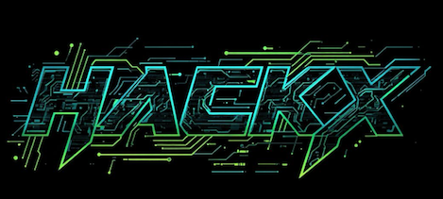

Digital Skill Passport Empowering Blue-Collar Workers with Verified Digital Identity
Synapase
A groundbreaking platform that brings India's unorganised workforce into the digital economy. By creating verified digital skill profiles accessible through simple QR codes, we're bridging the trust gap between workers and employers.
Digital Skill Passport builds verified digital identities for workers.
Enables QR-based authentication and fair hiring.

Slide 3

Project Overview
Synapase
500M+ Workers
India's blue-collar workforce powers the economy but remains digitally invisible in formal systems
Trust & Transparency
Promotes fair employment practices through verified credentials and transparent feedback systems
Smart QR Access
Enables instant access to authentic skill data via secure QR scans

Slide 4

The Problem We're Solving
Synapase
No Verified Records
Workers have no standardised way to prove their skills, experience, or employment history to potential employers
Verbal Proof System
Hiring decisions rely on word-of-mouth recommendations, leading to bias, fraud, and skill-job mismatches
Digital Invisibility
80% of India's informal sector workers lack any form of digital skill recognition or professional identity

Slide 5
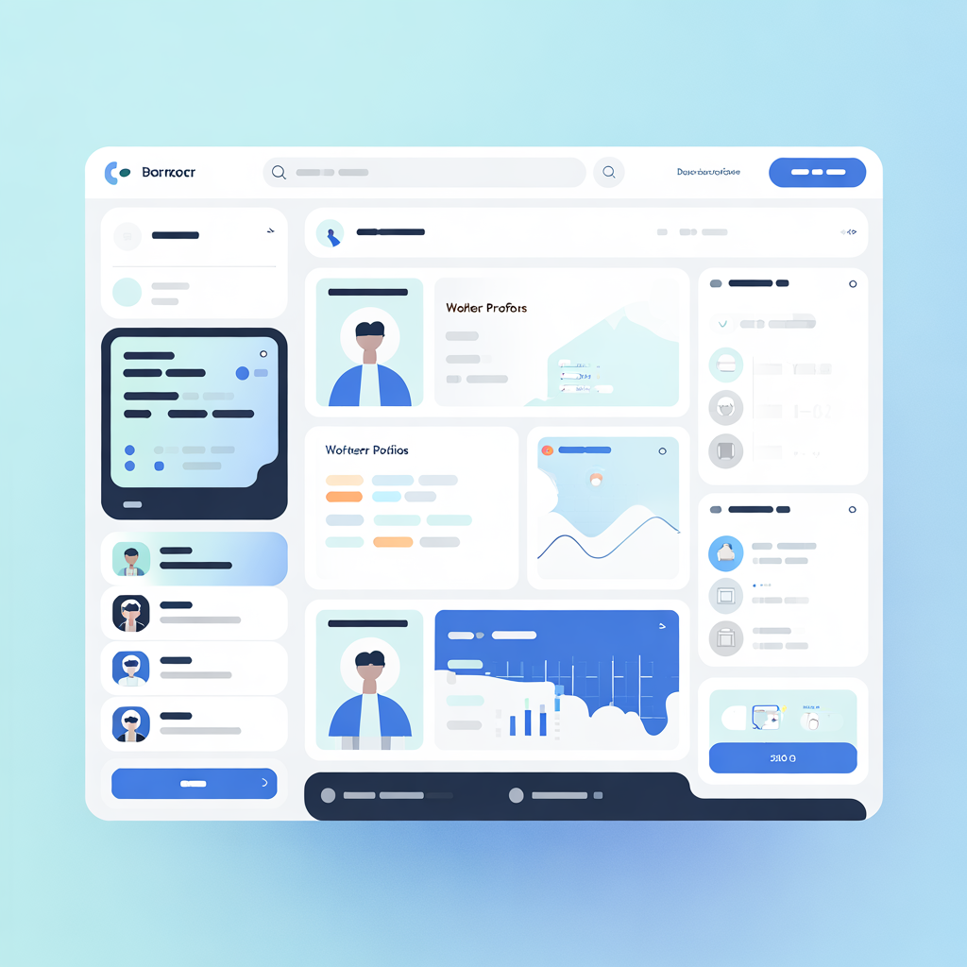
Our Solution
Synapase
Verified Worker Identities
Digital profiles with trusted authentication
Connects workers & employers seamlessly
Real-Time Communication
In-app chat for clear job discussions
QR-Based Skill Passport
Instant skill & identity verification
Rating & Feedback System
Transparent reviews build trust & credibility

Slide 6
How It Works
Synapase
Step 1: Register via OTP Workers register using mobile OTP
Step 2: Admin Verification
Admin validates worker credentials
Step 3: Skill Passport Created
QR-based digital identity generated
Step 4: Employer Verification
Employer scans QR to view the worker
Step 5: Feedback Update
Ratings auto-update worker profiles

Slide 7
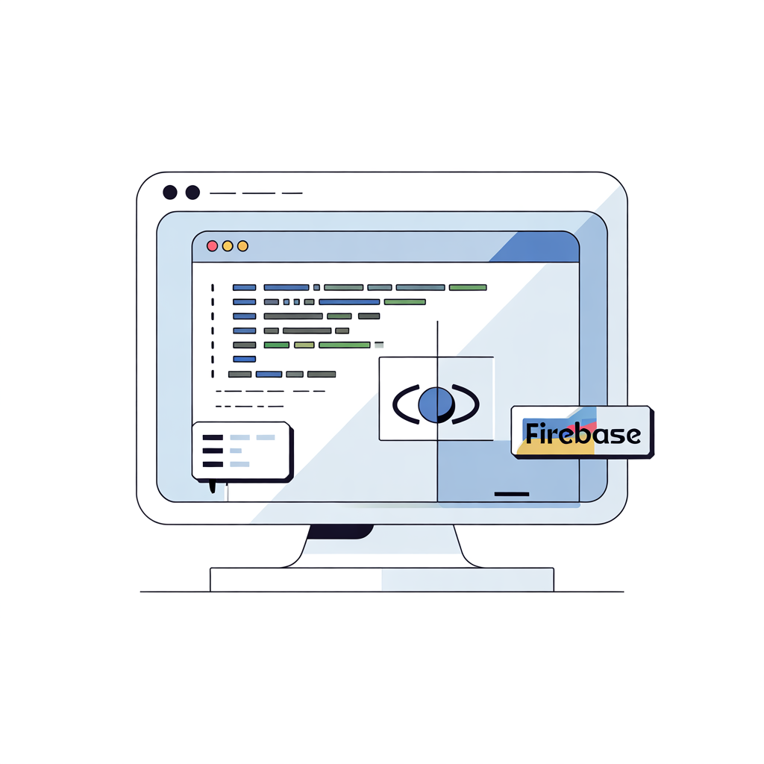
Synapase
Technical Implementation
Tech Stack
Key Features
Dynamic QR Codes: Unique identifiers for each worker profile
Real-time Synchronisation: Instant updates across all devices
Intuitive Interface: Simple, accessible design for low-digital-literacy users
Frontend
React.js for responsive, modern UI
Database
MongoDB
Backend
Node.js, Express.js
Deployment
Vercel for fast, reliable hosting

Slide 8

Impact & Results
Synapase
Faster Hiring
Transparent verification process reduces hiring time from days to minutes
Reduced Fraud
Verified credentials eliminate fake experience claims and credential manipulation
Worker Visibility
Digital profiles give workers professional identity and improved trust with employers
Secure Storage
Cloud-based data ensures safe, accessible records that never get lost

Slide 9
Future Roadmap
Synapase
Aadhaar Integration
Seamless e-KYC through Aadhaar authentication for enhanced security and government recognition
OTP-based Authentication:
Secure, passwordless login system
Multilingual Expansion
Support for regional languages including Hindi, Tamil, Bengali, Telugu, and more
MSME & Gig Economy
Platform expansion to serve MSMEs and integrate with India's rapidly growing gig workforce

