Slide 1


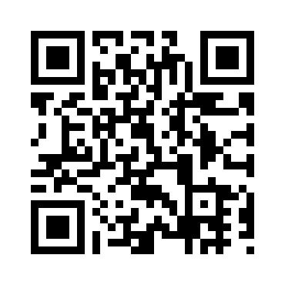
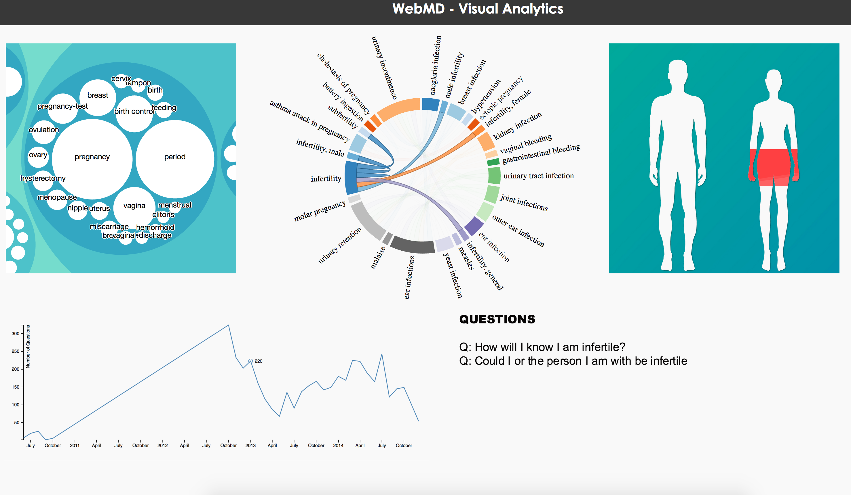
Know Your Diseases!
Kashyap Bhansali, Arizona State University, kashyap.bhansali@asu.edu
Saloni Shah, Arizona State University, saloni.shah@asu.edu
Raj Dalvi, Arizona State University, raj.dalvi@asu.edu
Shruti Mahajan, Arizona State University, shruti.mahajan@asu.edu
Motivation & Relevant Work:
Online health discussion forums are popular information seeking sites, which provide trustworthy health and medical news.
The health information retrieving and organizing patterns of a user can be recognized through this alternative called Question-answering systems and forums. (Dolares M.et al, 2010).
Methodology:
ICAP (Interactive, Constructive, Active, Passive) learning activity framework (Chi & Wylie, 2014), constructive learning activities: {inferring, creating, integrating new with prior knowledge, elaborating, comparing, contrasting, analogizing, generalizing, including, reflecting on conditions, explaining why something works}
Constructive lexicon library: {comparing & contrasting words, explanation, and justification & elaboration words}
Comparing product features in reviews (Ganapathibhotla & Liu, 2008) eg. versus, unlike, most …
Arguing lexicon to extract explanation, justification & elaboration words (Somasundaran, Ruppenhofer, & Wiebe, 2007) eg. “in my understanding...”, “all I’m saying is...” (assessment), “...this is why...(emphasis)”, “...as a result...(causation)”, “...everything...(generalization).
Research Questions:
What kind of questions are asked on the forum? What are the most commonly discussed topics?
What are the symptoms people with particular disease have? What parts of the human body are affected by this disease?
Are the diseases spreading more or decreasing over the years?
Data Collection:
Collected data about diseases, symptoms and posted date of question and answers from the WebMD dataset provided. Also extracted diseases and symptoms from Q/A data.
Collected additional diseases and symptoms from QA forum: WebMD (www.webmd.com) and from Mayo Clinic (www.mayoclinic.org)
Processed the data to map the diseases and symptoms to topics provided in the dataset. Collected data about the human body parts which the diseases affect.
Findings:
There is a lot of discussion about female related problems, followed by sensory organs of human body.
Infection and pain are the most common symptoms seen in almost every disease.

