Slide 1
Recurrent Neural Network (RNN)

Slide 2
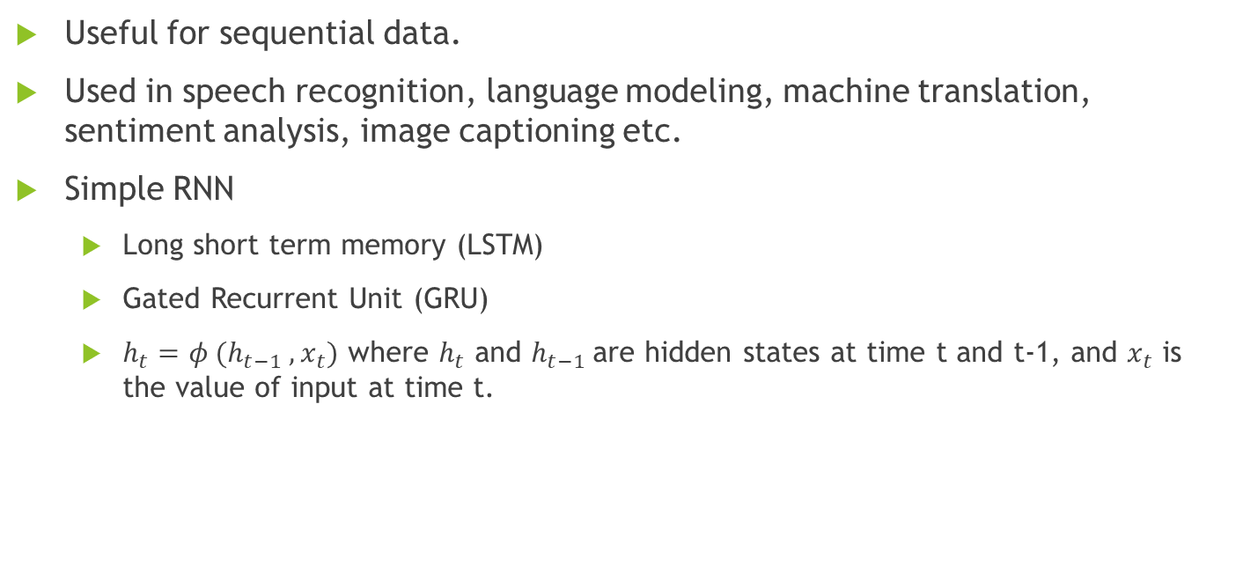
Introduction
Useful for sequential data.
Used in speech recognition, language modeling, machine translation, sentiment analysis, image captioning etc.
Simple RNN
Long short term memory (LSTM)
Gated Recurrent Unit (GRU)
$h_{t}=φ (h_{t−1} , x_{t})$ where $h_{t}$ and $h_{t−1}$are hidden states at time t and t-1, and $x_{t}$ is the value of input at time t.

Slide 3
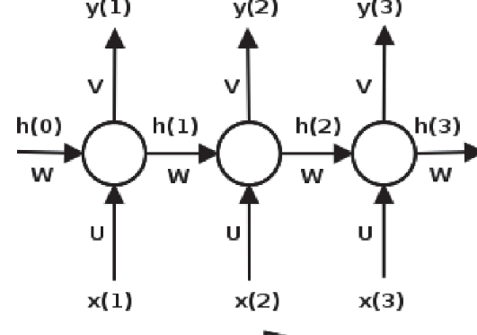

Simple RNN
$h_{t}=\tanh{(wh_{t−1}+u x_{t})}$
$y_{t}=softmax (vh_{t})$

