Slide 1
Recurrent Neural Network (RNN)
Created by
The RNN Team

Slide 2
Introduction
Useful for sequential data.
Application:
Speech recognition
Language modeling
Machine translation
Sentiment analysis
Image captioning etc.

Slide 3
Some Important Terms and Symbols
There are several terms and symbols which are used in RNN to represent the models.

Slide 4
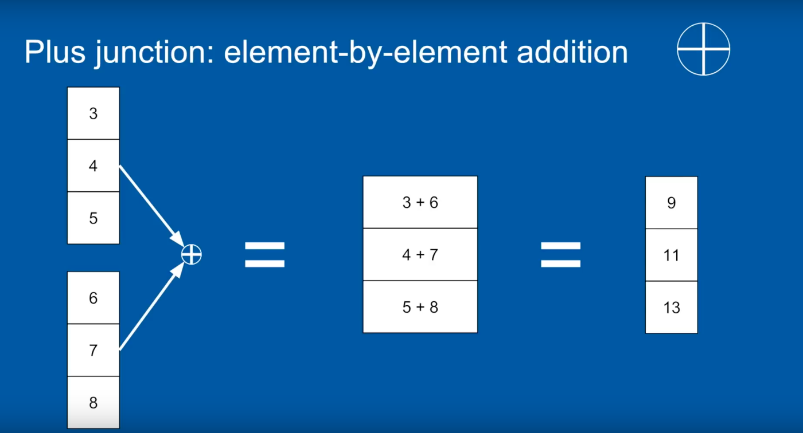
Addition

Slide 5
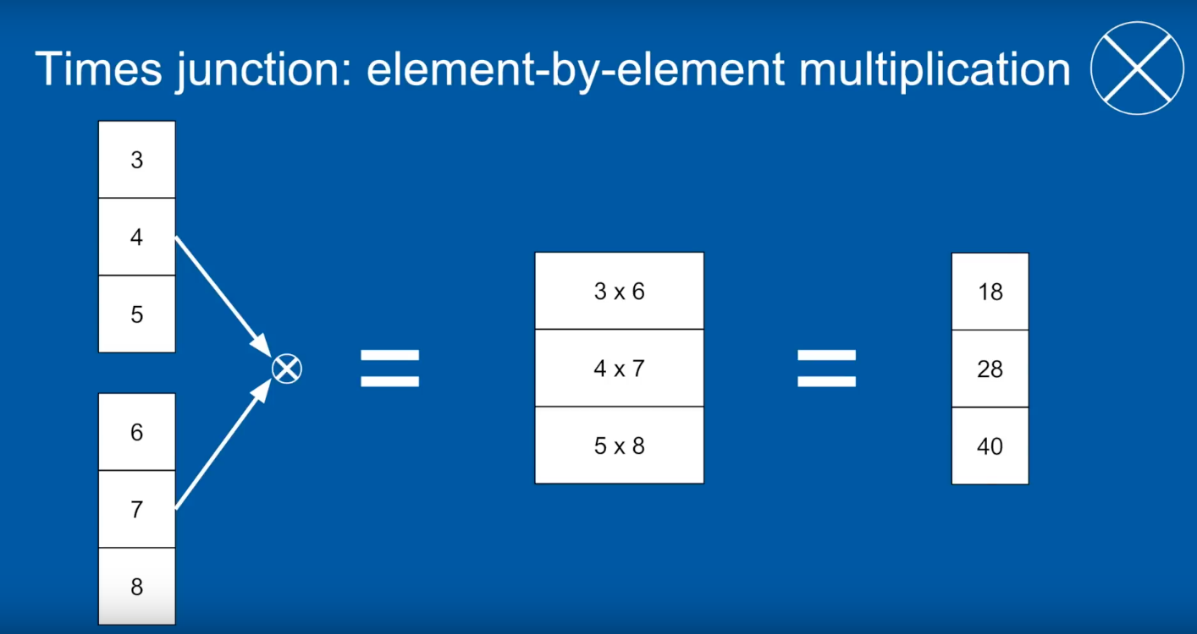
Multiplication

Slide 6
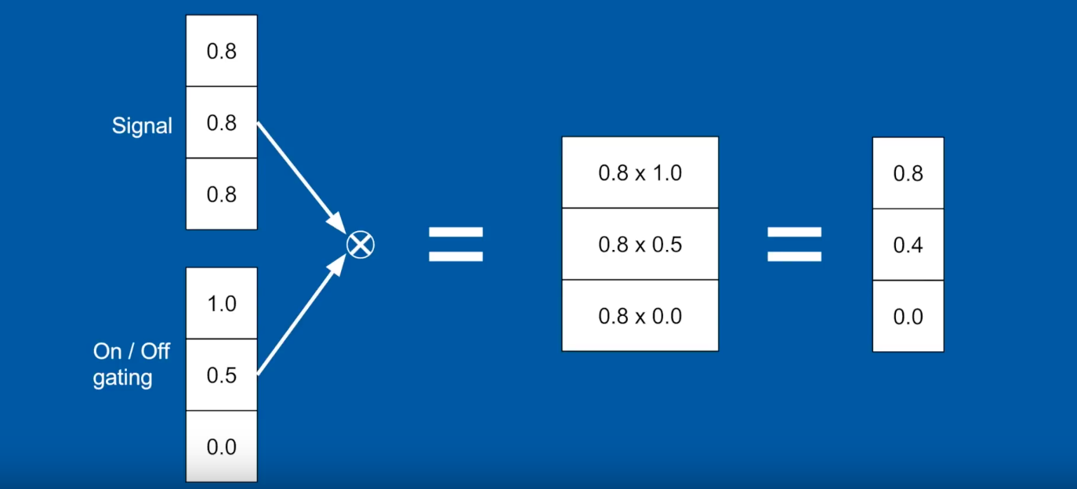
Gating

Slide 7
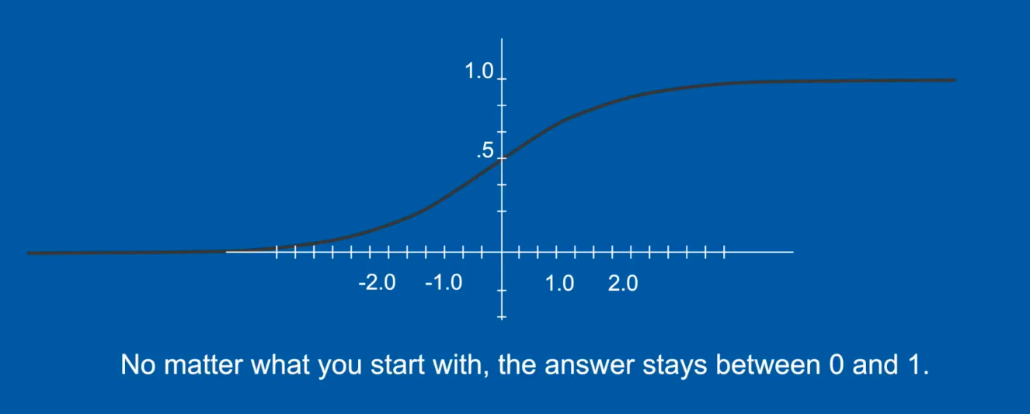
Activation Function

Slide 8
Common Activation Functions
Hyperbolic Tangent
Sigmoid Function

Slide 9
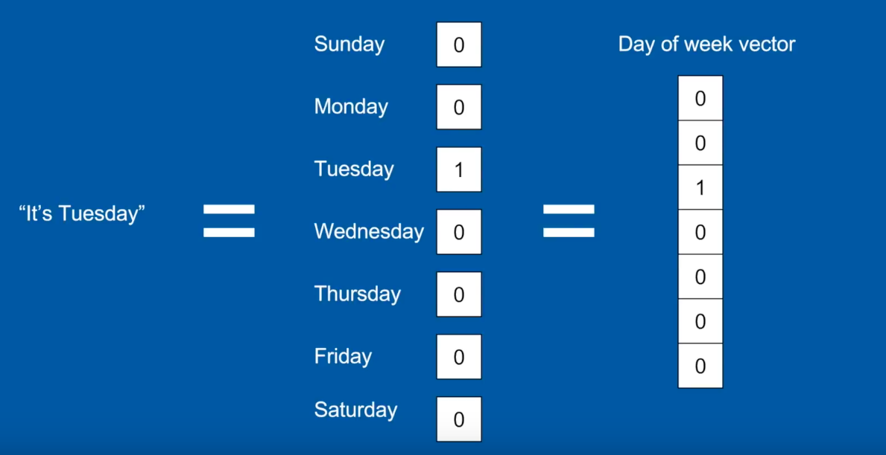
One hot Coding

Slide 10
RNN types
Simple RNN
Long short term memory (LSTM)
Gated Recurrent Unit (GRU)

Slide 11
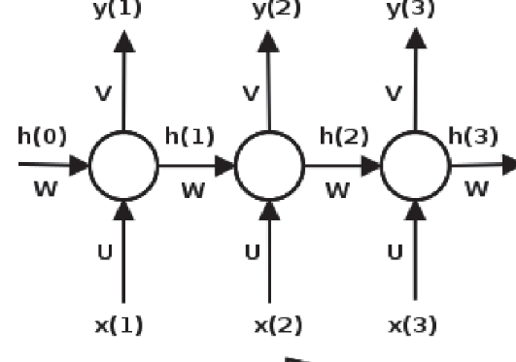

Simple RNN
$h_{t}=\tanh{(wh_{t−1}+u x_{t})}$
$y_{t}=softmax (vh_{t})$

Slide 12
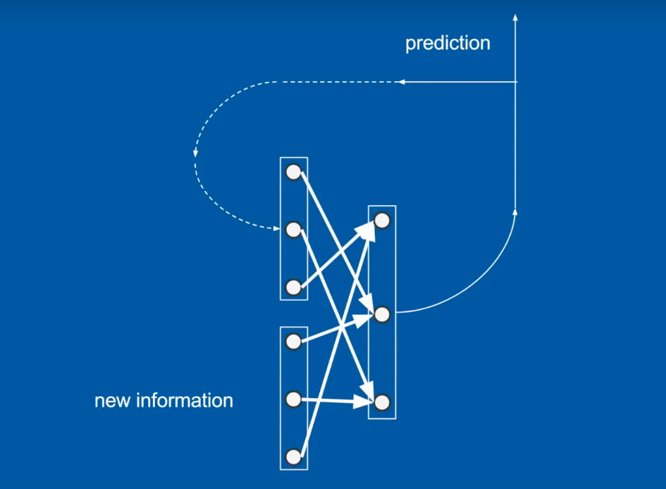
Simple RNN

Slide 13
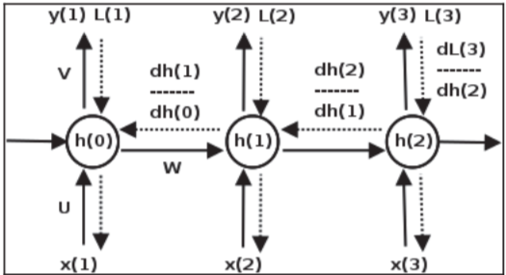
Vanishing and exploding gradients

Slide 14
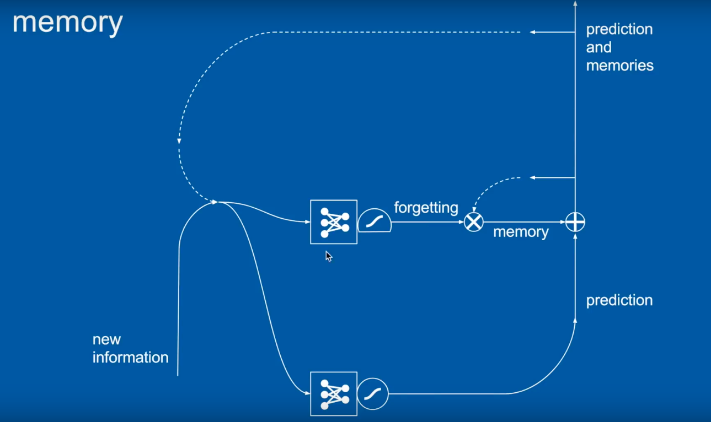
Forgetting Gate

Slide 15
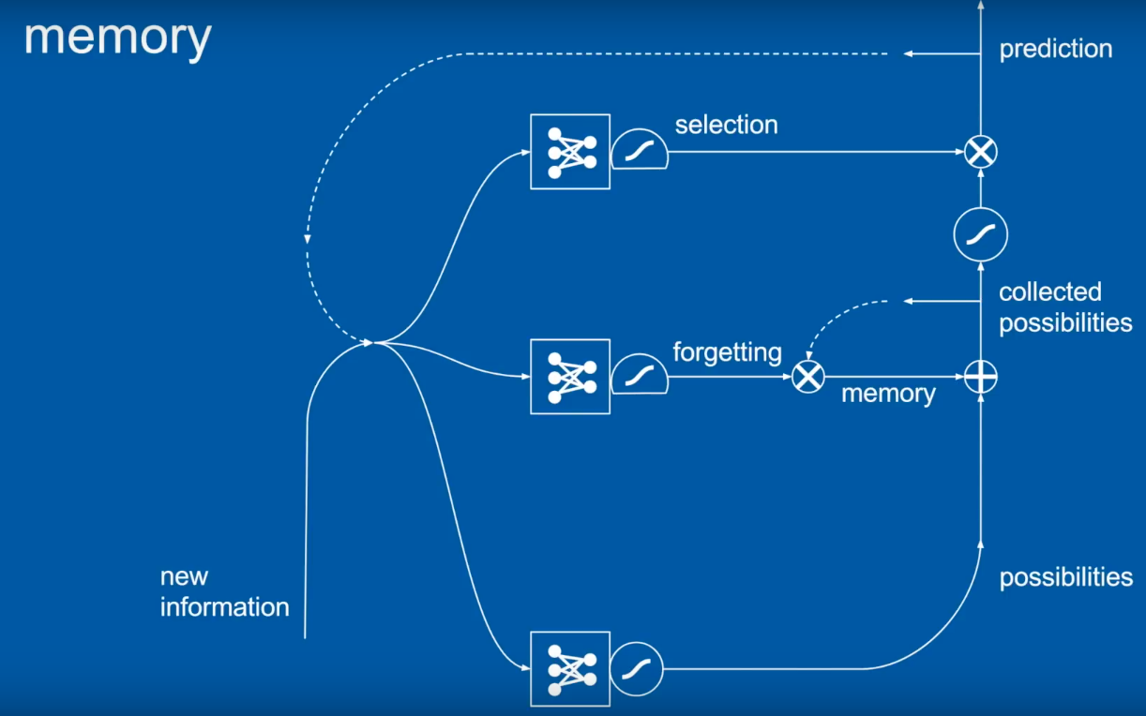
Selection

Slide 16
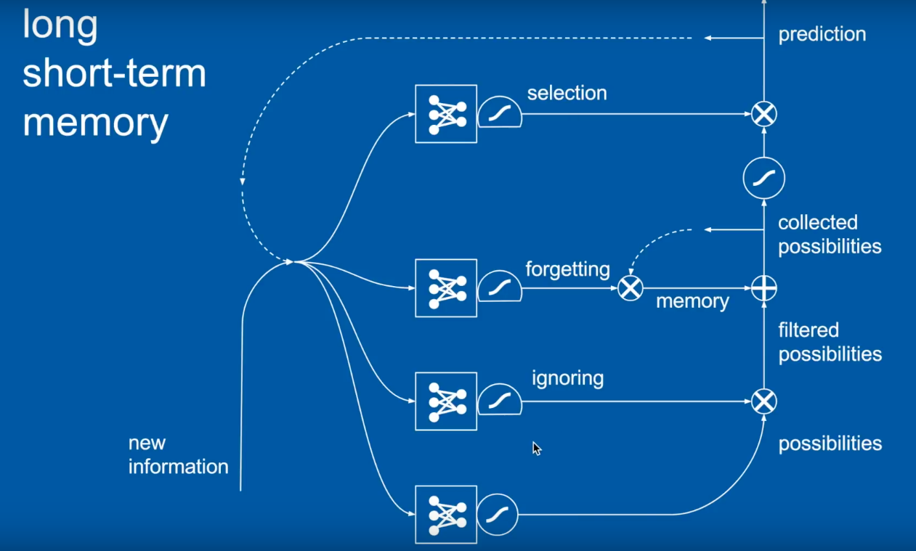
LSTM

Slide 17
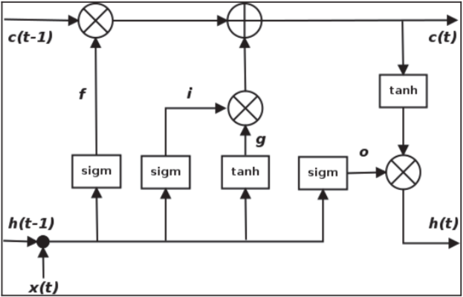
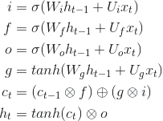
Long short term memory — LSTM

Slide 18
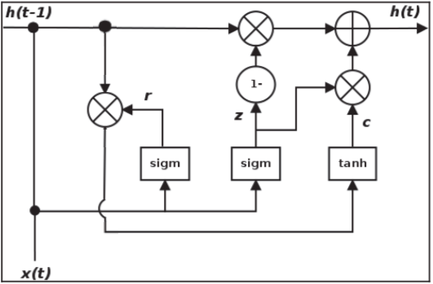

Gated recurrent unit — GRU

Slide 19
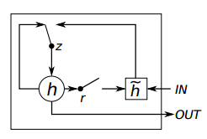
GRU - Simplified

Slide 20
Reference
Recurrent Neural Networks (RNN) and Long Short-Term Memory (LSTM)-Brandon Rohrer
Chapter 6 of Deep Learning with Keras

