Slide 1
ULTRASOUND NERVE SEGMENTATION
Mini Project Phase II
Presented by:
Sakshi Kelshikar-30 Shruti Rajput-52 Mansi Sambare-55
Guided by: Prof.Rachana Dhannawat

Slide 2
Contents
Introduction
2. Literature Survey
3. Existing System
4. Proposed System
5. Hardware/Software Requirements
6. Implementation
7. Future Scope
8. Conclusion
1

Slide 3
Introduction
The accurate ultrasound nerve segmentation has attracted wide attention, for it is beneficial to ensure the efficacy of regional anesthesia, reducing surgical injury, and speeding up the recovery of surgery. However, because of the characteristics of high noise and low contrast in ultrasonic images, it is difficult to achieve accurate neural ultrasound segmentation.
Ultrasound images provide some information on the anatomy of the particular patient under surgery, and it is possible to use this information for improving regional anesthesia.
A supervised method called U-net is used in the form of artificial neural networks in order to develop a classification rule for the said purpose. A set of ultrasound images is used as the training set, while another set of similar images is used as the test set, and is used for cross-validation of the resulting classification.
2

Slide 4
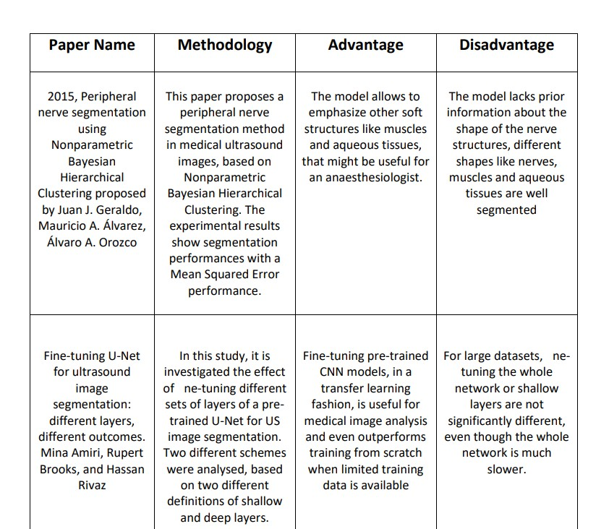
Literature Survey
3

Slide 5
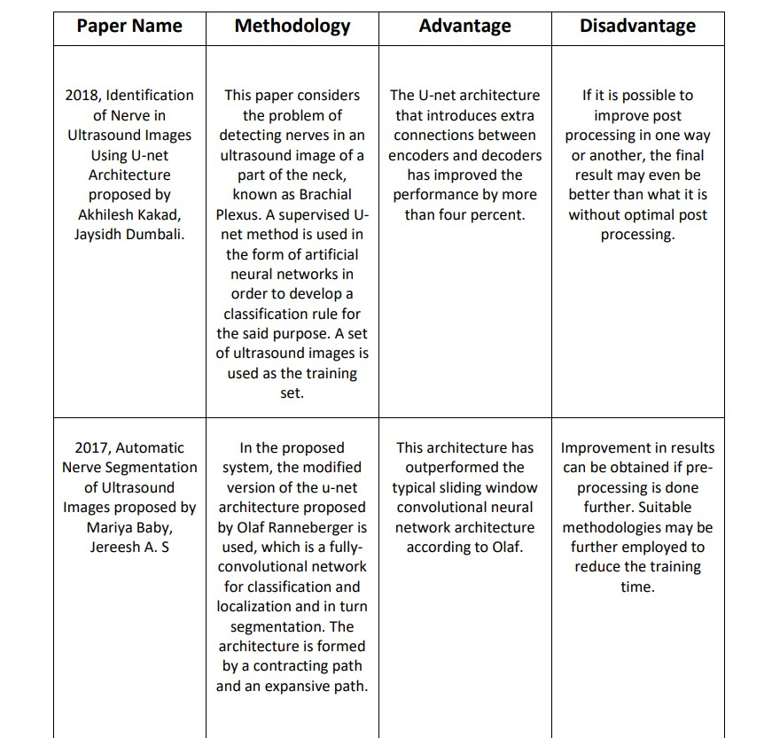
Literature Survey
4

Slide 6
Existing system
Even though there are many systems that have been developed till now using different technologies like Deep learning, deep neural networks,Deep Adversarial Networks and U-net neural networks, approaches like Random Under-Sampling (RUS) and Support Vector Machine (SVM) classifier using algorithms such as Principal Component Analysis–(PCA), the accuracy of the models are low as compared to the one using Convolutional Neural Network(CNN).
The overall accuracies of these methods indicated that the proposed model outperforms all the other methods in the classification.
CNN tends to be a more powerful and accurate way of solving classification problems.
In SVM after training and testing the accuracy, classification on some systems the data had a problem of hardware capacity to process it
5

Slide 7
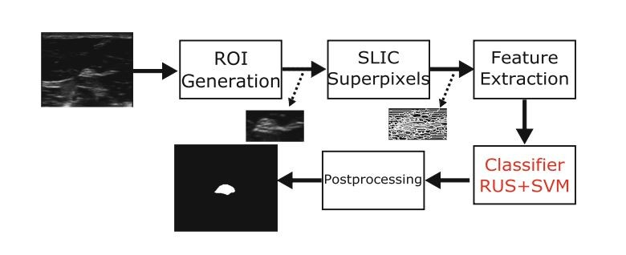
Block Diagram
6

Slide 8
Proposed System
The project focuses on the approach based on image processing using deep learning algorithm CNN for identification of plant diseases. In biomedical application, for the detection of the diseases, it is very essential to have the boundary detail of the acquired image of the organ under observation. Thus it is very essential to extract the edges of the images. Power is one of the main parameters that have to be considered while dealing with biomedical instruments. The biomedical signal processing instruments should be capable of operating at low power and also at high speed. In order to segregate the images into different levels or stage, we use convolutional neural networks for classification.
Dataset: In our proposed system, we are using a dataset consisting total of 47 subjects and 120 images and masks per subject resulting in a total of 5635 images to train on.We are using CNN algorithm to train and test the model.
Model: The proposed model will fetch input in the form of ultrasound image from the user and it is given to classifier.If nerve is detected, it is passed on to the segmentor and mask as output is predicted, else ‘No nerve found’ is displayed

Slide 9
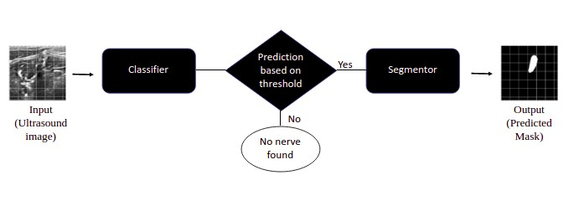
Block Diagram

Slide 10
Hardware and Software Requirements
Hardware Requirements
Processor – Intel Core i3 or above with 1.5 GHz speed
RAM of 500 MB and above for all devices
Free storage memory capacity of more than 100MB
Software Interface Requirements
Windows/ android/ Linux/ mac/ or any other operating system
Mozilla Firefox / Google chrome / opera mini / UC browser or internet explorer
Internet connectivity
9

Slide 11
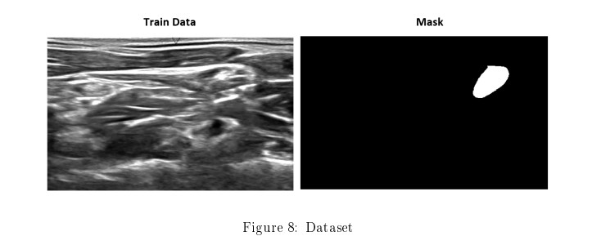
Implementation
Dataset :- The data has been provided by kaggle as part of one of their competitions which requires a model for nerve segmentation. The task was to segment a collection of nerves called the Brachial Plexus (BP) in ultrasound images. A large training set of images where the nerve has been manually annotated by humans was provided.
10

Slide 12
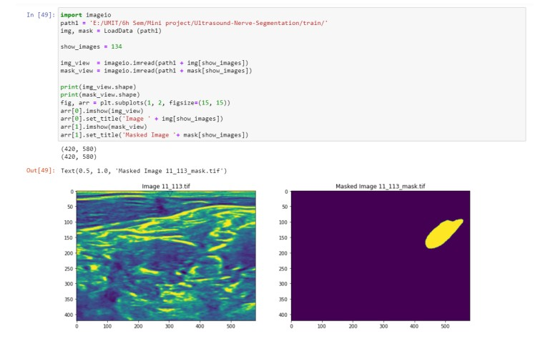
Implementation
We read a black-and-white image as a 3d image. After that we convert it into numpy array and display the input image and its masked image along with its shape
11

Slide 13
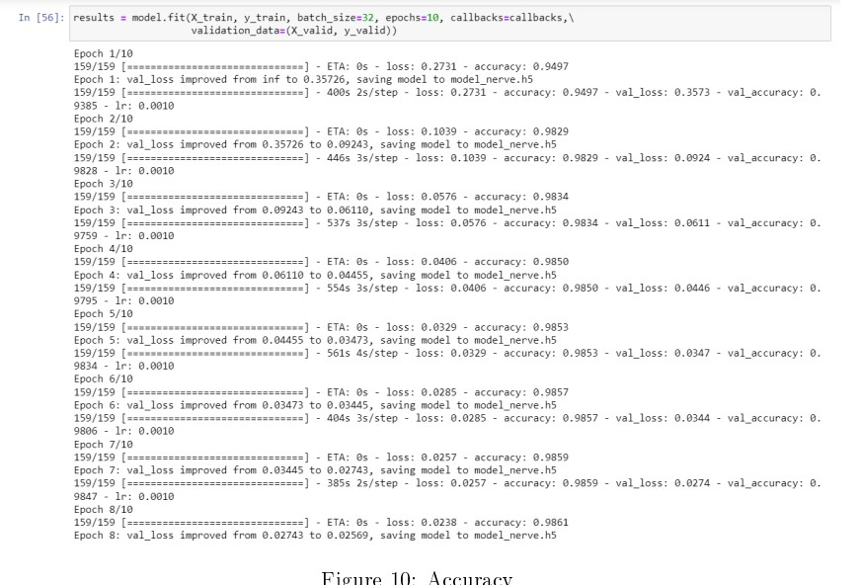
Accuracy
The two losses both loss and val loss are decreasing and the two acc : acc and val acc are increasing. So this indicates the modeling is trained in a good way. The val acc is the measure of how good the predictions of your model are. So in this case, it looks like the model was trained pretty well after 10 epochs, and the rest training is not necessary.
12

Slide 14
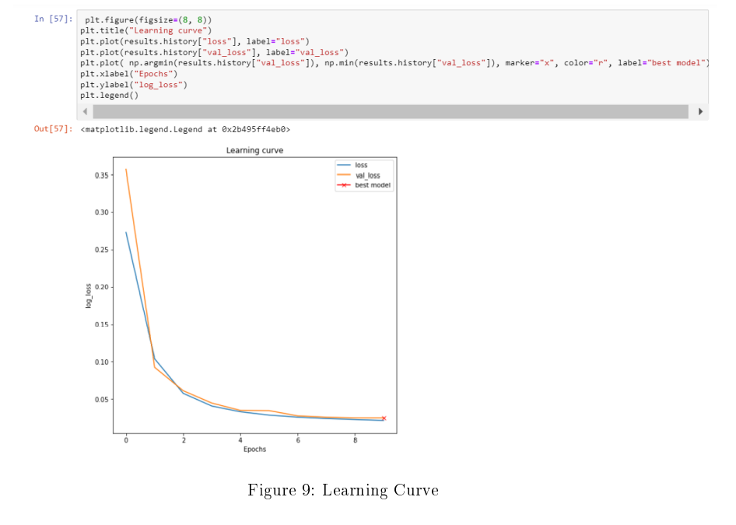
Learning Curve
A good fit is identified by a training and validation loss that decreases to a point of stability with a minimal gap between the two final loss values. A plot of learning curves shows a good fit:
1. The plot of training loss decreases to a point of stability.
2. The plot of validation loss decreases to a point of stability and has a small gap with the training loss.
As seen in the given figure the loss and val loss both are decreasing with the increasing epochs that means the overall model loss is decreased with the learning and best model is obtained at certain period of time.
12

Slide 15
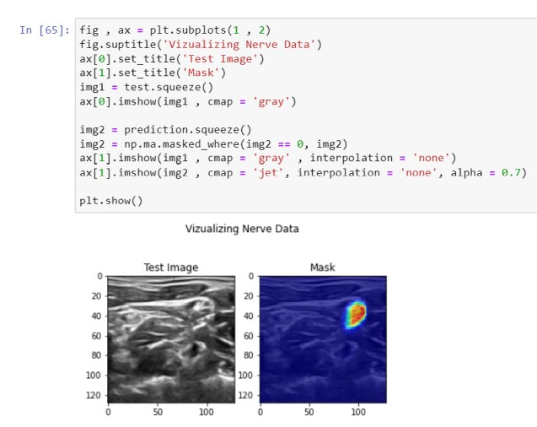
Result
After training the segmentation model for 10 epochs we got a validation score of 0.98 Let’s visualize a couple of predictions by the model on the validation set. We can see that our model can segment nerves from ultrasound images accurately.
13

Slide 16
Future Scope
Improvement in results can be obtained if preprocessing is done further. Suitable methodologies may be further employed to reduce the training time.
A newly proposed network needs to have a wide range of adaptability, and we have to test its performance on other datasets.
As an improved network, its working mechanism needs to be strictly proved by mathematics to prove that our interpretation of its optimization mechanism is in accordance with scientific basis.
14

Slide 17
Conclusion
We have developed a system based on the deep learning method for segmentation of ultrasound images. We have chosen the best possible combination of methodologies to improve the results. Improvement in results can be obtained if preprocessing is done further. We propose an improved u-net network called a mini-u-net network.
As compared to the original u-net and the 4 concatenations of u-net on the Kaggle 2016 neural image dataset, it was found that the mini-u-net works better. On comparison between the performance of the mini-u-net and the networks in the two papers, we have found that u-net can also achieve better results while keeping the dataset unchanged.
15 / 15

Slide 18
Thank You!

