Slide 1



TEXT MINING PROJECT
News Article Classification
Team:
Yashas Prashanth
Shruti Ravichandran

Slide 2

BACKGROUND
DATASET
209 K
News Articles
2012-2022
Data Duration
42
Categories
PROBLEM DEFINITION
Each article belongs to one particular category of article like ‘Politics’, ‘Sports’, ‘Arts’, etc
Multi-class
supervised classification
of Textual Data
A high class imbalance is observed in the dataset with the top 7 classes corresponding to 51% of the records

Slide 3
CLASSIFICATION PIPELINE
Pre-Processing
Feature Representation
Classification Model
Removal of punctuation
Sparse Vectors
Unigram Count
Multinomial Naïve Bayes
Lowercasing
TF-IDF
Linear SVM
Tokenization with NLTK
Linear SVM
Lowercasing
Dense Vectors
Word2Vec
Non-Linear SVM
Tokenization with NLTK
BERT
Neural Network

Slide 4
PERFORMANCE WITH SPARSE VECTORS
Feature Representation | Feature Selection | Model | Test F1-Score
Unigram Count | Most Frequent (20000) | Linear SVM | 52%
Unigram Count | Most Frequent (20000) | Naïve Bayes | 56%
TF-IDF | Most Frequent (20000) | Naive Bayes | 42%

Slide 5
PERFORMANCE WITH DENSE VECTORS
Feature Representation | Model | Test F1-Score
Word2Vec (skipgram) | Linear SVM | 49%
Word2Vec (skipgram) | Non-linear SVM | 54%
Word2Vec (skipgram) | Logistic Regression | 48%
Word2Vec (skipgram) | NN with 1 hidden layer | 51%

Slide 6
INTERMEDIATE RESULT ANALYSIS
HYPOTHESIS
ACTION
For sparse vectors – Feature space is too high in dimensionality leading to highly sparse vectors
The text was first POS tagged and then lemmatized using the POS tags
For dense vectors – Embeddings trained on the current dataset may not capture the semantic meaning properly due to limited context
Pretrained GloVe embeddings were used

Slide 7
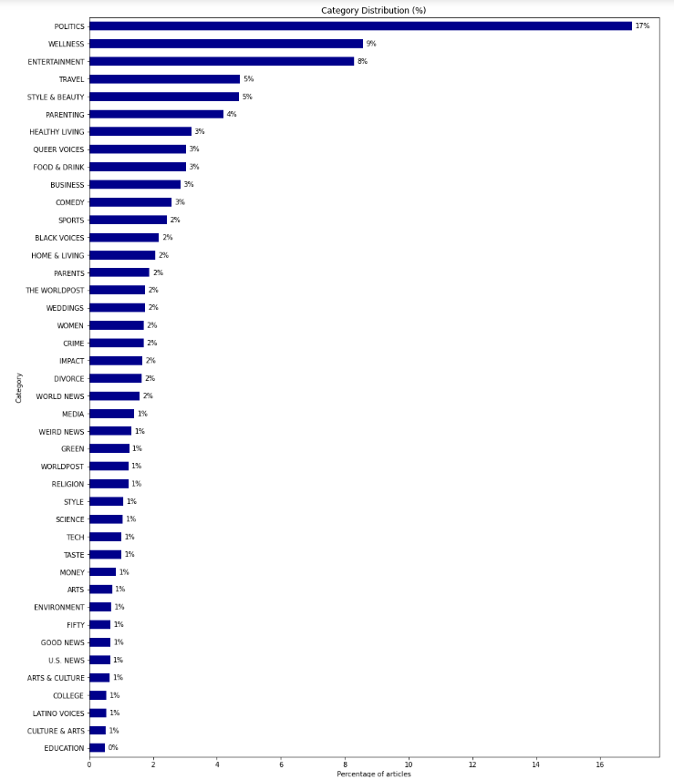
INTERMEDIATE RESULT ANALYSIS
HYPOTHESIS
ACTION
Classification performance was suffering due to a high degree of class imbalance between categories
Sampling strategies:
SMOTE: Synthetic samples for minority classes
HYBRID: Undersample top 4 and oversample the rest using SMOTE
Some of the classes had the same meaning – which could be confusing for the model
Some classes were combined leading to the number of classes from 42 to 36

Slide 8
PERFORMANCE WITH SPARSE VECTORS
Feature Representation | Feature Selection | Model | Test F1-Score (before) | Test F1-score (after)
Unigram Count | Most Frequent (20000) | Naïve Bayes | 56% | 58%
TF-IDF | Most Frequent (20000) | Naive Bayes | 42% | 57%

Slide 9
PERFORMANCE WITH DENSE VECTORS
Feature Representation | Model | Test F1-Score (before) | Test F1-Score (after)
Word2Vec (Combined classes, Hybrid Sampling) | Non-linear SVM | 54% | 56%
Word2Vec (Combined classes) | Logistic Regression | 48% | 51%
 | Neural Network | 51% (one hidden layer) | 53% (two hidden layers)
* The above models were also run with pretrained GloVe vectors but there was no impactful difference in the results

Slide 10
CONCLUSIONS
Both sparse and dense vectors produced comparable performance with F1-score between 50-60%
The large number of classes and imbalance account for the complexity in the classification task
Combining classes and Hybrid Sampling led to improvement in model performance across the board

Slide 11
THANK YOU!

