Slide 1
U.S. Airline Performance & Delay Analysis (2015)
A Data-Driven Study of Flight Trends, Delays & Cancellations Presented by: Shruti Sumadhur Ghosh

Slide 2
🏛️ Project Overview
Objective: Analyze U.S. domestic airline data (2015) to uncover patterns in flight delays, cancellations, and performance.
Tools Used: SQLite, Power BI
Data Sources:
flights.csv
airlines.csv
airports.csv

Slide 3
🔧 Methodology
Data Cleaning & Integration using SQL (SQLite)
Created enriched view: v_flight_data_enriched
Designed KPI measures and calculated metrics
Visualized key trends using Power BI

Slide 4
📊 Overall Flight Volume & Performance
Total Flights: 1.05 million
On-Time Arrival Rate: 78.13%
Average Arrival Delay: 7.61 minutes
Delay Rate: 21.87%
Cancellation Rate: 3.86%

Slide 5
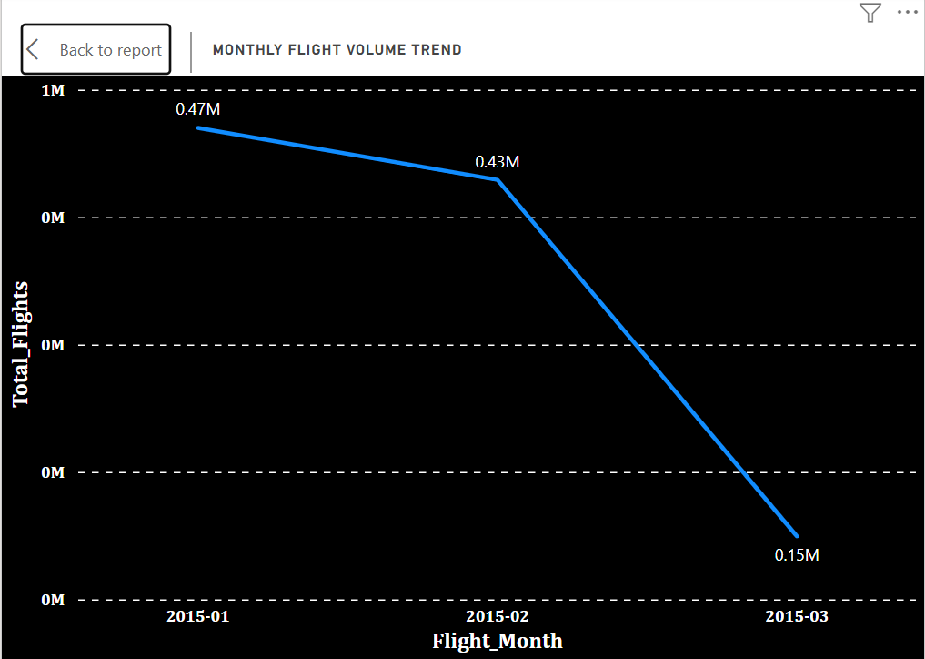
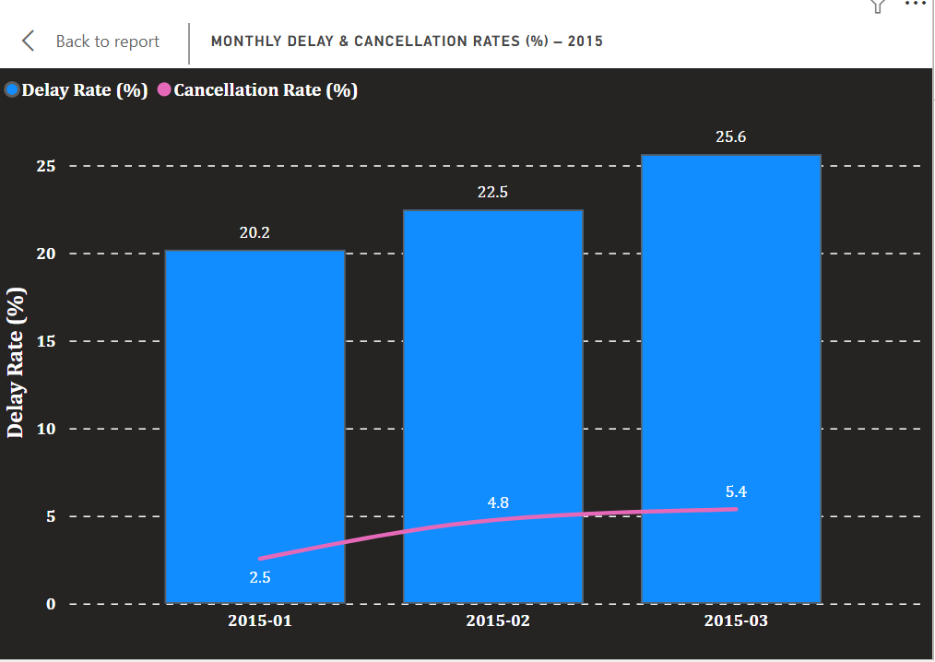
📅 Monthly Trends
Delay Rates by Month:
Jan: 20.18%
Feb: 22.46%
Mar: 25.62%
Cancellation Rates by Month:
Jan: 2.55%
Feb: 4.78%
Mar: 5.37%
Flight Volumes by Month:
Jan: 469,968
Feb: 429,191
Mar: 149,416

Slide 6
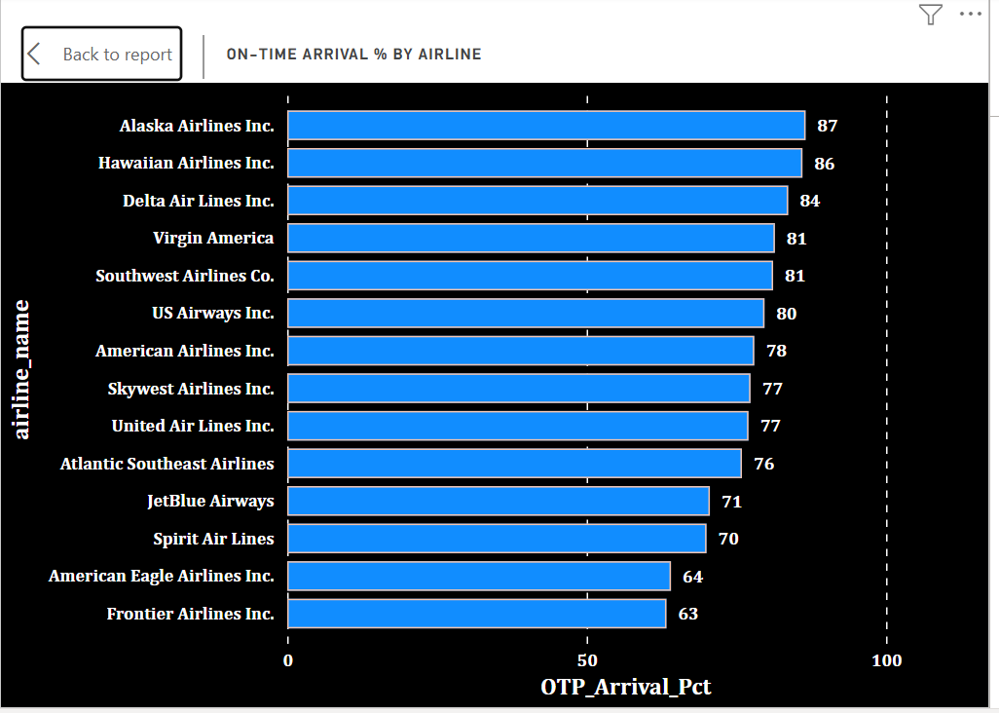
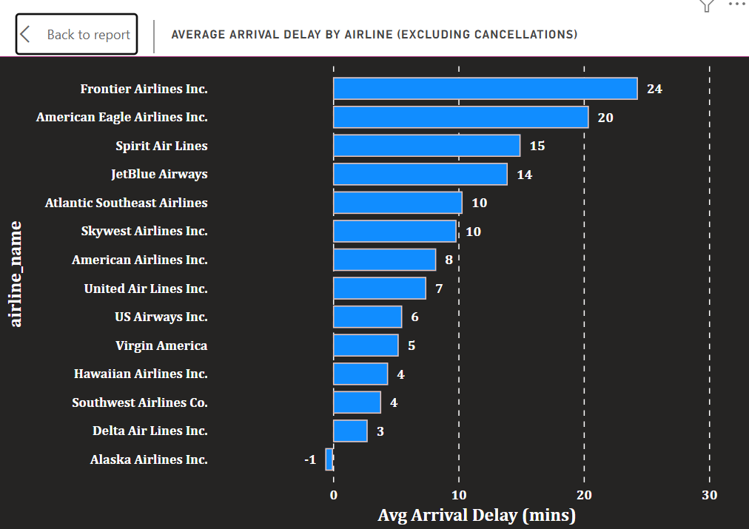
✈️ Airline Performance Comparison
On-Time Arrival % by Airline:
Highest: Alaska Airlines (86.56%)
Lowest: Frontier Airlines (63.32%)
Avg. Arrival Delay:
Worst: Frontier (24.33 mins)
Best: Alaska (-0.61 mins)

Slide 7
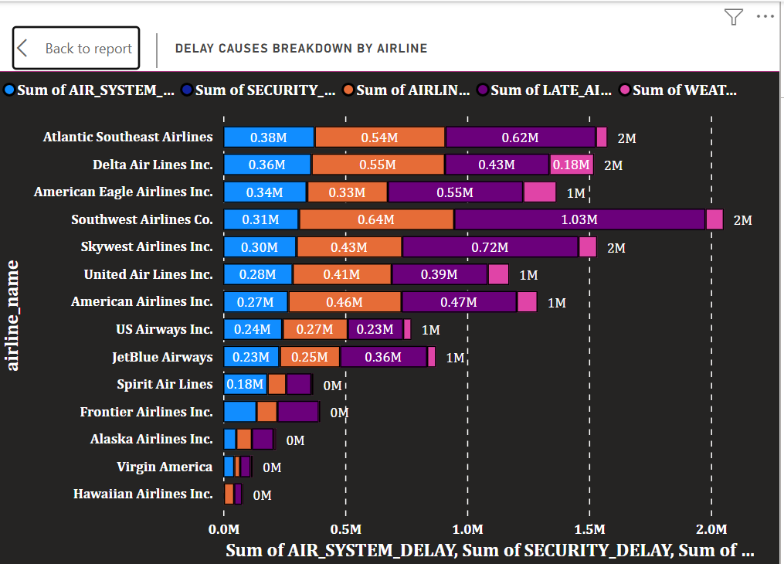
❄️ Delay Causes by Airline
Example (American Eagle):
Air System Delay: 342,148 mins
Late Aircraft Delay: 554,825 mins
Weather Delay: 137,750 mins
Airline Delay: 330,451 mins

Slide 8
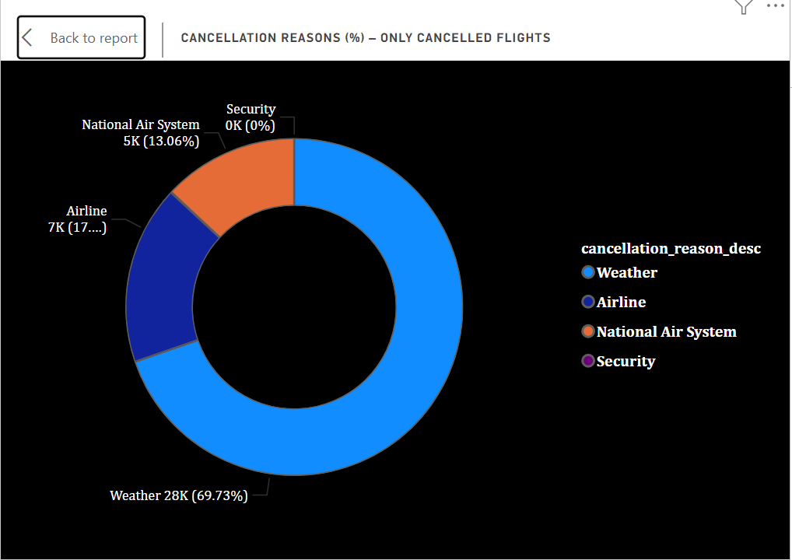
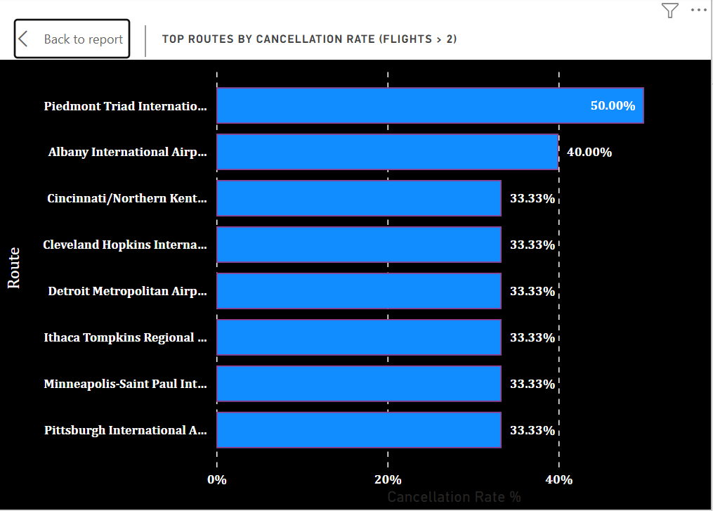
❌ Cancellations Analysis
Top Cancellation Causes:
Weather: 28,260
Airline-related: 6,974
Air System: 5,291
Routes with High Cancellation Rates:
Albany → Newark: 40.00%
Detroit → Ithaca: 33.33%
Pittsburgh → Cincinnati: 33.33%

Slide 9
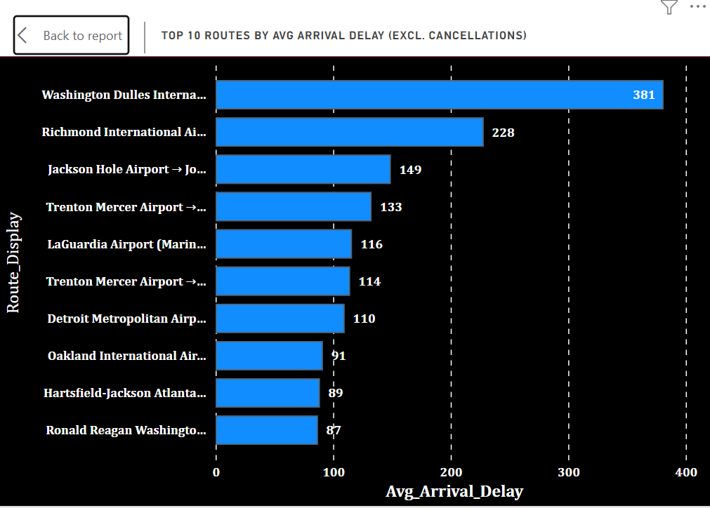
⚡ Worst Affected Routes by Delays
Richmond → Columbia: Avg Delay = 228 mins
Jackson Hole → JFK: 149 mins
Detroit → Trenton: 109.67 mins

Slide 10
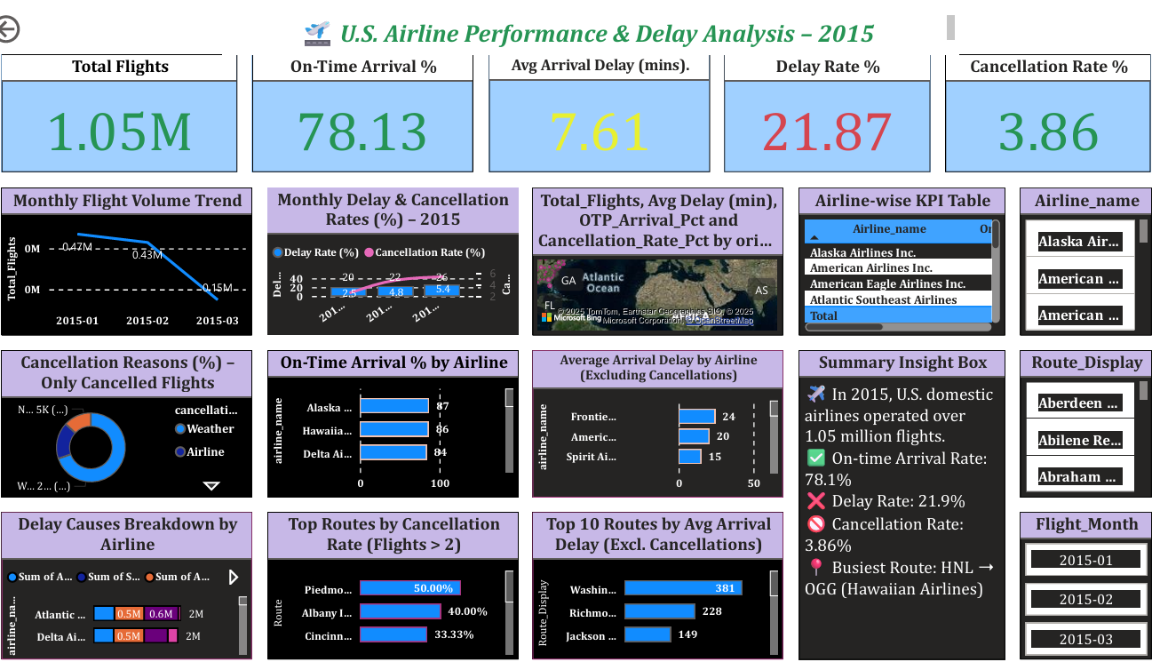
Dashboard Walkthrough
🟦 KPI Card Row
📉 Monthly Trends
(Flight Volume + Delay/Cancellation)
📊 Airline Bar Charts
(On-Time %, Avg Delay)
🍩 Cancellation Reasons Donut
📊 Stacked Delay Cause Chart
🌍 Map Visual: Total Flights by Origin State
🎛️ Slicer Panel
(with filters for Month, Airline, Route)

Slide 11
🙏 Thank You for Your Attention!
Feedback Welcome!
📧 Contact: Shruti Sumadhur Ghosh📩 shrutisghosh@outlook.com
📊 Project: U.S. Airline Performance & Delay Analysis – 2015

