Slide 1
Uber Trips Data Analysis
By Shruti Sumadhur Ghosh

Slide 2
Project Objective
To analyze Uber trip patterns using SQL and Python.
We aim to understand trip completion, cancellations, and car unavailability.

Slide 3
Data Overview
• Dataset: Uber_Cleaned.xlsx
• Key Columns: Status, Pickup point, Request time, Drop time
• Status Types: Trip Completed, Cancelled, No Cars Available

Slide 4
Key Questions Explored
• What is the overall distribution of trip statuses?
• Which pickup point had the most successful trips?
• Where were cancellations and unavailability highest?

Slide 5
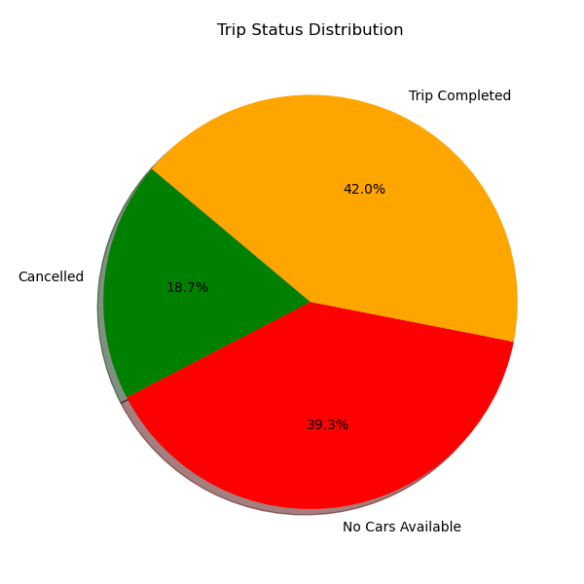
How Did Uber Trips End?

Slide 6
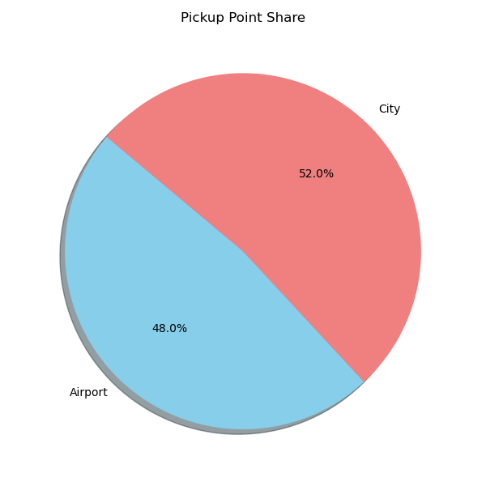
Where Were Trips Requested From?

Slide 7
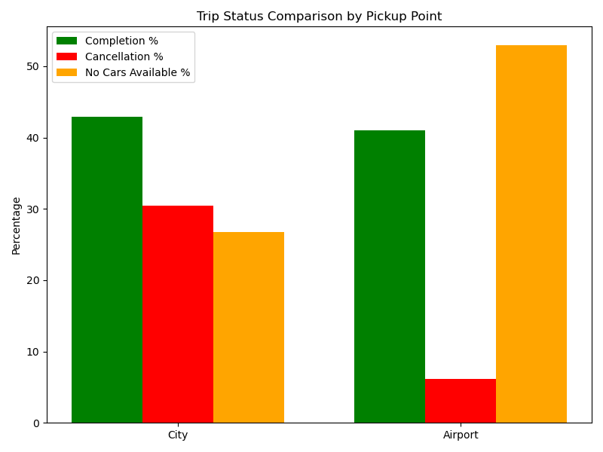
Success vs Failure by Location

Slide 8
Key Insights from the Analysis
• Most trip requests came from the City, but many were not completed.
• Airport trips had the highest completion rate and lowest cancellations.
• No Cars Available was a major issue for City pickups.
• Improving driver availability in the City could raise success rates.
• This data suggests operational focus should shift to City requests.

Slide 9
Thank You!
Questions are welcome.

