Slide 1
RECOMMENDATION
Consolidate four PM tools to two.
Save about €610K a year, 26% of spend.
Keep Jira for Engineering. Standardise everyone else onto Asana. Retire Monday.com and Trello. Fix the rate and the terms at the Asana renewal, and put a flex-down clause in the contract so idle licences cannot rebuild.
Range: €540K (conservative) to €750K (optimistic). The number rests on a modelled Asana rate, not a quote.
Procurement case study · Shruti Morab
Notes:
The answer is on the first slide on purpose. Four tools, 2.37M euros, down to two tools and 1.76M. The 26% is the headline but I lead the room to the range immediately, because a single round number on a modelled negotiation invites the wrong question. Jira stays because Engineering will not move and should not. Asana becomes the standard for everyone else. The flex-down clause is the part I care most about, because it stops this problem recurring.

Slide 2
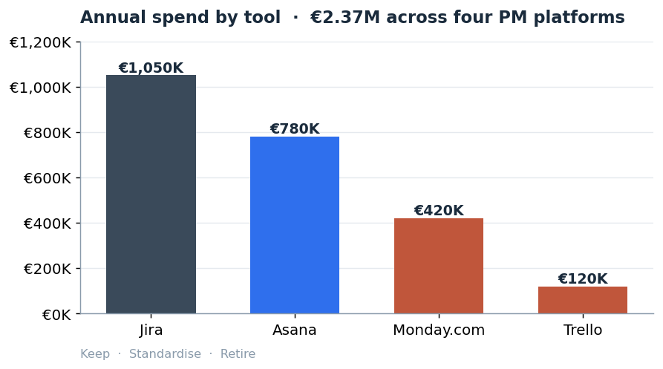
THE PROBLEM
One job, four tools, no single buyer
Duplication
~180 people hold licences on two or more platforms. We pay twice for the same person.
Low utilisation
Asana 510 of 650 seats used. Monday.com 230 of 350. Trello 120 of 250. 390 idle seats.
No leverage
Every contract signed separately by a different team. Meridian has never negotiated as one enterprise buyer.
Meridian Mobility · SaaS consolidation
2
Notes:
This is the situation, not the fix. 2.37M euros across four tools that do broadly the same job. Three problems underneath: duplication, shelf-ware, and the fact that nobody has ever bought this as one enterprise. Microsoft Planner is free with our M365 licence so I leave it out of scope. The colour coding carries through the whole deck: dark grey is keep, blue is the tool we standardise on, red is retire.

Slide 3
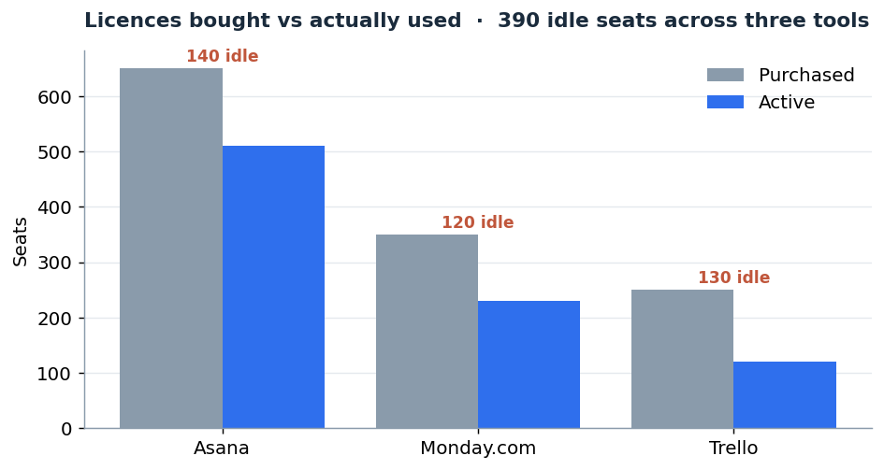
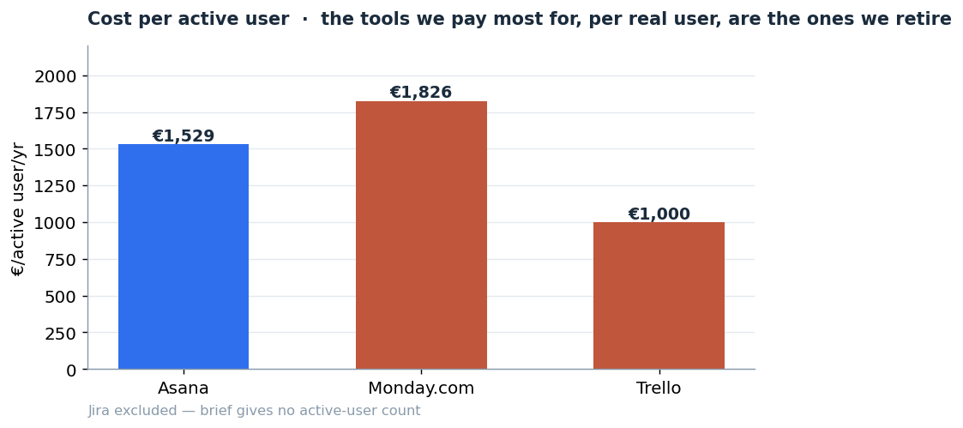
WHERE THE MONEY LEAKS
The tools we pay most for, per real user, are the ones we retire
Trello costs €1,000 per active user and Monday.com €1,826. Retiring them and rehoming those users onto the standard tool removes the waste without removing the capability.
Meridian Mobility · SaaS consolidation
3
Notes:
Two lenses on the same waste. Left: bought versus used, 390 idle seats. Right: cost per active user, the number that actually matters, because a cheap tool nobody uses is not cheap. Trello and Monday.com are worst on both. Not a coincidence, it is the case for retiring them.

Slide 4
THE RECOMMENDATION
Keep Jira for Engineering. Standardise the rest on Asana.
Jira
Asana
Monday.com
Trello
KEEP
STANDARD
RETIRE
RETIRE
Engineering only. Toolchain built around it. They will not move.
New standard for Product, Marketing, HR, Operations. Largest active base.
Competent but beats Asana on nothing. Users rehomed.
Lightweight. Hard to justify at Enterprise pricing.
Why not just pick the highest score?
On the weighted scorecard Asana and Jira tie at 4.00. Jira's score is carried by integrations, security and scalability, the things a software org needs and a marketer does not. Asana scores evenly, with its strongest mark on breadth of fit, the criterion that carries the most weight. So the tie is the recommendation: Jira wins for Engineering, Asana wins as the general standard. A scorecard read naively would have merged them and broken one side.
Meridian Mobility · SaaS consolidation
4
Notes:
This is where judgement shows. The scorecard has Asana and Jira tied at exactly 4.00. If I just followed the number I would standardise on one and break the other group. Instead I read why each got to 4.00: Jira on dev-specific strengths, Asana on even breadth. That is the argument for keep-one-plus-standardise rather than pick-one.

Slide 5
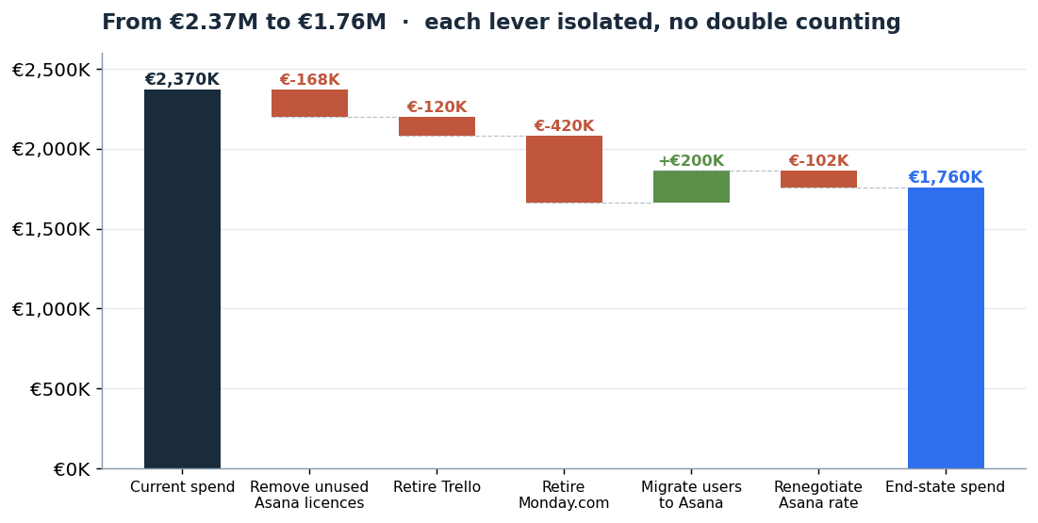
THE SAVINGS
€2.37M to €1.76M, with every lever isolated
SAVINGS RANGE
€540K
Conservative · Asana −8%, Jira untouched
€610K
Base · Asana −17%, Jira untouched
€750K
Optimistic · Asana −21% + Jira right-sized
Meridian Mobility · SaaS consolidation
5
Notes:
The waterfall reconciles current spend to end state through five moves, and it does not double count. The migrated seats are already priced at the negotiated rate, so the rate cut only applies to retained seats. That discipline is the difference between my number and the brief's, which double-counted unused licences against retired vendors. I lead any interview with the conservative 540K because it needs the least defending and it matches the brief.

Slide 6
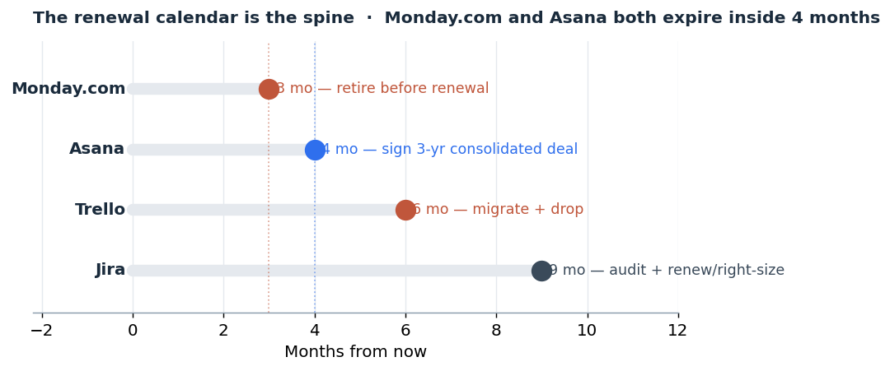
THE SEQUENCE
The renewal calendar is the strategy
Why the order matters
Monday.com expires one month before Asana. So I retire a vendor first, in full view of Asana's account team, and walk into the Asana renewal having already proven Meridian will cut a tool that is not earning its keep.
Sequence is leverage. The credible threat to walk is demonstrated before I need it.
"The savings are not in the spreadsheet. They are in the renewal calendar."
Meridian Mobility · SaaS consolidation
6
Notes:
Most people stop at the recommendation. This slide is why timing is the real work. Monday.com lapsing a month before the Asana renewal is a gift, because I get to demonstrate the walk-away before I sit down with Asana. If the order were reversed I would be asking Asana to expand my commitment before showing any willingness to cut, a much weaker position. Sequence is leverage.

Slide 7
THE NEGOTIATION
The Asana renewal, worked out
Rate per seat on 710 seats
I trade, I never give
Opening ask
€900
€639K
Give (cheap to me): 3-year term · reference rights · upfront payment · seat floor Take (what I want): rate at target · named CSM · bundled training · sandbox · uptime SLA with credits
Target
€1,000
€710K
Walk-away
€1,100
€781K
The one clause I will not give up
BATNA: standardise on Monday.com instead. Real, second-best, and Asana does not need to know how much I prefer them.
A flex-down clause: the right to reduce seats each year within a band. Everything else is money. This clause is governance. It is the difference between fixing the idle-licence problem once and fixing it every year.
Modelled, not quoted: the €1,000 target is reasoned from list price and deal shape. A live negotiation settles the exact number; the structure holds regardless.
Meridian Mobility · SaaS consolidation
7
Notes:
This is the slide the other repos do not have. Concrete target, opening and walk-away, all anchored to list price. A real BATNA in Monday.com, which makes the walk-away credible. A concession ladder where every give is traded for a take, led by the gives that cost me little and that Asana values. And the flex-down clause, the one I spend my last leverage on, because it is governance not money. I am explicit that the rate is modelled, not quoted.

Slide 8
APPENDIX
Numbers, assumptions and the parts I am least sure of
Current vs end state
Key assumptions
Vendor | Current | End state | Move
Jira | €1,050K | €1,050K | Keep, audit at renewal
Asana | €780K | €710K | 710 seats @ €1,000
Monday.com | €420K | €0 | Retire
Trello | €120K | €0 | Retire
Total | €2,370K | €1,760K | −€610K / yr
• End-state Asana = 510 retained + 200 net-new migrated seats = 710. • Negotiated rate €1,000/seat vs €1,200 list (modelled). • Jira held flat: brief gives no active-user count, so no cut claimed. • No double count: migrated seats priced at negotiated rate, so the rate cut applies only to retained seats.
The numbers I trust least, in order
1. The 150-person overlap. How many Monday.com/Trello users already hold Asana. Needs a licence-to-headcount join the brief lacks. Moves the answer. 2. Jira. 44% of spend, zero usage data. Base case claims no Jira saving for that reason. First thing I would audit. 3. The Asana rate. Modelled from list price and deal shape, not quoted.
Meridian Mobility · SaaS consolidation
8
Notes:
The appendix is where a CFO can check my working and where I put the honesty. The reconciliation table, the assumptions, and the three numbers I trust least, ranked. Leading with limitations rather than hiding them is what makes the rest credible. The Jira blind spot is the big one: 44% of spend with no usage data, so I claim nothing from it rather than guessing.

