Slide 1

The MessageBox has to be a billboard so it always faces the player(camera)
The MessageBox is placed above the object prefab and destroyed if player exits the collider
Press [X] to pick up
If Raycast hits MeshCollider:
GlowWalaShader = true;
If Player OnTriggerEnter:
PickUpItem = true;
PickUpMessageBox = true;
isTrigger = true

Slide 2
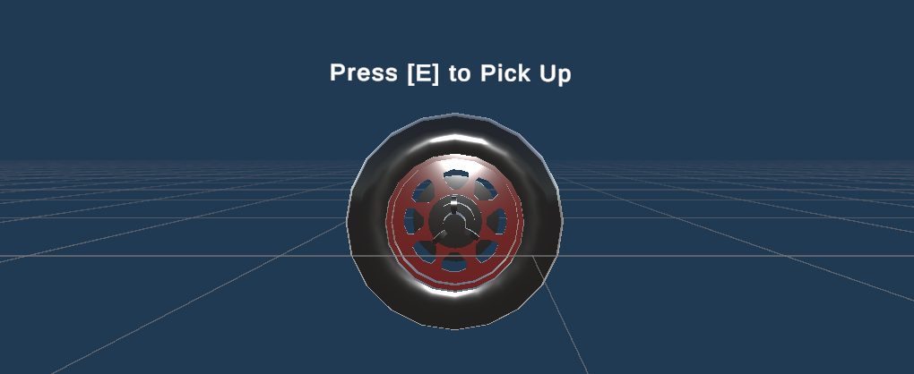
The MessageBox has to be a billboard so it always faces the player(camera)
The MessageBox is placed above the object prefab and destroyed if player exits the collider
If Raycast hits MeshCollider:
GlowWalaShader = true;
It is a Billboard
Always faces the camera
Destroyed after OnTriggerExit
If Player OnTriggerEnter:
PickUpItem = true;
PickUpMessageBox = true;

Slide 3
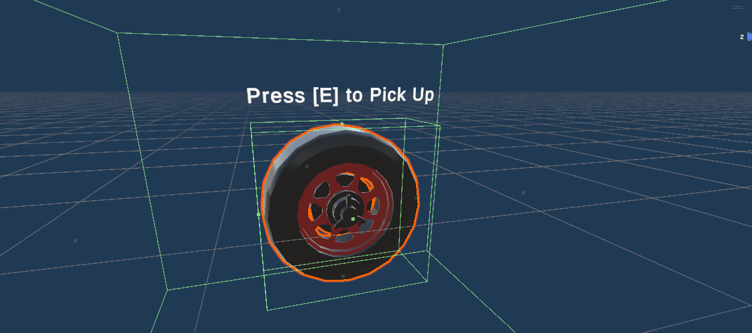


The MessageBox is placed above the object prefab and destroyed if player exits the collider
The MessageBox has to be a billboard so it always faces the player(camera)
If Raycast hits MeshCollider:
GlowWalaShader = true;
If Player OnTriggerEnter && Raycast:
PickUpItem = true;
PickUpMessageBox = true;

Slide 4
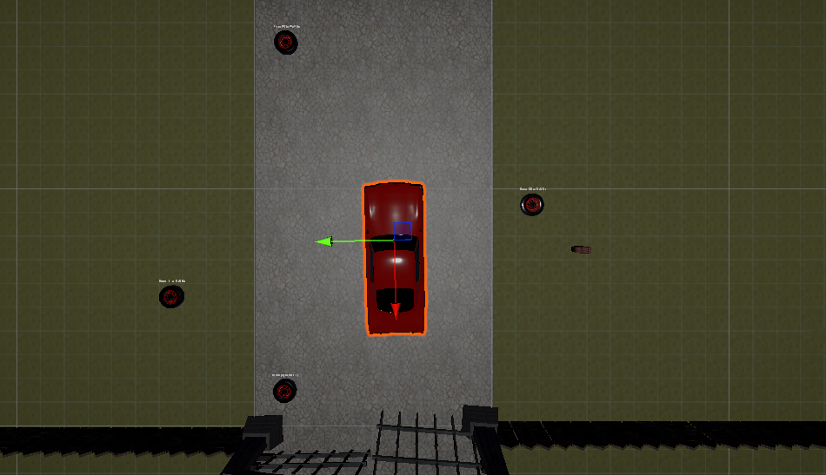
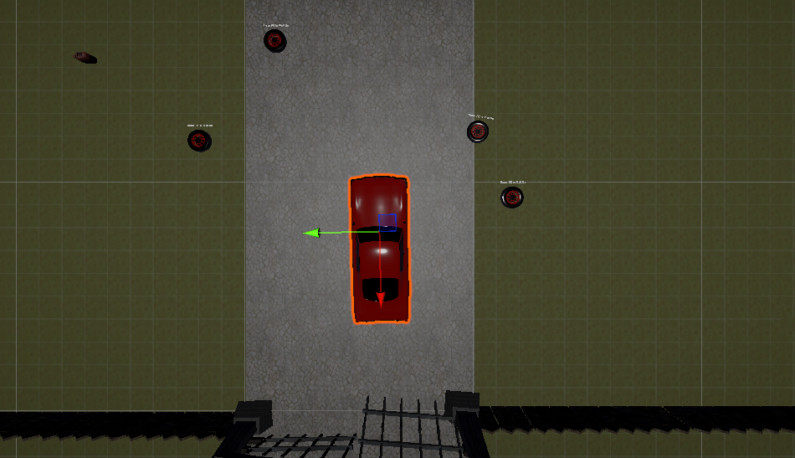

Slide 5
Player
Enemy AI State
PATROL State
Collect Items
Hide from
Enemy
No
CHASE State
Yes
Complete Tasks
Outrun Enemy
No
Enemy Grabs
Win Condition
Lose Condition

Slide 6
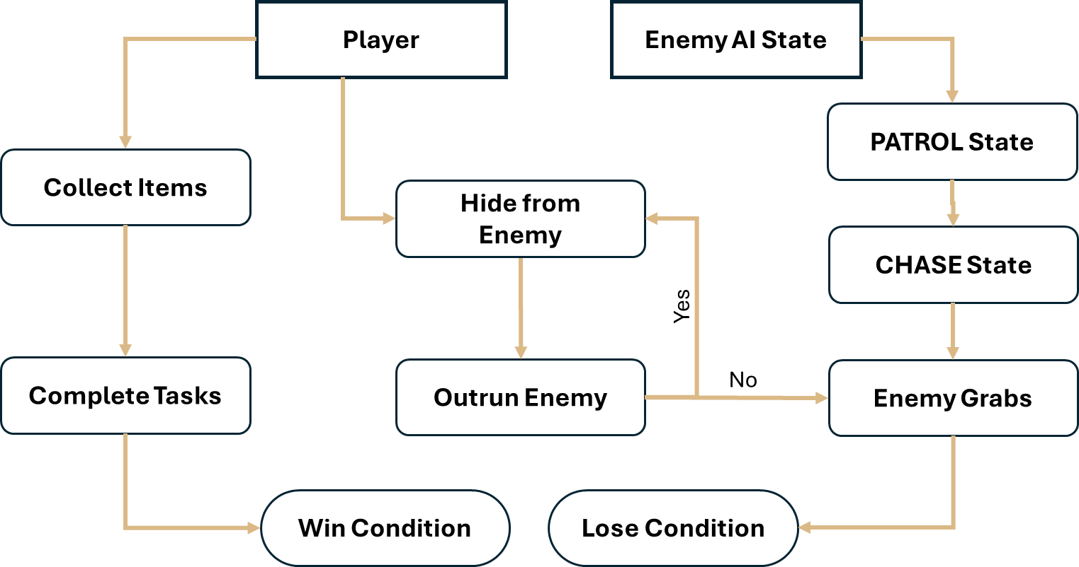
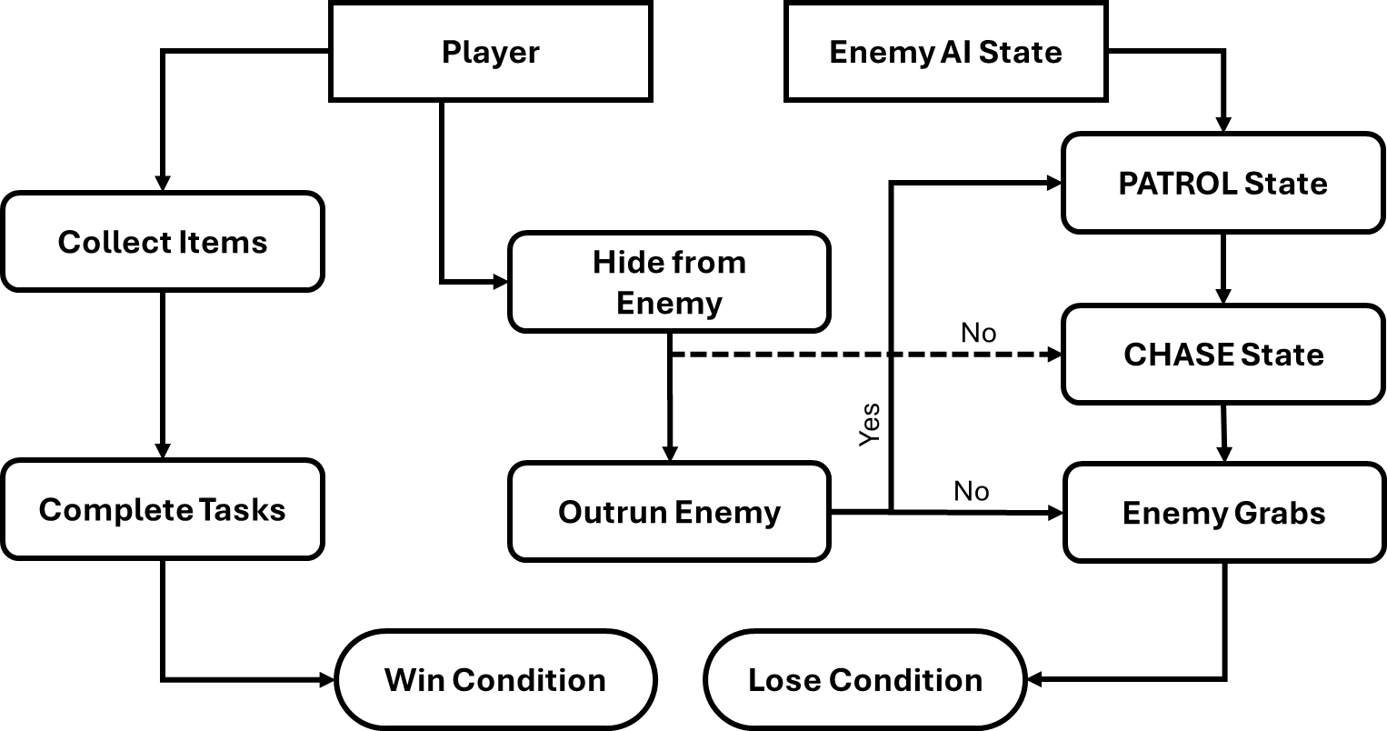

Slide 7
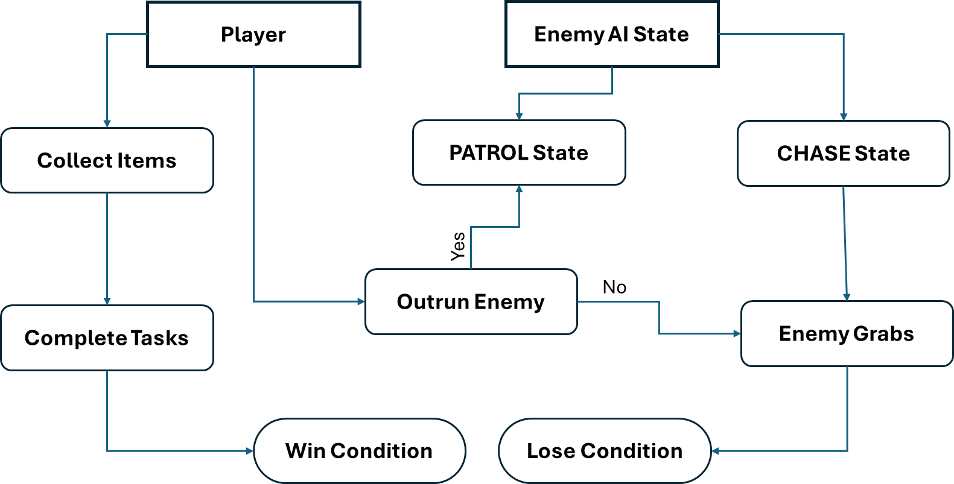

Slide 8
Game Engine
Rendering
Gyroscope
Audio
Gamepad Controllers
VR Headset

Slide 10
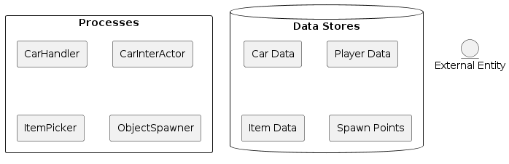
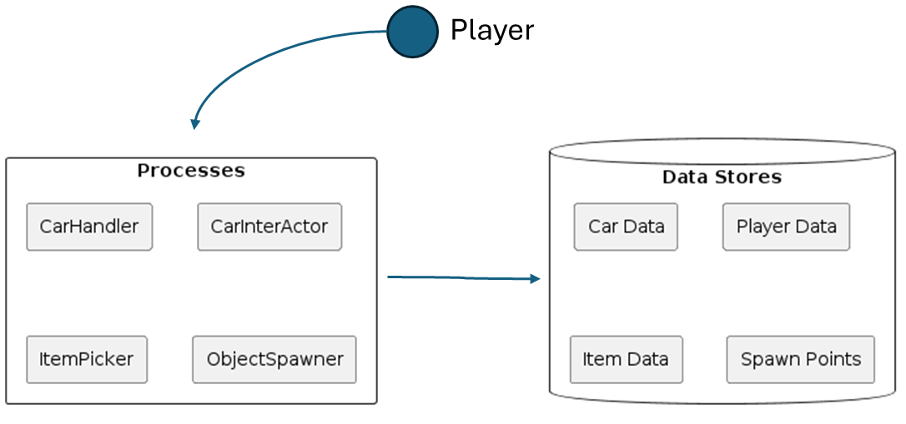
Player

Slide 11
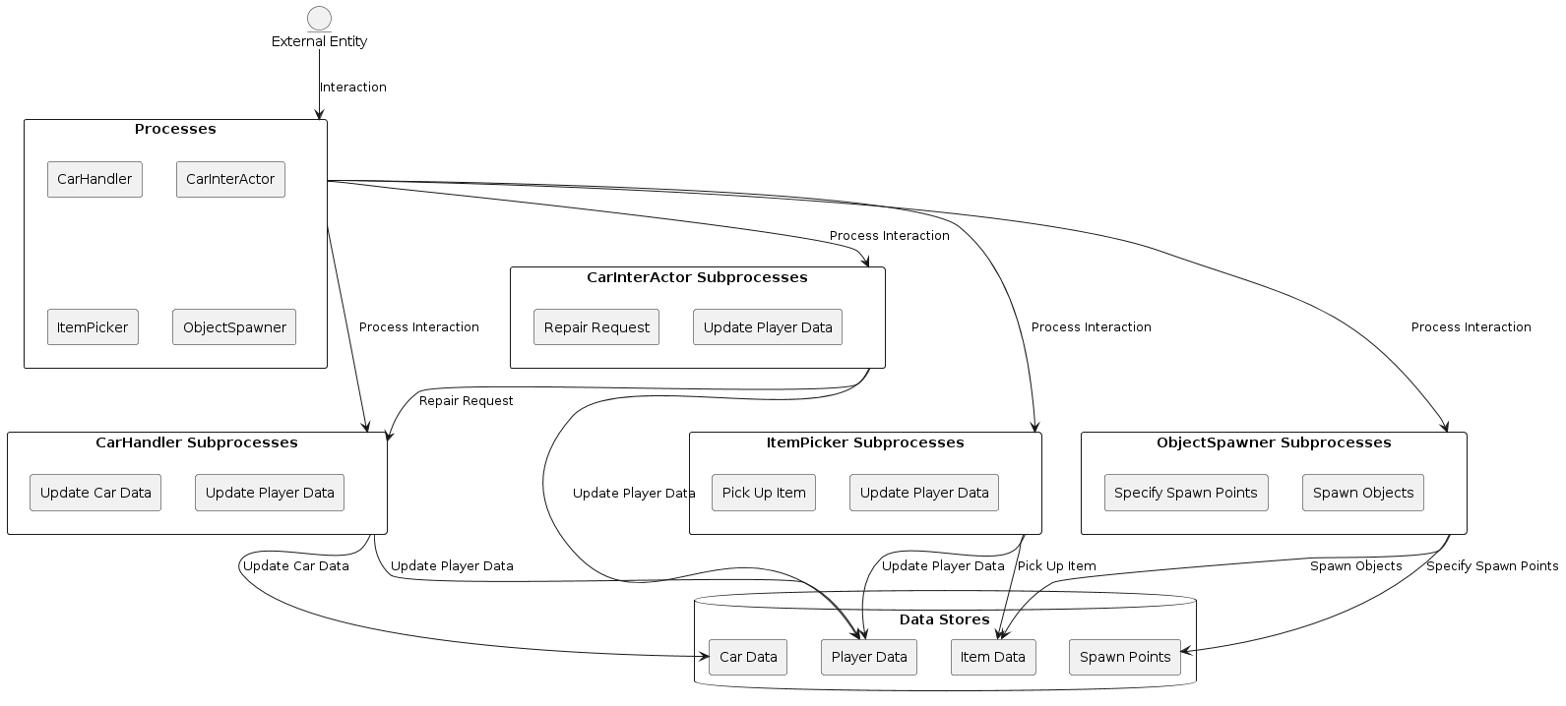

Slide 12
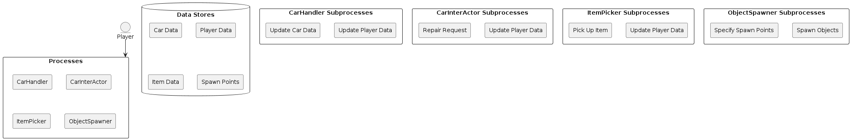
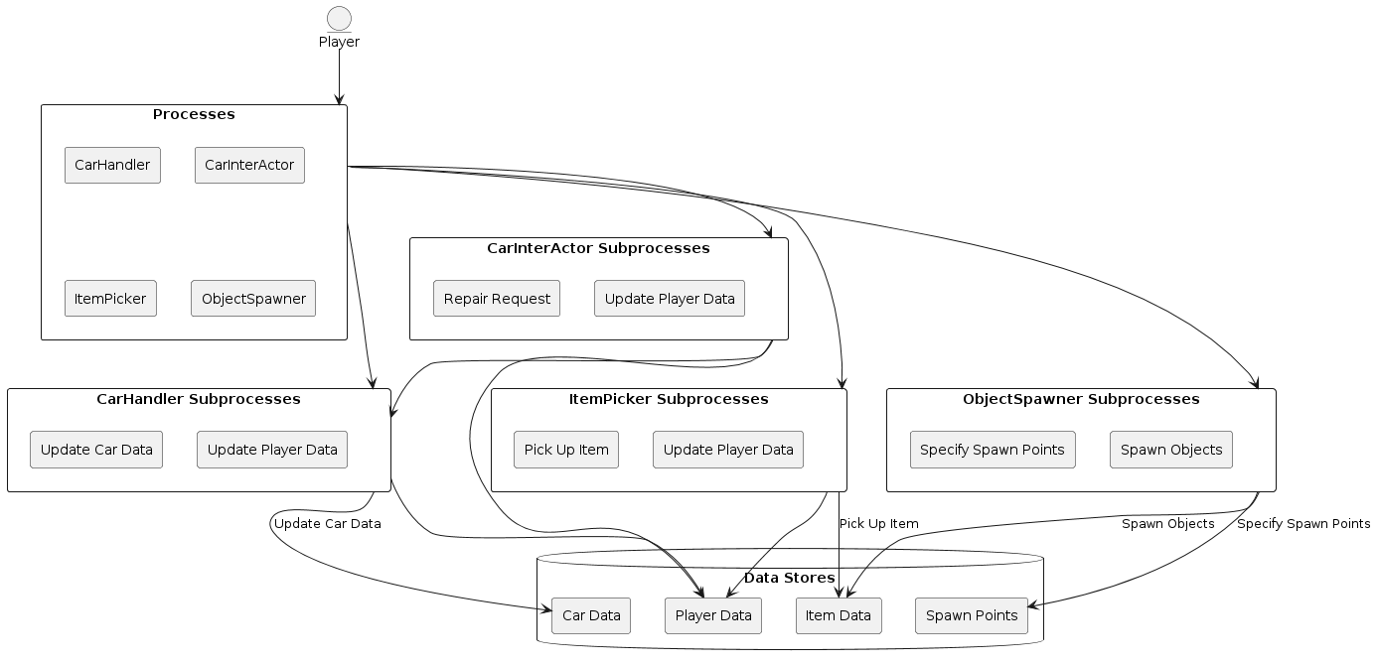

Slide 14
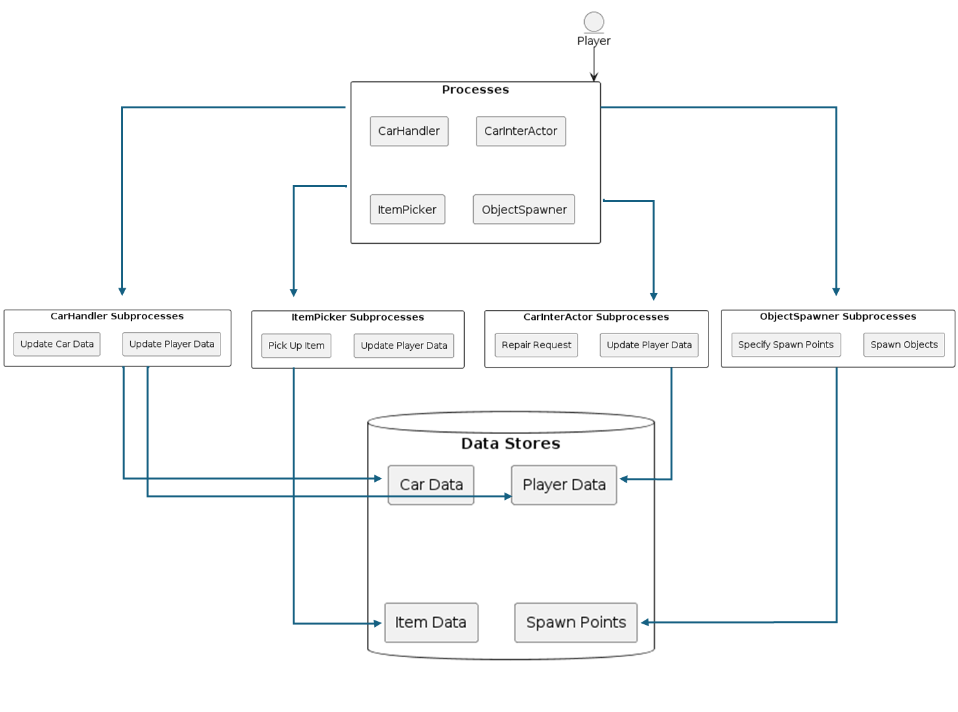

Slide 15
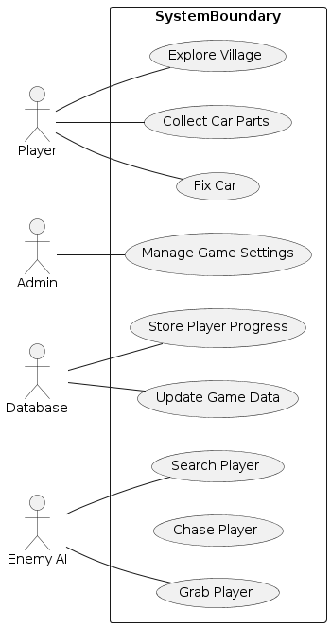

Slide 16
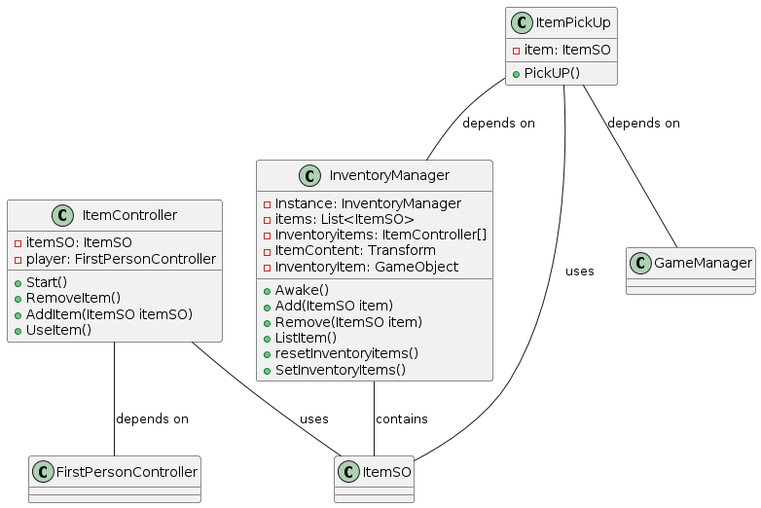

Slide 18


Slide 19



Slide 20


Slide 21


Slide 22
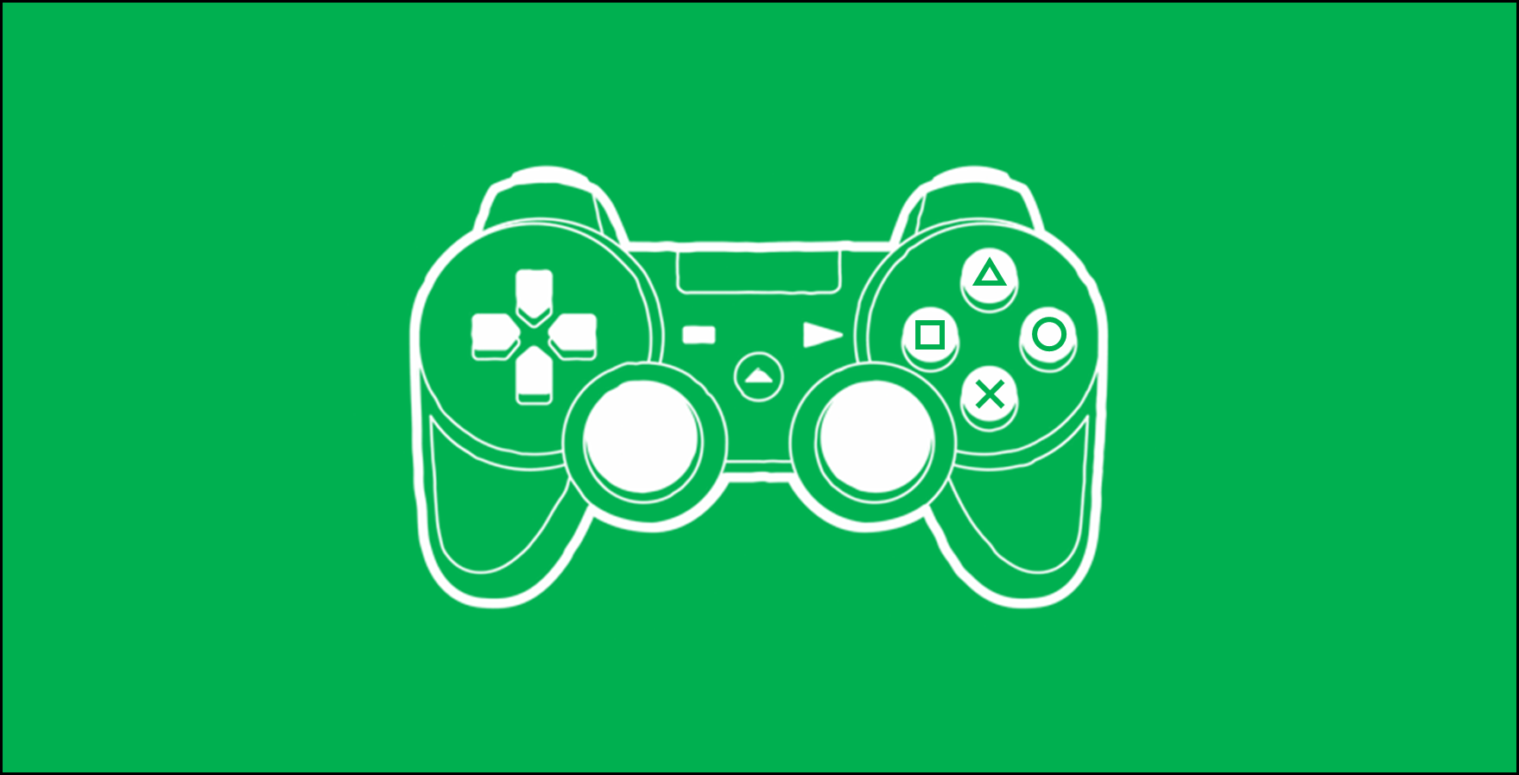

Slide 23
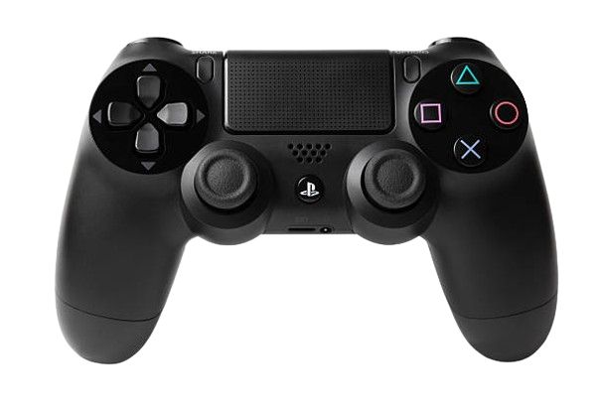
Sprint
Flashlight
Pause
Pick Items
Jump
Movement

Slide 24

DEAD-END-SUNRISE
Press “O” to START

