Slide 1

The MessageBox has to be a billboard so it always faces the player(camera)
The MessageBox is placed above the object prefab and destroyed if player exits the collider
Press [X] to pick up
If Raycast hits MeshCollider:
GlowWalaShader = true;
If Player OnTriggerEnter:
PickUpItem = true;
PickUpMessageBox = true;
isTrigger = true

Slide 2
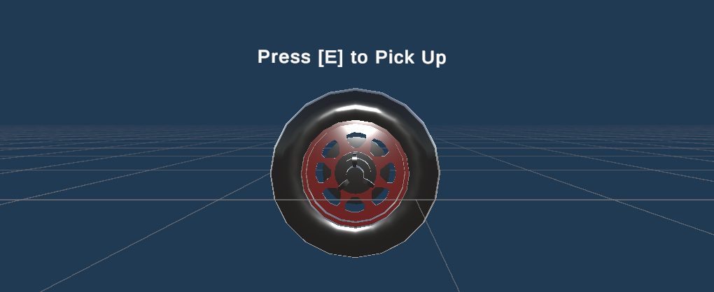
The MessageBox has to be a billboard so it always faces the player(camera)
The MessageBox is placed above the object prefab and destroyed if player exits the collider
If Raycast hits MeshCollider:
GlowWalaShader = true;
It is a Billboard
Always faces the camera
Destroyed after OnTriggerExit
If Player OnTriggerEnter:
PickUpItem = true;
PickUpMessageBox = true;

Slide 3
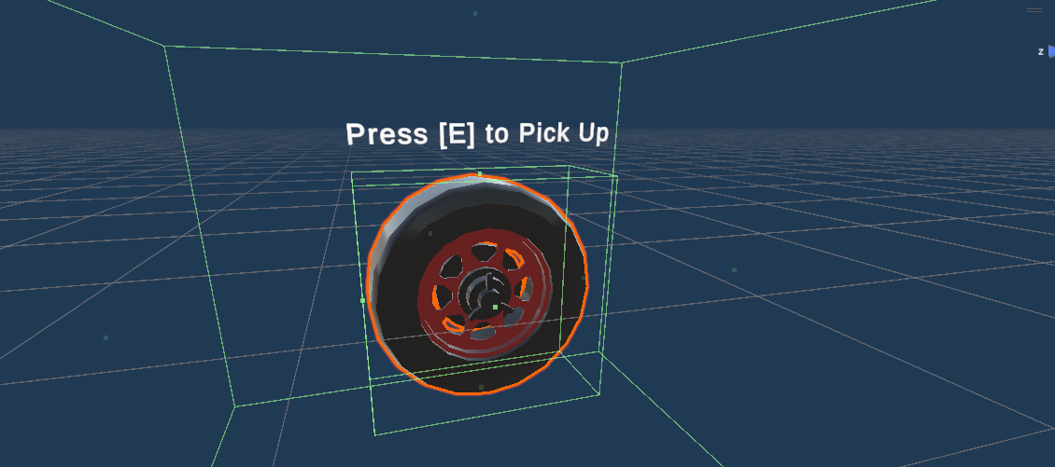


The MessageBox is placed above the object prefab and destroyed if player exits the collider
The MessageBox has to be a billboard so it always faces the player(camera)
If Raycast hits MeshCollider:
GlowWalaShader = true;
If Player OnTriggerEnter && Raycast:
PickUpItem = true;
PickUpMessageBox = true;

Slide 4
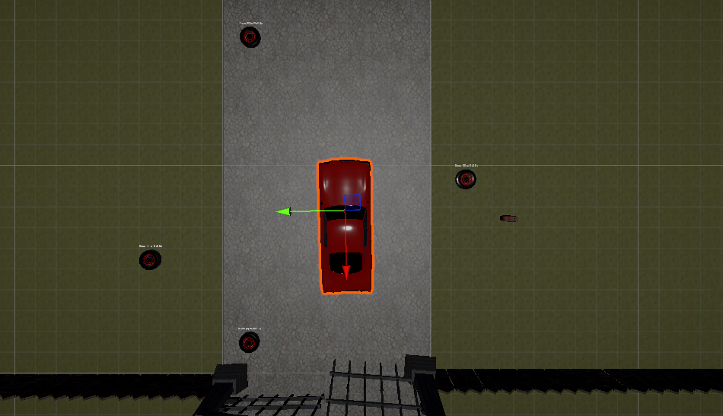
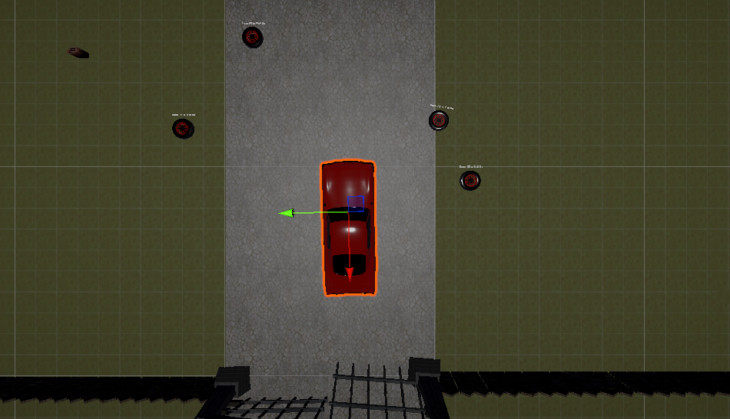

Slide 5
Player
Enemy AI State
PATROL State
Collect Items
Hide from
Enemy
No
CHASE State
Yes
Complete Tasks
Outrun Enemy
No
Enemy Grabs
Win Condition
Lose Condition

Slide 6
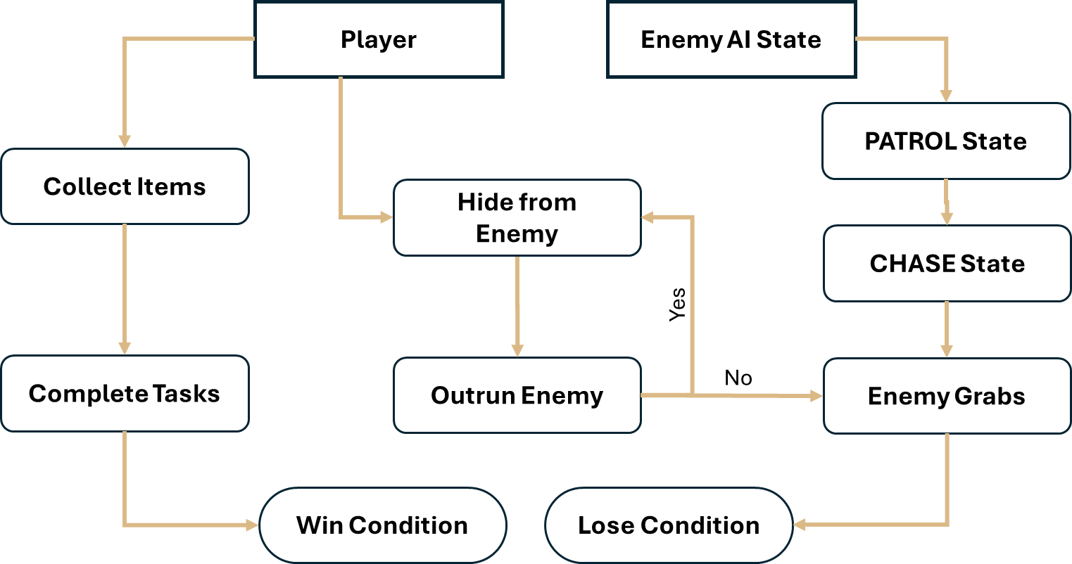
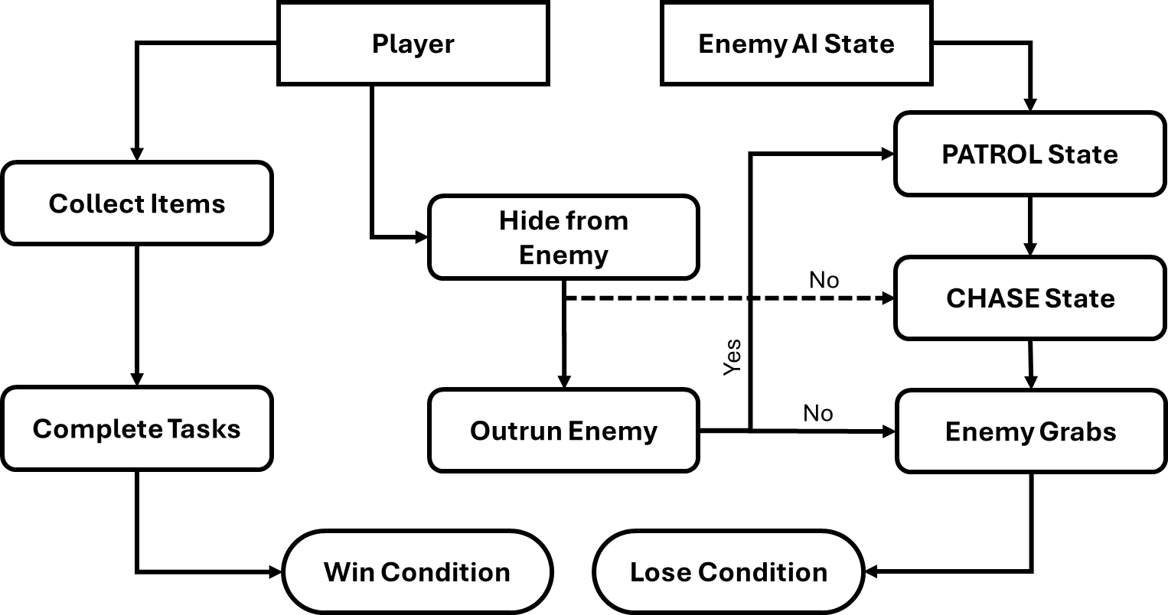

Slide 7
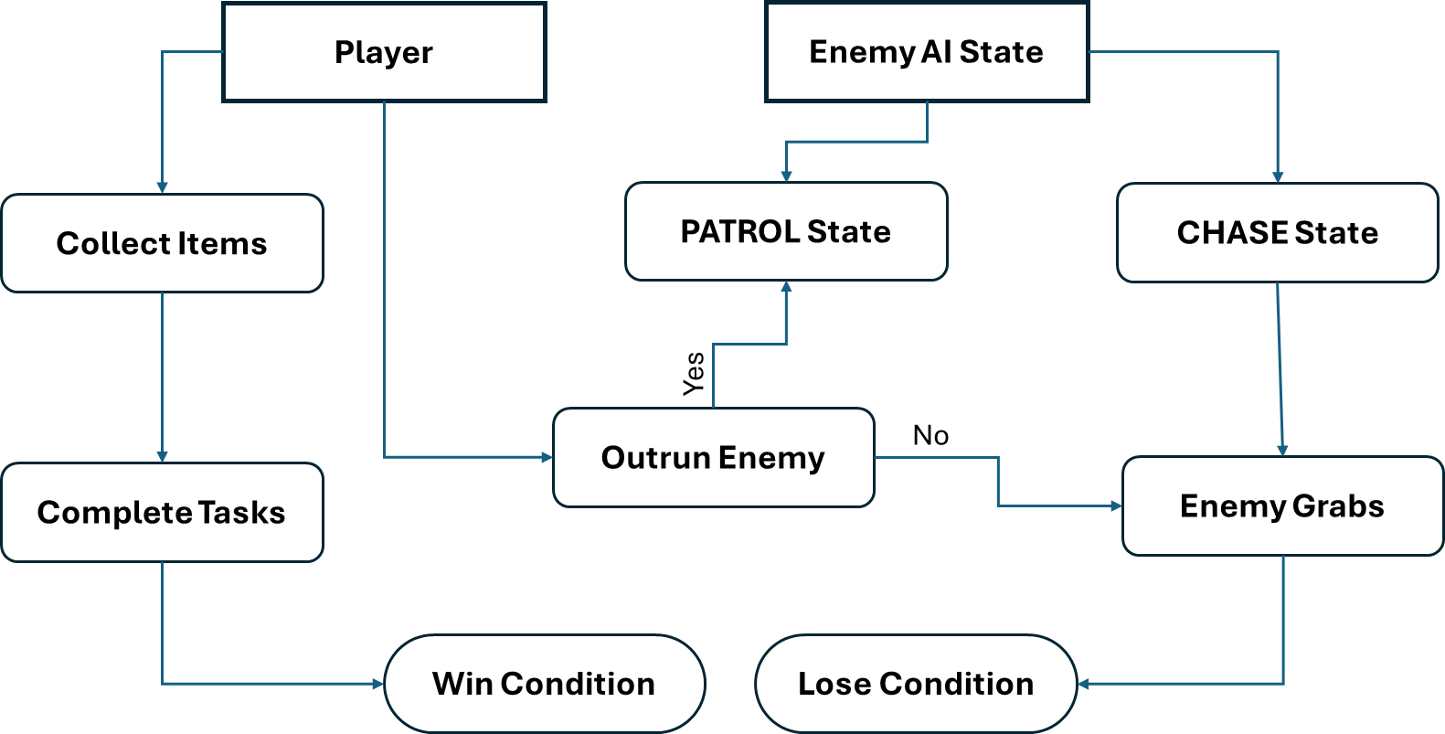

Slide 8
Game Engine
Rendering
Gyroscope
Audio
Gamepad Controllers
VR Headset

Slide 10
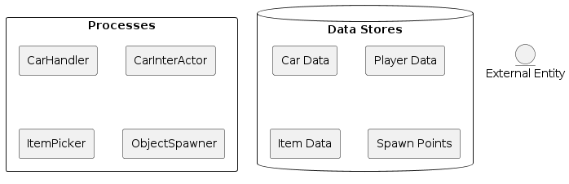
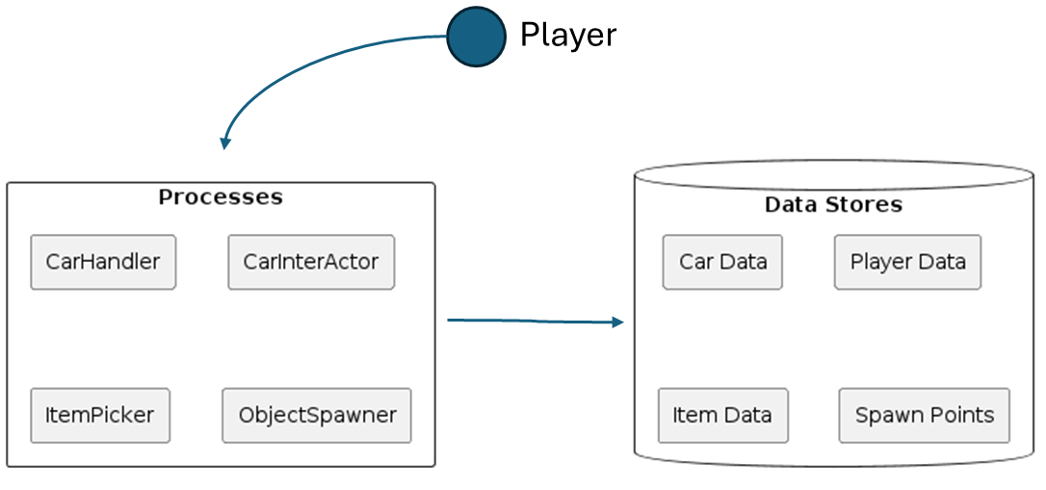
Player

Slide 11
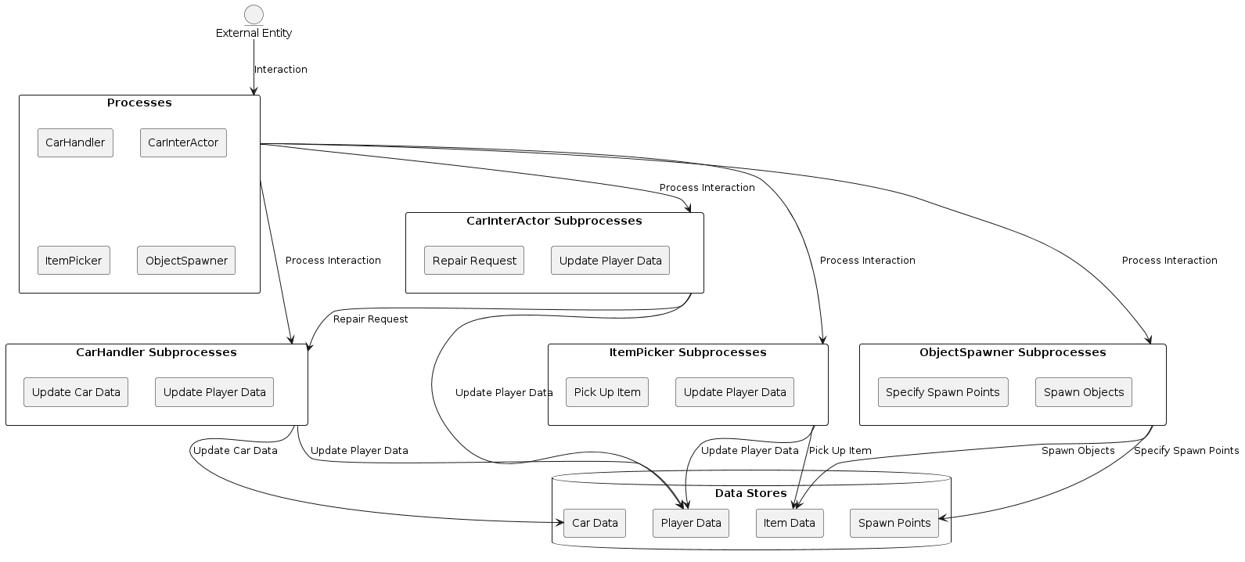

Slide 12
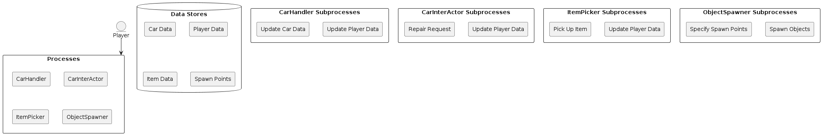
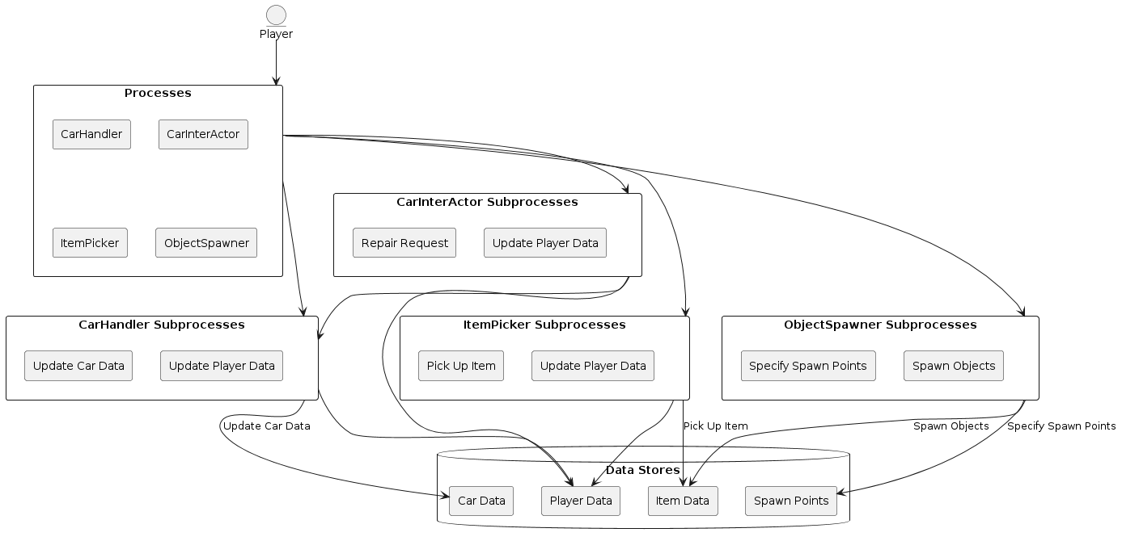

Slide 14
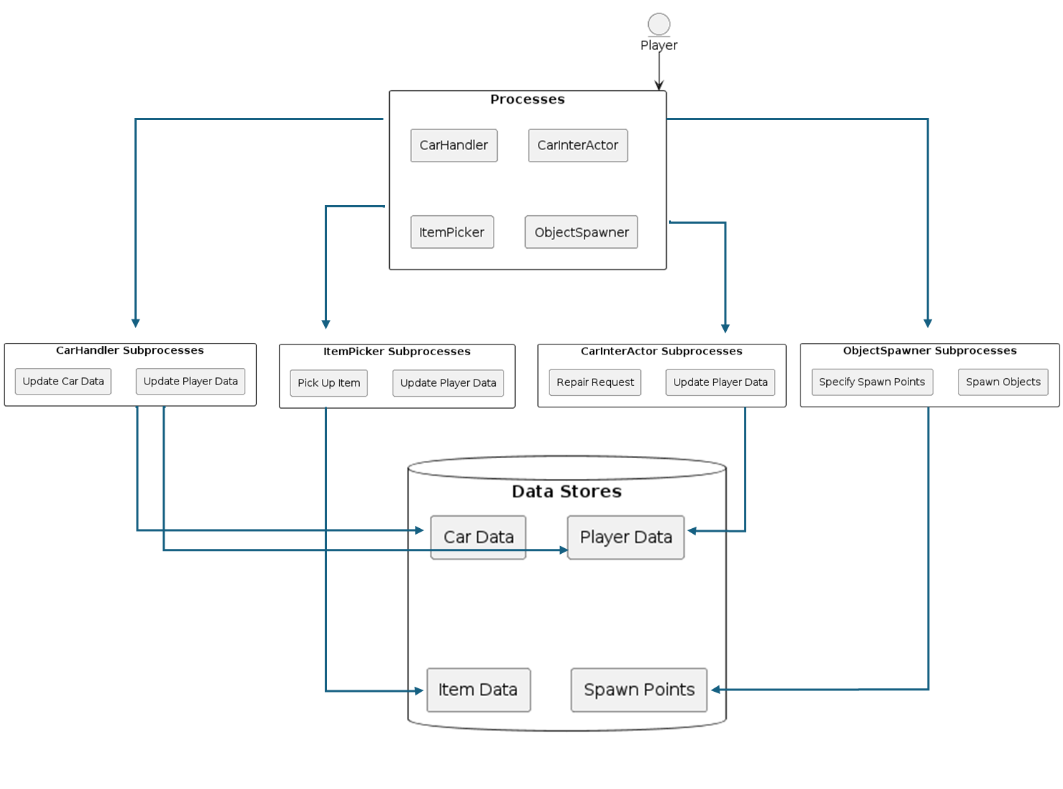

Slide 15
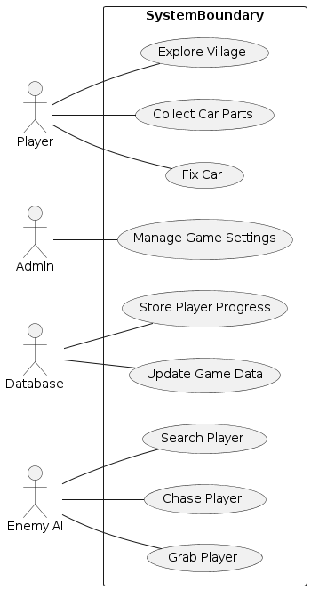

Slide 16
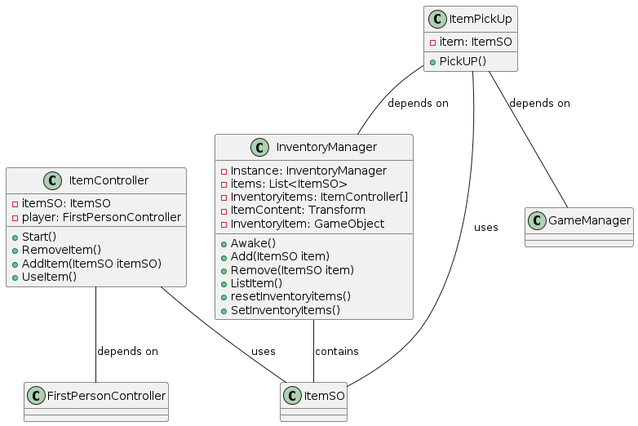

Slide 18


Slide 19



