Slide 1

Do you like this movie?
KNN algorithm for movie recommendation system
Team Goodfellow
Team Goodfellow
Aditya Narayan Singh
Christian Vargas
Gönül Reyhanoğlu
Mohamad Khaje
Renato Roschel Ribeiro
Saranya Kandhasamy
Shruti Sankhe
Final Project of Introduction to Machine Learning and Data Mining
UCSC- Silicon Valley Extension
Summer 2017

Slide 2
OBJECTIVE AND PROBLEM STATEMENT
Objective : Create a Recommender System Using MovieLens Dataset
Problem statement: Given a set of users with their previous ratings for a set of movies, can we predict the rating they will assign to a movie they have not previously rated and recommend top 5 movies s/he would like?
Data source: www.movielens.org

Slide 3
DATASET
Movielens Dataset
Number of ratings = 100,004
Number of users (Anonymous) = 671
Number of movies rated by them = 9,066

Slide 4
WHAT IS A RECOMMENDER SYSTEM?
A recommendation system is any system that automatically suggests content for website readers and users.
The goal of recommender systems is to provide personalized product recommendations to users.
These systems can suggest items to purchase, shows or movies to watch, articles to read, and much more.
The main benefit of recommender system to the user is an improved user experience (e.g. it's easier to find relevant content).
The main benefit for the provider are increased conversions (e.g. content consumed, product bought, engagement, etc).

Slide 5
WHAT ARE THE POPULAR USE CASES OF RECOMMENDER SYSTEMS?
Most popular recommendations systems :
Netflix systems recommend shows and movies for users to watch
Amazon recommends similar items for a user to purchase
Facebook, LinkedIn, and other social networks recommend new friends, groups, and other social connections

Slide 6
WHAT ARE THE SOLUTIONS TO RECOMMENDER SYSTEMS?
Collaborative Filtering based on
User's past behavior
Similar decisions made by other users
The most popular algorithms
  Nearest-neighbors
  Matrix Factorization
  Restricted Boltzmann Machines
  Clustering and LSH
  Association Rules
Content Base Filtering based on
Description of the item
Profile of the user’s preferences
The most popular algorithms
  Bayesian Classifiers
  Cluster Analysis
  Decision Trees
  Artificial Neural Networks
Source: https://en.wikipedia.org/wiki/Recommender_system

Slide 7
SOLUTION TO OUR PROBLEM:
K-NEAREST NEIGHBORS ALGORITHM
It is used for classification and regression
It is a memory based method
The basic idea of kNN is to compute the distance between the target data and the training samples and to only use the information of a certain number (k) of the nearest neighbors of the target data to make a decision.

Slide 8
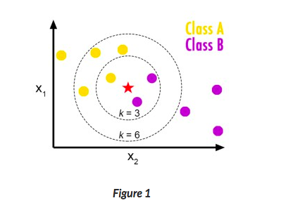
SOLUTION TO OUR PROBLEM:
K-NEAREST NEIGHBORS ALGORITHM
k-NN illustration with k=3, and k=6
Example:
Classifying the new data point “red star” to either class A or class B.
When k = 3, there is 1 vote for class A and 2 votes for class B. )Thus, the “red star” is assigned as class B.)
When k = 6, there are 4 votes for class A and 2 votes for class B. Thus, the “red star” is classified into class A.
We can see in the example that different values of k yield completely different results.
The most commonly used distance metric for continuous variables is Euclidean distance.
As to the selection of k, generally speaking, a reasonably large value of k is desired in order to make kNN less sensitive to noise.

Slide 9
SOLUTION TO OUR PROBLEM: K-NEAREST NEIGHBORS ALGORITHM
Advantages:
Simple to implement
Few tuning parameters (K, distance metric)
Flexible, classes do not have to be linearly separable
Disadvantages:
Computationally expensive
Sensitive to imbalanced datasets
Sensitive to irrelevant inputs

Slide 10
IMPLEMENTATION OF OUR SOLUTION :Data Preparation
Reshape the data with user as row and movies as columns and ratings as the values
Reason for reshaping data:
Each user should have one row with all movies as features
The algorithm finds the nearest users for a given user
Input dataset structure:
Reshaped dataset structure:
UserId | MovieId | Rating | Timestamp
User 1 | Movie 2 | 2 | 1260759144
User 2 | Movie 1 | 1 | 1260759179
User 3 | Movie 1 | 3 | 1260759182
User 3 | Movie 2 | 1 | 1260759185
User ID/Movie ID | Movie 1 | Movie 2
User 1 | na | 2
User 2 | 1 | na
User 3 | 3 | 1

Slide 11
IMPLEMENTATION OF OUR SOLUTION :Normalization
Need for normalization:
While rating movies, some people may be too generous, some might be conservative
Saranya rates the movie she likes the most as 3 and the least as 1
Gonul rates the movie she likes the most as 5 and the least as 3
We are comparing Saranya and Gonul with different personal opinions
How to deal with this problem? Normalize the data
Normalization steps
Calculate the mean and standard deviation of each user
Subtract the mean of each user from his/her rating
Divide the above number the standard deviation of the user
User ID/Movie ID | Movie 1 | Movie 2
User 1 | na | 0.811813645
User 2 | -0.89203004 | na
User 3 | -2.509242176 | 0.775217091

Slide 12
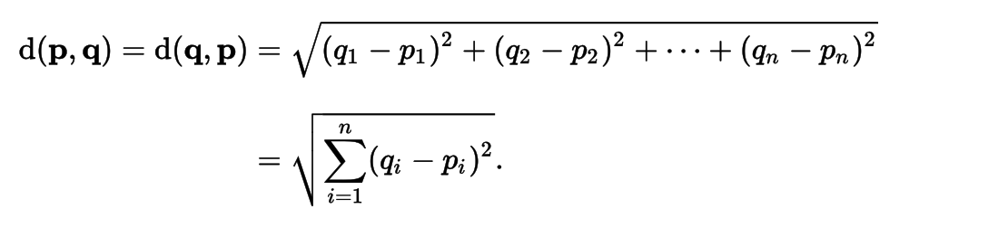
IMPLEMENTATION OF OUR SOLUTION :KNN steps
Training & Testing Data split:
Split the reshaped and normalized data into testing and training (80%-20%).
We are going to predict the ratings for every ratıng in test data and compare wıth actual to evaluate
KNN Steps
For every user in test data who rated a movie, pick all the users from training data who rated the same movie
For this 2 data find the Euclidean distance between the commonly rated movies (Ignoring NA)

Slide 13
IMPLEMENTATION OF OUR SOLUTION : KNN steps
KNN Steps continued…
Sort the Euclidean distance in ascending order and find the K minimum distance users for the input user
Take the average ratings for that movie from the selected K nearest users
De-normalize the average rating
Predicted rating = (Average Rating * SD of I/P user) + Mean of I/P user
Calculate predicted rating for all movies the input user rated.

Slide 14
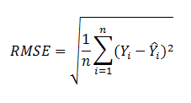
EVALUATION
Compare the actual ratings from the test dataset to its predicted ratings using RMSE
RMSE
Take the differences between actual and predicted values
Sum them and take the average of it
Take the square root of it

Slide 15
EVALUATION
HOW DO WE SELECT THE OPTIMUM K?

Slide 16
CONCLUSION
Optimum K is 5
RMSE is 0.75076454
K | RMSE
1 | 0.88423942
2 | 0.79288900
3 | 0.76466025
4 | 0.75445994
5 | 0.75076454
6 | 0.75051436
7 | 0.74834050
8 | 0.75064838
9 | 0.75050205
10 | 0.75286240
Convergence begins
Min RMSE

Slide 17
CONCLUSION
Optimum K is 5
RMSE is 0.75076454
K | RMSE | Running Time | Team member | Machine | Processor | Memory
1 | 0.88423942 | 4:48:42 | Aditya
2 | 0.79288900 | 2:05:25 | Renato | MacBook Air | 1.6 GHz Intel Core i5 | 8 GB
3 | 0.76466025 | 2:40:57 | Christian | Asus Windows | 2.2 GHz Intel Core i5 | 8 GB
4 | 0.75445994 | 5:28:29 | Saranya | Lenovo thinkpad | 2.4GHz Intel I7 | 24GB
5 | 0.75076454 | 1:36:35 | Shruti | MacBook Pro | 2 GHz Intel Core i5 | 8 GB
6 | 0.75051436 | 2:54:37 | Gonul | MacBook | 1.1 GHz Intel Core M | 8 GB
7 | 0.74834050 | 2:00:26 | Renato | MacBook Air | 1.6 GHz Intel Core i5 | 8 GB
8 | 0.75064838 | 3:37:11 | Payman | MacBook Air | 1.6 GHz Intel Core i5 | 8 GB
9 | 0.75050205 | 2:24:17 | Renato | MacBook Air | 1.6 GHz Intel Core i5 | 8 GB
10 | 0.75286240 | 2:30:39 | Christian | Asus Windows | 2.2 GHz Intel Core i5 | 8 GB

Slide 18
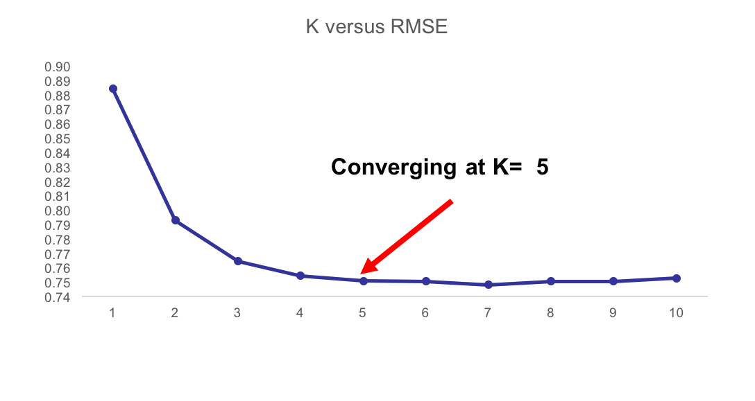
CONCLUSION
Run the KNN with multiple K to fınd optimum K
RMSE
K

Slide 19
FUTURE WORK
More ratings may result in smaller RMSE
Run time is long due to comparison of query user with all users in training data
To reduce the running time, clustering may help
Different algorithms could be applied and results could be compared for better recommendation outputs

Slide 20
REFERENCES
https://medium.com/machine-learning-for-humans/supervised-learning-3-b1551b9c4930
https://en.wikipedia.org/wiki/K-nearest_neighbors_algorithm
https://grouplens.org

