Slide 1
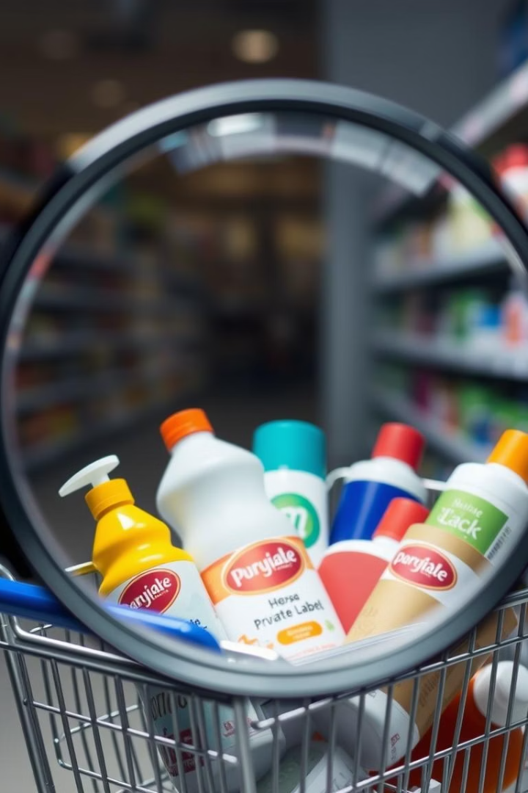
A Study on Consumer Perception of Private Label Brands
M.Sc. Applied Statistics | PRN: 23060641083 Name: Shruti Shukla Guide: Miss Navya Sharma

Slide 2
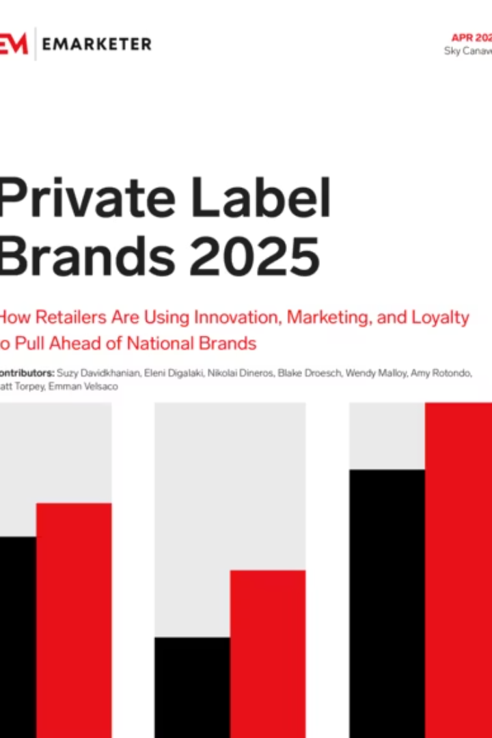
Executive Summary & Introduction
Study explores consumer perception of private label brands (PLBs)
PLBs have evolved from low-cost options to quality-driven alternatives
Based on survey data from 109 respondents
Focus areas: demographics, satisfaction, brand familiarity
Tools used: Python, pandas, seaborn, matplotlib, scikit-learn
Methods: descriptive analysis and predictive modelling

Slide 3


Aims & Objectives
Aim
To explore and analyze consumer perceptions, satisfaction, and purchasing patterns toward private brands using statistical and machine learning techniques.
Objectives
Measure awareness and brand recognition.
Evaluate opinions on quality, value, and trustworthiness.
Identify key factors influencing private brand choice.
Analyse satisfaction's impact on recommendation willingness.
Build predictive models for consumer behaviour.
Offer practical recommendations for retailers.

Slide 4
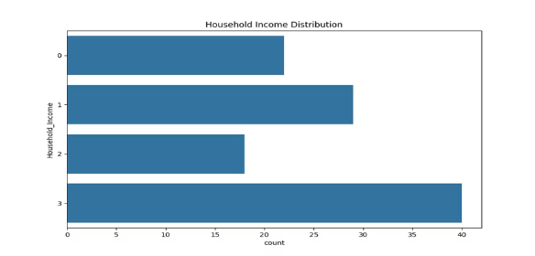
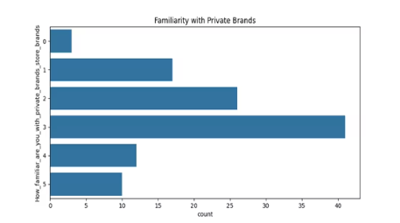
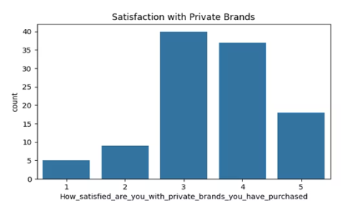



Descriptive Analysis: Key Consumer Trends
Household Distribution
Brand Familiarity
Satisfaction & Recommendation
Most respondents were from lower to middle-income groups. They are careful with spending, which matches the value of private brands, making them good targets for special offers and deals.
Most people know about private brands, so the next step is to build their trust and make them prefer these brands more.
Most consumers rated private brands 3 or 4, showing they meet expectations. Satisfied buyers were more likely to recommend them, stressing the need for high product standards.

Slide 5
Predictive Modelling: Understanding Consumer Behaviour
Evaluating Models for Target: “What is your overall perception of private brands compared to national brands”
Logistic Regression
84%
The first model did okay but struggled to identify strong opinions. It worked better for average responses.
Random Forest
93%
The second model had high accuracy and did well in identifying most opinion types. However, it was slightly weak in spotting strong opinions.
Support Vector Machine
96%
The third model performed the best with 96% accuracy. It was very good at recognizing different opinions, especially strong positive ones, making it the best choice for this task.
The perception was effectively modeled using ensemble and margin-based classifiers. Among them, SVM performed the best by accurately distinguishing different levels of customer opinions. The analysis showed that positive perceptions were mainly driven by product quality, past experience, and familiarity with the brand.

Slide 6
Results and Conclusion: Strategic Implications
Product Experience
Brand Familiarity
Consistent quality builds loyalty and trust.
Higher awareness improves perception and recommendations.
Segment-Based Targeting
Predictive Models
Young, budget-conscious consumers are highly engaged. Personalize marketing efforts to deepen relationships with this segment.
Use Random Forest and SVM to find loyal and potential customers for better engagement.
The project studied how consumers view, use, and feel about private label brands (PLBs). Young, urban, price-conscious buyers preferred PLBs. Positive perception came from quality and familiarity, while satisfaction and trust led to more recommendations. Buying habits were shaped by availability and routine. Ensemble models worked best, showing that both emotions and practical needs influence PLB choices. PLBs are becoming trusted, value-based options.

Slide 7
THANK YOU

