Slide 1
The label was a coin flip.
Cleaning 50,000 corrupted career profiles and proving what they can and cannot tell us
Pandas & Co. · Analytrix TCET · Problem Statement 3

Slide 2
Ten kinds of corruption in every column
nan NULL MISSING ? ""
{"v": 59}
51-56
five missing tokens
JSON-wrapped numbers
ranges instead of values
Val_52
$67508 118274 USD
UmV0YWls → Retail
junk prefix
currency noise
base64 categoricals
tsylanA ataD → Data Analyst
0x1
muideM TWVkaXVt
reversed strings
hex IDs
the label itself
Each type hits 8 to 30 percent of rows. Roughly 20 percent of every column is genuinely missing.

Slide 3
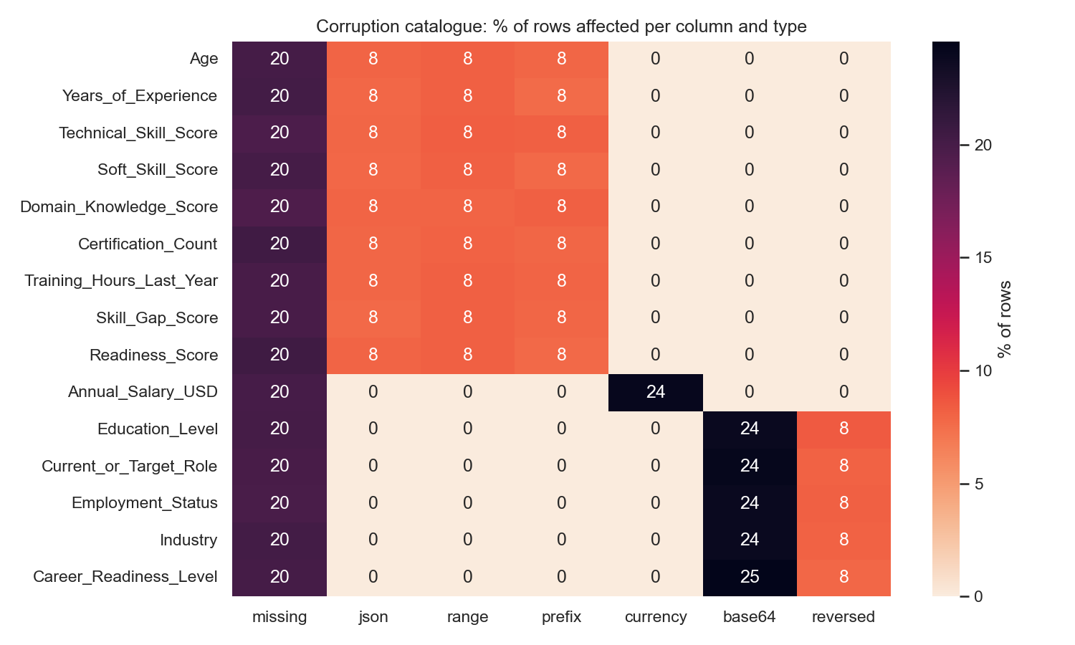
We measured it before touching it
215,910
values repaired
0
unparseable values left

Slide 4
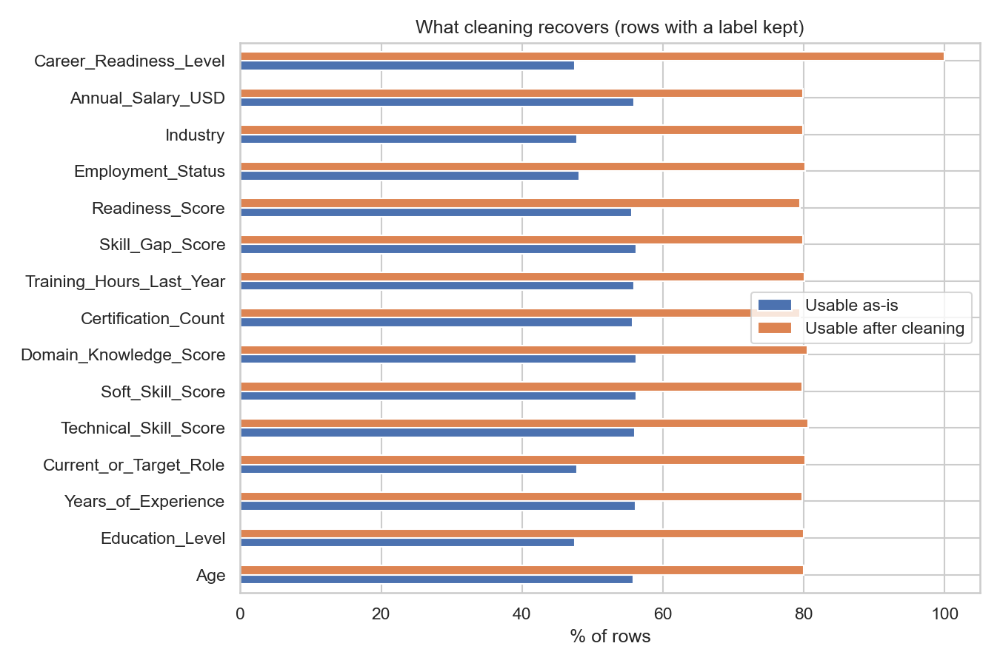
One small function per corruption
1
2
3
4
5
6
missing tokens → NaN
unwrap JSON
strip Val_ / $ / USD
range → midpoint
base64 → decode → vocab
reversed → reverse → vocab
clean(df) → (clean_df, report)
Same function in training and in the demo app, so nothing drifts between the two. Every fix is counted. Five assert-based tests guard the cleaners.

Slide 5
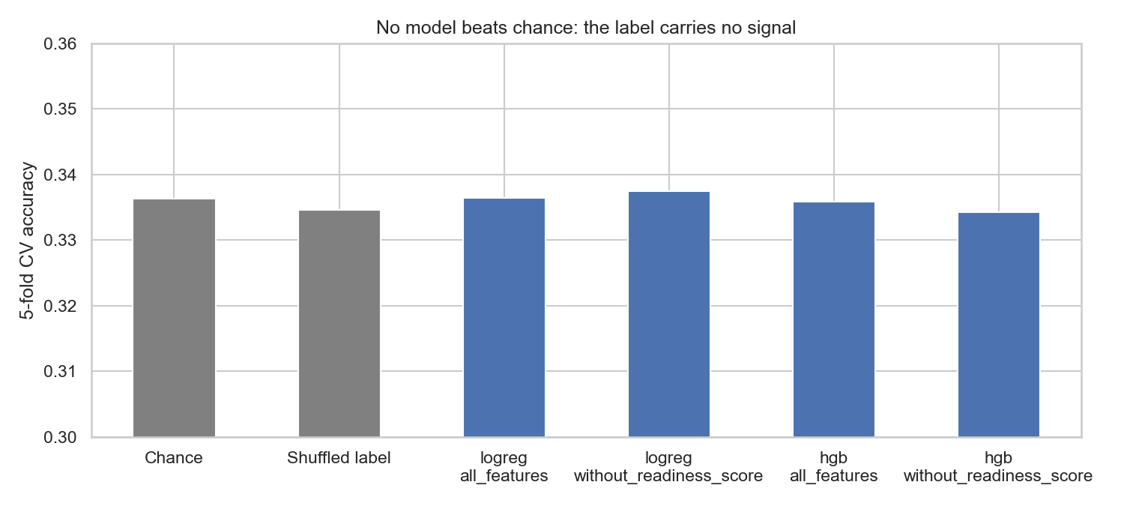
We tried to predict it. Honestly.
Model | 5-fold CV accuracy
Chance | 0.336
logistic regression, all features | 0.336
logistic regression, without readiness score | 0.337
gradient boosting, all features | 0.336
gradient boosting, without readiness score | 0.334
gradient boosting, shuffled labels (20 runs) | 0.335
Chi-square of every categorical vs the label: p > 0.36.
No feature correlates with any other above 0.02.

Slide 6
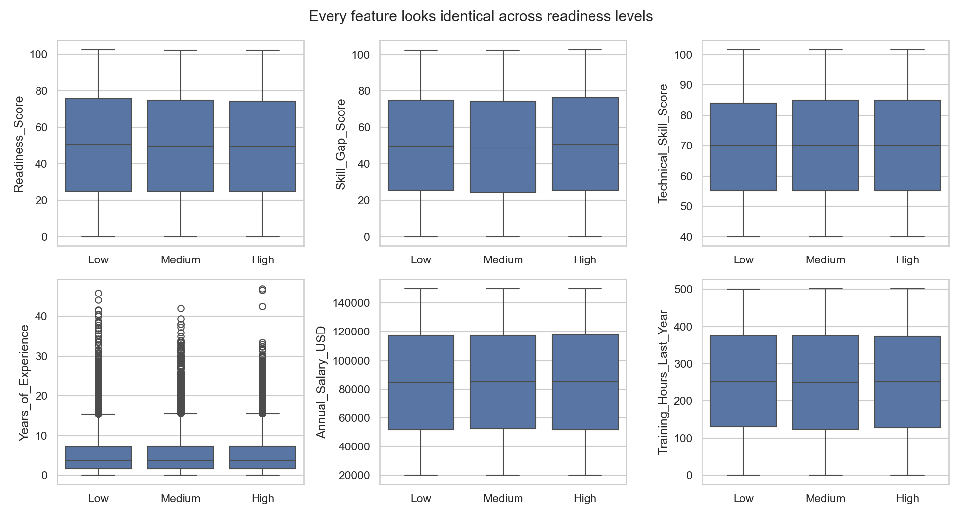
The features are uniform noise.
The label is a fair three-sided coin.
Nobody can beat 33 percent on this data. A submission that does is leaking the target or overfitting. We report the truth instead of a fake score.

Slide 7
What we ship instead
40%
20%
20%
10%
10%
skills average
experience
closed skill gap
certifications
training hours
A transparent Readiness Index, 0 to 100, built only from cleaned inputs.
Explainable, tunable, and it does not pretend to learn from a random label. Live in the Streamlit demo: upload any dirty CSV, get it cleaned, audited and indexed, with a try-your-own-profile form.

Slide 8
Takeaways
1
Clean first, and count every fix.
2
Test for leakage before celebrating.
3
Test against chance and against shuffled labels.
4
A truthful "no signal" beats a fake 99 percent.
github.com/Shrutiiicodes/Pandas-and-Co

