Slide 1
AMS 563 · Medical Image Analysis
RadClinNet
Multimodal Fusion of Chest CT and Clinical Variables
for Survival Prediction in Non-Small Cell Lung Cancer
Presented to Prof. Chenyu You · Stony Brook University
Dataset: NSCLC-Radiogenomics (TCIA)
Task: Binary Survival Classification

Slide 2
OBJECTIVES
What This Project Sets Out to Do
01
Build a complete end-to-end pipeline that fuses raw CT DICOM images with EHR-derived clinical variables for NSCLC survival prediction
02
Compare three models (clinical-only, CT-only, and multimodal fusion) to understand each modality contribution
03
Apply key medical image analysis techniques: transfer learning, data augmentation, class-weighted loss, and Grad-CAM interpretability
04
Honestly evaluate results and limitations, and propose directions for future improvement

Slide 3
MOTIVATION
Why Multimodal Survival Prediction?
85%
#1
2
5-year mortality rate
for advanced NSCLC
Leading cause of
cancer mortality worldwide
Modalities fused:
CT imaging + EHR data
Clinical risk models today rely almost exclusively on tabular EHR features: lab values, demographics, cancer stage. CT scans are routinely collected but rarely integrated into risk scores. This project investigates: whether fusing CT imaging with structured clinical data yields stronger survival prediction in NSCLC compared to either modality alone.

Slide 4
DATA
NSCLC-Radiogenomics Dataset (TCIA)
Dataset Overview
Why NSCLC-Radiogenomics?
112 labeled patients with survival status 48 patients with matched DICOM CT studies Target: Survival Status (Dead = 1, Alive = 0) Tabular features include: Age, gender, smoking history, cancer stage,
histology type, EGFR mutation status,
recurrence status, and clinical lab values
Only public dataset with both raw CT DICOMs and matched EHR-derived clinical labels
Class Distribution (n=112)
Alive 46 (41%)
Dead 66 (59%)
⚠ Class imbalance → weighted loss used during training

Slide 5
METHODOLOGY
End-to-End Pipeline
DICOM
Loading
Preprocessing
Tabular
Prep
Model
Training
Evaluation
& Explainability
PyDICOM
HU conversion
Multi-frame support
HU windowing
Slice sampling
Bilinear resize → 96×96
One-hot encoding
Imputation
Standardization
3 architectures
Weighted loss
Weight decay
AUROC · AUPRC
Brier · Sens · Spec
Grad-CAM
Data Augmentation
Transfer Learning
Random horizontal flipping applied during training to increase
diversity and reduce overfitting on the small 36-patient train set.
ImageNet-pretrained ResNet18 used as CT encoder. Pretrained
features compensate for small dataset, critical for only 36 patients.

Slide 6
MODELS
Three Architectures Compared
Clinical Only
Imaging Only
Multimodal
Tabular MLP
CT-Only
(ResNet18)
Fusion
Model
Input: EHR-derived clinical features
Architecture: 3-layer MLP
Dropout: 0.4 → 0.3
Output: survival probability
Input: 8 axial CT slices @ 96×96
Encoder: pretrained ResNet18
Slice pooling: mean across slices
Output: survival probability
CT encoder: ResNet18 (512-dim)
Tabular encoder: MLP (64-dim)
Fusion: concatenation → 576-dim
Shared classifier head → output
All models: Adam optimizer · weight_decay=1e-3 · BCEWithLogitsLoss with class weights · 6 epochs · lr=1e-3

Slide 7
METHODOLOGY
Iterative Model Development
1
Custom Lightweight CNN
3-layer Conv2D encoder trained from scratch
CT-only AUROC: 0.722 | Fusion AUROC: 1.000 (overfitting)
Problem: too little data to learn features from scratch
Overfit
2
Regularization Additions
Added: Dropout 0.4, weight decay 1e-3, random flip augmentation, class-weighted loss
CT-only AUROC: 0.722 | Fusion AUROC: 1.000 (no improvement)
Problem: regularization alone cannot fix a fundamentally small dataset
Insufficient
3
Transfer Learning with ResNet18
Replaced custom CNN with ImageNet-pretrained ResNet18 backbone
CT-only AUROC: 0.917 ↑ | Fusion AUROC: 0.861
Pretrained features compensate for limited training data
Best Results ✓

Slide 8
RESULTS
Final Evaluation Metrics
Model | AUROC | AUPRC | Brier Score | Sensitivity | Specificity
Tabular MLP | 1.000* | 1.000* | 0.034 | 1.000 | 1.000
CT-Only (ResNet18) | 0.889 | 0.917 | 0.162 | 1.000 | 0.500
Fusion Model | 0.861 | 0.856 | 0.214 | 1.000 | 0.500
* Tabular model achieves perfect test separation on n=12 test patients. Result is consistent with strong clinical predictors (stage, histology) but should be interpreted cautiously given the small test set.
Key finding: Transfer learning boosted CT-only AUROC from 0.722 → 0.889. Fusion model (0.861) reflects genuine multimodal combination rather than tabular dominance.

Slide 9
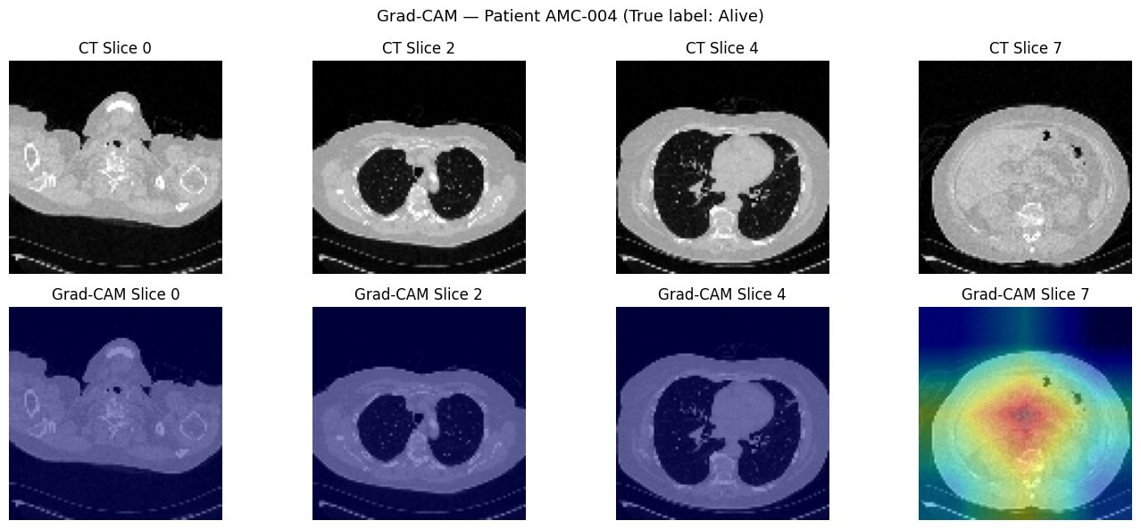
Grad-CAM Visualization
INTERPRETABILITY
Observation: Attention concentrates on background rather than lung tissue, a small-data artifact. With more training patients, ResNet18 would learn to focus on clinically relevant anatomy.

Slide 10
DISCUSSION
Findings & Analysis
📊 Tabular dominance is expected
🧠 Transfer learning is essential at this scale
Clinical variables (stage, histology, age) are strong survival predictors. Perfect test separation on n=12 is plausible but must be interpreted cautiously. Larger test sets needed to confirm.
A custom CNN trained from scratch on 36 patients cannot learn meaningful imaging features. ResNet18 pretrained on ImageNet provides a strong initialization that generalizes even with limited CT data.
🔗 Fusion is more conservative than tabular alone
👁 Grad-CAM reveals attention on background
Fusion AUROC (0.861) < Tabular (1.000) on this test set, actually a healthier result. The CT branch now contributes genuine signal that modulates the overconfident tabular predictions.
Attention maps focus on image borders rather than lung tissue. This is a known small-data artifact and motivates future work using lung segmentation masks as spatial priors.

Slide 11
LIMITATIONS & FUTURE WORK
Honest Assessment & Next Steps
⚠ Limitations
→ Future Work
Small dataset
112 total patients, only 12 in test set for CT experiments. Results not statistically stable. Tabular ceiling effect
Structured clinical variables are too strong on this dataset for imaging to demonstrate added value. Grad-CAM background attention
CT model does not focus on clinically relevant anatomy, needs spatial supervision.
Scale to larger cohorts
TCGA-LUAD or NLST datasets for statistically stable evaluation and cross-validation. Cross-attention fusion
Replace concatenation with a Transformer cross-attention mechanism for dynamic modality weighting. 3D volumetric models
Explore 3D CNNs or ViT-based models to capture full volumetric CT context rather than 2D slices.

Slide 12
Conclusion
1
Built a complete multimodal pipeline combining CT DICOM preprocessing with EHR-derived tabular features for NSCLC survival prediction
2
Demonstrated that transfer learning (ResNet18) is essential for CT-based learning at small dataset scale, improving AUROC from 0.722 → 0.889
3
Applied course techniques: data augmentation, class-weighted loss, transfer learning, and Grad-CAM interpretability
4
Honestly reported the limitations of small-scale multimodal learning and identified clear directions for future work

Slide 13
Thank You
Questions Welcome
Shruti Jagdale | AMS 563 | Stony Brook University

