Slide 1
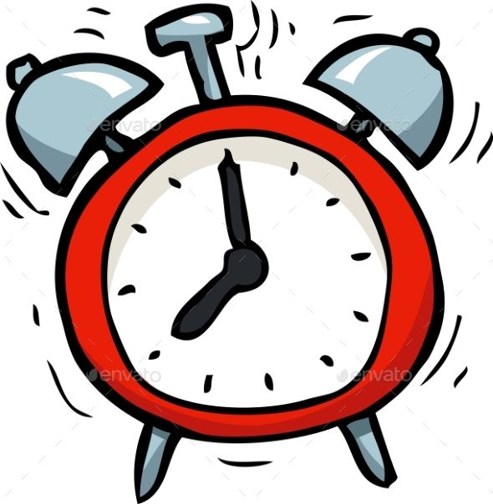
ALARM CLOCK

Slide 2
GROUP MEMBERS
10827_Purva Bapecha
10829_Kareena Manghani
10830_Anuja Katruwar
10832_Shruti Jagdale
10838_Rahul Sakharkar

Slide 3
AIM/OBJECTIVE
It is no doubt that an alarm clock is always handy to alert us whenever we sleep, take a short nap, or to remind us about the work, we always get oblivious about.
The objective of our project is to implement an alarm clock using Python.
Python consists of some very innovative libraries such as datetime and tkinter which help us to build the project using the current date and time as well as to provide a user interface to set the alarm according to the requirement in 24-hour format.
Python when combined with Tkinter provides a fast and easy way to create GUI applications.
All the modules used need not be downloaded beforehand like the other libraries like NumPy, thus this project will be user friendly and accessible in any virtual environment used for python programming.

Slide 4


Slide 5
Research or Literature:
PYTHON LIBRARIES-
https://www.geeksforgeeks.org/python-programming-language/
TKINTER-
https://youtu.be/VMP1oQOxfM0
https://www.google.com/amp/s/www.geeksforgeeks.org/creat-an-alarm-clock-using-tkinter/amp/
DATE/TIME-
https://www.w3schools.com/python/python_datetime.asp
https://youtu.be/mHezNgNBnuA
TIME-
https://www.programiz.com/python-programming/time

Slide 6
Requirements and feasiblility:
This project requires good knowledge of Python and GUI (Graphic User Interface). Tkinter provides a powerful object-oriented interface to the Tk GUI toolkit
TKINTER module belongs to a standard library of GUI in Python. It helps us to create a dialog box with any information that we want to provide or get from the users.
DATE-TIME and TIME modules in python help us to work with the dates and time of the current day when the user is operating python and to manipulate it too.
This project is designed with the use of python language and the various libraries available in it.
.

Slide 7


Slide 8
PROJECT STRUCTURE
Importing all the libraries and modules required
Putting forward a while loop which takes the
argument of the time, the user wants to set the
alarm on and automatically breaks when the time
is up, with sound
Create a display window for user input.

Slide 9
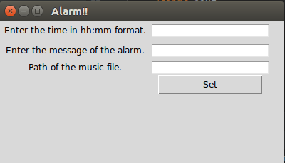
CONCLUSION
With this project in Python, we have successfully made the Alarm Clock. We used the popular GUI library for rendering graphics on a display window. We learned how to extract the current time from the computer and to use it for manipulation using the DateTime library. This way we can set an alarm in the computer interface using python programming which rings with the random song chosen from the directory.

