Slide 1


{THALI SANJHA } WASTE FOOD REDUCTION WEBSITE
Shruti Jain, Tanisha, Aprajita Kumari
Under Supervision of
Internal Supervisors : Shweta Bansal
External Supervisor : Sahil (PG owner)
School of Engineering and Technology
[THALI SANJHA]

Slide 2
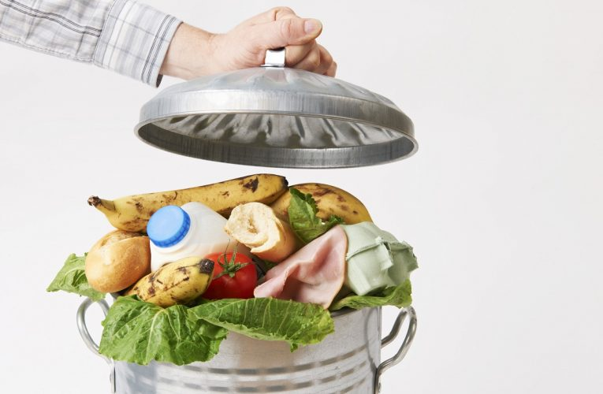
Introduction
Overview:
A platform to connect food donors (individuals, hotels, party organizers) with needy people, reducing food waste and hunger.
How It Works:
Donors: Share food details (type, amount, location).
Needy People: Track and collect food nearby.
What problem are we solving?
Excess leftover food being wasted in homes, hotels, and restaurants.
Difficulty in distributing surplus food to needy individuals.
Lack of awareness and a reliable platform to connect donors and recipients.
[THALI SANJHA]

Slide 3
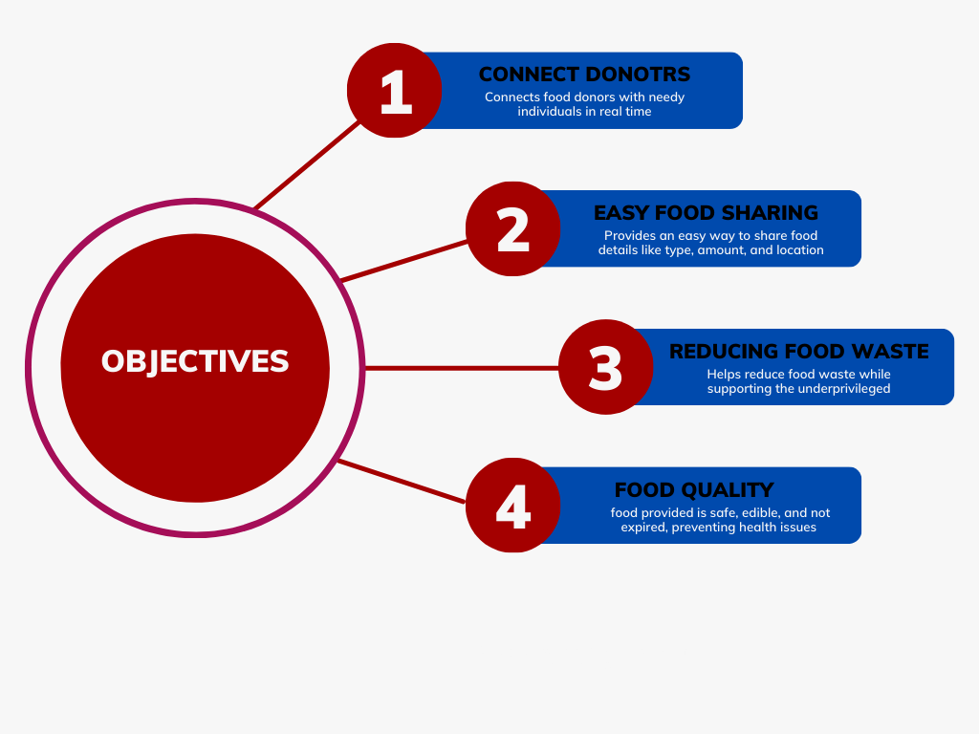
Objectives
Shruti Jain, Tanisha, Aprajita Kumari, Chhaya Singh
[THALI SANJHA]

Slide 4
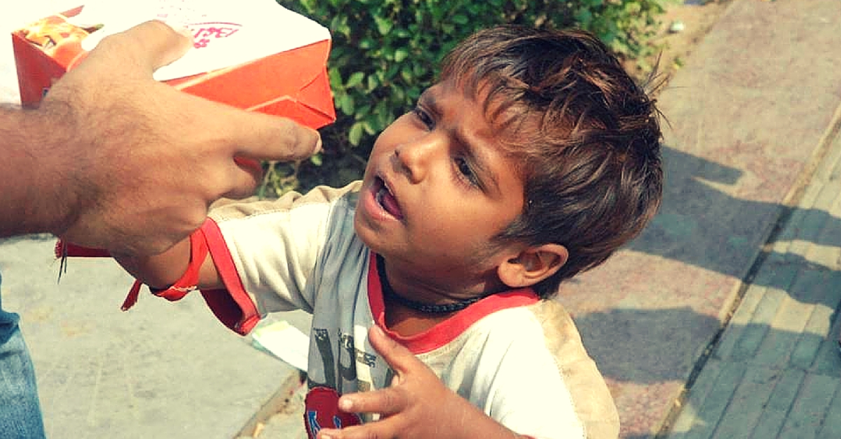
Problem Statement
PG accommodations often face a significant issue of daily food wastage. Due to unpredictable consumption patterns, excess food is frequently discarded, leading to unnecessary waste and resource misuse. Many PG residents may skip meals, while food prepared in bulk often goes uneaten. Observing this recurring problem, we came up with the idea of developing a Food Waste Reduction Website. This platform will help connect PGs with needy individuals to ensure surplus food is utilized effectively instead of being wasted, promoting a more sustainable and responsible food distribution system.
Problem Gap
Food Waste: Excess food is often discarded despite being fit for consumption.
Accessibility: Needy individuals lack a platform to find surplus food nearby.
Lack of Awareness: Donors are unsure how to distribute leftover food effectively.
[THALI SANJHA]

Slide 5
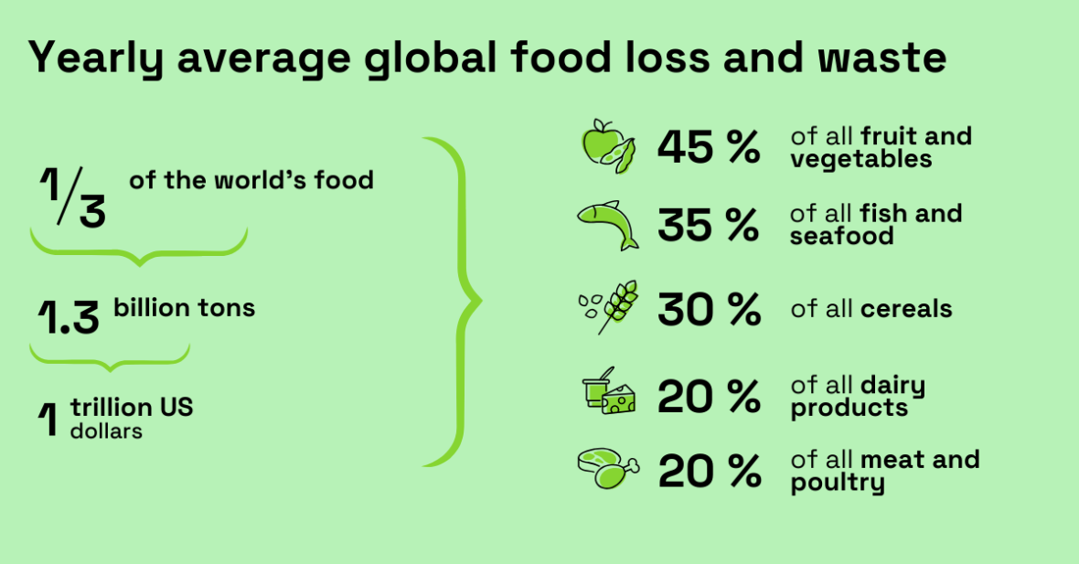
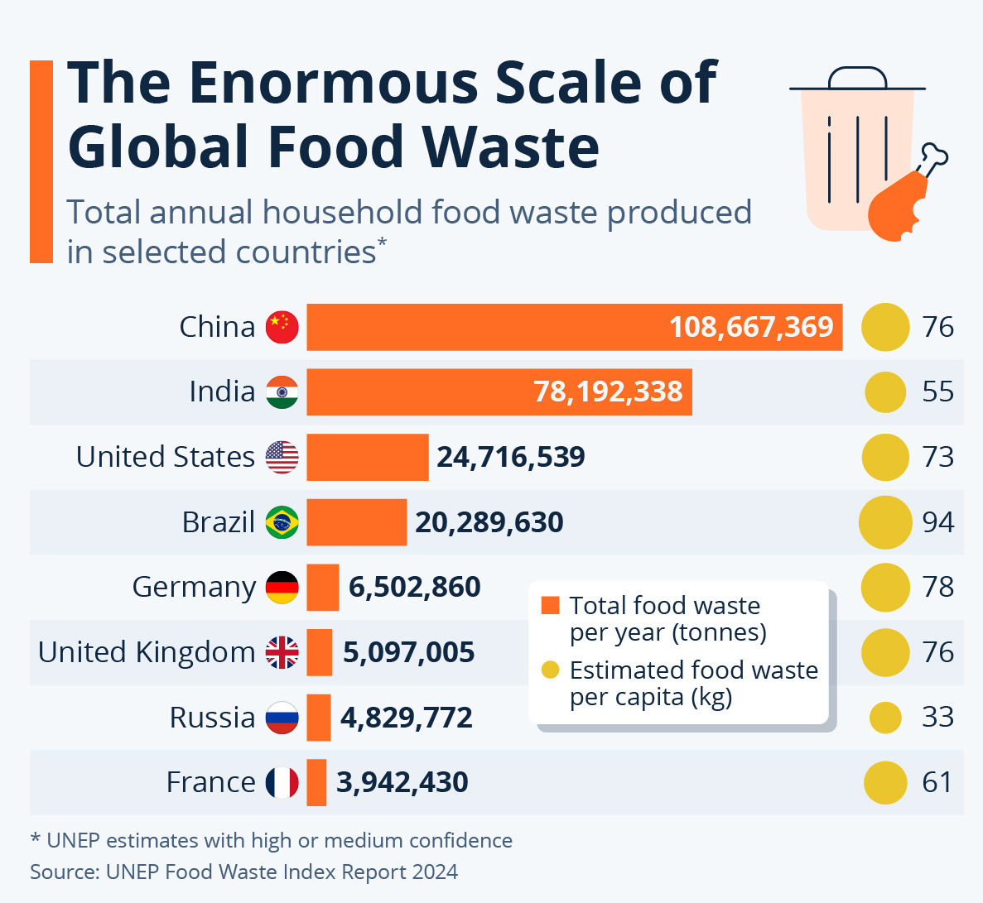
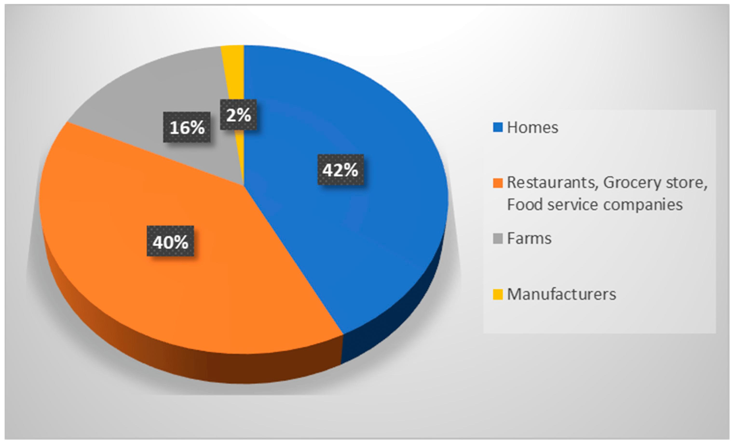
Statistical overview

Slide 6
Methodology
Technology Stack
Frontend: HTML, CSS, JavaScript (React)
Backend: Node.js/Express.js
Database: MongoDB/PostgreSQL
APIs:
Google Maps API (for location tracking).
Notification APIs (email/SMS for updates).
Hosting: AWS/Heroku
Workflow
Food Donor Flow:
Register → Add Food Details → Share Location → Mark Food as "Picked Up".
Needy People Flow:
Register → Search for Food → Contact Donor → Collect Food.
Admin Flow:
Oversee the database and ensure smooth operations.
Shruti Jain, Tanisha, Aprajita Kumari, Chhaya Singh
[THALI SANJHA]
ENSI152
6 / 11

Slide 7
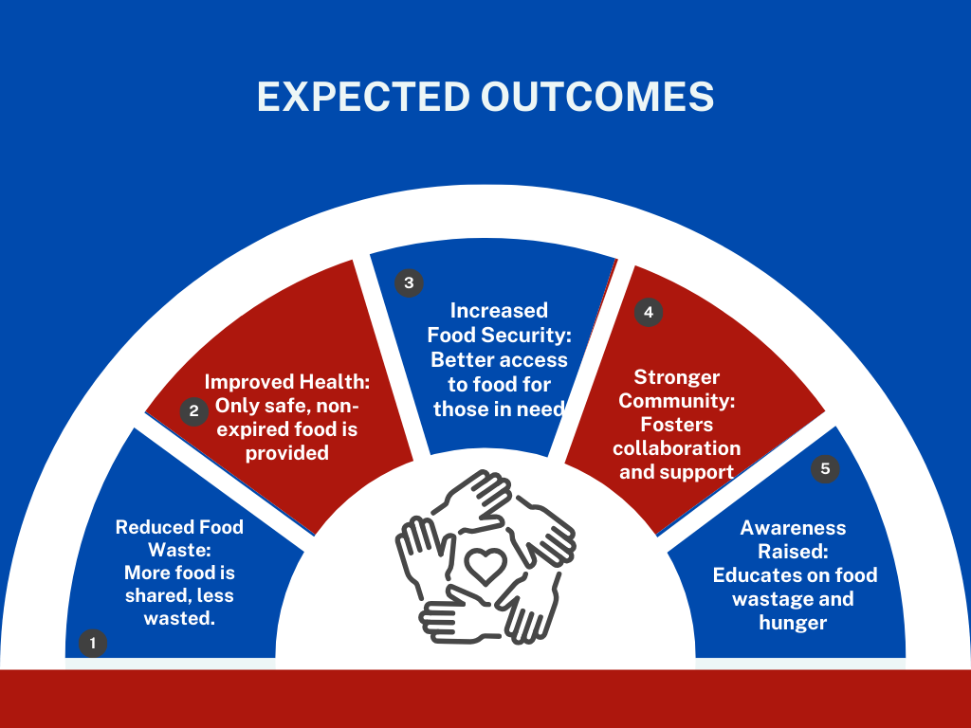
Expected Outcomes
[THALI SANJHA]

Slide 8
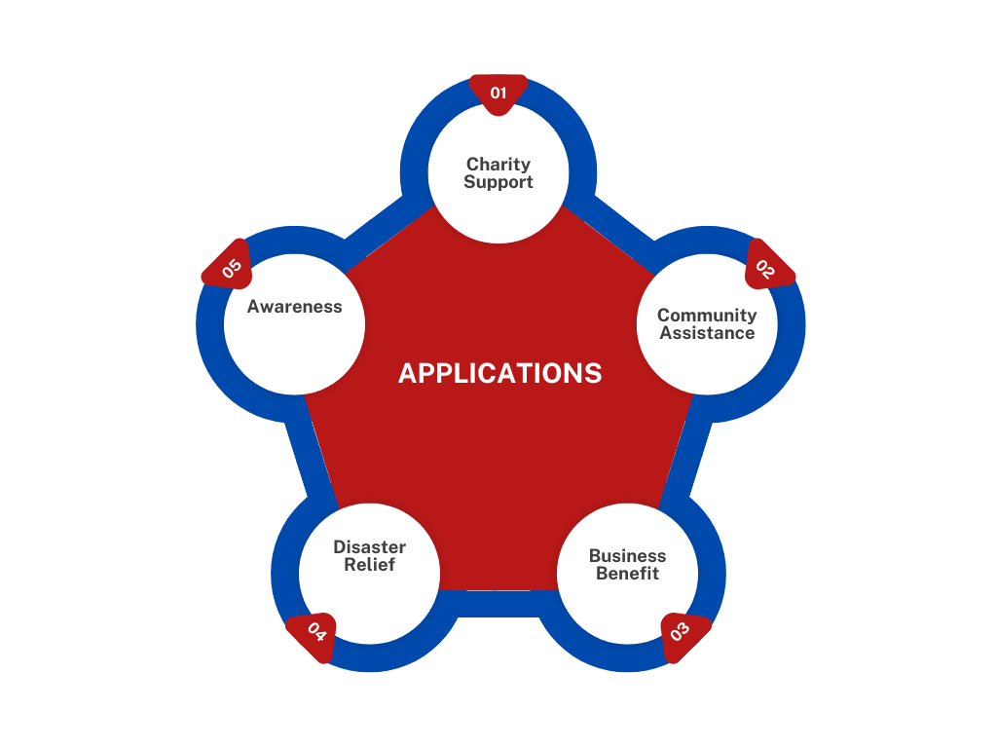
Applications
[THALI SANJHA]

Slide 9
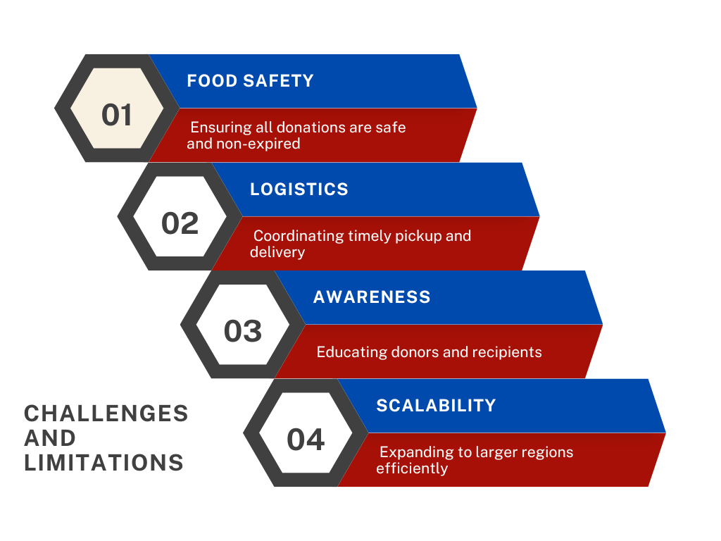
Challenges and limitations
[THALI SANJHA]

Slide 10
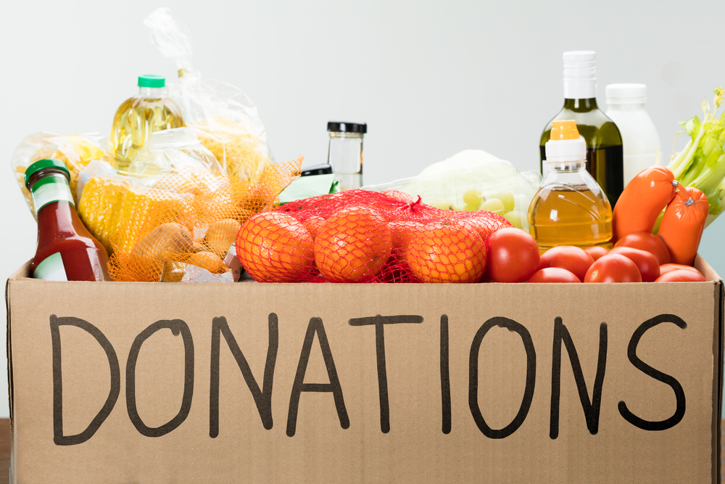
Conclusion
Project Summary:
This project connects food donors with those in need, reducing food wastage and addressing hunger. The platform ensures only safe, non-expired food is shared, benefiting both donors and recipients.
Importance of Outcomes:
The outcomes—reducing waste, improving health, increasing food security, and raising awareness—are vital for tackling hunger and promoting sustainability, creating lasting social impact.
Shruti Jain, Tanisha, Aprajita Kumari, Chhaya Singh
[THALI SANJHA]

Slide 11
References
Building on credible insights and research, the following references highlight the foundation and importance of this initiative:
https://www.unep.org/resources/publication/food-waste-index-report-2024
https://www.nrdc.org/bio/andrea-collins/reducing-food-waste-climate-nature-and-people
https://www.wri.org/food/food-loss-and-waste
https://www.fsis.usda.gov
[THALI SANJHA]

Slide 12
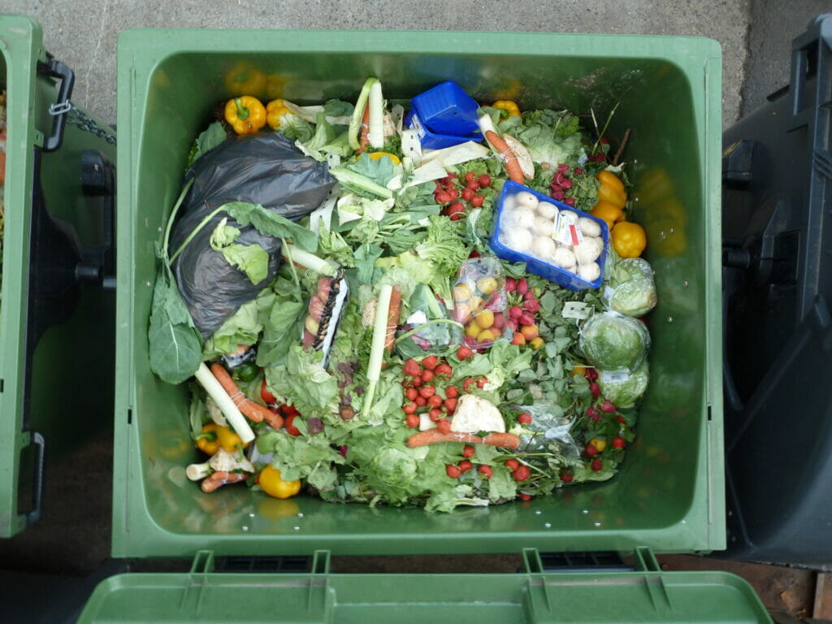
Q&A
Q1.Is there any scope for future enhancements?
Scope for Future Enhancements:
Develop a mobile app for better accessibility.
Introduce food quality verification systems.
Implement AI for efficient donor-recipient matching.
Q2: How does the platform ensure food safety?
Donors are required to confirm that the food is safe, edible, and within its expiration date. Guidelines for safe donations are also provided.
Q3: What kind of food can I donate?
You can donate raw food, cooked food, or packaged food that is safe and fresh.
Shruti Jain, Tanisha, Aprajita Kumari, Chhaya Singh
[THALI SANJHA]

