Slide 1

THERAPY CONNECT
School of Computer Science and Engineering
Department of Computer Science and Engineering
Submitted By:
SHRUTI KUMARI
2427010237
Supervised By:
Dr. Onkar Singh

Slide 2
Outline
Introduction
Literature Review
Problem Statement
Proposed Solution
Objectives

Slide 3
Introduction
Students’ mental and emotional wellbeing is a growing global concern due to academic pressure, social competition, and family expectations, leading to stress, anxiety, and depression.
The transition from adolescence to adulthood often causes emotional exhaustion and low self-esteem.
Therapy welfare programs in schools and colleges provide structured mental health support, including counseling, peer support, mindfulness sessions, and digital tools.
Therapy helps students understand emotions, develop coping skills, and improve focus and confidence.
With increasing awareness, AI and online counseling platforms make therapy more accessible, affordable, and stigma-free, encouraging wider participation.

Slide 4
Literature Review I
This table shows that online therapy for students reduces stress and anxiety but faces challenges like engagement, tech barriers, and limits for severe cases.
Author & Year | Method Used | Focus Area | Limitations
Andersson, 2018 | Randomized Controlled Trial (RCT) | Internet-based Cognitive Behavioral Therapy (iCBT) for student anxiety and depression | Limited long-term follow-up; requires internet access; adherence issues in self-guided format
Reynolds et al., 2020 | Teletherapy evaluation | Video/phone counseling for university students | Technological barriers; loss of non-verbal cues; not suitable for high-risk cases
Fleming et al., 2019 | Program Evaluation | Integration of digital therapy platforms in campus counseling | Limited long-term effectiveness data; dependent on institutional support and training
Farrer et al., 2019 | Meta-analysis | Effectiveness of online therapy for young adults | Heterogeneity of studies; some studies lack control groups; mostly short-term outcomes

Slide 5
Literature Review-II
Online therapy reduces stress, anxiety, and depression among students.
Engagement and long-term adherence remain major challenges.
Students value accessibility and flexibility, but digital therapy can feel impersonal.
AI chatbots provide scalable, 24/7 mental health support.
Limitations of chatbots include lack of empathy, complex case handling, and misinformation risk.
Gamified interventions increase engagement, motivation, and improve mental wellbeing.
Ethical concerns include emotional dependency, privacy, and the need for human oversight.

Slide 6
Problem Statement
Despite growing awareness of student mental health, many students face stress, anxiety, and depression due to academic pressure, social challenges, and personal issues. Traditional counseling services are often limited by accessibility, flexibility, cost, and stigma. Online therapy platforms, including AI-based tools and teletherapy, offer a promising solution, but challenges such as low engagement, technological barriers, and limited effectiveness for severe cases prevent widespread adoption. This study aims to explore how “Therapy Connect” can improve student mental health support while addressing these challenges.

Slide 7
Proposed Solution
Integrated Online Platform: “Therapy Connect” combines AI-driven chatbots, teletherapy sessions, and personalized mindfulness/CBT modules for students.
AI-Powered Personalization: Uses machine learning to tailor therapy exercises based on student mood, stress, and engagement patterns.
Blended Care Approach: Combines self-help digital tools with live counselor support to increase effectiveness and adherence.
24/7 Support via Chatbots: Provides immediate emotional support and guidance, reducing barriers like stigma and limited counselor availability.
Predictive Mental Health Insights: Detects early signs of stress, anxiety, or depression using AI analytics to enable proactive interventions.
Gamified Wellness Modules: Encourages participation through interactive exercises, progress tracking, and reward systems.
Accessibility and Affordability: Ensures students from diverse backgrounds can access therapy anytime, anywhere, minimizing cost and logistical constraints.

Slide 8
Objectives
To provide accessible and effective mental health support to students through an online therapy platform.
To reduce stress, anxiety, and depression among students using AI-driven tools and teletherapy.
To personalize therapy interventions based on students’ emotional state, engagement, and needs.
To enhance student engagement and adherence through gamified wellness modules and blended care.
To detect early signs of mental health issues and offer proactive interventions for better emotional wellbeing.

Slide 9
Result :
1. The Therapy Connect website was successfully developed and executed.
2. The system provides a user-friendly and emotionally supportive interface for students.
3. The chatbot responds appropriately based on:
  User text input
  Selected emotional state
  Facial emotion detection (demo feature)
4. Real-time interaction enhances student engagement and comfort.
5.The project demonstrates the practical use of technology in mental health support

Slide 10
References
Fischer-Grote, L. (2024). Effectiveness of Online and Remote Interventions for Student Mental Health. PMC. https://www.ncbi.nlm.nih.gov/pmc/articles/PMC10877489/
Reyes-Portillo, J. A. (2025). Generative AI–Powered Mental Wellness Chatbot for College Students. JMIR Formative Research. https://formative.jmir.org/2025/1/e71923
Cheng, C. (2023). Gamification: a Novel Approach to Mental Health Promotion. PMC. https://www.ncbi.nlm.nih.gov/pmc/articles/PMC10654169/
Lattie, E. G. (2022). Uptake and Effectiveness of a Self-Guided Mobile App for College Students. ScienceDirect. https://www.sciencedirect.com/science/article/pii/S2214782921001330
Ollio, J. (2022). Using Telehealth to Provide Behavioral Healthcare. PMC. https://www.ncbi.nlm.nih.gov/pmc/articles/PMC9013217/
CBSE (2023). For Students' Mental Health, CBSE Pushes Tele-MANAS Scheme. Times of India. https://timesofindia.indiatimes.com/city/nagpur/for-students-mental-health-cbse-pushestele-manas-scheme/articleshow/123551705.cms
Andersson, G. (2018). Internet-based Cognitive Behavioral Therapy for Students: A Review of Evidence. Journal of Medical Internet Research.

Slide 11
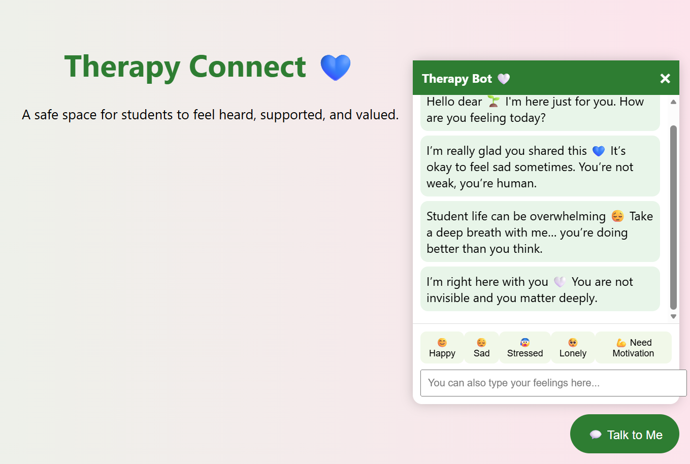
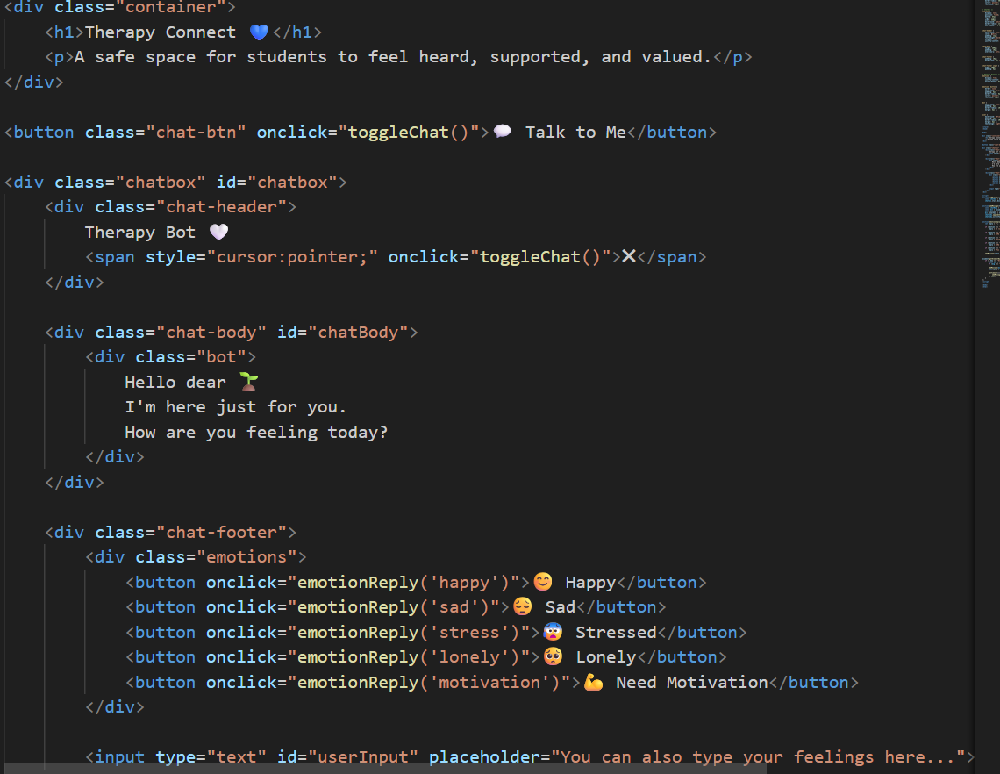
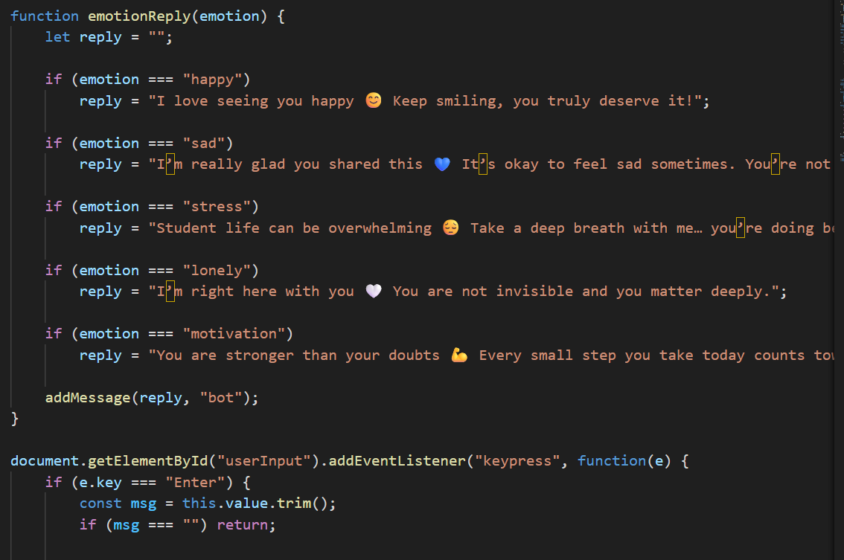

Slide 12
Thank You

